Slide 1
A DATA-DRIVEN ASSESSMENT OF SAFETY INSPECTION PROGRAMS’ EFFICACY
Prithvi Acharya and H. Scott Matthews
Departments of Engineering and Public Policy / Civil and Environmental Engineering
Carnegie Mellon University

Slide 2
Passenger Vehicle Safety a Big Challenge
In the USA..
In 2017, 6.4 million car crashes, 2.7 million injuries (including 100,000+ pedestrians and cyclists) and 37,000 fatalities (including 6,000 pedestrians)
In last 10 years, VMT has been generally flat..
Fatality rates have generally been decreasing
There are many strategies to reduce crashes and fatalities, including highway enforcement, technology, and behavior
Source: NHTSA Crash Stats Website

Slide 3
A Major Policy Instrument in Reducing Fatalities are Periodic Safety Inspections
Purpose: identifying non-compliance
In Europe, these are called PTIs
Done at an inspection location (station, dealer, etc.)
In USA, are NOT nationally required
States opt-in to having programs
Show of hands: how many of you are from a place where cars have periodic safety inspections
Notes:
Safety - History –used to be almost everybody, now just a few
There are resulting paid and unpaid costs (e.g., time)

Slide 4
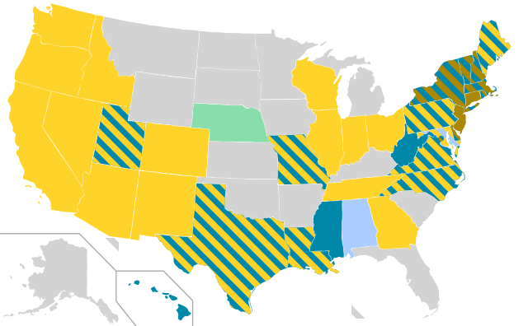
Light-Duty Vehicle Inspections in USA
By Szyslak (Own work) [CC BY-SA 3.0 (http://creativecommons.org/licenses/by-sa/3.0)], via Wikimedia Commons
Notes:
First, in all of this work, we focus on light duty vehicles, or vehicles less than 10k lbs., these are also considered passenger vehicles.
Federally mandated emissions
State-regulated safety → focus of the first half of this presentation and shown in blue
A safety inspection typically checks vehicle components, such as brakes, tires, & lights, against an allowable threshold defined by that state where it is implemented
Key takeaway here is that relatively few states currently have safety inspection programs
PA is one of the few that requires annual inspections
As we will see in the next few chapters of my work, VMT will play a large role in both measuring vehicle safety. In addition to this, VMT creates a platform for policy-makers to allocate transportation funds as well as making other policy decisions for states.
As a result, part of this presentation more thoroughly Investigates the uncertainty around VMT estimates that are used
Which brings me to the research goals and outline of this dissertation:

Slide 5
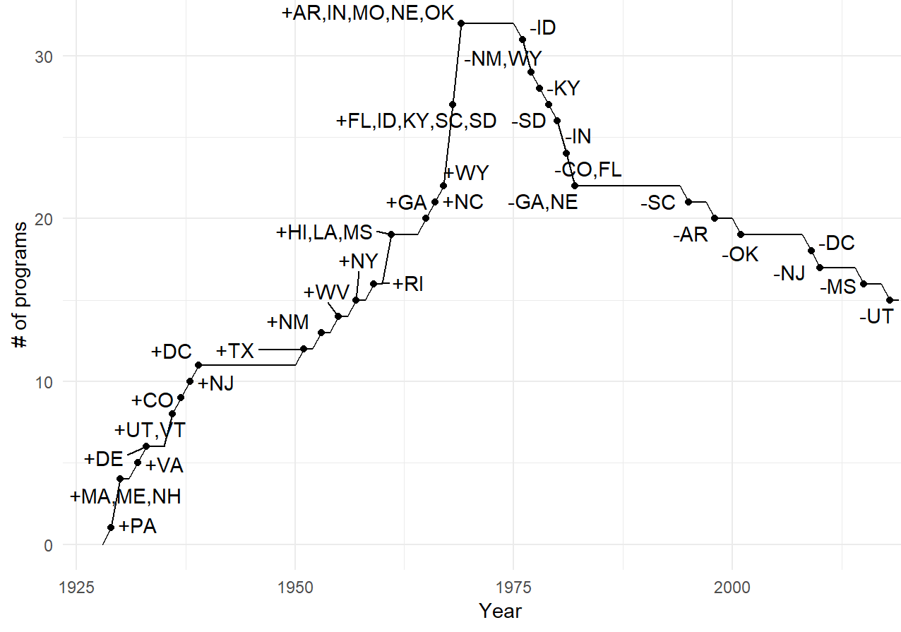
Safety Programs Over Time in USA
Notes:
Messages:
PA was first state in about 1930.
Peak was 32 states in 1970s
Generally declining since then..

Slide 6
Safety Inspection 101: What Components Are Checked?
Tires (tread)
Brakes
Lights
Wheels
Suspension
Steering
Battery
Glazing
Mirrors
And More..
Source: autotraining.edu

Slide 7
An Important Thing to Understand is “How is a Fail Classified”?
What Happens within the Inspection Black Box…?
Leave with a ‘pass’ or ‘fail’
INSPECTION
?
Notes:
Before I talk about the data.. Its primarily important to follow whats going on here.
A typical inspection: a vehicle comes in, inspected, leaves with pass or fail, but Important to identify what occurs within the inspection itself
Work performed= may leave with a pass, but in essence, the vehicle “would have failed” if there were no safety program, and work would not have been performed
Really we Need to focus on how cars are entering inspection to get idea of effectiveness of current program

Slide 8
From Our Past Work: Safety Failures Increase as Vehicles Get Older
AGE AVERAGE
OVERALL STATE AVERAGE
D. Peck, H. S. Matthews, P. Fischbeck, And C. T. Hendrickson, “Failure rates and data driven policies for
vehicle safety inspections in Pennsylvania,” Trans. Research Part A, Vol. 78, No. C, Pp. 252–265, Aug. 2015.
Notes:
First fail rate distribution I examined was failure by age:
Explain axes, bars, error bars, line
Average failed vehicles over 6 years of data – ranges represent min/max within those 6 years.
Much higher than the 2-3% fail rates published by legislators
Point out that age 0 and 1 not zero, newer cars ARE failing, and also…back to legislator recommendation to exempt up to 2 year old vehicles

Slide 9
PA Estimated Failed Vehicles, 2012
Overall, nearly 2 million vehicles in Pennsylvania “would not have been safe to drive” without inspection program
Range between state and private datasets
Decreasing number of failed vehicles after age 12 due to fewer in fleet, even though the failure rate is consistently high for the older vehicles
In one year, 1-2 million vehicles would have failed (10% of 10 million)
Notes:
This distribution represents the vehicles that would have failed, without the current inspection implementation scheme
Ranges represent the range of vehicles between the two datasets
Again, age 0,1 vehicle failures are not at zero…thousands → back to legislator suggested amendment, not necessarily ideal
1-2M vehicles are failing annually. (~10.4 million vehicle fleet according to registration count)
What components are most commonly causing these vehicles to fail?... Tires, brakes, lights (lots of deep analysis not shown here)
So, to quickly recap…

Slide 10
Leveraging Detailed Safety Inspection Records
Past failure rate analysis just looked at overall pass/fail data in safety inspection categories (e.g., 12-18% rate)
Sought to leverage our analytics engine for each vehicle inspection to demonstrate data-driven analyses possible.

Slide 11
Estimated Annual User Costs of Emissions Inspections in Pennsylvania
Total User Cost about $280 M per year
About $50 per vehicle
Note: safety much higher due to higher fail rates, expenses
Cost Category | Annual Cost ($ millions)
Cost of Time | $60
Cost of Test | $170
Cost of Repairs | $50

Slide 12
But Need to Consider the Big Picture
The real question is not whether vehicles will fail an inspection, but, whether safety inspections save lives
States have been removing programs – does it matter?
Answering this question requires a consideration of various aspects, and data, as well as modeling
Requires statistical analysis that shows whether the presence of a safety program in a state leads to lower fatality rates

Slide 13
Past Studies Related to Effectiveness of Safety Inspection Programs
Conducted in US since 1975 (first was Peltzman)
Have generally either done short-term comparisons (i.e., a few years)
Have generally done comparisons over a small number of regions (i.e., a few states)
Studies have shown mixed results, some suggesting the safety programs save lives, some studies did not
“Statistical power” of results has generally been fairly weak

Slide 14
Goal of Our Study
Consider all states, over a long period of time
Use of consistent data set (NHTSA FARS Data)
Detailed records of every fatal crash in USA over 30 years
Shows all vehicles involved (and their state of registration)
Make all data and code publicly available
To broadly and consider the impact of establishing / repealing safety inspection programs, allowing legislators to quantitatively estimate impacts
Better gauge cost-effectiveness of I/M programs as a means of preventing road fatalities, in comparison to other possible policy interventions with the same aim (e.g., rural roads, DUI, etc.)

Slide 15
Fatality Rate Equation and Model
We adjust for the state of registration of each vehicle involved
Create a pooled panel data based multiple linear regression analysis, trying to predict the adjusted fatality rate defined above
Generally expect a “time lag” would be required to see effects, and consider lags of 1-10 years

Slide 16
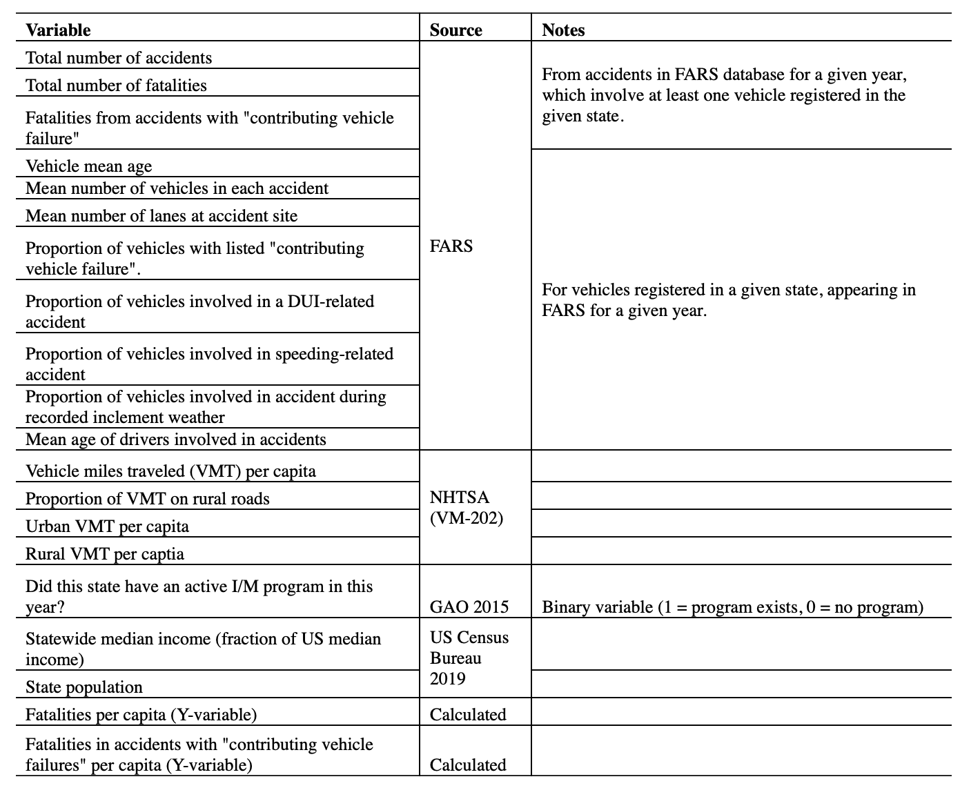
Model Variables
We have considered many variables in our work to date.
The HKSTS submission shows a subset and our analysis as of summer 2019

Slide 17
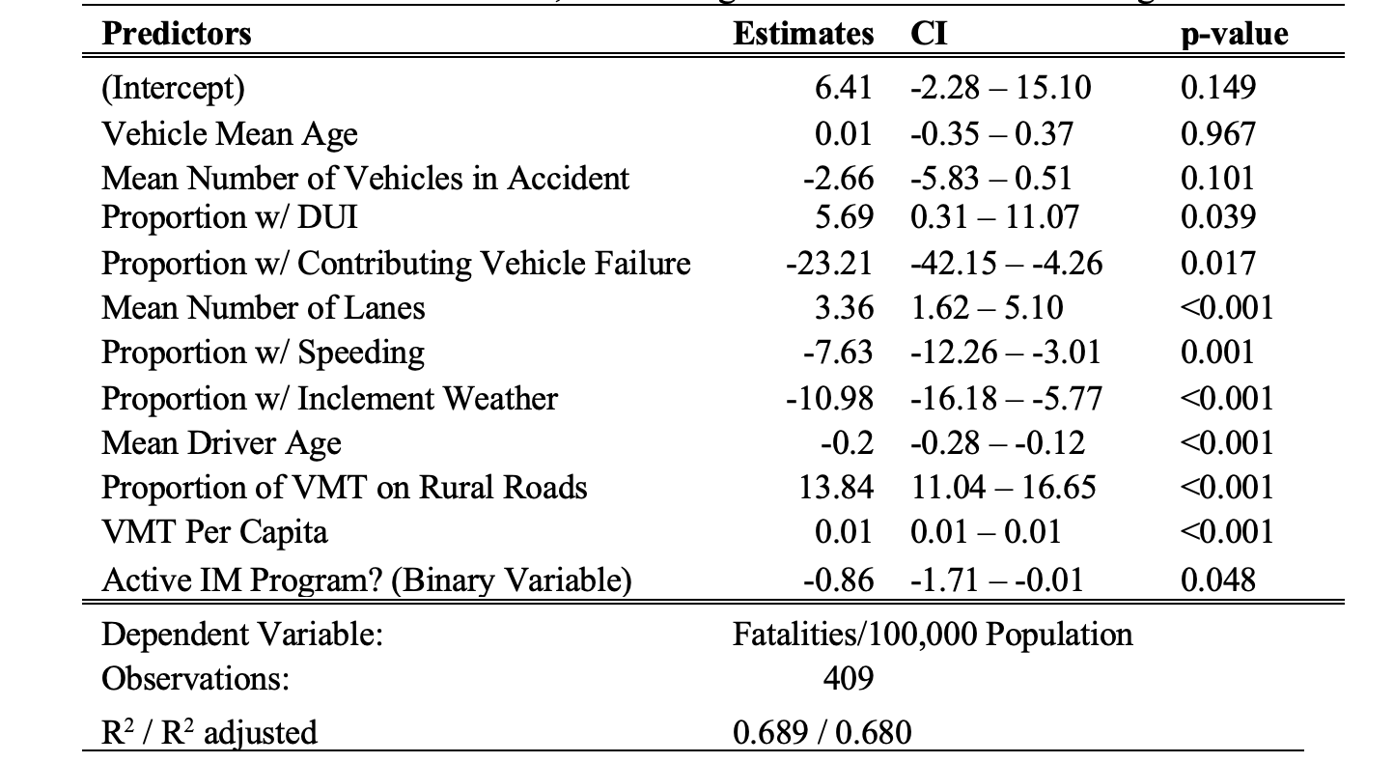
Results – Initial Model
Notes:
Found Several Confirming Effects
Active IM program significant and negative
Rural roads positive
Also found two variables not very relevant
Mean vehicle age
Mean number of vehicles in accident

Slide 18
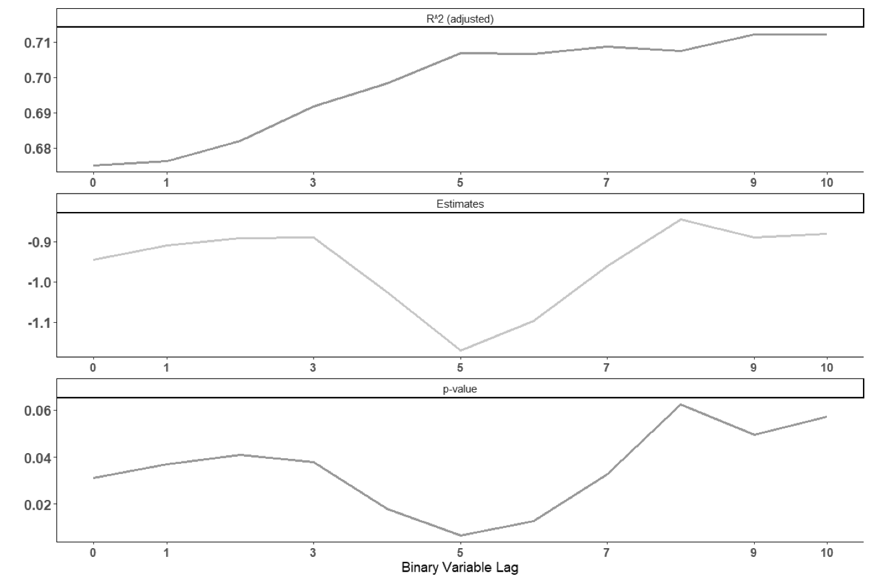
Results of Lagged Program Variable
Overall, the effects of losing a program seem to be strongest at about 5 years after loss of program (although effects are still significant until about 7 years)

Slide 19
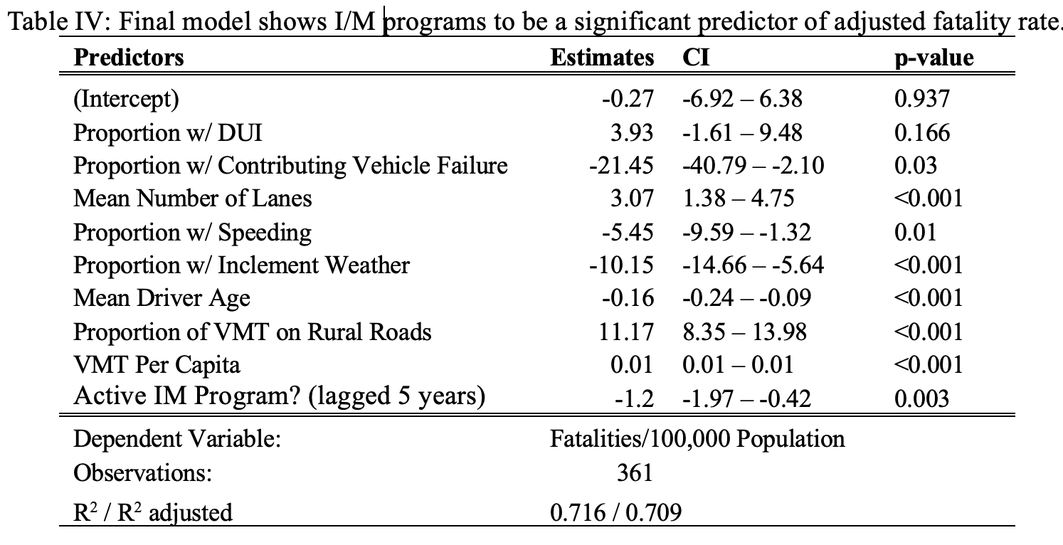
Final Model Results
The lag variable result suggests, the number of road fatalities may be expected to be between 0.42 and 1.97 fewer per 100,000 citizens, than if the state did not have an inspection program.
Example: New Jersey with 9 million people, repealing an existing program could lead to 38-178 additional deaths in the fifth year after the program has been repealed.
Notes:
several of our regression variables may be statistically significant.
a counter-intuitive, negative effect of recorded instances of speeding and inclement weather, which warrant further analysis.
The highest positive effects (i.e., regressors correlated to an increase in adjusted fatality rate) were attributable to the proportion of miles typical drivers in each state drive on rural roads), followed by the proportion of fatal accidents involving drivers under the influence of alcohol or drugs (DUI).
Regarding the presence of I/M programs, the lagged term (i.e., was there an active I/M program in this state five years ago) was found with a high confidence (p < 0.01) to have a negative impact on adjusted fatality rates, with a coefficient estimate between -0.42 and -1.97.
This may be interpreted to mean that in states which had an inspection program five years before any year being analyzed, the number of road fatalities may be expected to be between 0.42 and 1.97 fewer per 100,000 citizens, than if the state did not have an inspection program.
In real terms, for a state such as New Jersey (2017 population, 9.01 million), repealing an existing program could lead to 38-178 additional deaths in the fifth year after the program has been repealed.

Slide 20
Discussion
The presence (or absence) of a safety program in a state has a negative correlation to the population adjusted number of fatalities caused by motor accidents involving vehicles registered in that state.
The ability of vehicle inspections to reduce road fatalities can potentially last for up to seven years.
Analyses should consider these effects related to changing programs
Further analyses are required to explain findings surrounding some other regressor variables.
Presence of inclement weather and speeding – mixed results unclear
These data driven methods can support policymaking in support of society

Slide 21
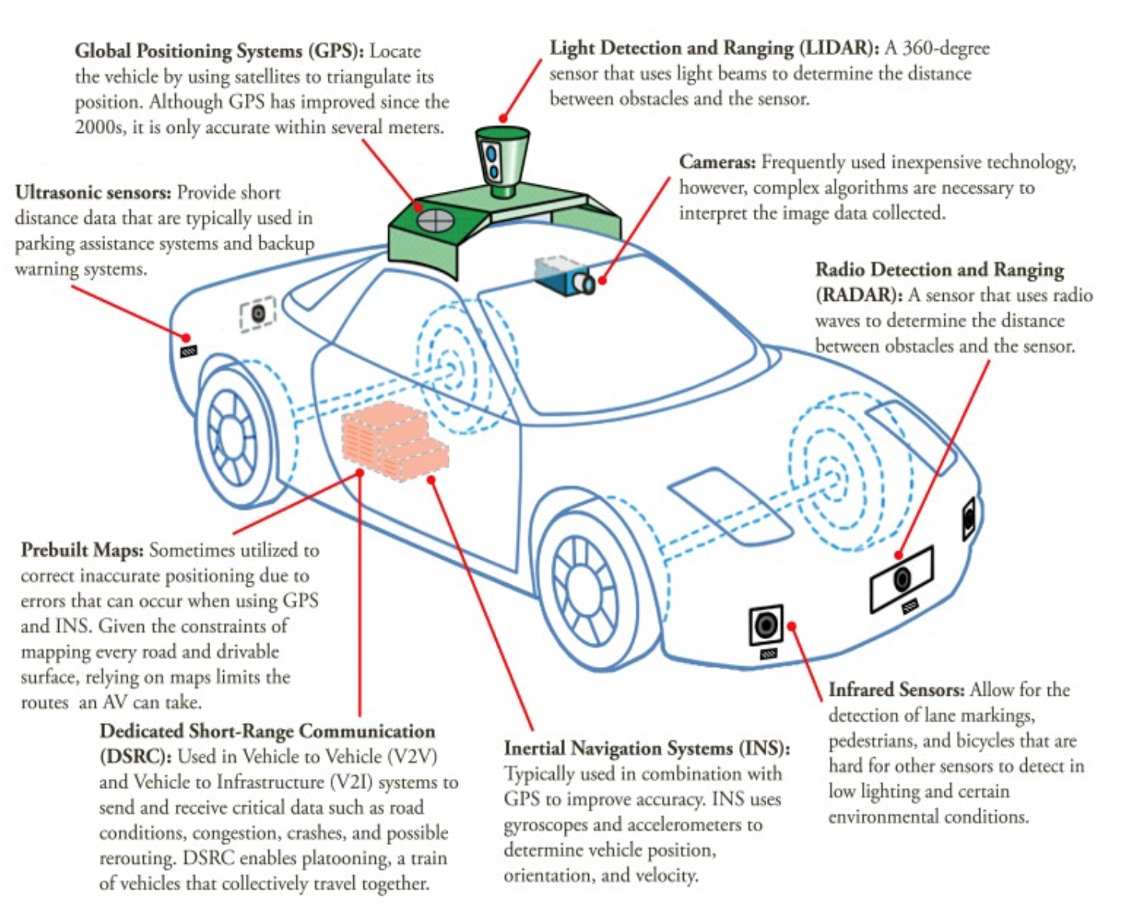
Beyond our Study – Important Context AV Technologies Affect Vehicle Safety
AVs add even more technology to vehicles, and they need to be maintained at the highest levels to promote safety
Example – lane following, auto-braking, blind spot monitoring and how our behavior will adapt to their existence
Drivers are increasingly depending on them to work correctly and safely

Slide 22
The emerging era of CAVs will be disruptive!
Connected vehicles can ‘self-report’ some problems (perhaps even before they fail)
Ex: “OBD based monitoring of components” (e.g., “check LIDAR light”)
Opinion #1: AVs will lead to expansion of scope of inspected components in states with programs (the AV technologies)
Opinion #2: More states with safety programs
How will ’inspections’ evolve in the next 15 years to ensure the fleet remains safe?
Lots of work to achieve this vision

