Slide 1
Analyzing And Defending Cyberattacks On Electric, Hybrid & Autonomous Vehicle Battery Systems
Venkat Viswanathan (MechE), Vyas Sekar (ECE)
Students:
Vikram Pande (MechE), Shashank Sripad (ESTP), Sekar Kulaindaivel (ECE)

Slide 2
Premise

Slide 3
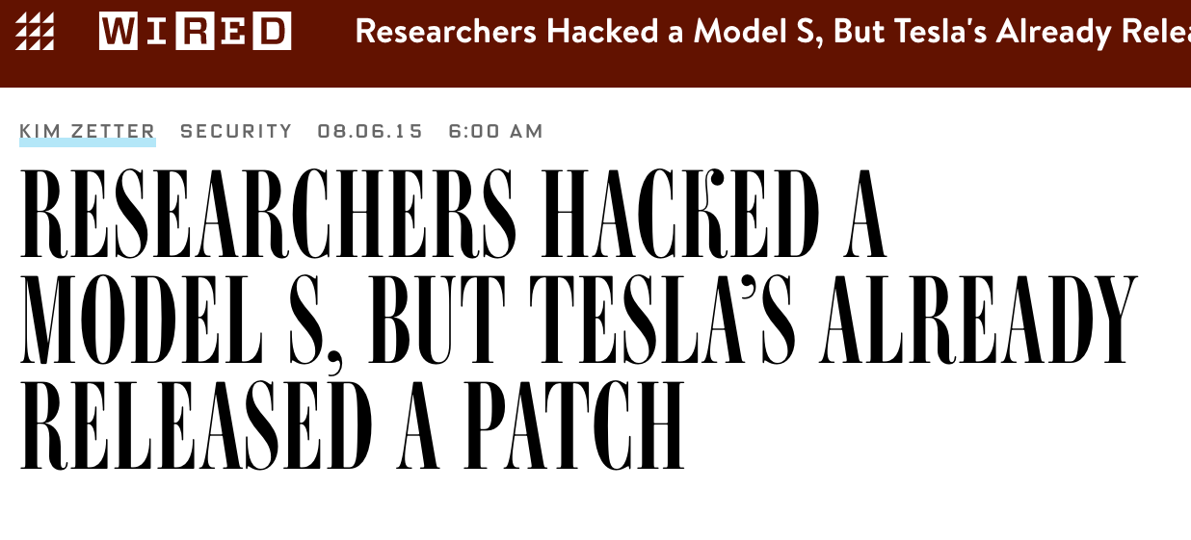
Premise
PT&C LWG (Oct 2016) www.ptclwg.com/news/the-most-hackable-cars-on-the-road-1

Slide 4
Three big questions
Which component and how long?
At what state of the battery pack?
At what ambient conditions?

Slide 5
Outline
Information on the auxiliary loads
Data on damage for different conditions
Battery
Simulation
Insights
Parameters that define the state of the battery, the operation, and the ambient conditions
Battery Pack Model specific to the electric vehicle

Slide 6
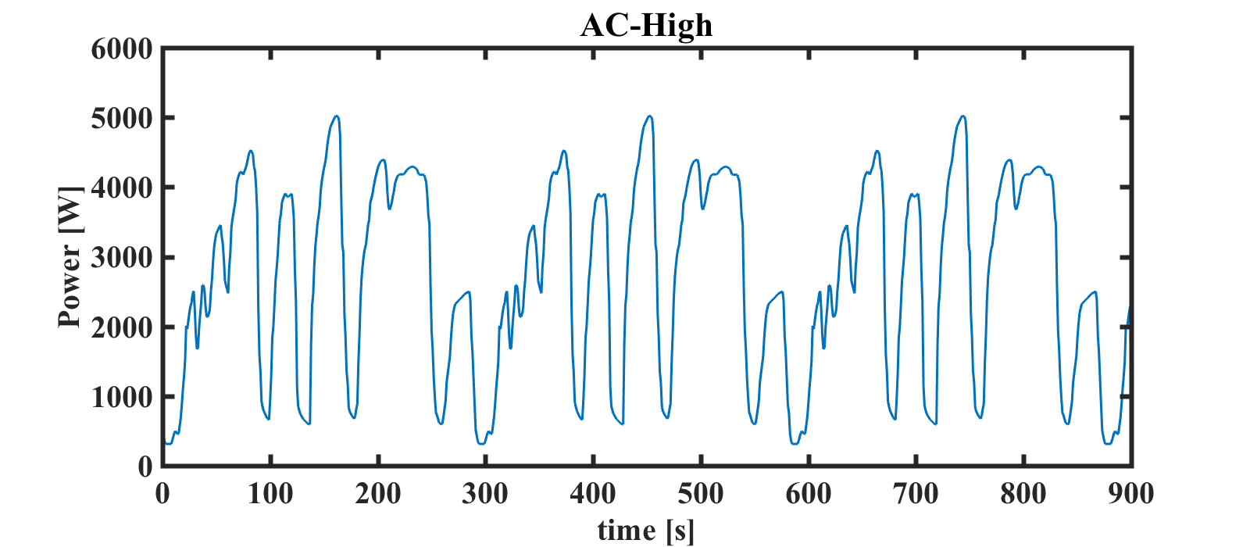
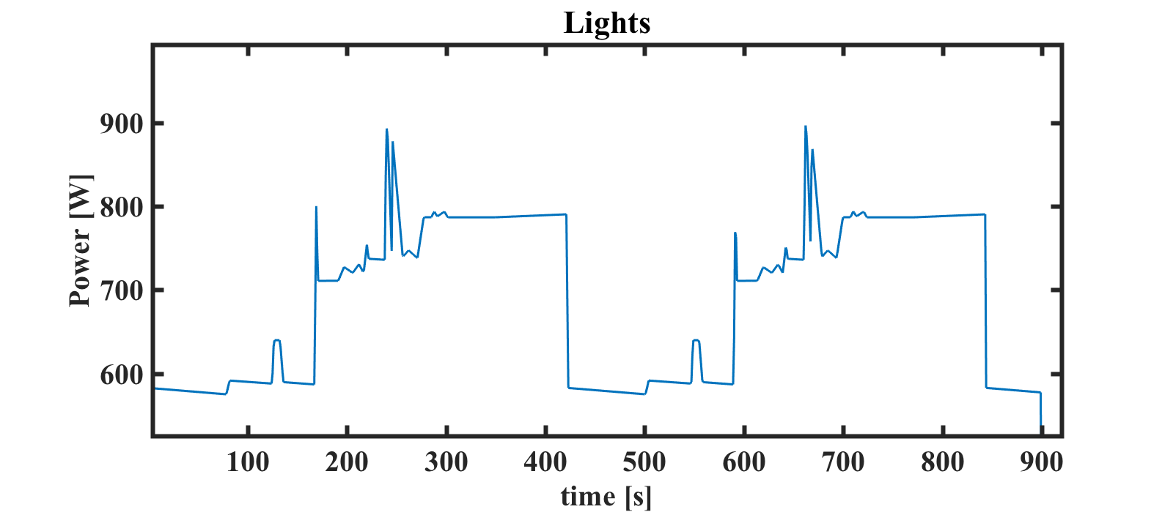
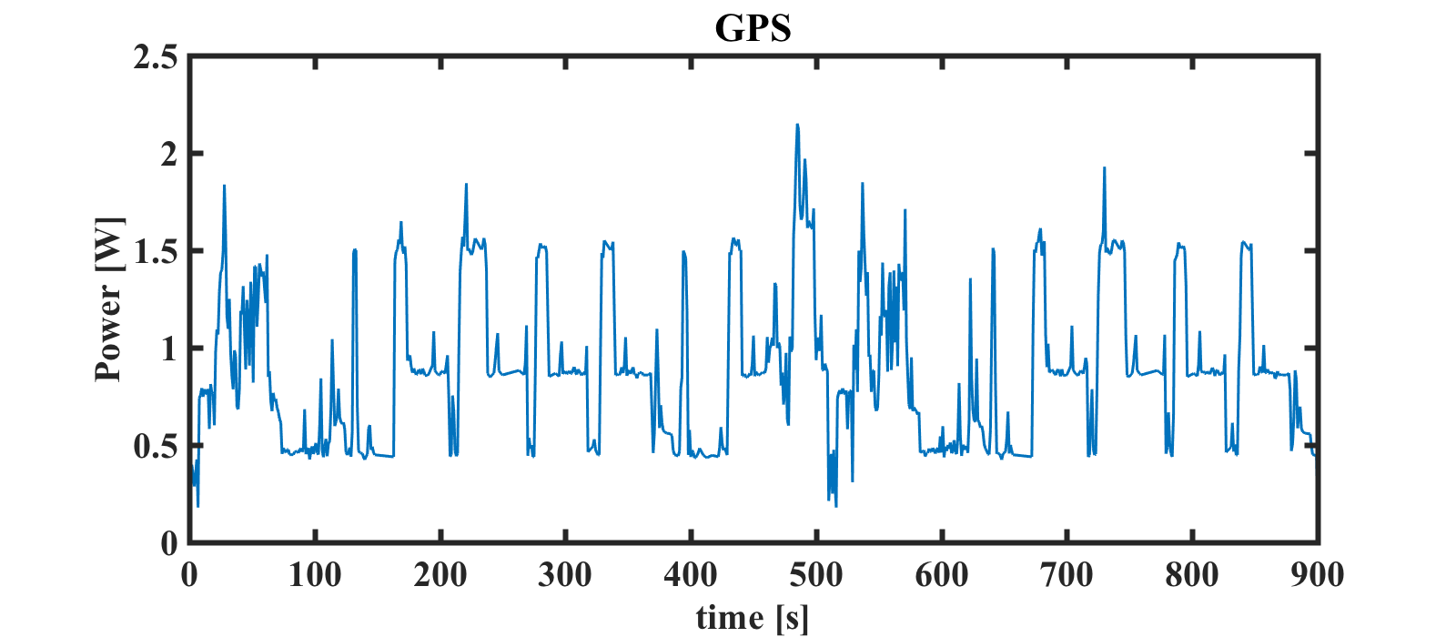
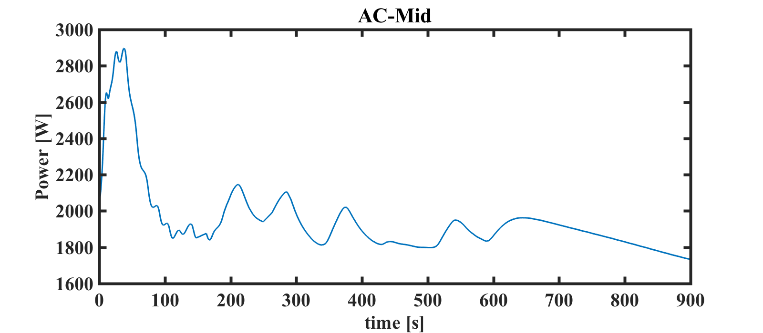
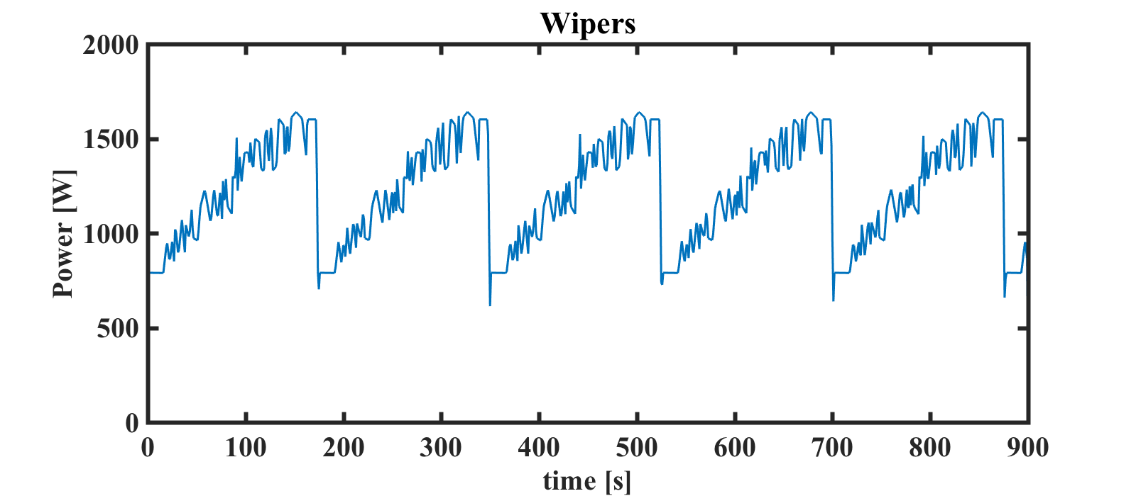
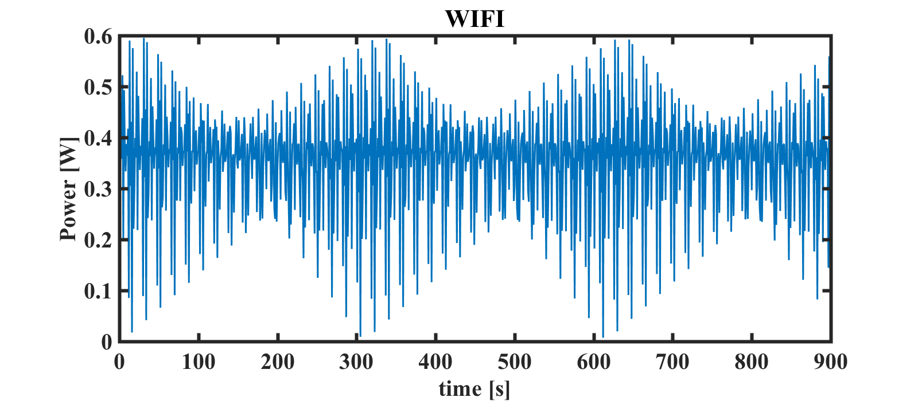
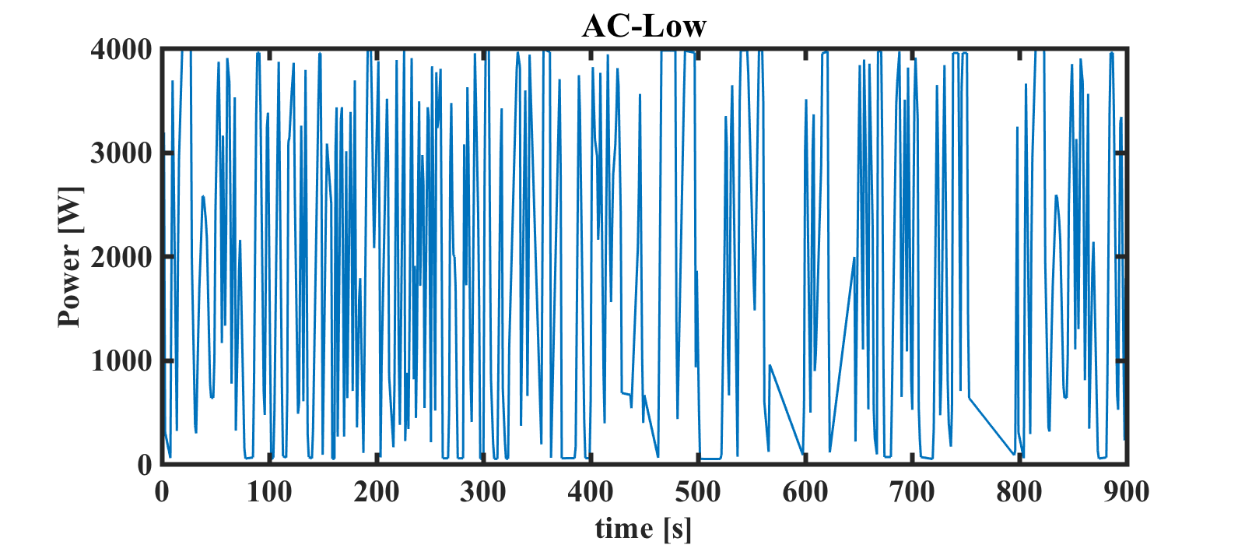
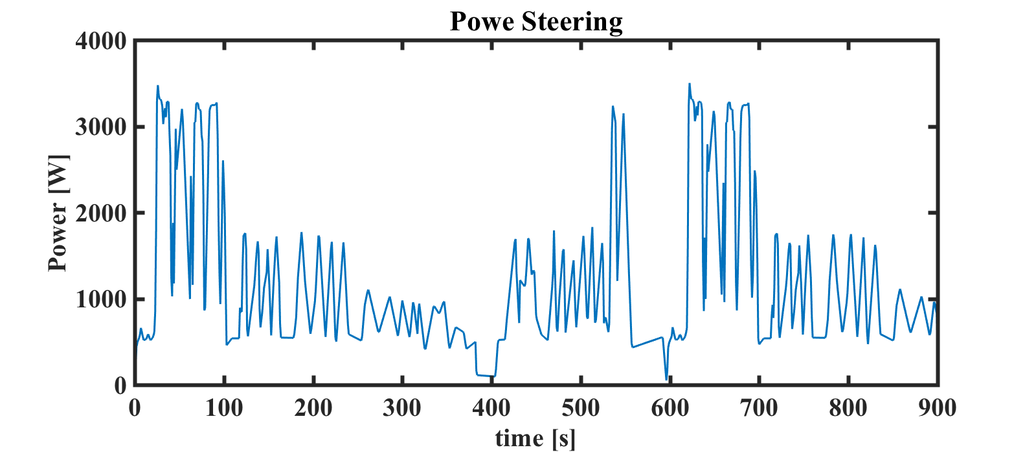
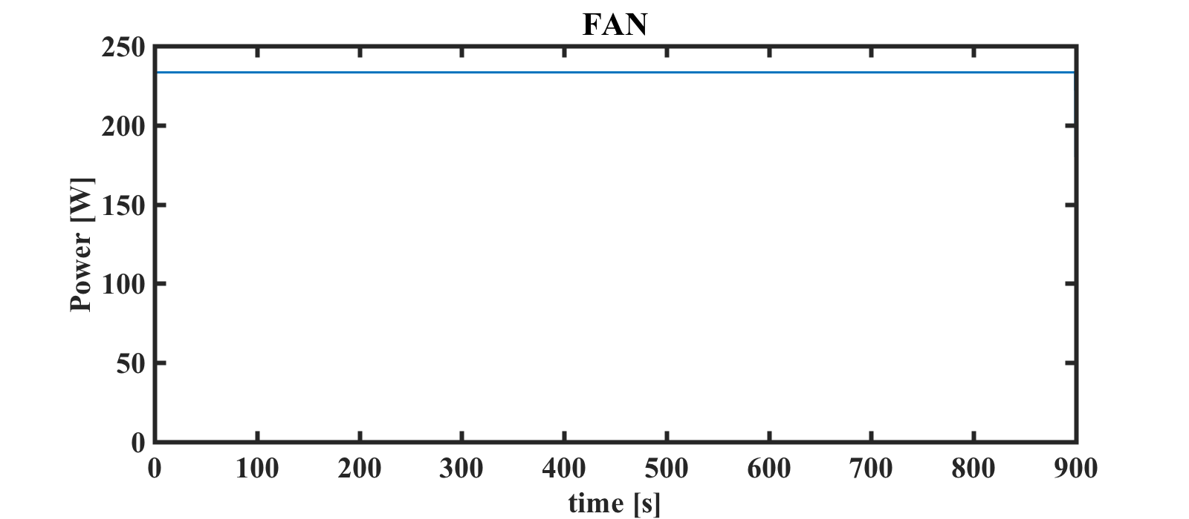
Auxiliary Loads

Slide 7
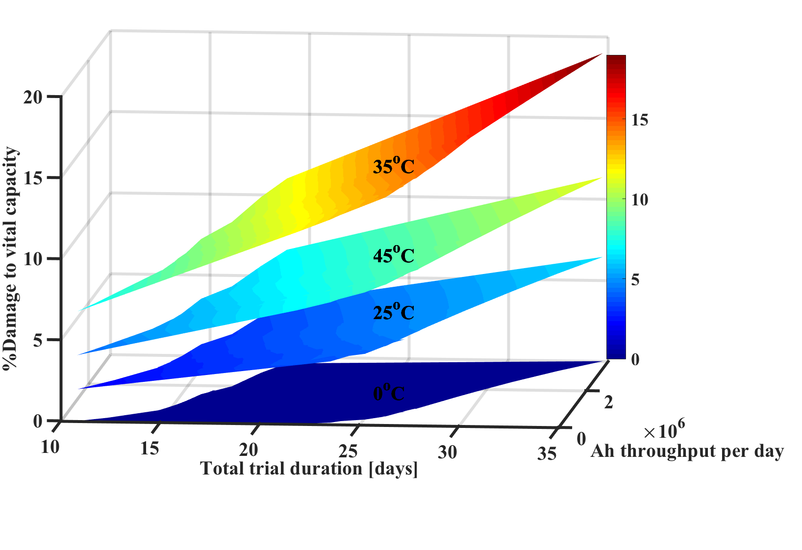
Damage database
Damage data for each component, cycled for different time scales at different temperatures is collected to examine trends

Slide 8
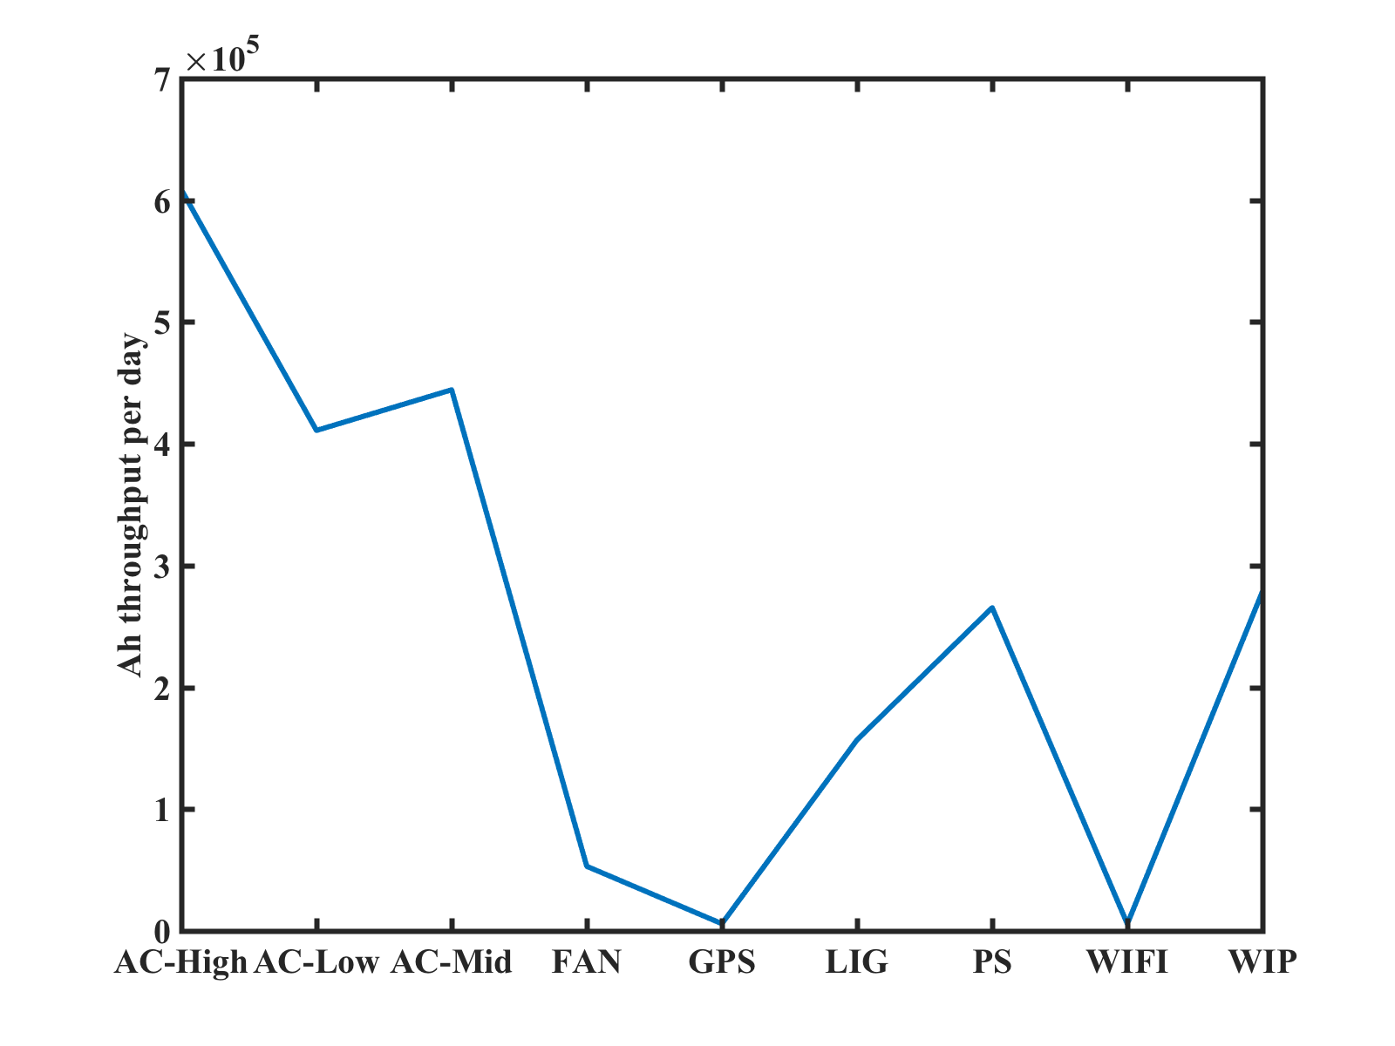
Comparing the components
Greater damage is caused by more power consuming components

Slide 9
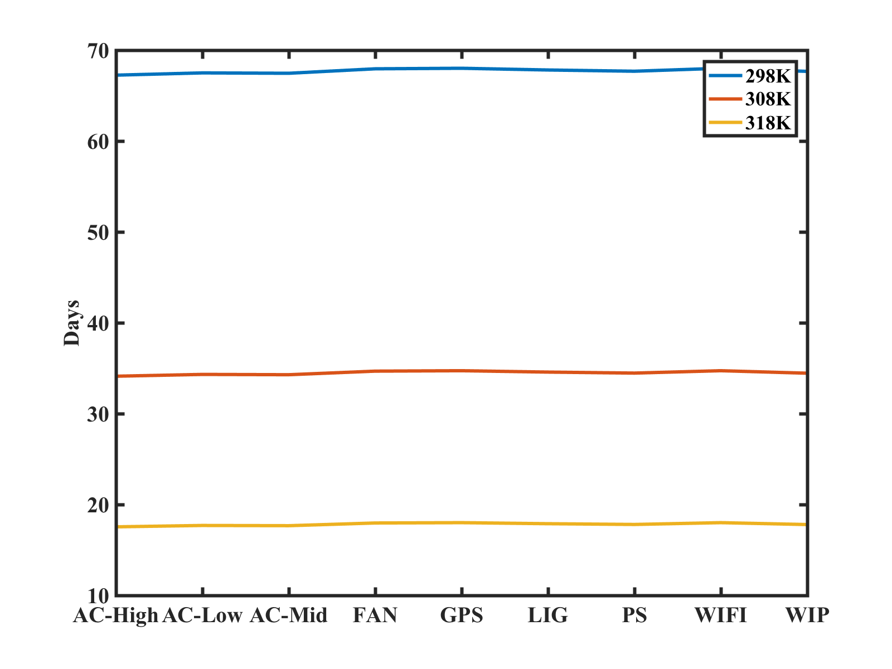
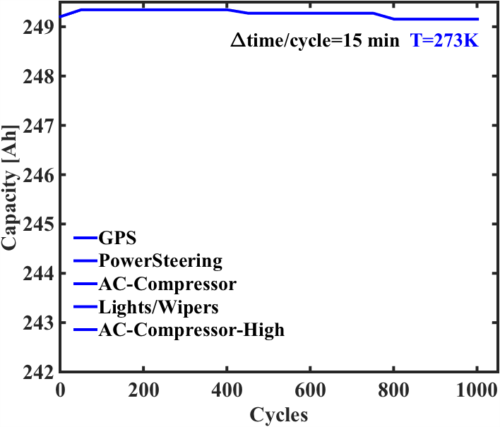
What conditions (T)?
No Damage to Vital Capacity at 273K/0ºC
25ºC
35ºC
45ºC

Slide 10
Three big questions
Which component and how long?
Higher Ah components
At what state of the battery pack?
Fully charged
At what ambient conditions?
Hot!

Slide 11
Next steps
Test, validate and demonstrate on cars!

Slide 12
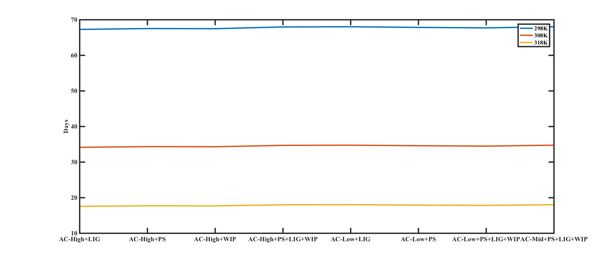
More than one component?
25ºC
35ºC
45ºC

Slide 13
What causes the more damage?
A component with a larger Ah throughput, engaged for a longer time, at a higher temperature, when the battery is at a higher SOC.

Slide 14
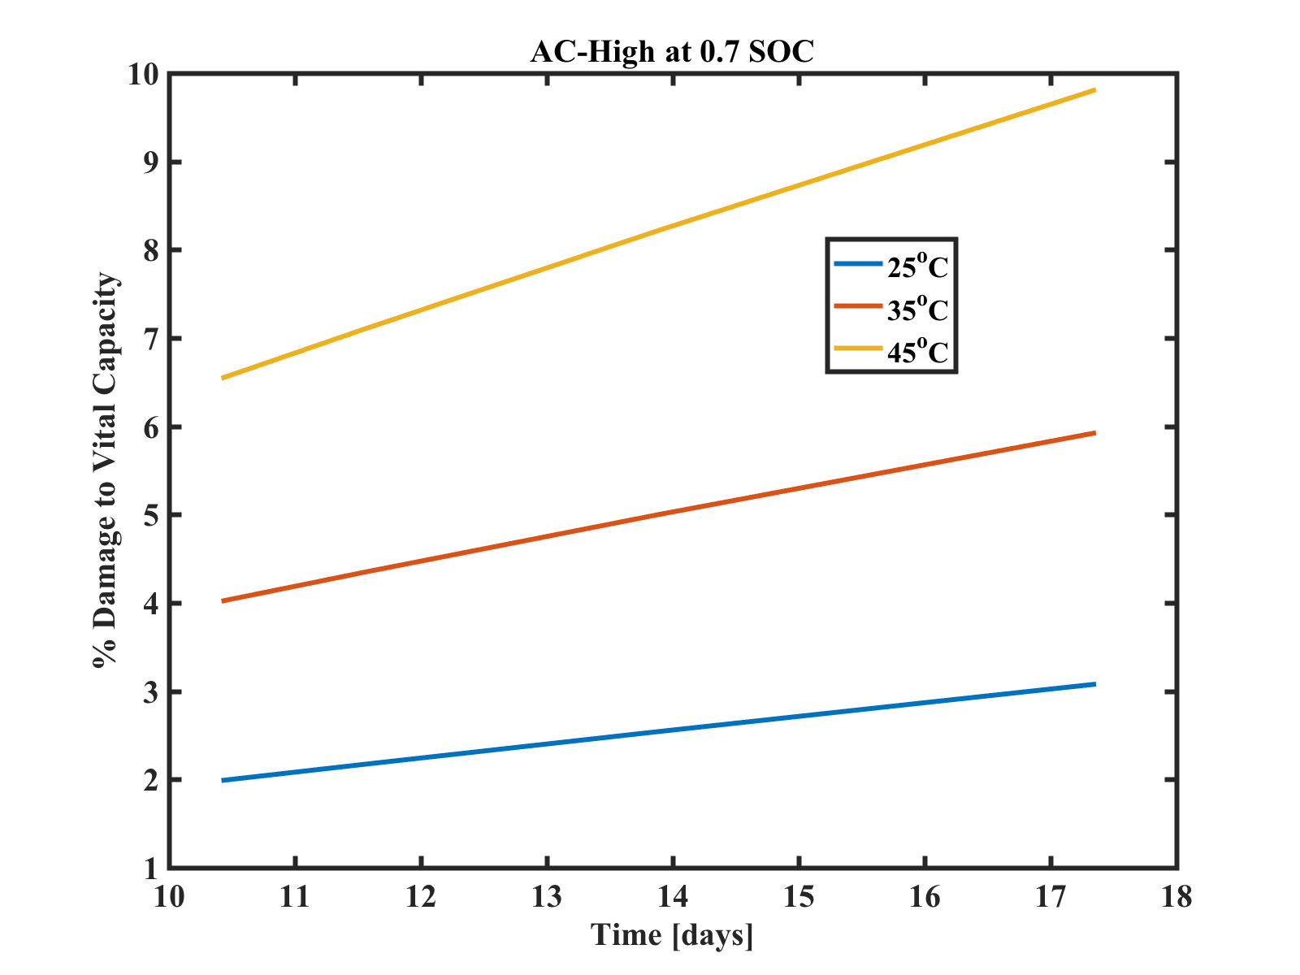
How long?

Slide 15
Extra

Slide 16
Damage due to charge and discharge parts
^Safari, M., Morcrette, M., Teyssot, A., & Delacourt, C. (2010). Journal of The Electrochemical Society, 157(7), A892-A898.
Notes:
Change this to SOC variation

Slide 17
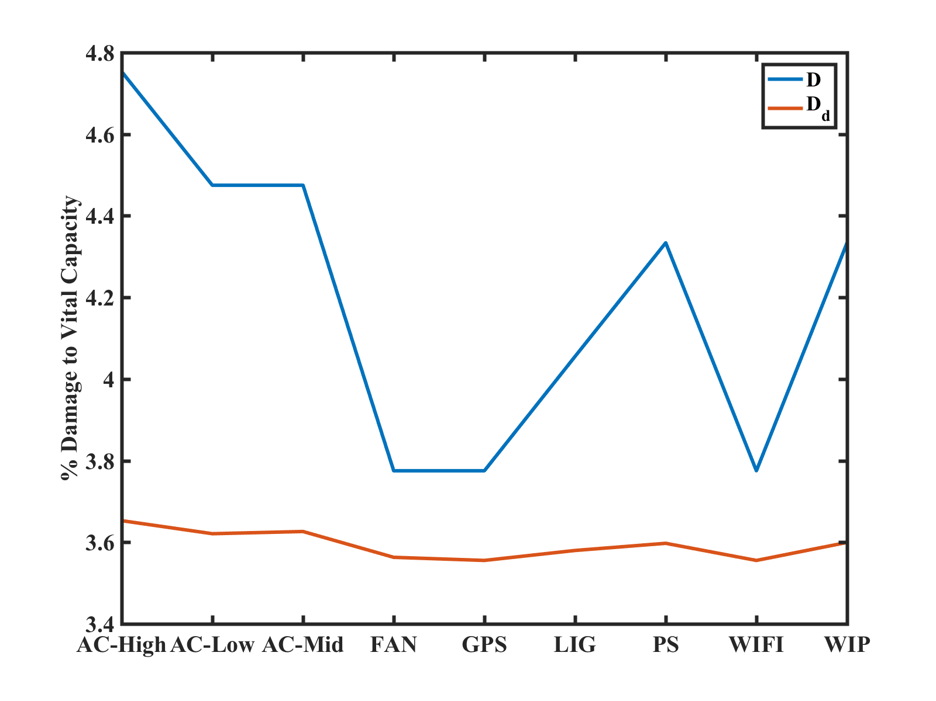
Damage due to charge and discharge parts
308K Δt_{d} = 30min, SOC 0.7
D_{d} is damage due to discharge part alone, and D includes charging part as well.
Charging causes a significant amount of damage.
Notes:
Change this to SOC variation

Slide 18
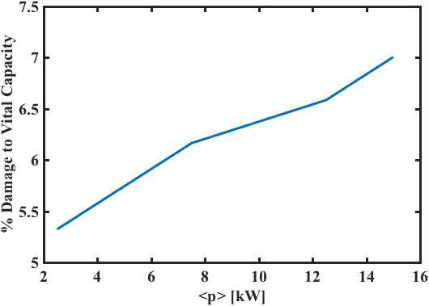
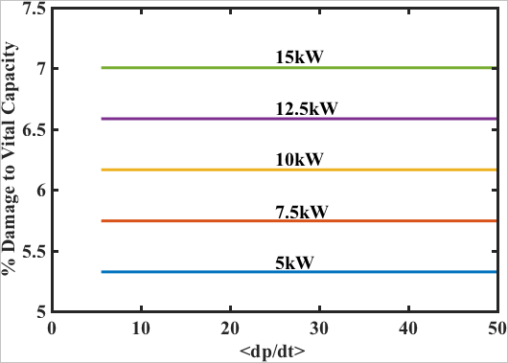
Effect of the ‘Nature’ of the load

