Slide 1

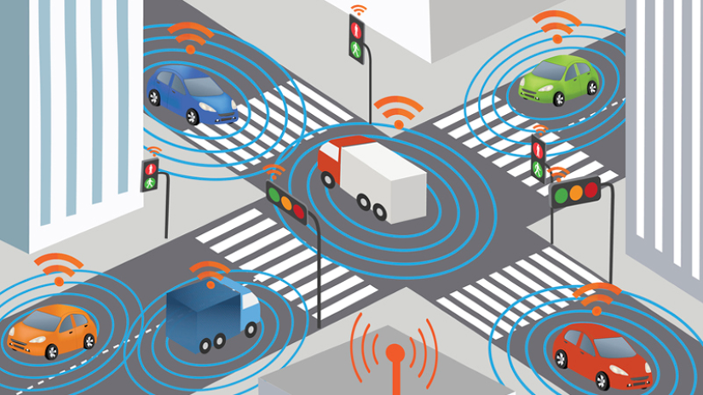
Vision-centric Connected Autonomy for Vulnerable Road Users' Safety (ViCARUS)
Lead Faculty: Vijayakumar Bhagavatula
Project Team: Prof. Bhagavatula, Dereje Shenkut
Camera Units
Vision-centric Connected Autonomy via V2X

Slide 2
ViCARUS – Brief Overview
Motivation: Number of deaths of vulnerable road users (VRUs) in US rising rapidly (pedestrian deaths increased from 4,779 in 2013 to 7,522 in 2022)
Goals: Increased VRU safety through:
    Investigation of gaps in object detectors’ performance
    Development of cooperative perception framework
    Simulation-to-real adaptation
    Analysis of C-V2X communication constraints
Outputs:
    Enhanced detection framework for VRUs
    Synthetic datasets with VRUs using CARLA simulator
    Validation on real-world data
    Technical publications and reports
Notes:
2

Slide 3
ViCARUS – Expected Outcomes
  Enhanced VRU safety through improved detection capabilities via cooperative perception
  Robust performance in degraded imaging conditions
  Practical insights into C-V2X system constraints
  Framework for safety critical perception performance evaluation via simulation using synthetic and real-world data
Notes:
3

