Slide 1
Data Challenges in Implementing Mileage-Based User Fee Systems
Project Team:
H. Scott Matthews (CEE)
Prithvi Acharya (EPP)
Sean Donnelly (CEE/EPP) Zhufeng Fan (CEE)
Lin Lyu (CEE) Rachel Sin (CEE/EPP)
Chenyu Yuan (CEE)
Deanna Matthews (EPP)
Source: https://beyondstandards.ieee.org/connected-vehicles/
the-internet-of-things-and-the-connected-vehicle/

Slide 2
Project Overview
Studying the literature, and data flows needed and available to further enable deployment of mileage-based fees in states
Data Analytics
Economics
Policy Analysis
Submitted two papers to 2021 TRB, will summarize one here
Notes:
2

Slide 3
Intro (Tailored for this Group)
We all know about:
Funding challenges (resistance to gas tax increases)
Expected transition from $ / gallon to $ / mile funding
Doing it for passenger and commercial vehicles
Lots of pilots and programs already done here and abroad
→ Technology exists, and can be basis of a program
We have thus focused on rate setting, and using existing data to help states or federal DOT with this task
Notes:
3

Slide 4
Introduction
Gas taxes ($/gal) have been primary funding source for transportation at the federal and state levels since beginning
Federal funds augment state funds
But federal gas tax rate hasn’t increased since 1990s
Inflation has eroded value of federal share, caused states to have to increase rates
Hybrid/electric/high fuel economy vehicles pay far less
Expected transition from “pay by gallon” to “pay by mile”
Notes:
4

Slide 5
What are Mileage-Based User Fees
(a.k.a. Road User Charges)?
A direct way of charging vehicles for use of transportation
So far we have been focused on passenger fleet
Requires: technology to track mileage (and maybe location), account for gas taxes paid, and a pre-set per-mile fee structure
Various states have done MBUF/RUC pilot programs
Technology is here and can work to assess and collect fees
“Double charging” gas taxes is key financial challenge
Several states have moved from pilot to program
Notes:
5

Slide 6
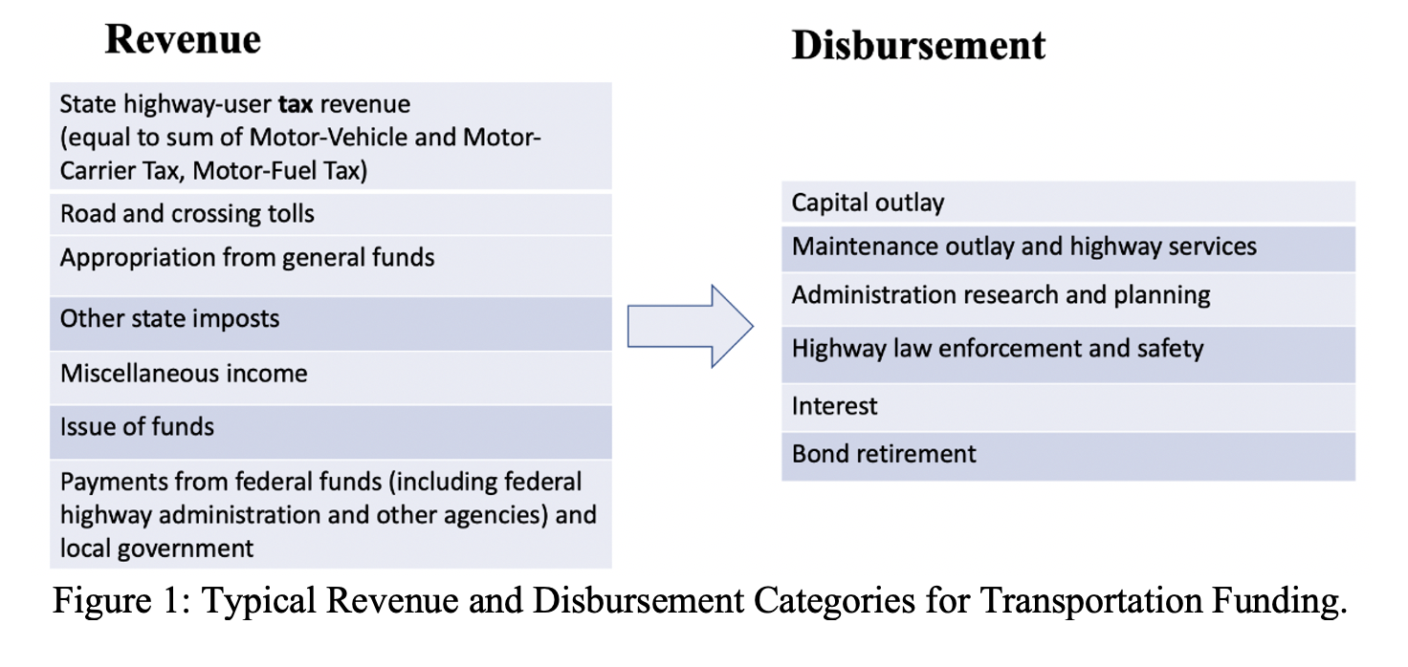
Focus After Literature Review:
Existing Transportation Funding Issues
State ‘transportation’ expenditures and funding systems complex
Funds construction, maintenance, administration, police, etc.
Mix of state and federal funds (including gas taxes)
Data Source:
DOT Highway Statistics Series
Gas taxes or MBUFs ->
Need to pay for
all of this
Notes:
6

Slide 7
Focus After Literature Review:
Existing Transportation Funding Issues
Most pilots / programs seeking to set MBUF rates at equivalent of current gas taxes (“revenue neutral”)
Replacing all gas tax revenues with MBUFs may still not be enough to pay for all relevant disbursements
But this complexity is often overlooked
And would lead to insufficient funding coverage at scale !
We want to create tools and frameworks to help states with the funding transition with decision support
Notes:
7

Slide 8
Findings about Fee Structures
Setting fee rates appears straightforward, is complicated by diversions of disbursements to other areas (e.g., police)
Seems likely states would undercollect fees
Federal data collected appears inconsistent and not helpful
Fee structures for MBUF/RUC could be intentionally complex
Example: rates could differ by fuel type, weight, road, ..
Higher rates for privacy-protecting systems (no location)
But existing data flows on highway use might not be sufficient to predict total fees collected (vs. gas tax rate)
Notes:
8

Slide 9
Sources in Highway Statistics Data
Revenue Tables (units: thousands of dollars)
HDF | Highway-user revenue sources (e.g., federal fuel tax, state fuel tax, state, and local tolls) and their disposition (e.g., for highways, for mass transit) for all levels of government (federal, state, and local)
HF-1 | Disposition of highway-user revenues for highways, all levels of government
SF-1 | Revenues used by the state for highways, from all sources (e.g., state fuel taxes, vehicle taxes, and federal funds, etc.).
SF-3 | Revenues used by state for only state administered highways (same columns as SF-1)
Disbursement Tables (units: thousands of dollars)
HF-2 | Disbursement (e.g., capital outlay, maintenance outlay, administration, etc.) of transportation revenues across all units of government. Capital and maintenance include the disbursement on state-administered, local-administered, and federal roads, respectively
SF-2 | Disbursement (e.g., capital, maintenance, administration, etc.) of state government funds on state administered highways and local roads and streets
SF-21 | State receipts and disbursements for highways detailed in Tables SF-1 (receipts) and SF-2 (disbursements). A key difference between state results is the presence of toll roads.
LGF-2 | Disbursement (e.g., capital, maintenance, administration, etc.) from local government
SF-4 | Disbursement (e.g., capital, maintenance, administration, etc.) of state administered highways, not including local roads and streets (SF-2 includes this).
SF-12 | State capital and maintenance outlays, classified by functional system and rural/urban/urbanized area
VMT Tables (units: millions of miles)
VM-1 | Annual vehicle distance traveled by highway functional system and vehicle type, a national scale table
VM-2 | Annual vehicle traveled by functional system for each state

Slide 10
Challenges with Using Highway Statistics (HS) Data
“Matching” data is hard, also inconsistent (e.g., detail of revenue sources does not match across HS tables)
Inconsistent reporting of federal share from state survey replies
Categories not ideal – seemingly good data on federal aid highways but not always locally managed (where state money would be spent!)
Notes:
10

Slide 11
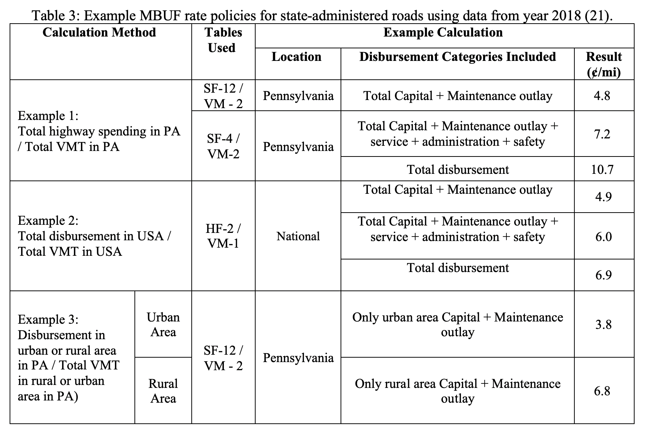
Pennsylvania Examples Using DOT-collected data
While a direct conversion of gas tax to MBUF should be about 2.5 cents/mile, if existing DOT data sources used, fees needed could vary widely based on rate setting method chosen
For all shown, rate would be “total disbursements needed divided by total VMT of passenger vehicles”
An imperfect metric, meant to be instructive!
Notes:
11

Slide 12
Our Eventual Goal – Planning Dashboard Tool
The wide range of results from the “consistent data source for all states” shows us the challenge in using national data
We can do better via direct collaboration with state DOTs, who can verify the data needed and disbursements to be ‘covered’
Can organize available data for passenger and commercial vehicles (VMT), revenues, disbursements and create what-if scenarios relevant to rate setting decisions
Note: Revenue neutral may be a mistake!
Notes:
12

Slide 13
Quick Tease of Other Paper
Leveraged 10 years and 100 millions of data records on
Annual inspections of safety and emissions in Pennsylvania
Registration data
Session is Monday Jan 25th (#1073) 11:30 am-1 pm
Paper is TRBAM-21-02330

Slide 14
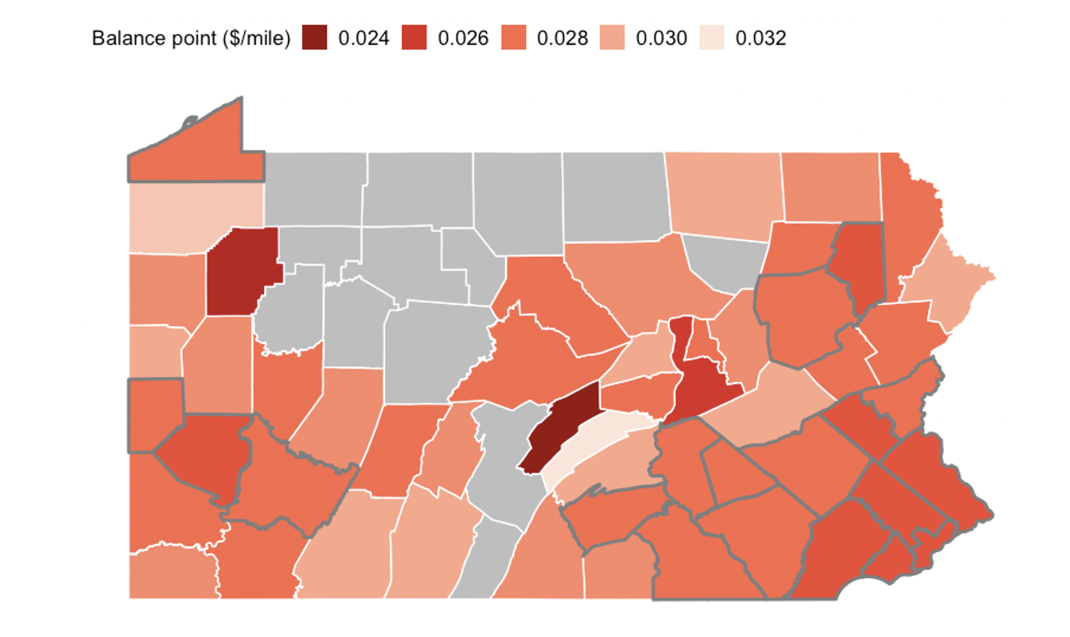
PA Examples Using Inspection Records and Algorithms
“Direct conversion” gas tax to MBUF should be ~ 2.5-3 cents/mile
But federal DOT data suggests that PA spends 7-10 cents per mile traveled!
Notes:
14

Slide 15
Expected Continuing Outcomes
Further data analysis, report, state dashboard models
Focus on helping states see discrepancies and set rates
Demonstrate technical feasibility of existing data flows to enable mileage-based fees
Notes:
15

Slide 16
How Can you Help?
We need partners interested in using our work to date, and willing to help us improve the planning tool.
Ideal partners are state DOTs and technology providers
Contact me if interested or for copies of the papers!
hsm@cmu.edu
Notes:
16

