Slide 1
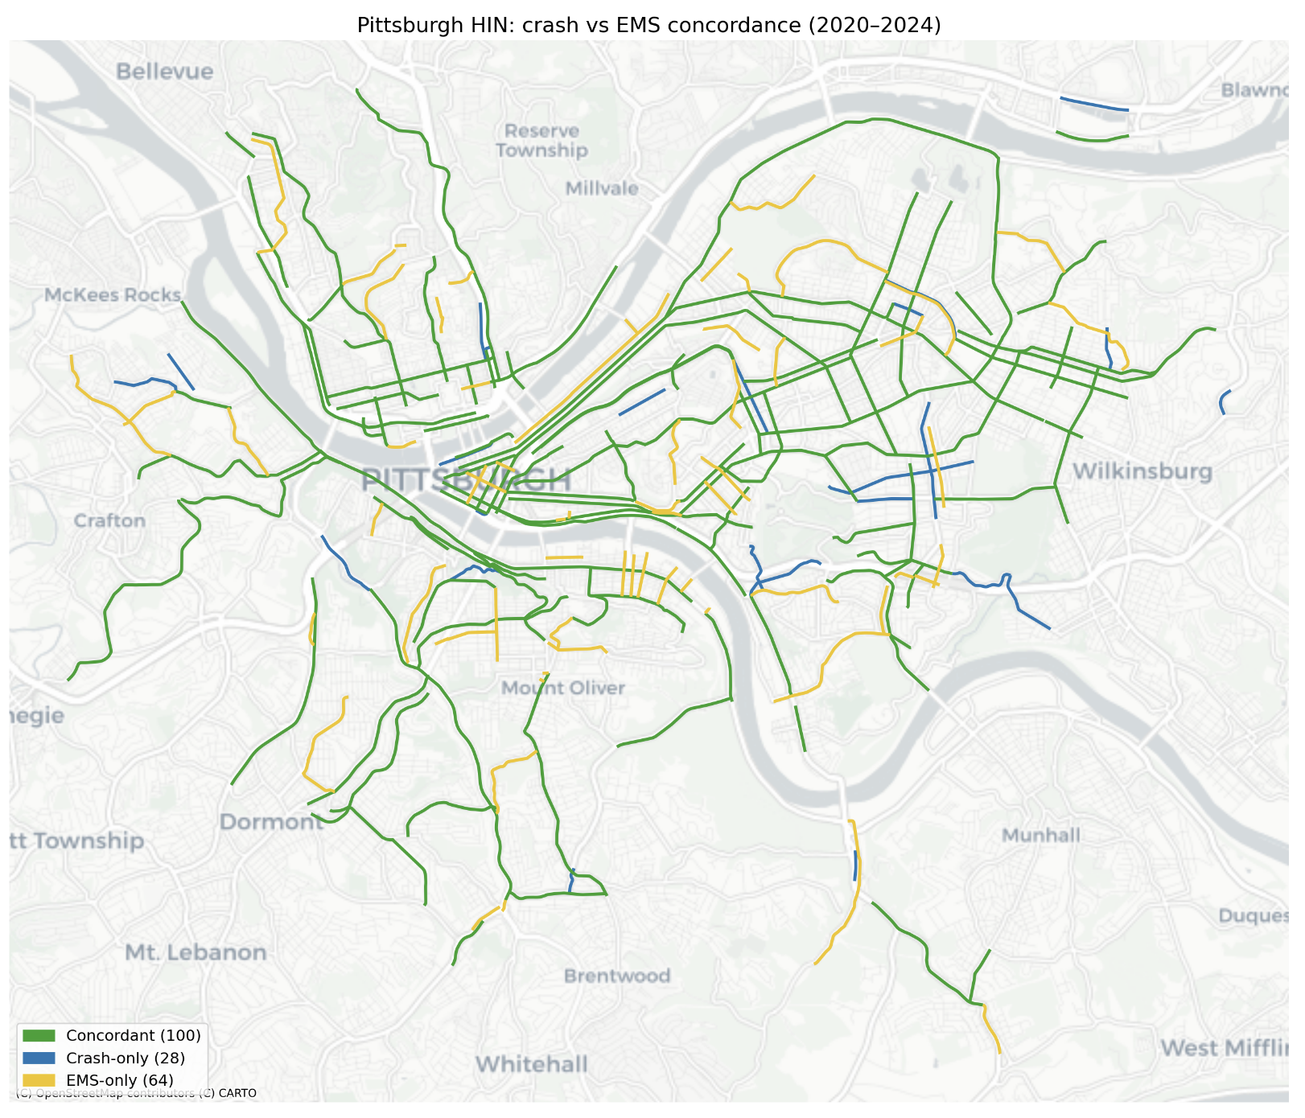
Project Card — Single Project
Enhanced Crash Risk Estimation in Urban Environments: Integrating Multi-Source Data and Advanced Modeling Approaches for the City of Pittsburgh | CMU | Sean Qian | 590
Status
WHAT
STATUS
WHY IT MATTERS
Tech Transfer
Objective: Examine single data sourced High Injury Network with a second complete data source from healthcare services
% Complete: 100%
Impact: Improve the estimation of High Injury Network for most cost effective decisions on safety action plan
Software
Budget Allocated: $190,000
Data availability and quality
Research Priority: Safety
Federal Share: $95,000
Any public agencies with safety action plan
Approach: Data analytics, machine learning, GIS
Non-federal Share: $95,000
Budget Spent: $190,000
Outcome / relevance: A replicable framework for estimating High Injury Network from multiple data sources, with a more reliable estimation of hotspot crash locations
Partner: City of Pittsburgh
Next Milestone: Completed
Optional: Public or policy visibility
A replicable framework for estimating High Injury Network from multiple data sources, with a more reliable estimation of hotspot crash locations

Slide 2
Project Deep Dive
Enhanced Crash Risk Estimation in Urban Environments: Integrating Multi-Source Data and Advanced Modeling Approaches for the City of Pittsburgh | CMU | Sean Qian | 590
TIMELINE
BUDGET
DELIVERABLES
RISKS / NOTES
All completed
% Complete: 100%
Deliverable 1: An automated data pipeline in Python
Risk: none
Budget Allocated: $190,000
Deliverable 2: Detailed technical report
Federal Share: $95,000
Non-federal Share: $95,000
Deliverable 3: Presentations to public agencies
Budget Spent: $190,000
Keep this slide factual. If a detail does not drive a decision, it should not be here.

