Slide 1



Roboracer LMS
An Open-Sourced Learning Management System
Portal Walkthrough

Slide 2

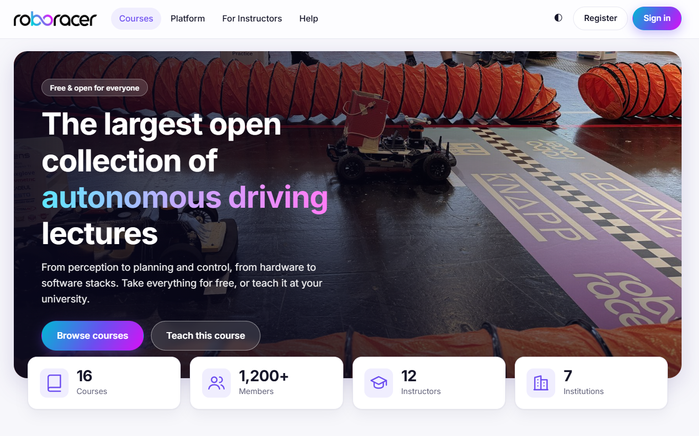
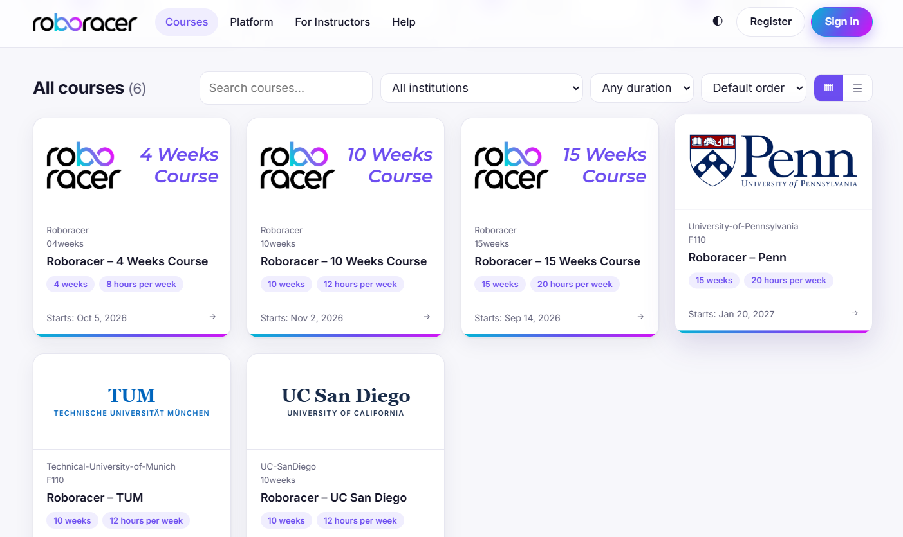
Home Page
01
Welcome Page for Students and Instructors around the Globe
Offer, list and manage multiple open sourced courses across Subjects, Universities, and Countries all at one place

Slide 3

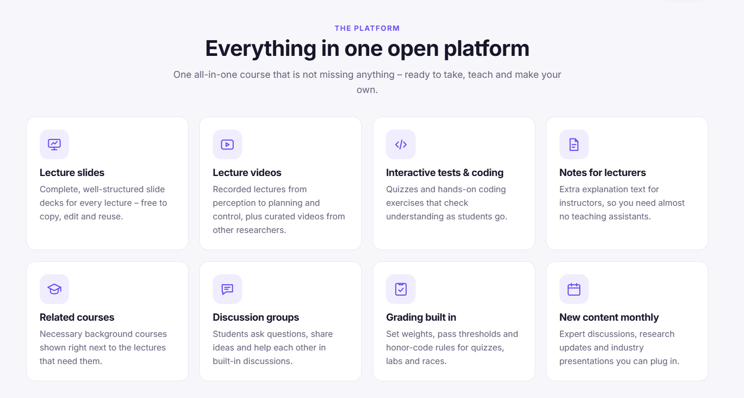
LMS PLatform General Features
Upload and Manage Lectures, Tutorials, Tests, Assignments, Notes, Discussions, Updates

Slide 4
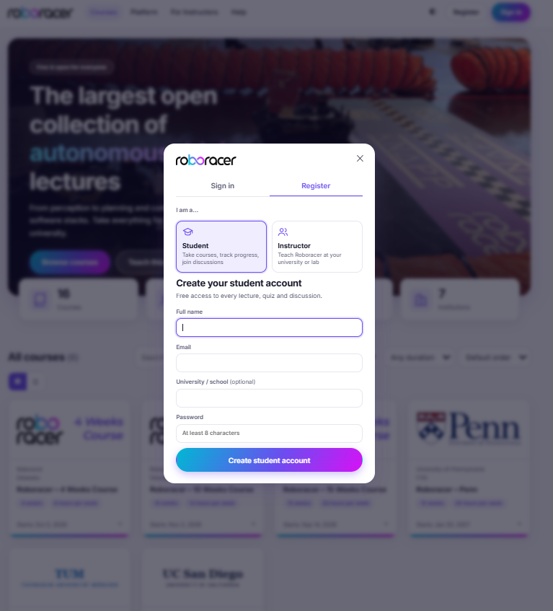
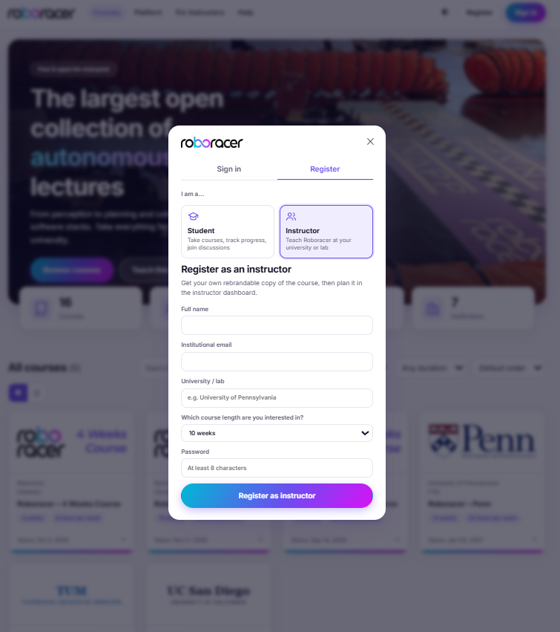
Registration Pages
Student Registration -
Register with your School ID
to enter your courses portal
Instructor Registration -
Verify your identity and get access to the instructor portal to upload and manage your course content
Dedicated Sign-In and Registration Pages for Students and Instructors

Slide 5
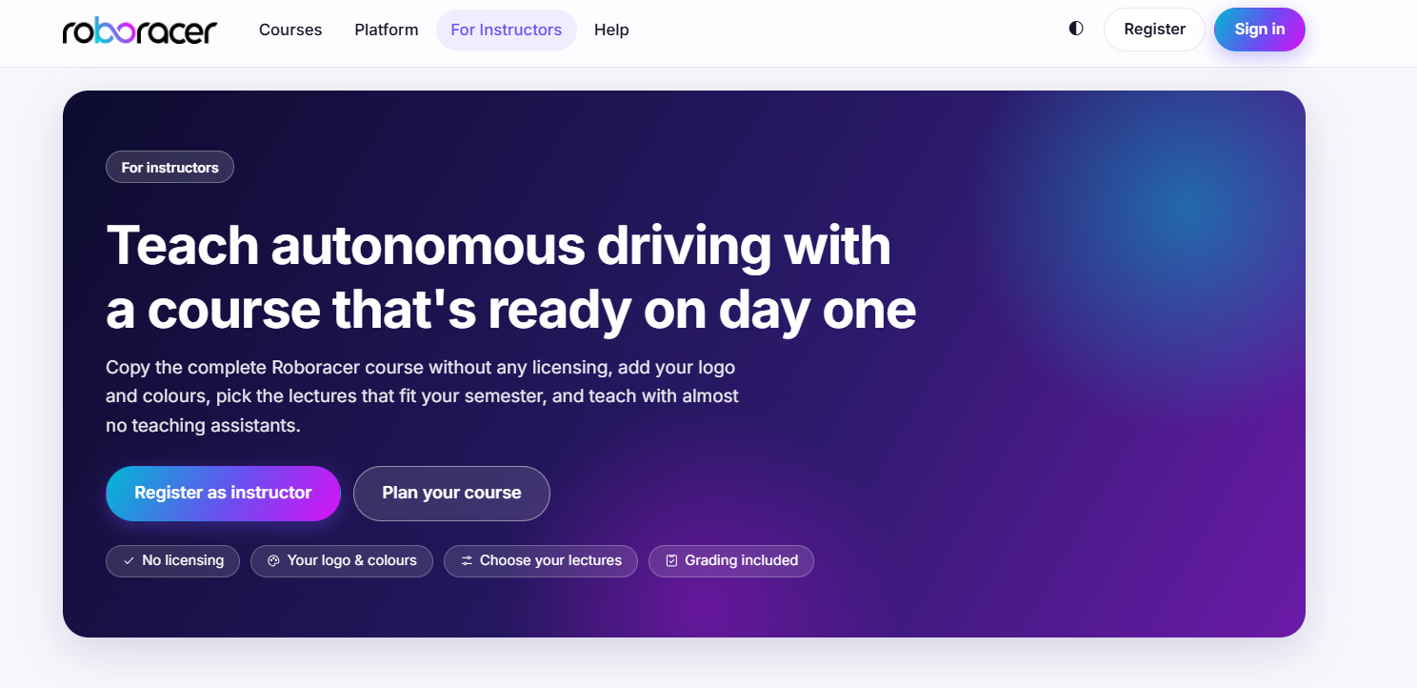
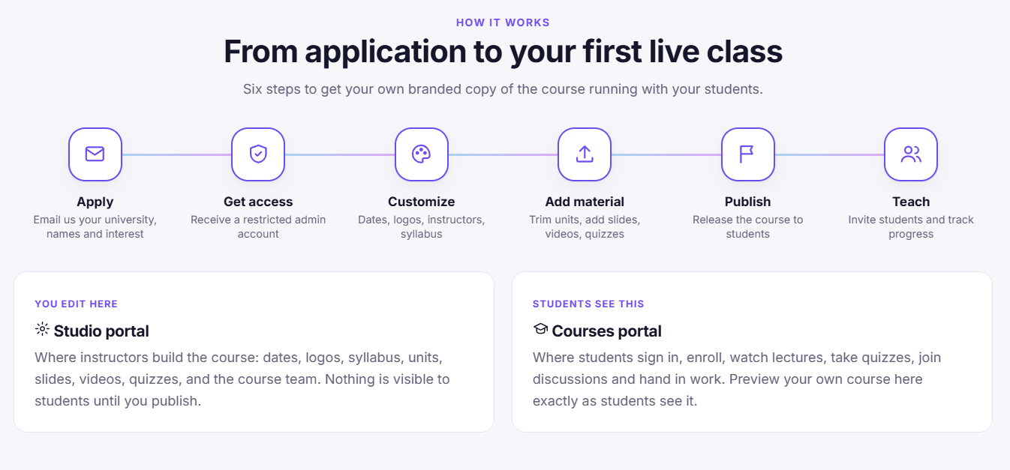
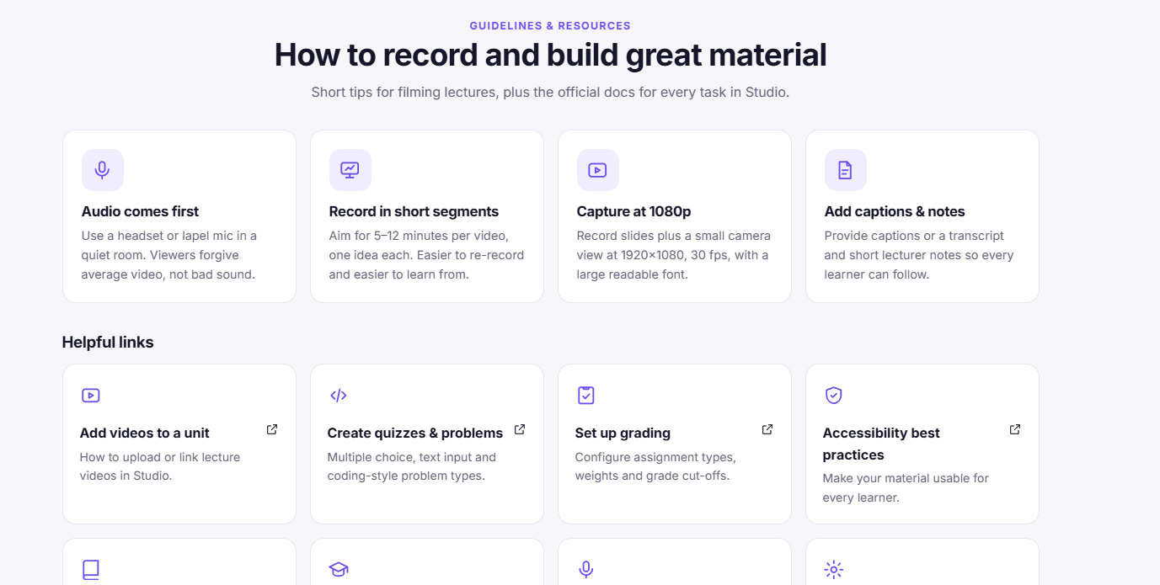
Features for Instructors
02
Get guided documentation and step-by-step free tutorials to help you create and maintain your content
Easy to Setup and Manage, Separate Portals for Tasks

Slide 6
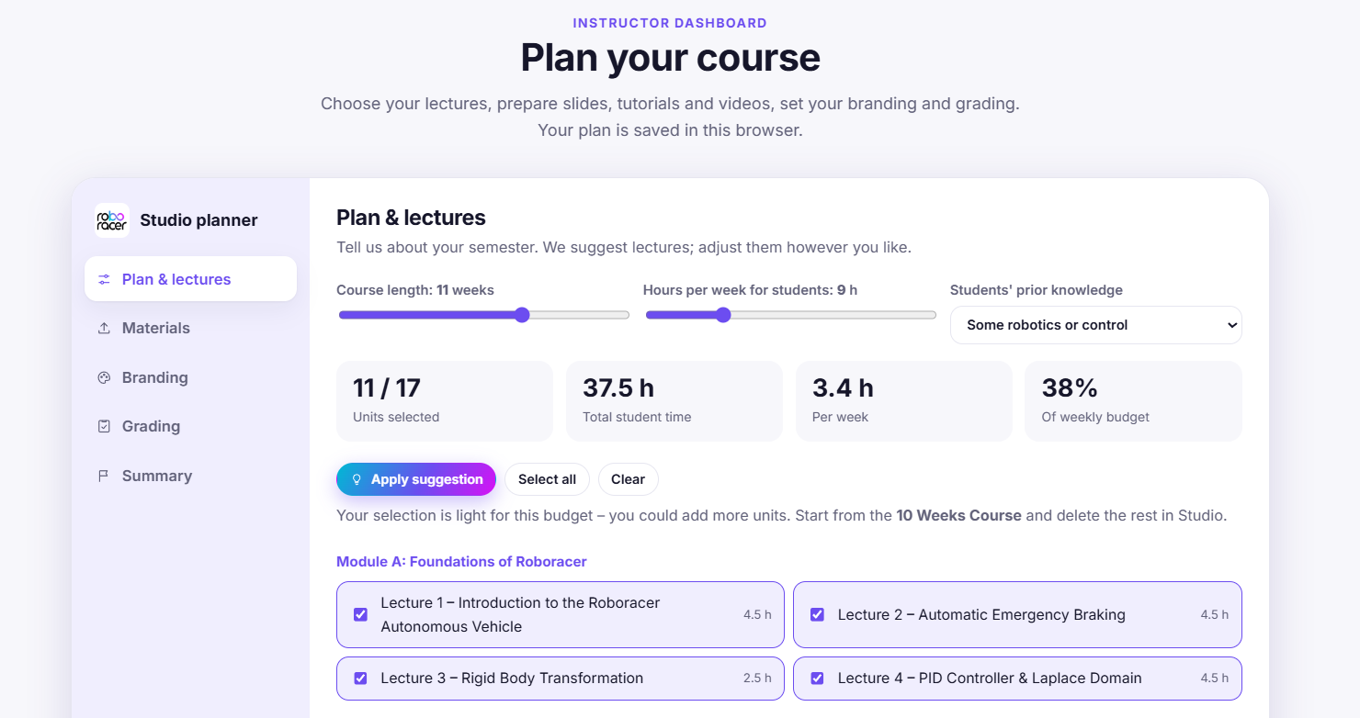
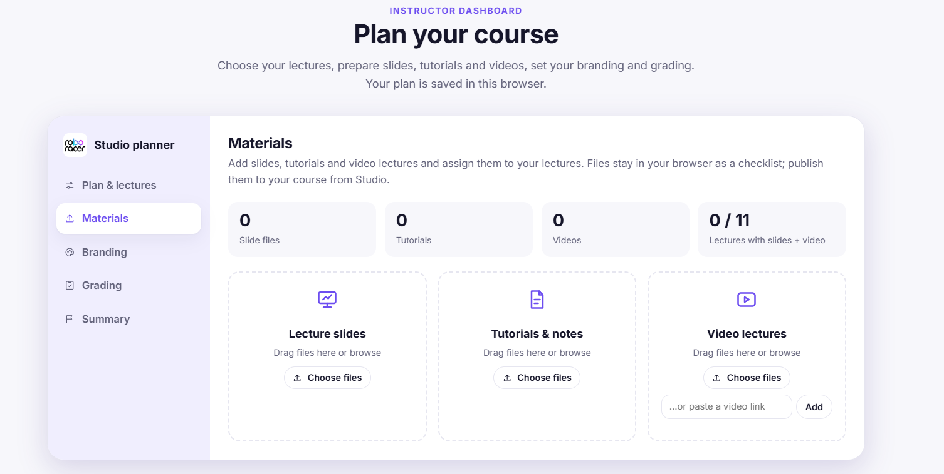
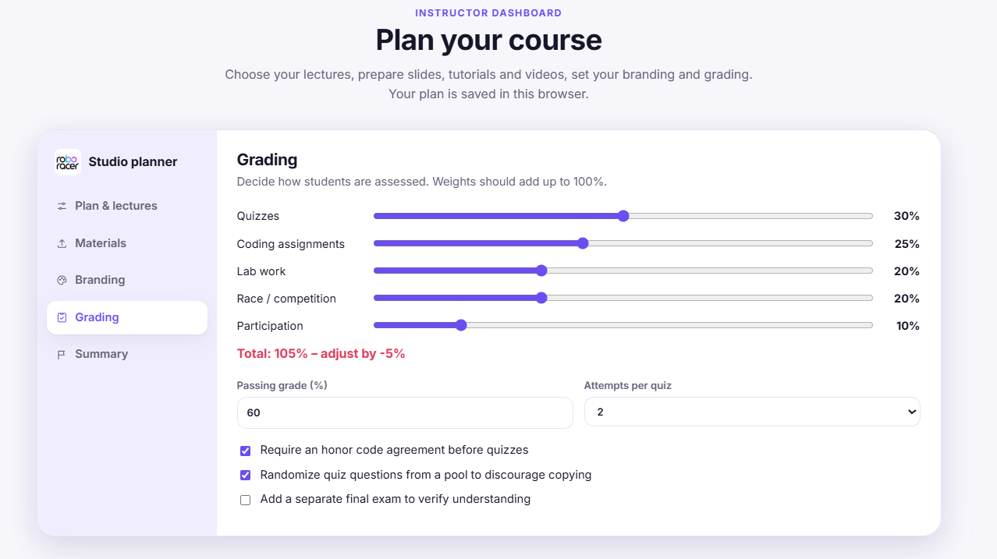
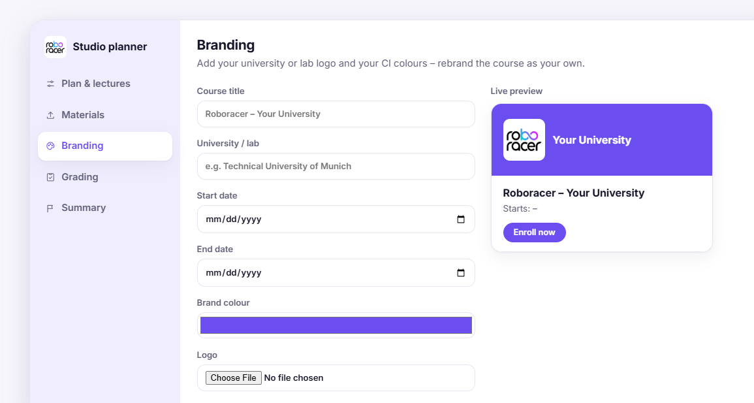
Instructor Portal
Set course timeline, lecture duration, content requirements
Upload Slides, Video Tutorials, Notes
Set grading templates, rubrics and other evaluation metrics
Brand your course as per your preference and university guidelines

Slide 7
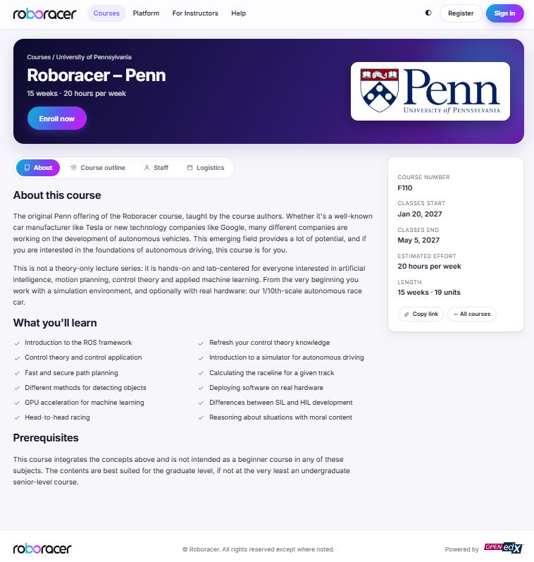
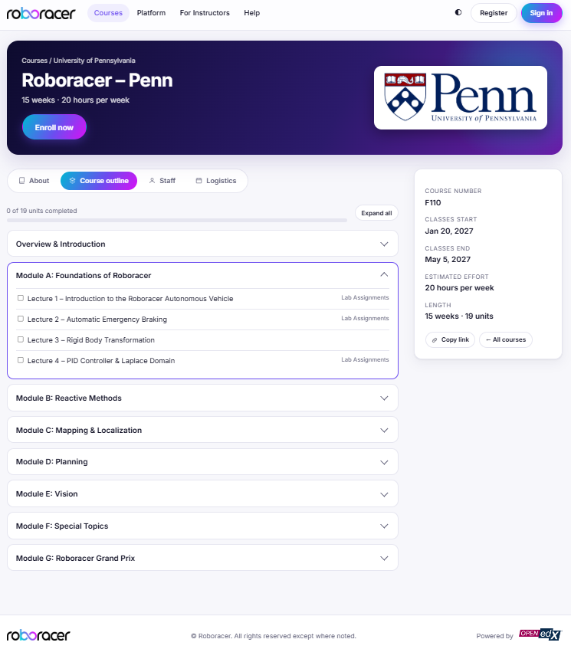
Course Page
03
Course Details and Prerequisites
Course Outline & Modules

Slide 8
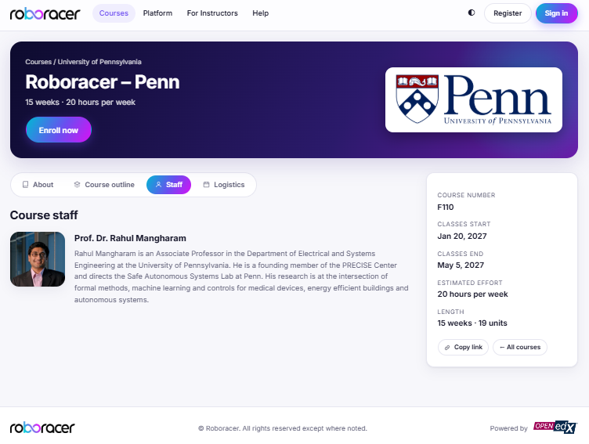
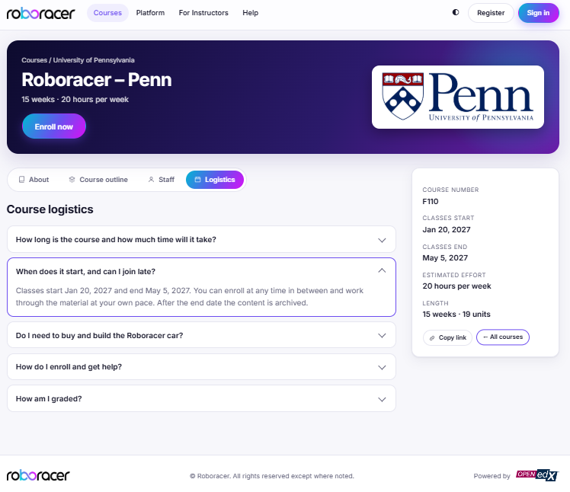
Course Page
Instructor and Teaching Staff Information
Course Related FAQ Section

Slide 9
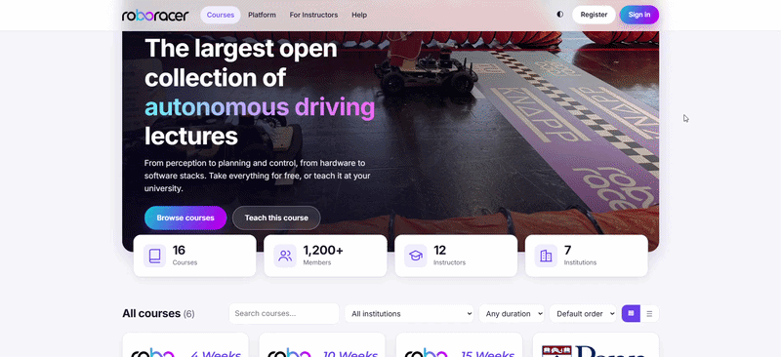
Complete Walkthrough
04

