Slide 1
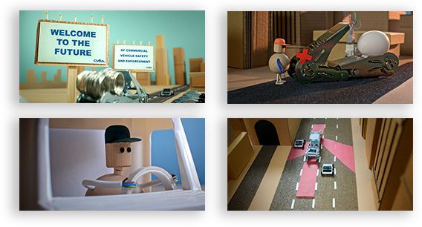



Deterioration Digital Twins of Commercial Trucks and Trailers for Targeted Inspection and Maintenance
Lead Researcher: Pingbo Tang, CEE
Project Team: Truck-Lite, CompuSpections
(image credit: CVSA)

Slide 2
Project Name – Brief Overview of Project
Goals: 1) Enhance the safety of fleets of commercial trucks and trailers without compromising mobility and operating costs; 2) Effective use of historical and real-time telematics data for deterioration digital twinning of vehicle fleets for proactive inspection and maintenance
Anticipated Outcomes: 1) Deterioration Digital Twins of Commercial Vehicle Fleets for Predicting Safety and Mobility Impacts of Inspection and Maintenance Plans; 2) Algorithms for Generating Inspection and Maintenance Plans of a Commercial Vehicle Fleet based on Digital Twins
Partners – Private: Truck-Lite; Private: CompuSpections
Notes:
2

Slide 3
Project Name – Expected Outcomes
Deterioration models of commercial trucks and trailers based on historical data
Best practice of targeted use of telematics for monitoring safety-critical component status in trucks
Reduced operating cost and improved safety performance of the commercial vehicle fleets through data-driven inspection and maintenance planning
Policy suggestions for safety inspection programs and automatic vehicle inspection technology uses in practice
Digital Twin Deterioration Simulation - Out of a 1000 vehicles fleet, about 120 – 125 vehicles will have a low tire tread and a low brake pad if we have a reactive maintenance plan
Notes:
3

