Slide 1
Improving public transit accessibility by leveraging emerging mobility options
Lead Researcher: Katherine A. Flanigan

Slide 2
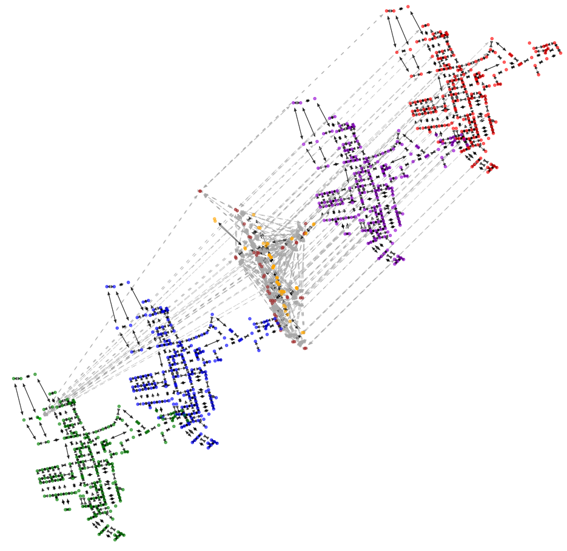
Brief Overview of Project
The goal is to develop a multimodal network modeling framework to measure point-of-interest accessibility, considering a diverse set of time-dependent travel costs and a comprehensive set of travel modes.
Anticipated outcomes include a methodological framework and demonstration using a multimodal network in Pittsburgh’s Hazelwood neighborhood.
Notes:
2

Slide 3
Expected Outcomes
This framework will enable the evaluation of mobility disparities that exist across different populations.
Evaluation of how improvements in mobility services impact accessibility across origin-destination pairs.
Determination of the pattern of network usage across each mode and facility.
Notes:
3

