Slide 1
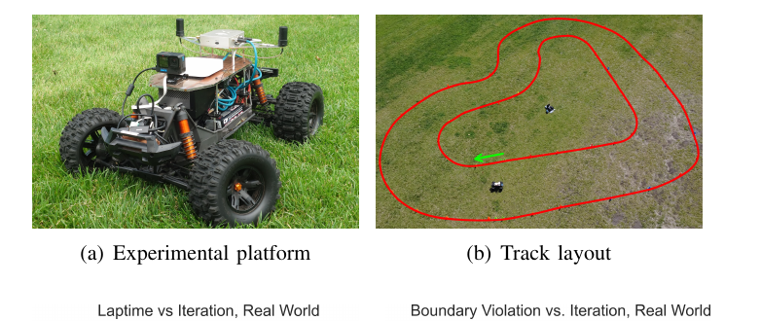
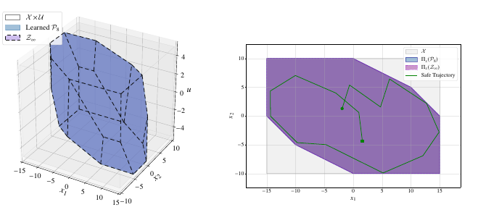
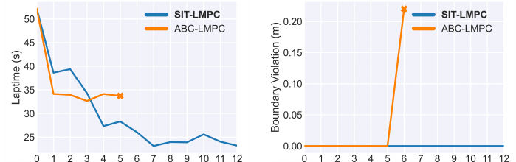
Autonomous Driving in Hazardous Conditions: Pushing the Limits of Vehicle Control
University of Pennsylvania | Rahul Mangharam | Project #612
Status: Green
WHAT
STATUS
WHY IT MATTERS
Tech Transfer
Objective: Let vehicles drive safely and fast on rough, hazardous terrain by learning controllers from imperfect models and from failures.
Research Priority: Automation/ADS; ADAS; Artificial Intelligence and Machine Learning; Robotics.
Approach: A GPU-parallel safe learning controller (SIT-LMPC) tested on a 1/5-scale off-road car, plus learning invariant safe sets from failures (FAIL).
Partners: Delaware Valley Regional Planning Commission (DVRPC) and the Autoware Foundation.
% Complete: 100%
Budget Allocated: $220,000 total
Federal Share: $110,000
Non-federal Share: $110,000 (Penn cost share, 1:1)
Budget Spent: $110,000 federal
Next Milestone: Oct 05, 2026
Deliverable due: Final report, the last remaining deliverable.
Impact: Driver-assistance and emergency-response vehicles gain controllers that improve speed while staying inside safety limits off-road.
Outcome: On a real off-road car, SIT-LMPC raised average speed 75% with zero boundary violations while the baseline crashed.
Visibility: Published in IEEE RA-L (Jan 2026); accepted to IEEE CDC 2026.
Type: Open research methods and a controller running at 100+ Hz on an NVIDIA Jetson Orin AGX.
Barriers: Full-size and hazardous-terrain validation is still needed.
Partners: DVRPC; Autoware Foundation.
High Visibility: Recommend awareness of pilot planning with DVRPC.
Off-road test car and grass track
Real-world lap time and violations
FAIL learned safe set

Slide 2
Project Deep Dive
Autonomous Driving in Hazardous Conditions: Pushing the Limits of Vehicle Control | University of Pennsylvania | Rahul Mangharam | Project #612
Status: Green
TIMELINE
BUDGET
DELIVERABLES
RISKS / NOTES
Jul 01, 2025: Project start; complete.
Oct–Nov 2025: SIT-LMPC accepted and published online in IEEE RA-L; complete.
Jan 2026: SIT-LMPC appears in RA-L Vol. 11, Issue 1; complete.
Apr 2026: FAIL preprint posted; accepted to IEEE CDC 2026; complete.
Jun 30, 2026: Project end date; complete.
Allocated: $110,000 federal
Spent: $110,000
Burn %: 100%
Cost share: $110,000 Penn cost share, 1:1.
Variance: None.
Publications: Complete; two papers (IEEE RA-L, IEEE CDC 2026).
Hardware demo: Complete; real 1/5-scale off-road car.
Deployment: This project provides a prototype vehicle to the Autoware Foundation for design and build of next generation autonomous vehicles with safe and high-performance control.
Data, software, patents: Continuing into the next phase.
Final report: Submitted with these slides, Oct 2026.
Risk: Hazard-specific datasets and DVRPC pilot sites are not yet complete.
Mitigation: The safe learning methods are ready to carry into pilot planning with DVRPC and Autoware.
Decision request: None.
Community Impact: The IEEE Intelligent Transportation Society and IEEE Robotics Automation Society have selected this platform for education and competitions across top conferences in 2027.
100+ Hz
real-time control on an NVIDIA Jetson Orin AGX
+75%
average speed gain on the real off-road car
0
boundary violations on the real car; baseline crashed
6
failing trajectories were enough to learn all 14 safe-set constraints (FAIL)

