Slide 1
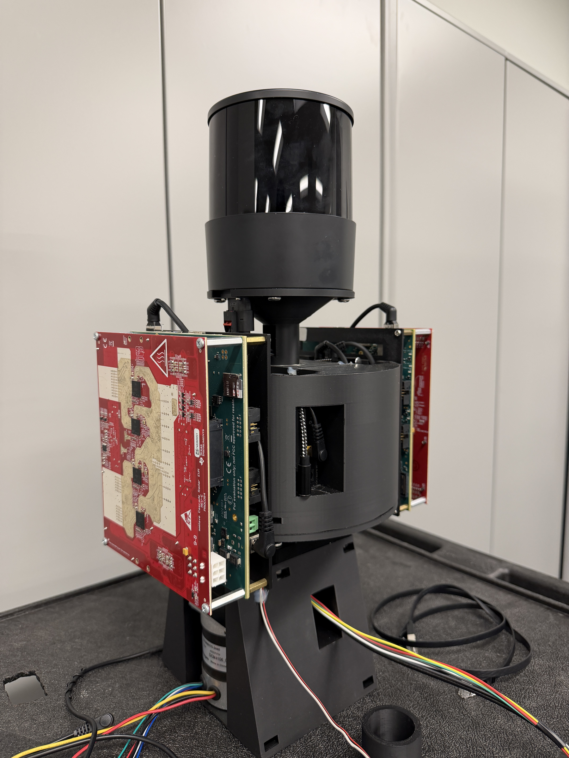
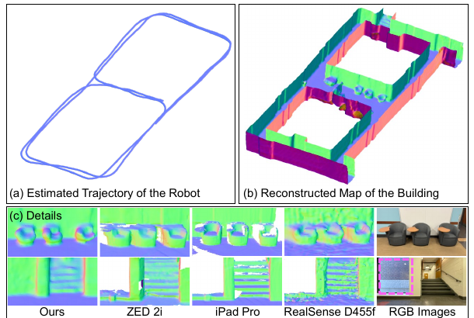
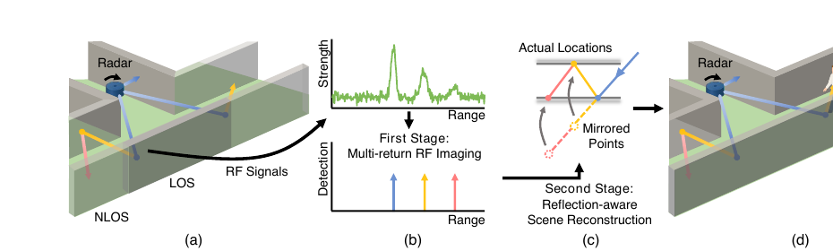
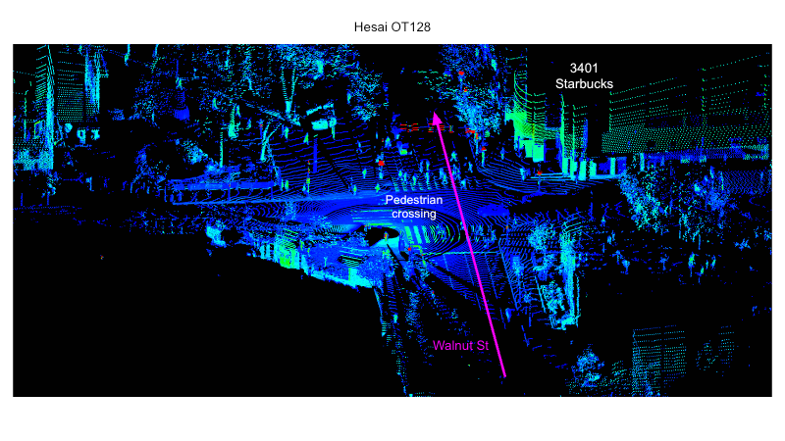
Reliable Vehicle Sensing in All Weather Conditions
University of Pennsylvania | Rahul Mangharam | Project #610
Status: Green
WHAT
STATUS
WHY IT MATTERS
Tech Transfer
Objective: Make vehicle perception reliable when cameras and LiDAR are degraded by fog, rain, snow, darkness, or occlusion.
Research Priority: Automation/ADS; ADAS; Artificial Intelligence and Machine Learning; Robotics.
Approach: A rotating mmWave radar forms a synthetic aperture, and learning models convert it into dense 3D geometry, maps, and hidden-object detection.
Partners: SEPTA and the Autoware Foundation (deployment partners).
% Complete: 100%
Budget Allocated: $110,000
Federal Share: $110,000
Non-federal Share: $110,000 (Penn cost share)
Budget Spent: $110,000
Next Milestone: Oct 05, 2026
Deliverable due: Final report, the last remaining deliverable.
Impact: Vehicles and transit buses gain an independent sensor that still sees road users when cameras and LiDAR are blinded.
Outcome: Peer-reviewed results show centimeter-level 3D mapping and 97% recall for people hidden around corners.
Visibility: PanoRadar and CartoRadar won MobiCom Best Demo and Best Artifact awards.
Type: Open-source code, public datasets, and a vehicle prototype.
Barriers: Rotating hardware must be hardened for transit service.
Partners: SEPTA; Autoware Foundation.
High Visibility: Recommend leadership awareness of the SEPTA bus pilot.
PanoRadar++ vehicle unit
CartoRadar RF-based 3D map
HoloRadar around-corner sensing
On-car outdoor data collection

Slide 2
Project Deep Dive
Reliable Vehicle Sensing in All Weather Conditions | University of Pennsylvania | Rahul Mangharam | Project #610
Status: Green
TIMELINE
BUDGET
DELIVERABLES
RISKS / NOTES
Jul 01, 2025: Project start; complete.
Nov–Dec 2025: CartoRadar (MobiCom) and HoloRadar (NeurIPS) published; complete.
Jan–Jul 2026: PanoRadar++ vehicle platform built and tested on a car; complete.
Jun 30, 2026: Project end date; complete.
Schedule note: PPMS shows "Overdue" only until this final report is filed.
Allocated: $110,000 federal
Spent: $110,000
Burn %: 100%
Cost share: $110,000 Penn cost share, met and on file.
Variance: None.
Publications: Complete; CartoRadar and HoloRadar extend the PanoRadar foundation.
Software: Complete; PanoRadar and CartoRadar code released on GitHub.
Datasets: Complete; PanoRadar and CartoRadar datasets are public.
Final report: Submitted with these slides, Oct 2026.
Risk: Controlled adverse-weather tests and Autoware integration remain for the next phase.
Mitigation: The car-tested PanoRadar++ platform is ready for SEPTA field trials.
Decision request: None.
3.4 cm
median 3D range error (PanoRadar)
14 cm
trajectory error, radar-only SLAM (CartoRadar)
97%
recall for people hidden around corners (HoloRadar)
5 Hz
panoramic scan rate on the vehicle (PanoRadar++)

