Slide 1
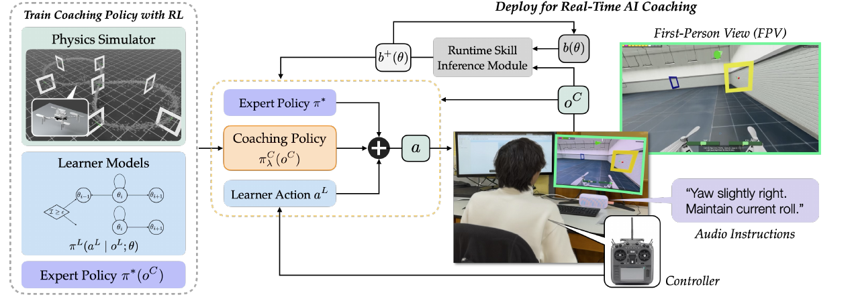
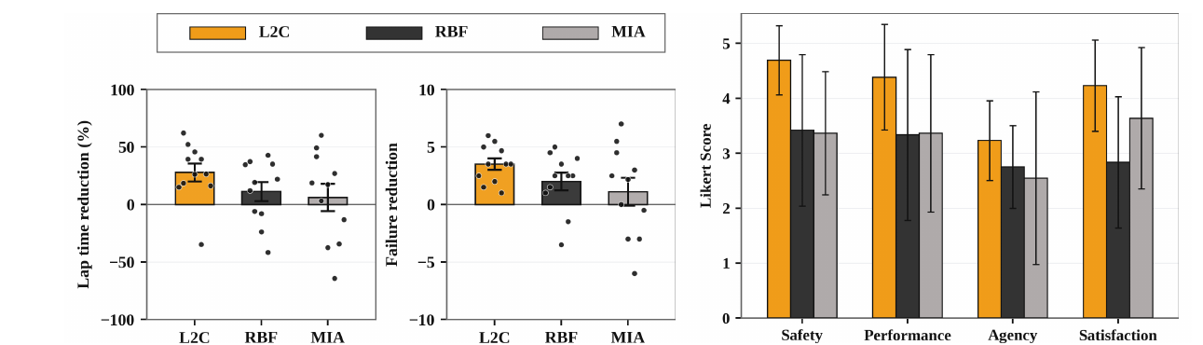
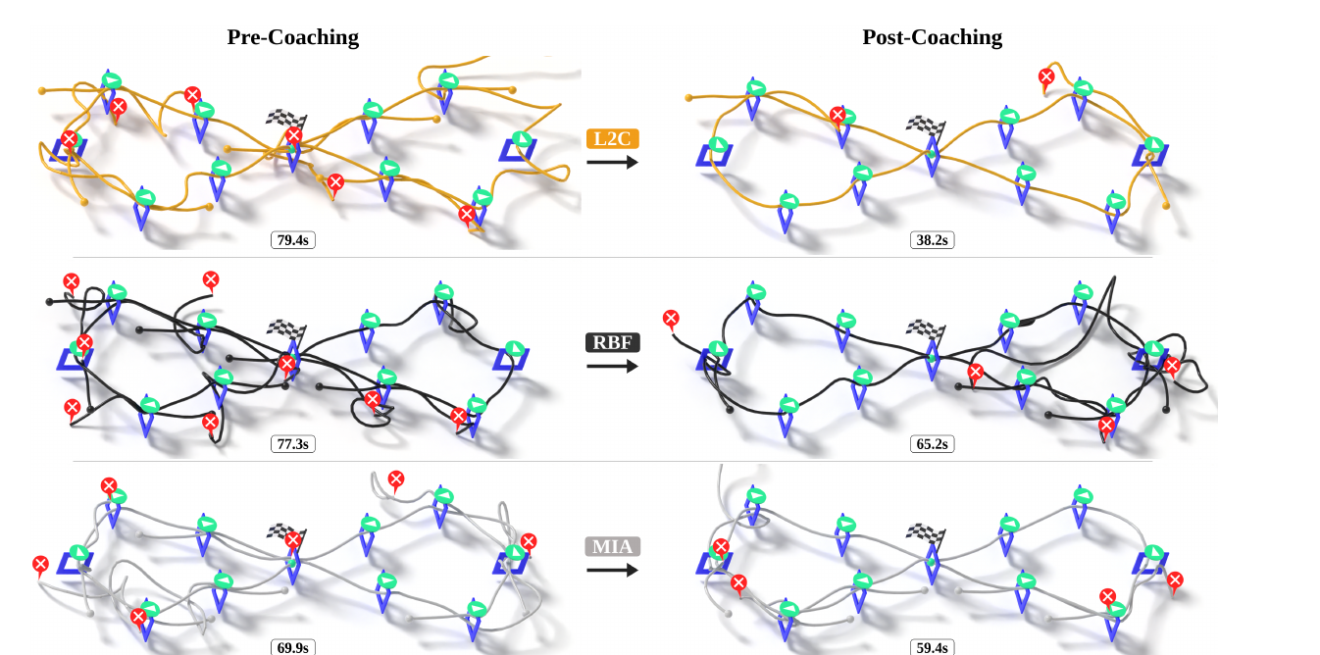
Guardian Angel: Building Trust in Shared Autonomy Vehicles with Safe Human-Machine Interaction
University of Pennsylvania | Rahul Mangharam | Project #586
Status: Green
WHAT
STATUS
WHY IT MATTERS
Tech Transfer
Objective: Build trust and safety in shared autonomy by having an AI agent help people become better drivers and pilots, not more dependent on automation.
Research Priority: Automation/ADS; ADAS; Artificial Intelligence and Machine Learning; Robotics.
Approach: Learning to Coach (L2C): reinforcement learning trains an AI coach that decides when to assist and when to step back. Tested with 33 people in a drone racing simulator.
Partners: University of Pennsylvania with Johns Hopkins University (co-author).
% Complete: 100%
Budget Allocated: $70,000 total
Federal Share: $35,000
Non-federal Share: $35,000 (Penn cost share, 1:1)
Budget Spent: $35,000 federal
Next Milestone: Oct 05, 2026
Deliverable due: Final report, the last remaining deliverable.
Impact: Shared-control driver aids that build a person's own skill and trust, instead of causing over-reliance on automation.
Outcome: After 40 minutes of coaching, lap times fell 27.9% and failures fell 3.52 per lap (33 participants).
Visibility: Accepted to the Conference on Robot Learning (CoRL) 2026; preprint on arXiv.
Type: Open research method with a public project website; code and data release not yet public.
Barriers: Validation so far is in a simulator; on-road vehicle studies are still needed.
Partners: None formal in this period.
High Visibility: None.
Learning to Coach system
User study results
Before and after coaching

Slide 2
Project Deep Dive
Guardian Angel: Building Trust in Shared Autonomy Vehicles with Safe Human-Machine Interaction | University of Pennsylvania | Rahul Mangharam | Project #586
Status: Green
TIMELINE
BUDGET
DELIVERABLES
RISKS / NOTES
Jul 01, 2025: Project start; complete.
2025-26: Coaching method developed and user study with 33 participants run; complete.
Jun 24, 2026: Paper posted on arXiv; complete.
Jun 30, 2026: Project end date; complete.
Oct 2026: Paper accepted to CoRL 2026; complete.
Allocated: $35,000 federal
Spent: $35,000
Burn %: 100%
Cost share: $35,000 Penn cost share, 1:1.
Variance: None.
Publication: Complete; one paper accepted to CoRL 2026.
User study: Complete; 33 participants, three coaching methods.
Code and data: Not yet public.
Final report: Submitted with these slides, Oct 2026.
Risk: Study was in a simulator, and differences between the three coaches were not statistically significant (11 people per group).
Mitigation: Gains within the L2C group were significant; larger and on-road follow-up studies are needed.
Decision request: None.
27.9%
average lap time reduction after 40 minutes of coaching
3.52
fewer failures per lap after coaching
33
participants in the user study
3
coaching methods compared: L2C and two baselines

