Slide 1
Using Municipal Vehicles as Sensor Platforms to Monitor the Health and Performance of the Traffic Control System
Lead Researcher: Mark R. McCord
Project Team: Benjamin Coifman, Rabi Mishalani
Add a photo/graphic representing project (if there is one)

Slide 2
Municipal Vehicles as Sensor Platforms
This research seeks to develop a viable, on-going monitoring program that utilizes municipal vehicles as sensor platforms and uses these sensors to monitor the roadway traffic conditions and performance of signalized intersections in a metropolitan area
The first step in this research is collecting reliable measures of traffic volumes, a fundamental input to any signal timing or evaluation
The tasks in the coming year will primarily focus on
Establishing the capability to rapidly collect these data from buses
Exploring aspects that will benefit from refinement, e.g., identifying the start and end of platoons so that we can control for observations from partial cycles
Notes:
2

Slide 3
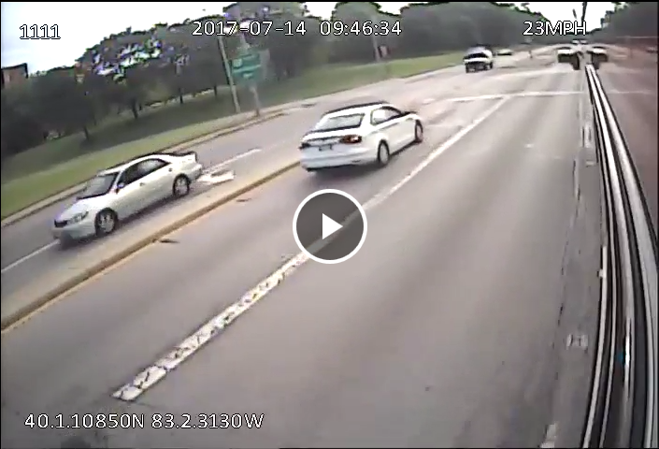
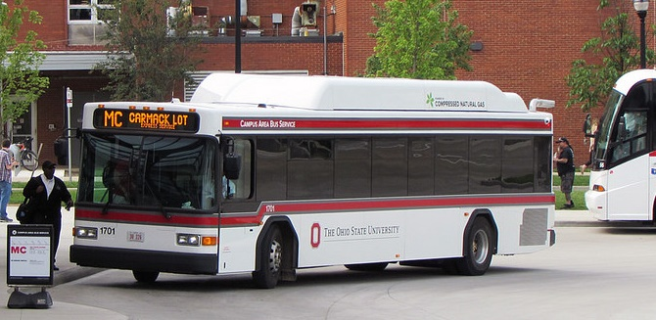
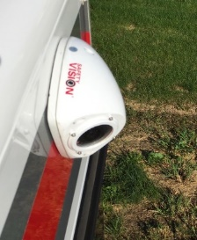
Municipal Vehicles as Sensor Platforms
Goals
Refine traffic flow theory-based methodology used with mobile traffic observing platforms to estimate traffic volumes on urban roadway segments
Demonstrate methodology in operational use
Take steps toward widespread operational use
Notes:
3

Slide 4
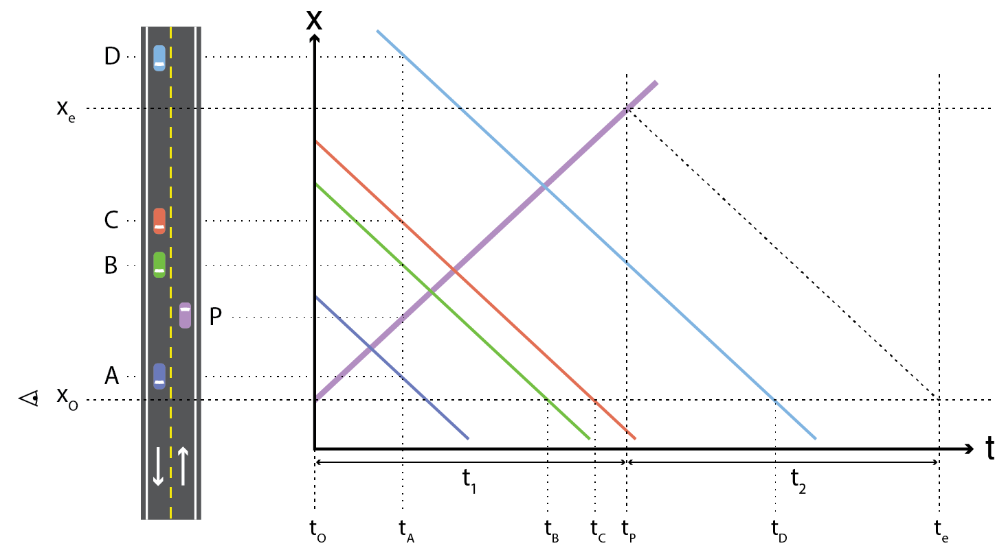
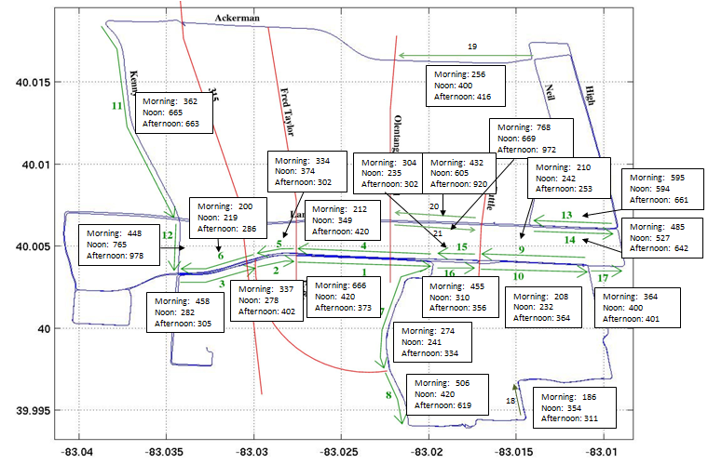
Municipal Vehicles as Sensor Platforms
Anticipated outcomes
General methodology that can be used with urban transit buses to estimate vehicles traffic flows from existing bus video
Analytical approaches to fine-tune estimates as a function of roadway, traffic, and vehicle characteristics
Empirical demonstration using in-service transit buses and observations manually extracted from bus-based video
$$q=n^{veh}/(t_{1}+t_{2})$$
log(CV) = β₀ + β₁AvgFlow + β₂Avg Time
+ β₃I(Video Data) + β₄I(Morning) + β₅I(Noon)
Notes:
4

Slide 5
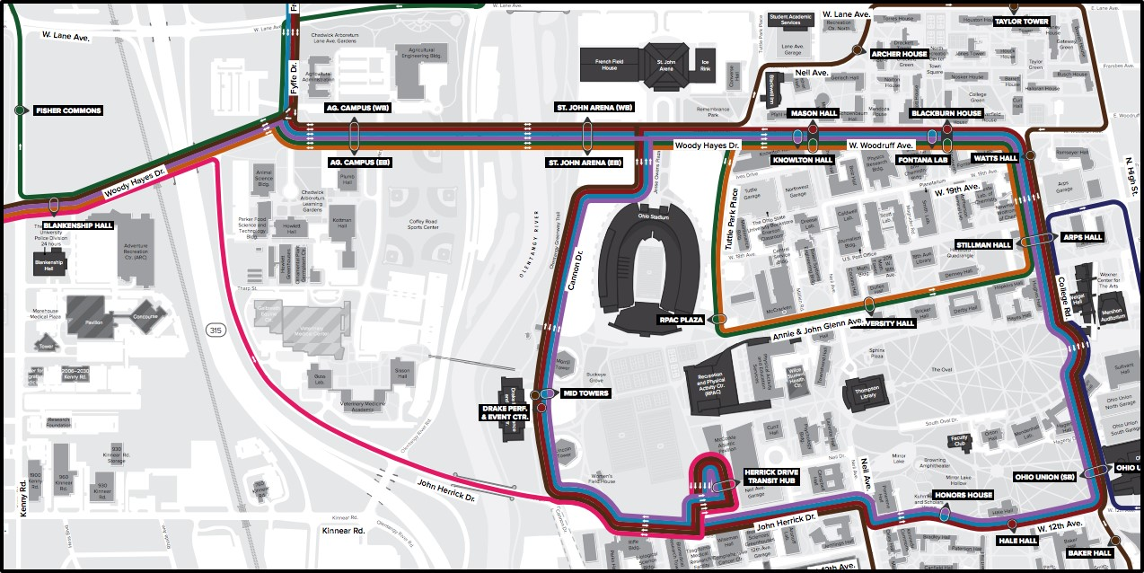
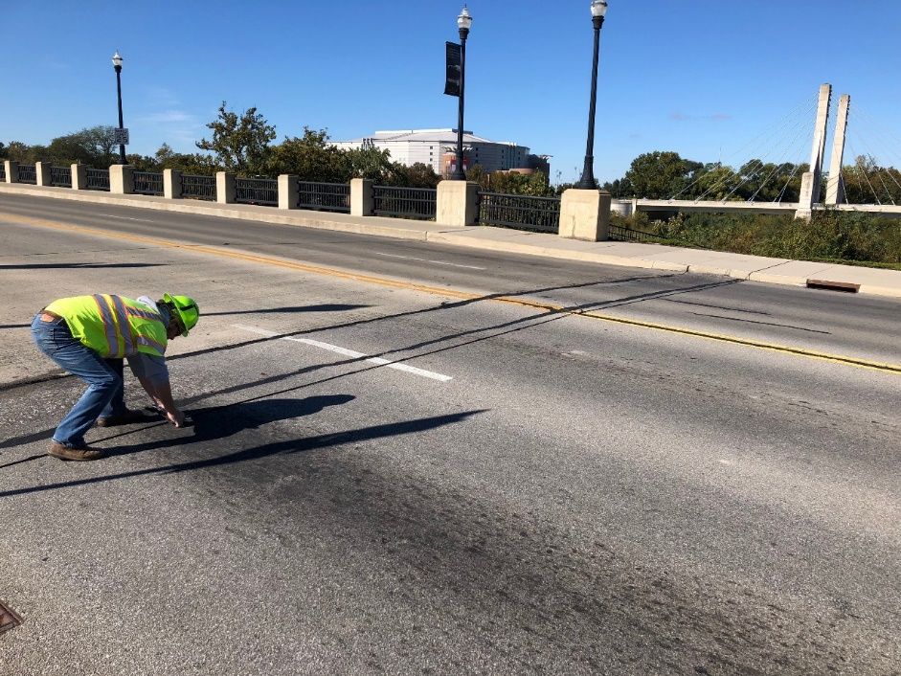
Municipal Vehicles as Sensor Platforms
Partners – Private, public, community
The Ohio State University Transportation and Traffic Management Office
Mid-Ohio Regional Planning Commission
Notes:
5

Slide 6
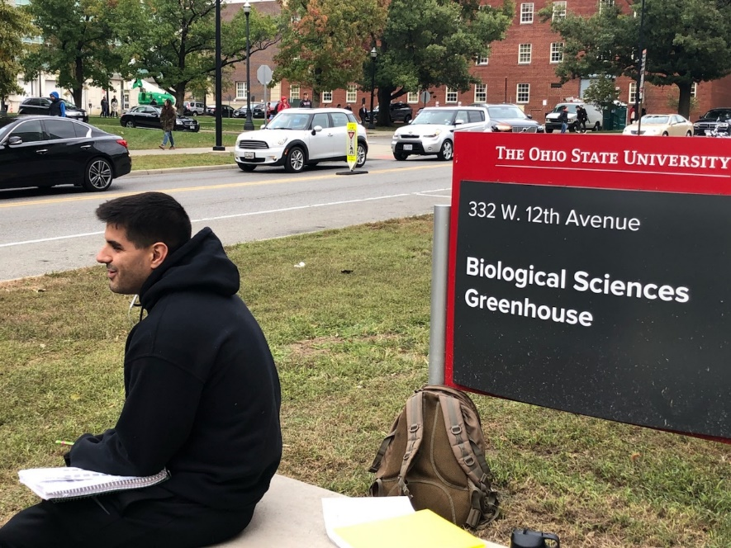
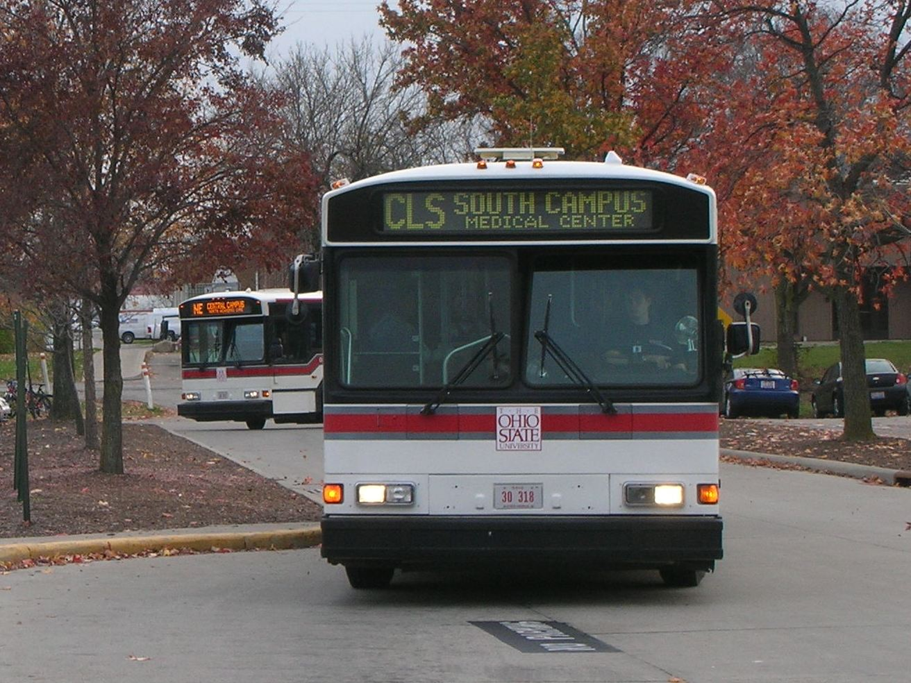
Municipal Vehicles as Sensor Platforms
Expected outcomes
A procedure that can reduce or potentially eliminate the need for manually intensive traffic counts while increasing the spatial coverage and accuracy of traffic flow estimated in urban areas at low marginal cost
Guidelines for operational use of the procedure
Notes:
6

Slide 7
Municipal Vehicles as Sensor Platforms
How the research will improve traffic monitoring and the related people/organizations who rely on the systems
By taking advantage of video that is already being collected on transit buses, the research could provide traffic flow information that is presently collected at greatly reduced cost and with greatly increased spatial coverage
By avoiding in-road counting, the procedure could also improve safety and reduce traffic disruption
Notes:
7

