Slide 1
Mobile Augmented Reality Traffic Management Center (MAR-TMC)
Yang Cai, PI
Visual Intelligence Studio
Carnegie Mellon University
David Martinelli, Co-PI, WVU
Lenny Weiss, Co-I, UPMC, EM
Mel Siegel, Co-I, RI, CMU
Thomas Carr, EM Consultant

Slide 2
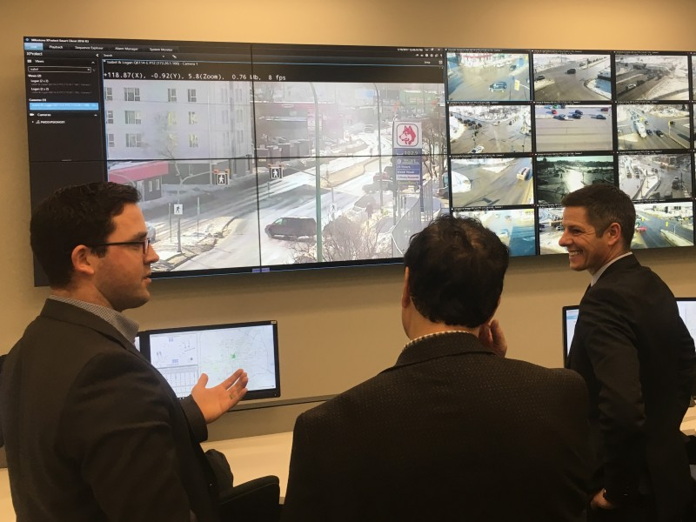
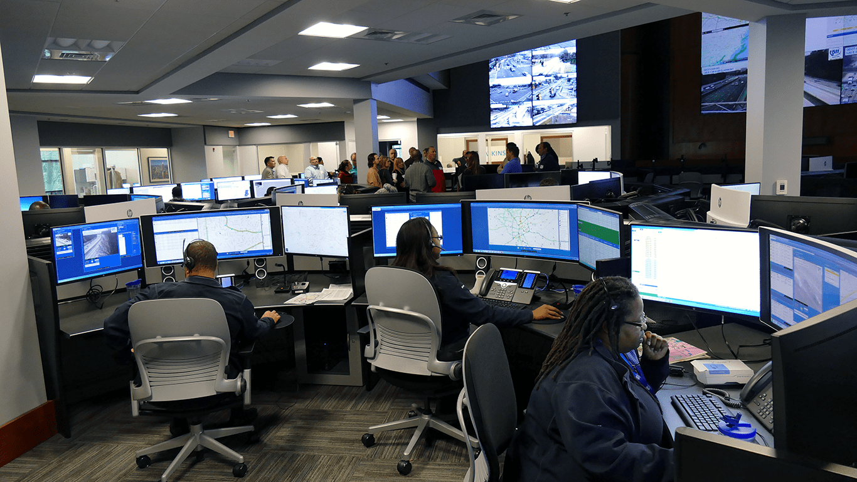
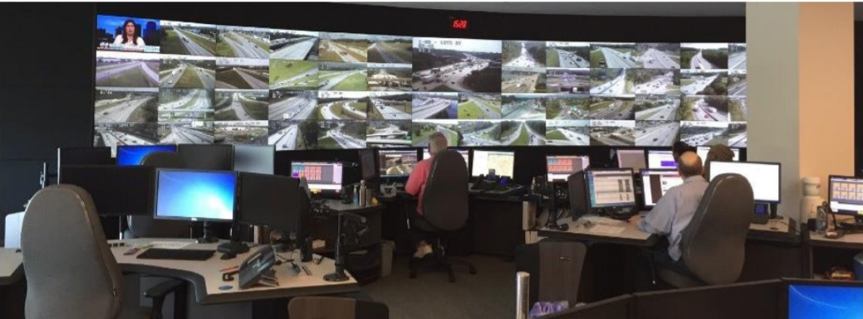
A Traffic Management Center is a Hub of Real-Time Data

Slide 3
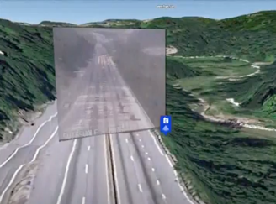
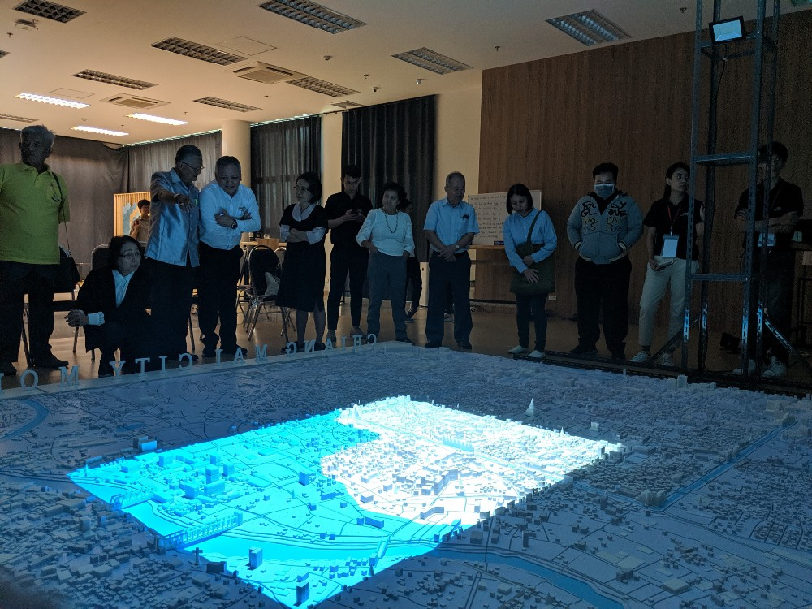
AR City – Registering IoT Data to Virtual City
Overlay CCTV on 3D Model
Multimodal AR EMC
https://www.youtube.com/embed/aEzewo6xDMU

Slide 4
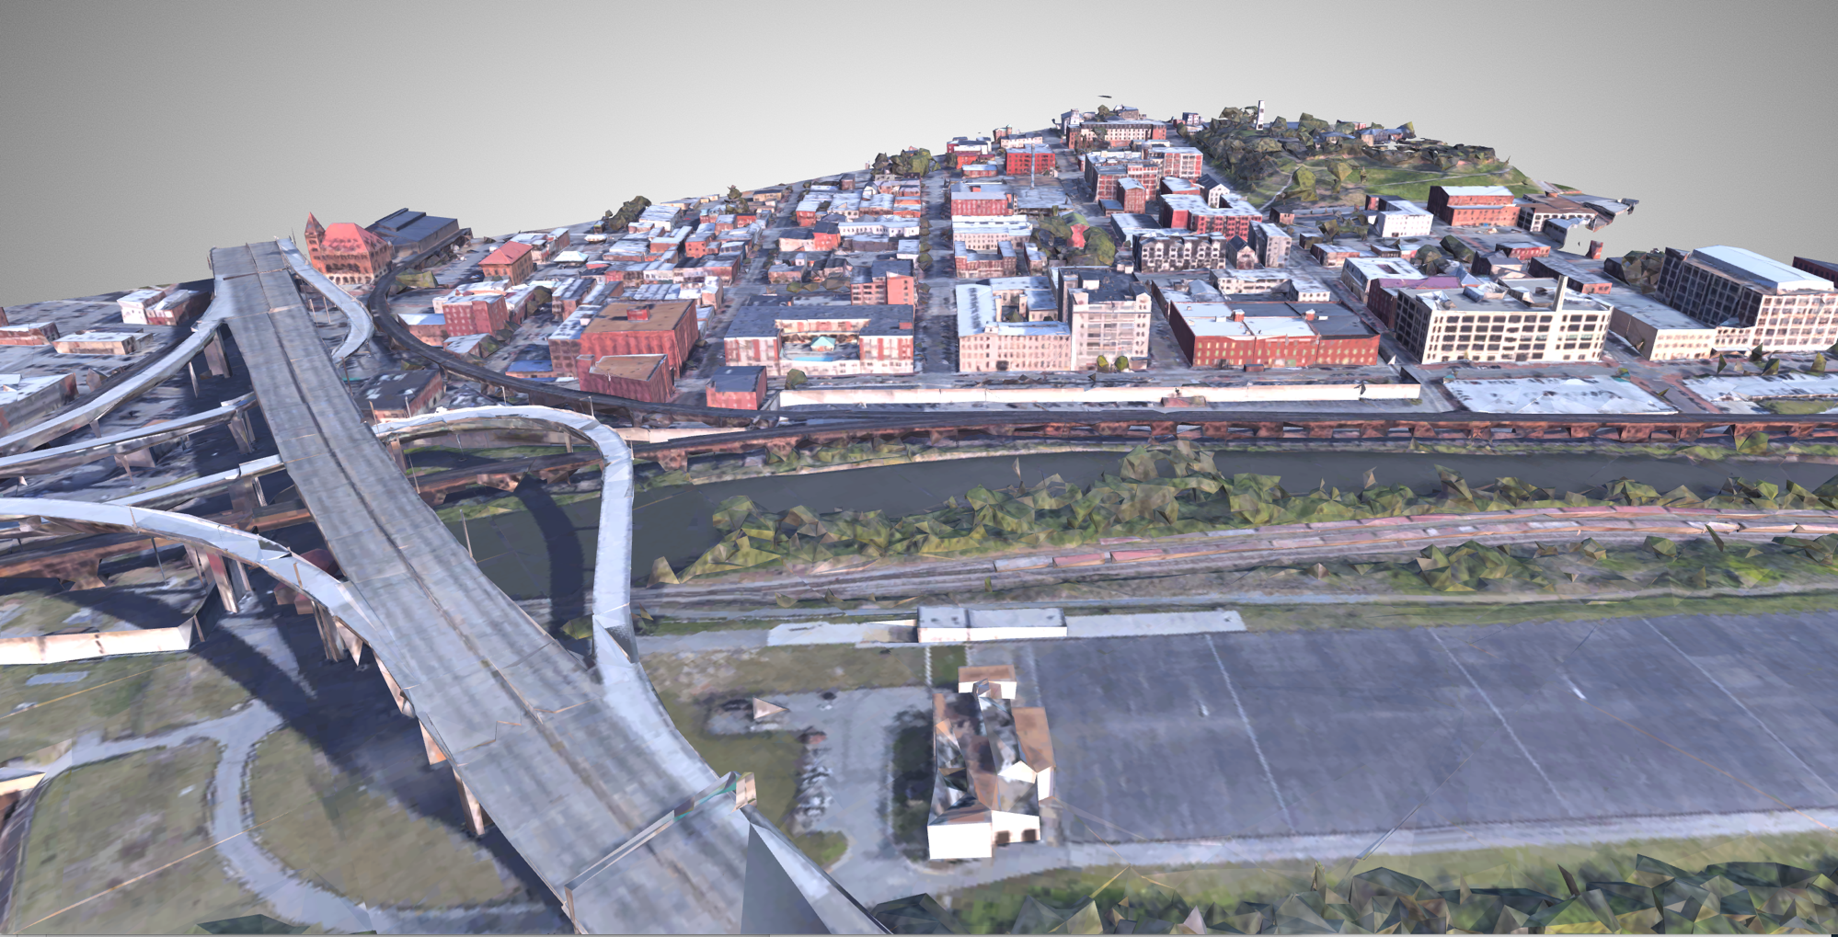
3D Model of a City

Slide 5
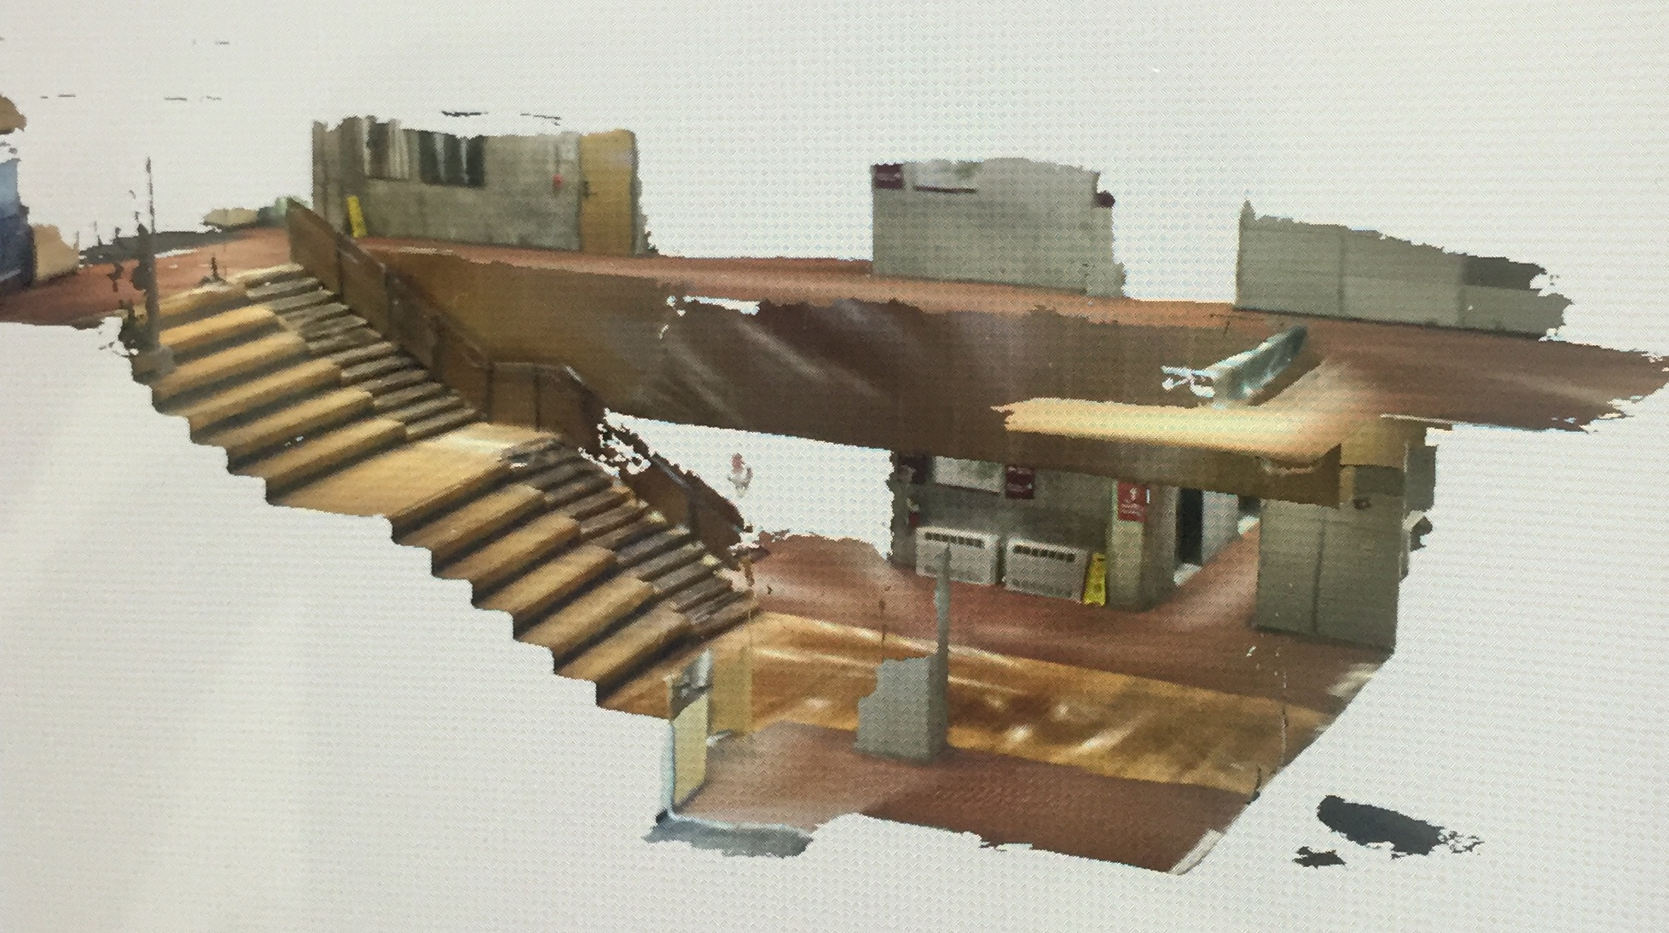
3D Imaging of Subterrain Space

Slide 6
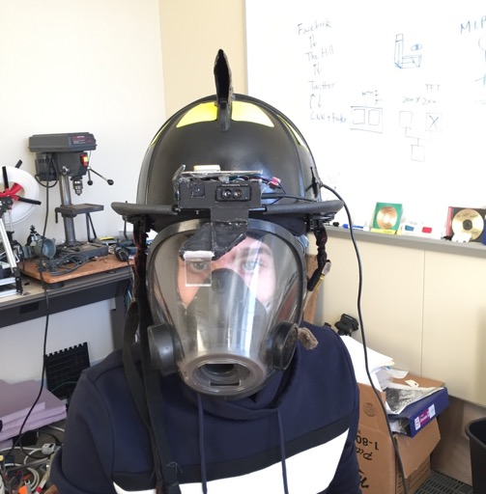
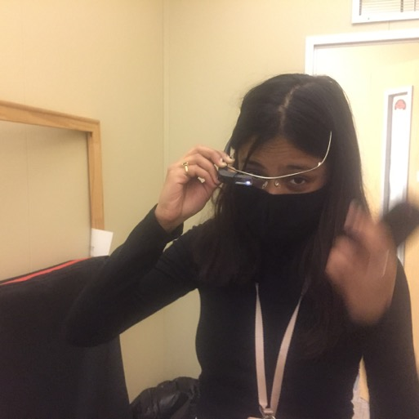
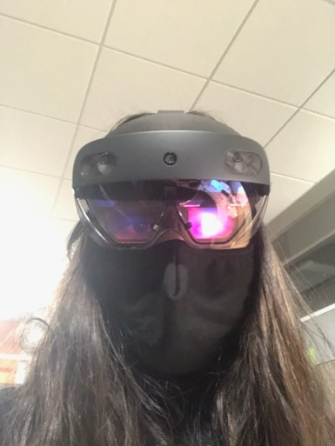
Real-Time Sensor Data Telemetry
Hyper-Reality Helmet
HoloLens 2
Google Glass

Slide 7
Deployment Plan
July – September 2021
Identify and connect with PennDOT Traffic Management Center
Collect TMC data
Design AR TMC functions and interfaces
October – December 2021
Develop geographical referenced 3D city model
Prototype the demo of the “Digital Twin” of Emergency Management Center
Briefs, Outreach events with local TMCs and first responders

