Slide 1


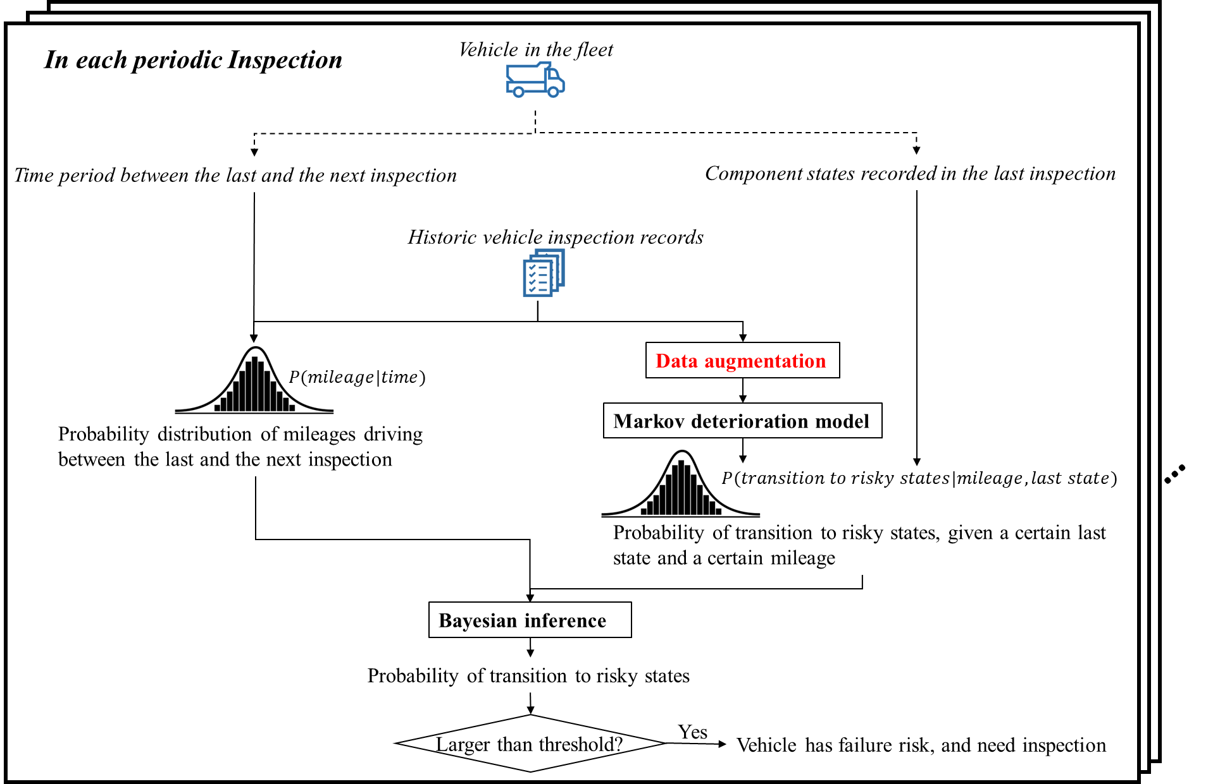





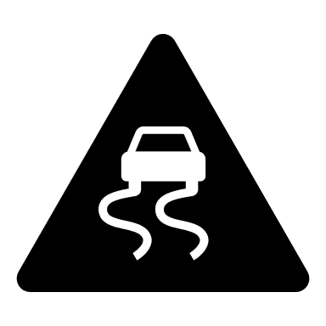





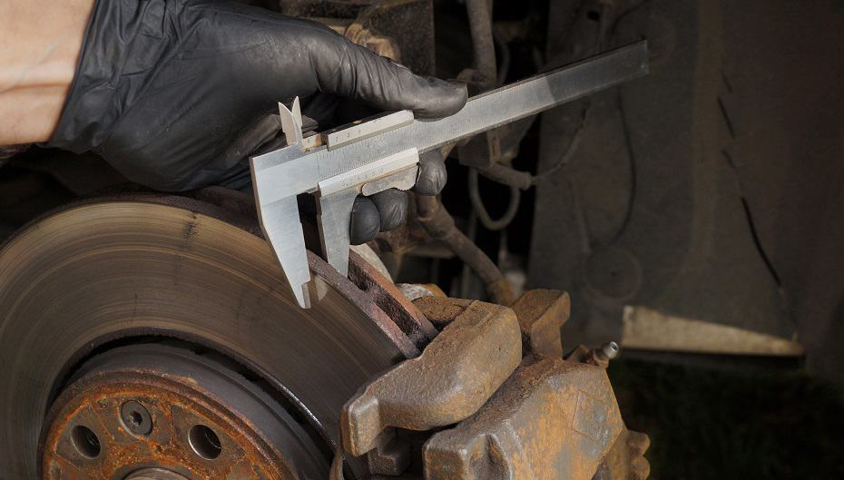


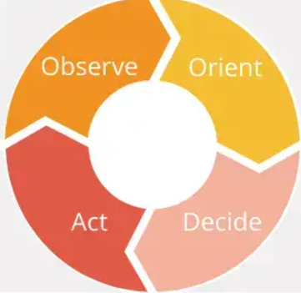
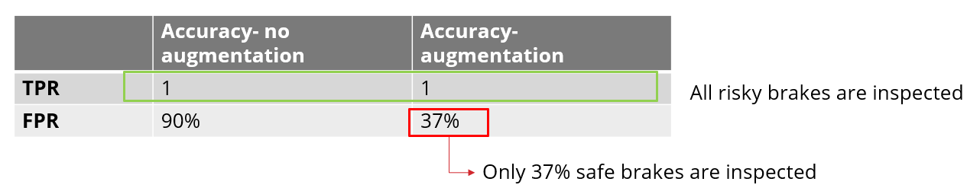
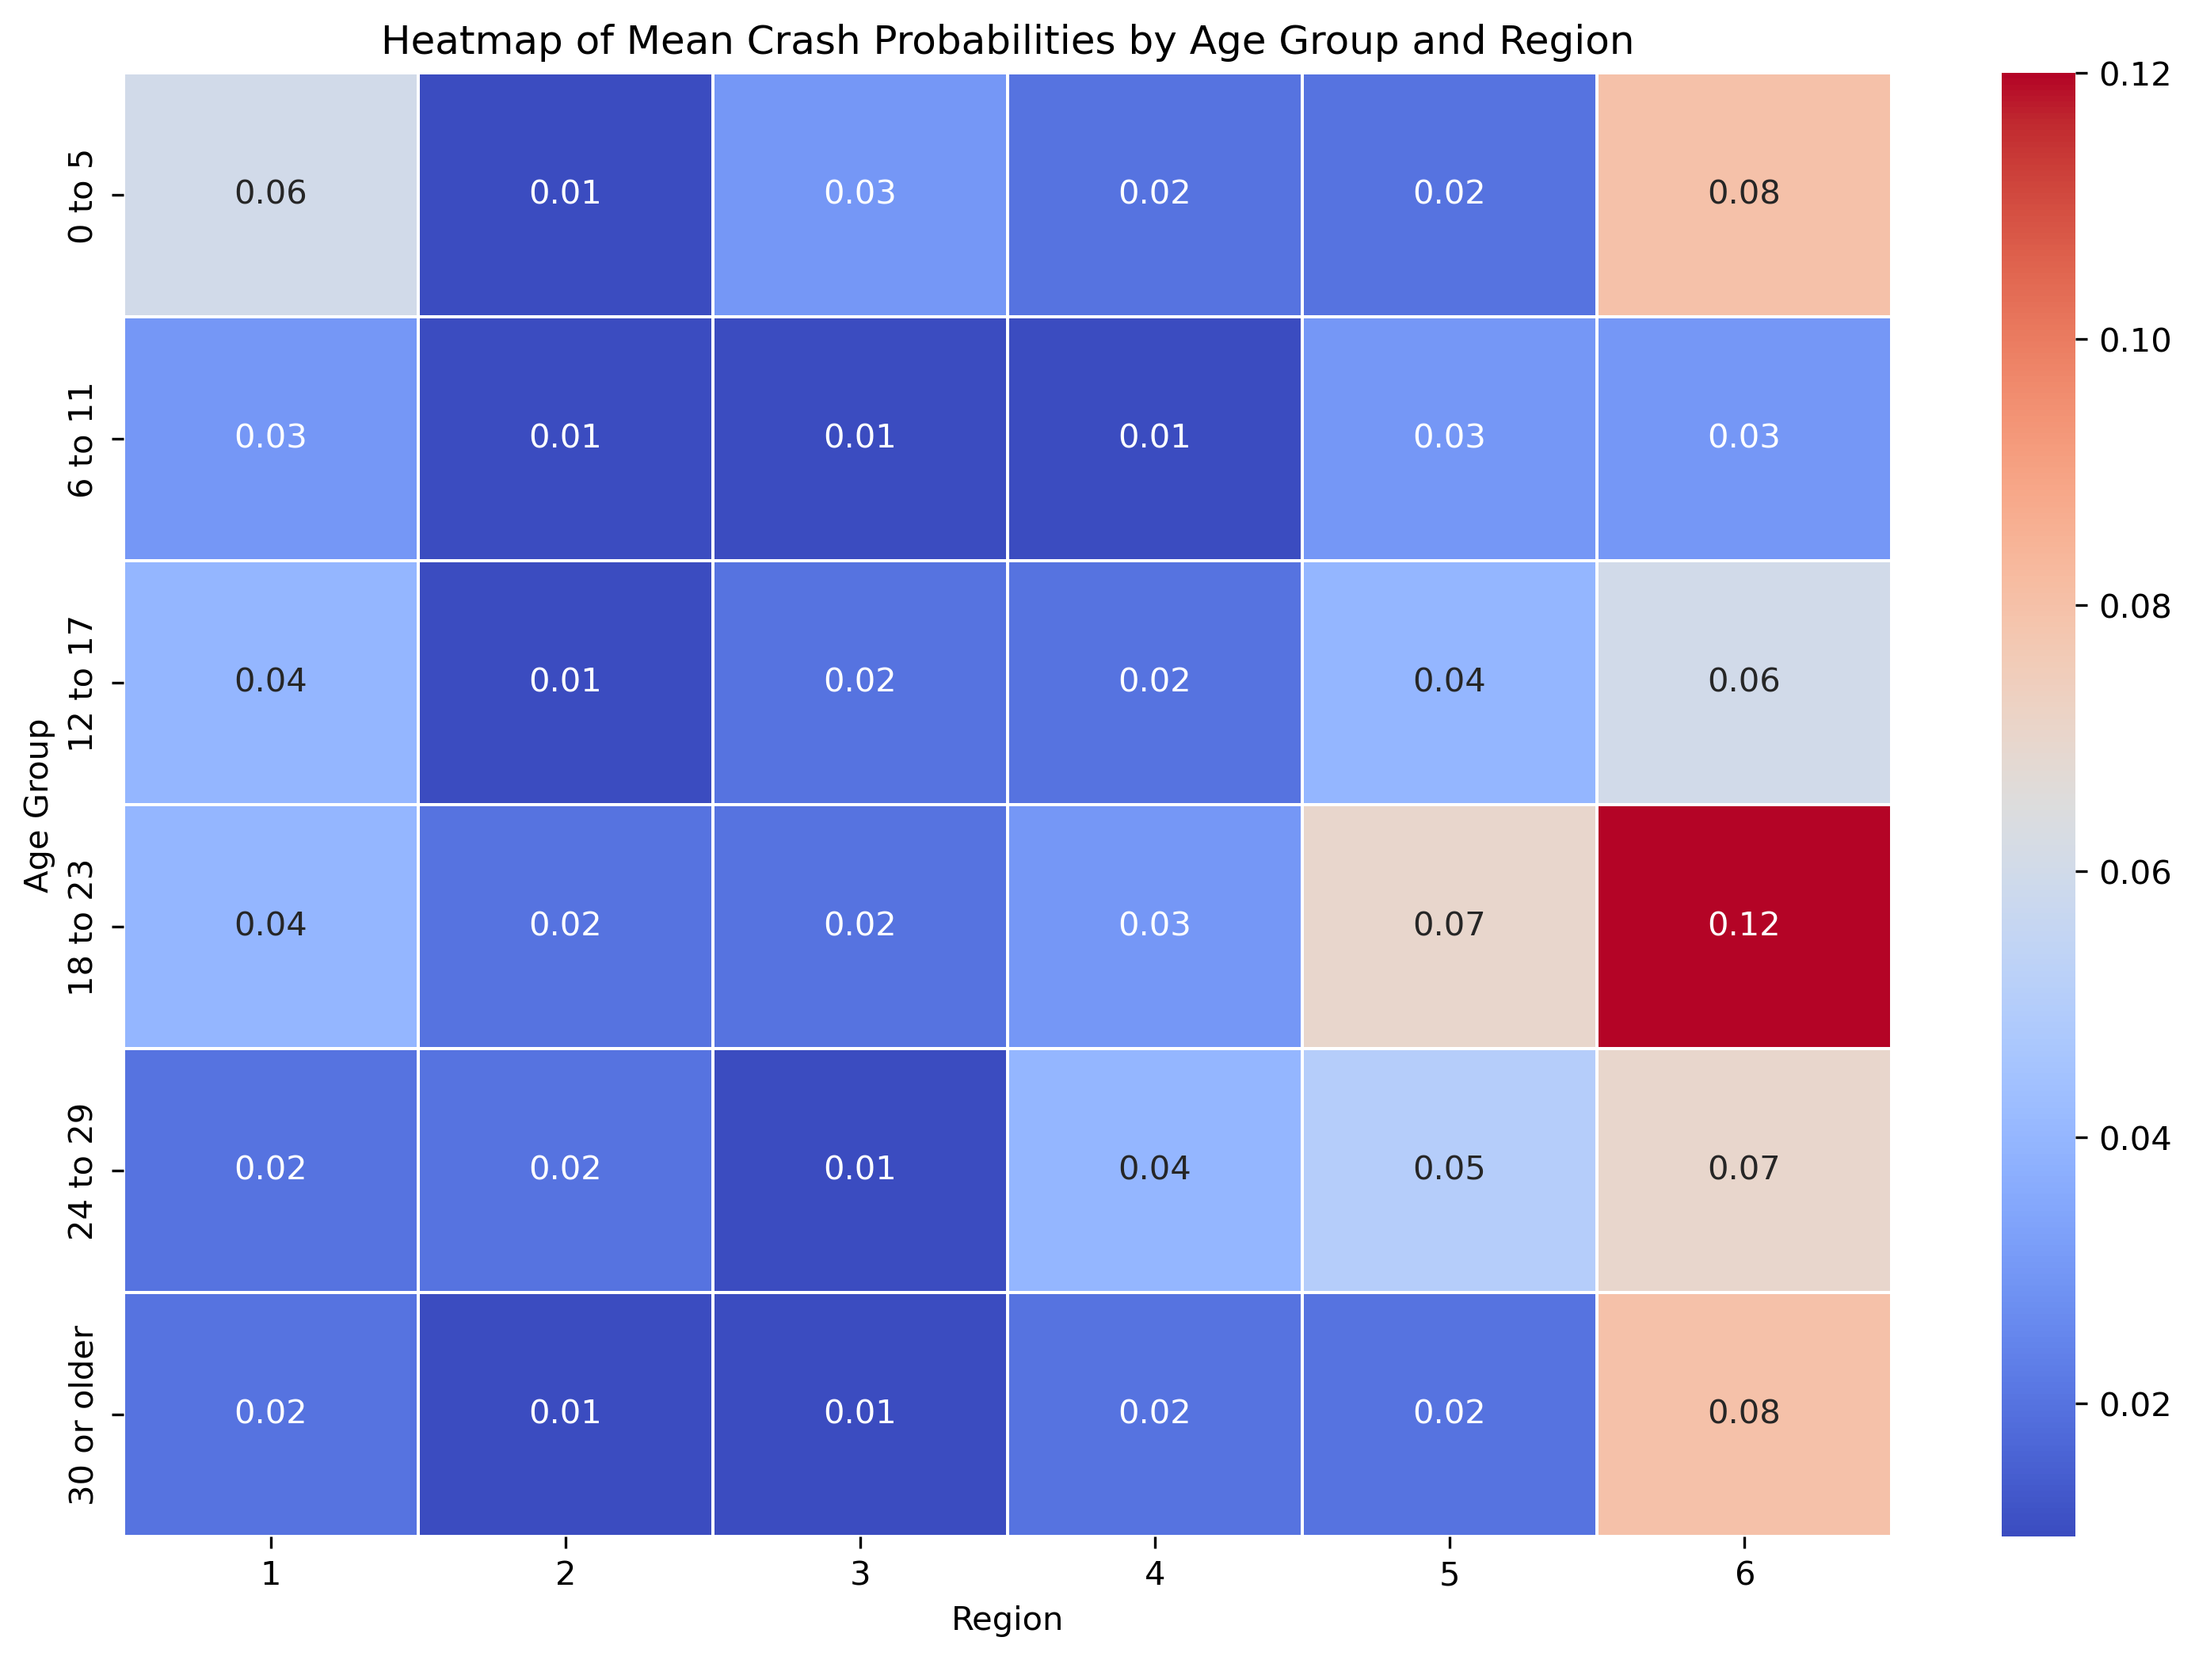
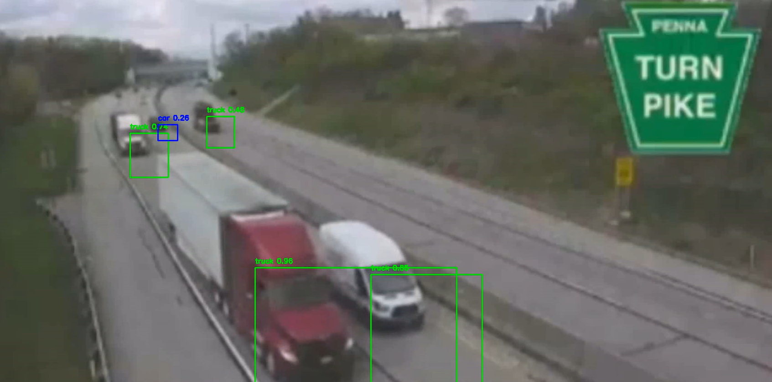
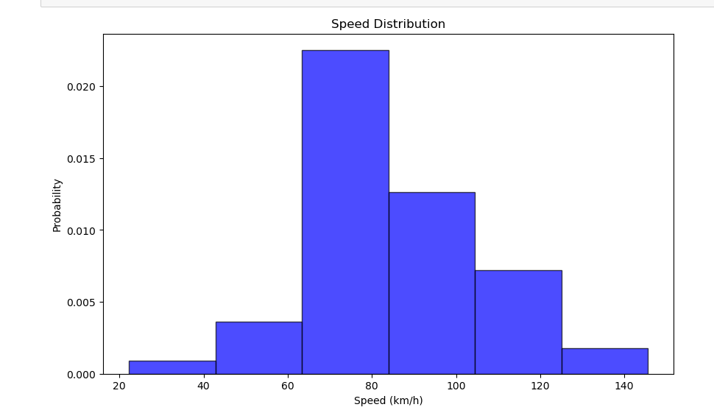


Integrated telematics, computer vision, and data analytics for crash prevention of heavy-duty vehicle fleets
Ava JahanBiglari, Ying Shi, Pingbo Tang*
Carnegie Mellon University, Civil and Environmental Engineering Department
Introduction
Methodology
Methodology
In 2021, there were 5,788 people killed in traffic crashes involving large trucks. This was a 17% increase from 4,945 in 2020
Safety System Digital Twins Framework
Deterioration Model
Social Context: Small and Large motor carriers
Fatal and injury crashes involving large trucks: Defective brakes contribute to 29% of and tire problems account for 6% of these crashes
Social context: Region based on the population
Computer Vision and Telematics capture the Form, Function, and Behavior of the physical system
System Twin
The most frequent inspection violations of vehicles involved in crashes 2021 were Brake, Lighting, and Tire (15.8%, 15.2%,7.8%)
Critical regions identified
Environmental condition
1- Detecting risky behaviors such as lane deviation, near misses, speeding, etc. to potentially mitigate vehicle damage and crash
2- Identifying what type of vehicles, in what environmental conditions, and what social context tend to show risky behaviors
In 2021, small motor carriers, owning only 8% of all vehicles involved in crashes, accounted for 76% of fatal crashes and 50% of all crashes in the United States
Region classification in PA
Mechanical system:
Vehicle deterioration model
$$P\left(E\right)=\frac{Number of observed events \left(crashes or violations within each group\right)}{Total number of opportunities \left(total vehicles in each group\right)}$$
Failure probability of components and predictive inspection planning
Results
Results from the Deterioration Model
Risky vehicle age and region groups
Brake pad thickness
Units: /32inch
State range: 2/32inch - 17/32inch
Failure states: ≤ 2/32inch
Technology adoption and management
OODA Loop
Risky Groups
Critical vehicle malfunction
Brake failure
Tire or wheel failure
…
Physical System
Virtual Model
Age | Region
0 - 5 | 1 & 6
12 - 17 | 6
18 - 23 | 5 & 6
24 - 29 | 5 & 6
30≥ | 6
Objectives:
What vehicles in what social context and environmental conditions tend to show risky behaviors?
How can computer vision technologies be integrated into vehicle safety systems to detect near-miss in real-time, and reduce crash rates in commercial fleets?
Why do small carriers show lower safety outcomes than larger ones, and which regions and vehicle age groups with higher crash probabilities should be prioritized for sensor installation?
Video Analysis
The proposed data augmentation method can fill in historical data to help with identifying more risky vehicles, and reduce the inspections in safe vehicles
The proposed method performs good in extremely sparse area
Object detection by Computer Vision:
Proportion of Trucks on the Road in a Single Day
7,243
Analyzing the video data of traffic cameras: TurnPike and PennDOT
21,159
Under the same safety level, data augmentation reduces inspections
Discussion and Future Research
Why computer vision?
Recognized the need for real-time dynamics and environmental conditions data for informed decision-making and enhanced situational awareness.
Future Research:
Aim to collect the missing data using telematics, cameras, and computer vision to develop a digital twin of the safety system, enhancing crash prevention through near-miss identification.
Utilizing the OODA loop to refine safety strategies and improve real-world applications, focusing on the specific needs of small motor carriers, who face budget, workforce and technology constraints.
The digital twin framework will inform dynamic safety strategies and help customize sensor deployment for targeted, cost-effective interventions in fleet management.
Behavior analysis:
Lane deviation,
speeding,
sudden brakes
Challenges:
Historical data on heavy-duty truck component deterioration is limited
It is hard to find sufficient vehicle samples in both inspection reports and crash reports
Data reported by small motor carriers such as annual mileage may have quality issues
Incorporating environmental conditions and real-time dynamics is essential for informed decision-making, currently missing beyond modeling vehicle component deterioration and understanding social contexts.
Data Processing
Historic Truck Inspection Data
(data source: CompuSpections, MCMIS)
Predict the potential risks by Monte Carlo Simulation
Simulate
Inspection and maintenance plan
(Comparing Telematics with annual inspection)
Historic Truck Crash Data
(data source: MCMIS)
Acknowledgements
Fleet management’s safety and costs:
Crash rates
Maintenance costs
Vehicle operation time losses due to outages
Energy Consumption
Estimate the motor carriers’ performance in safety and energy aspects (FMCSA)
We thank FMCSA for providing the raw data and approving its use for this project, and Bernie Elder of CompuSpections, Paul Sniegocki and Roger Elmer of Clarience Technologies for discussing heavy-duty vehicle inspection and vehicle telematics for this project. We also thank the US DOT Safety21 UTC and the Department of Civil and Environmental Engineering at Carnegie Mellon University for funding.
Project Website: TrSafety
Optimize
https://sites.google.com/andrew.cmu.edu/trsafety/home

