Slide 1
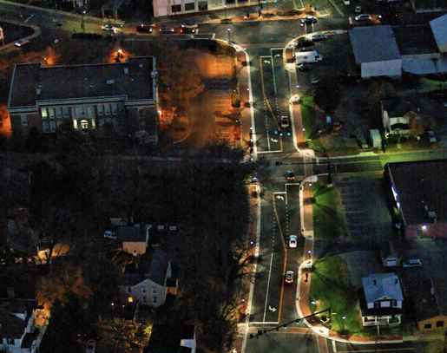
PedX: Automation for Safer Pedestrian Street Lighting at Intersections
Lead Researcher/Faculty: Katherine A. Flanigan
Project Team: Katherine A. Flanigan & Stephen Quick
Advising Collaborators: Stephen Smith

Slide 2
PedX: Automation for Safer Pedestrian Street Lighting at Intersections: Brief Overview of Project
Goals
Improve pedestrian lighting at roadway intersections to enhance visibility and safety.
Develop technology for individual diode control in LED streetlights to improve crosswalk visibility.
Position streetlights for optimal driver visibility of pedestrians, minimizing shadows and silhouettes.
Inform city planners and develop guidelines for smart LED lighting system deployment.
Notes:
2

Slide 3
PedX: Automation for Safer Pedestrian Street Lighting at Intersections: Brief Overview of Project
Anticipated Outcomes
Development of individual diode control for LED streetlights, enabling dynamic lighting at pedestrian crossings and intersections.
Creation of geometric models for the best positioning of streetlights to improve pedestrian visibility from drivers' perspectives.
Implementation of a responsive lighting environment that adapts in real-time to pedestrian presence and needs through the PedPal app (developed in previous Safety21 project).
Notes:
3

Slide 4
PedX: Automation for Safer Pedestrian Street Lighting at Intersections: Brief Overview of Project
Anticipated Outcomes (cont’d)
Generation of valuable data from field tests, simulations, and literature reviews to advance research in urban lighting and pedestrian safety.
Anticipated patent filings related to innovative lighting control technologies developed through the project.
Partners – Private, public, community
PedPal team (Robotics Institute), City of Pittsburgh DOMI
Notes:
4

Slide 5
PedX: Automation for Safer Pedestrian Street Lighting at Intersections: Expected Outcomes
How will it benefit the people using the service/product, subject you are researching, and workforce?
Improved lighting at intersections will significantly enhance pedestrian visibility, reducing the risk of accidents and increasing overall safety.
Development of advanced LED lighting control systems sets a new standard for urban lighting infrastructure, focusing on pedestrian needs.
Integration with the PedPal app ensures that lighting adjusts dynamically based on pedestrian presence and crossing needs
Notes:
5

Slide 6
PedX: Automation for Safer Pedestrian Street Lighting at Intersections: Expected Outcomes
How will it benefit the people using the service/product, subject you are researching, and workforce? (cont’d)
Provides hands-on experience in advanced lighting technology, control systems, and urban infrastructure design.
Offers opportunities for collaboration across engineering, urban planning, and data analysis, fostering a multidisciplinary skills.
Safer intersections contribute to a more walkable and livable urban environment, encouraging more pedestrian activity and fostering a sense of community.
Notes:
6

