Slide 1
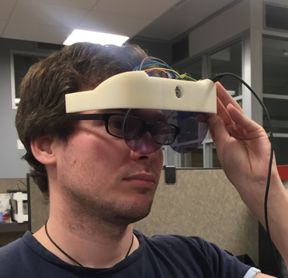
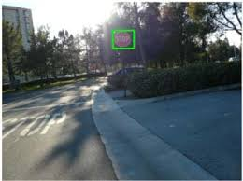
Improving Mobility of Low Vision People with Super-Reality Glasses
PI: Yang Cai, CMU
Objective
To develop the assistive technology for people with vision disabilities of central field loss (CFL) and low contrast sensitivity (LCS).
Approach
The real-time visual enhancement and alert information are overlaid on the transparent glasses. The visual enhancement module can be expanded to highlight details for macular degeneration and low contrast sensitivity people.
Conceptual Illustration
Collaborator
Dr. Paul Freeman, OD, from Department of Ophthalmology, Allegheny General Hospital, Low Vision Rehabilitation Services of Beaver County Association for the Blind and Keystone Blind Association.

