Slide 1
Feasibility Study of Parking Space Availability Monitoring
Alexander Hauptmann

Slide 2
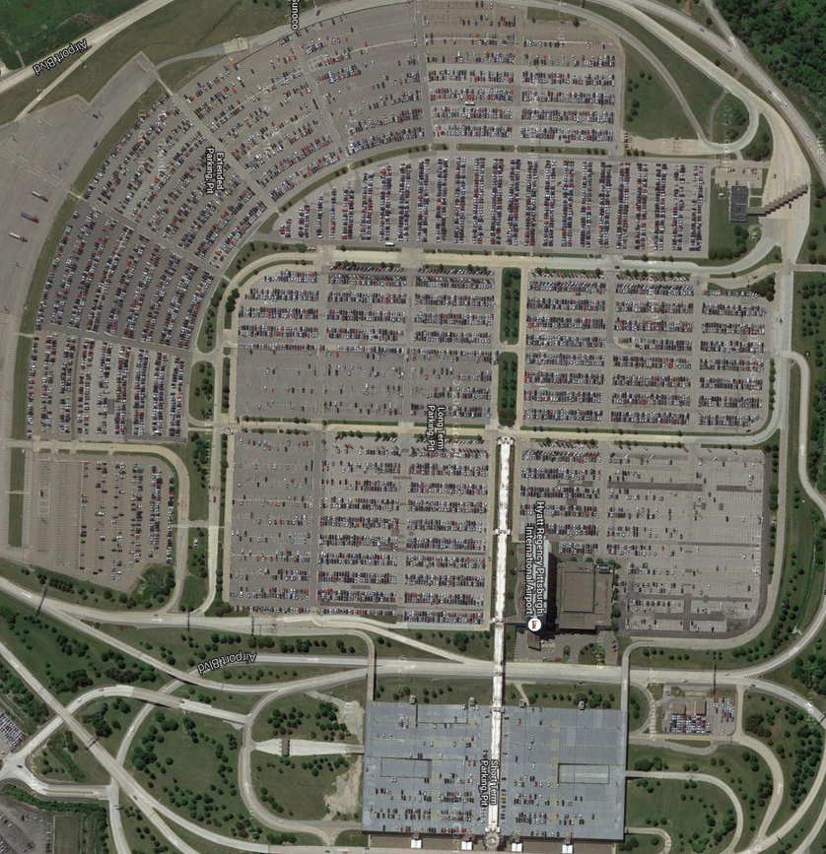
:Problem
Finding Available Parking Spaces
In most parking lots, finding an empty an covenient space is very difficult
Current method wastes time and fuel cruising for available spots

Slide 3
Proposed Solution
Use intelligent video analysis to track available and filled parking spots
Index all spots in a central database
Develop smartphone guidance app to guide individual car to best available spot

Slide 4
Real World Partners
Pittsburgh Airport (Airport Authority of Allegheny County)
Grant Oliver Parking

