Slide 1
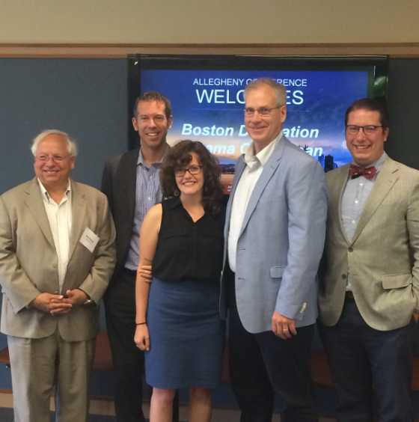
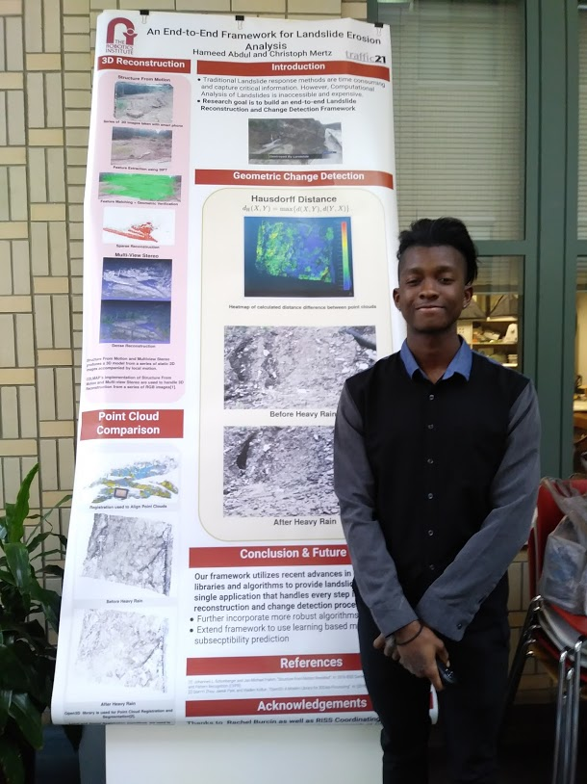
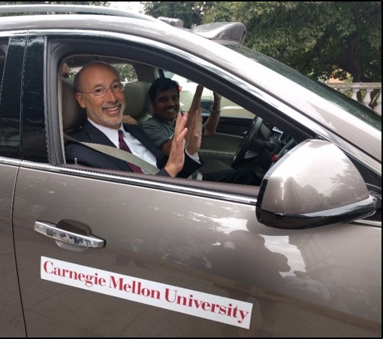
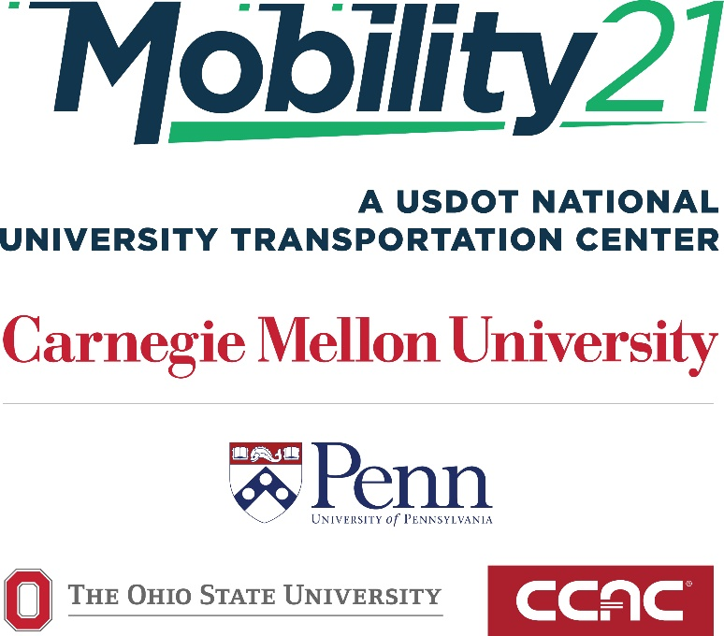
Stan Caldwell, Executive Director
Notes:
Traffic21 is a University wide initiative.
The purpose today is not so much to report on research results;
but rather to report on a research program.
One which may provide you with an opportunity

Slide 2
AI Currently Disrupting the Transportation Industry
Improving Safety
Improving Mobility of People and Goods
Preserving Infrastructure
Promoting Sustainability
Increasing Accessibility
But Concerns of:
Security
Privacy
Equity

Slide 3
Technologies Enabling AI in Transportation Information and Communications
Sensors
Cyber Physical Systems
Cloud and Edge Computing
Data Analytics (predictive)
Advanced Wireless
Internet of Things

Slide 4
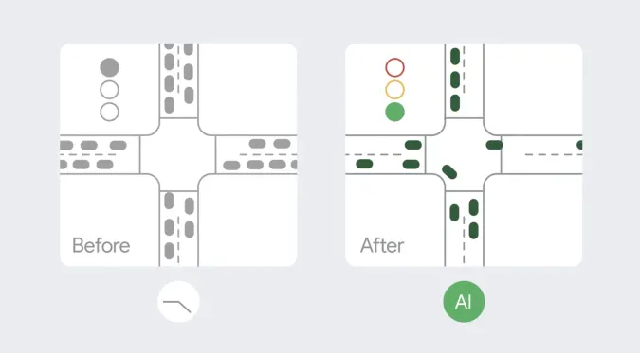
AI in Traffic Control Devices
Google turns its AI on traffic lights to reduce pollution
Engadet October 6, 2021

Slide 5
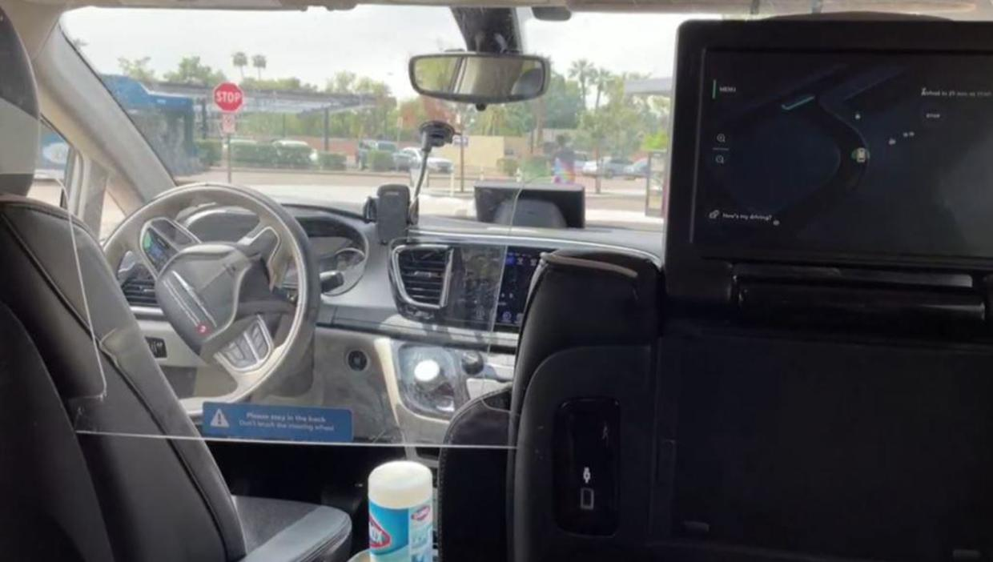
AI in Vehicles
Robotaxis are taking over China's roads. Here's how they stack up to the old-fashioned version.
August 18, 2022 CBS News

Slide 6
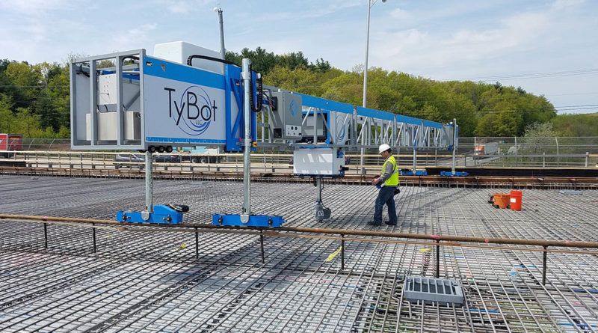
AI in Construction
TyBot Rebar-Tying Robot Helps Speed Up Road Work
Yellrobot February 20, 2020

Slide 7
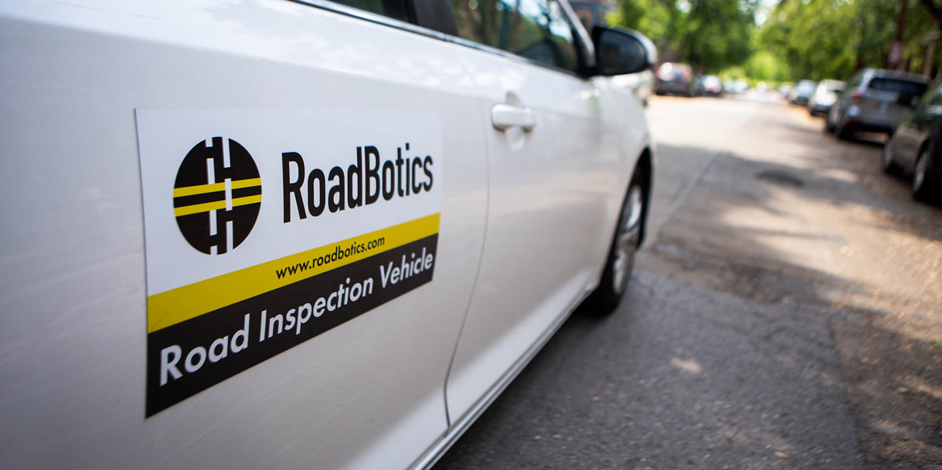
AI in Asset Management
Michelin Acquires Start-up Specializing in Road Infrastructure Image Analysis Tire Review Magazine August 2, 2022

Slide 8
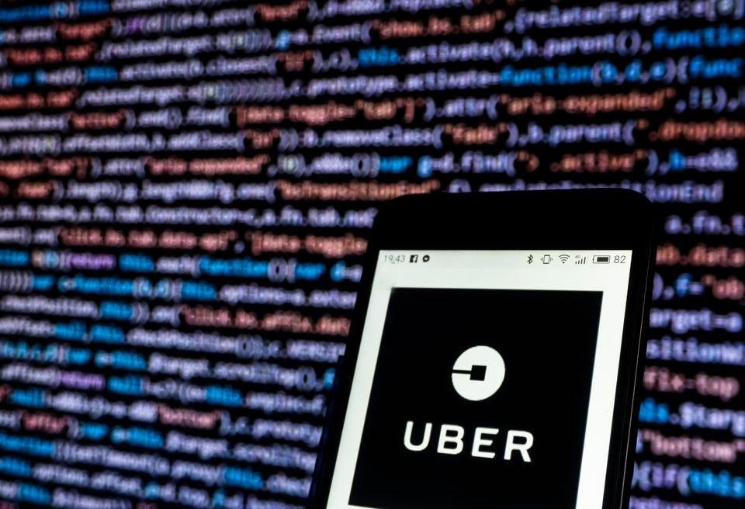
AI in Shared Mobility
Uber Might Be The First AI-First Company, Which Is Why They 'Don't Even Think About It Anymore‘
Forbes August 22, 2018

Slide 9
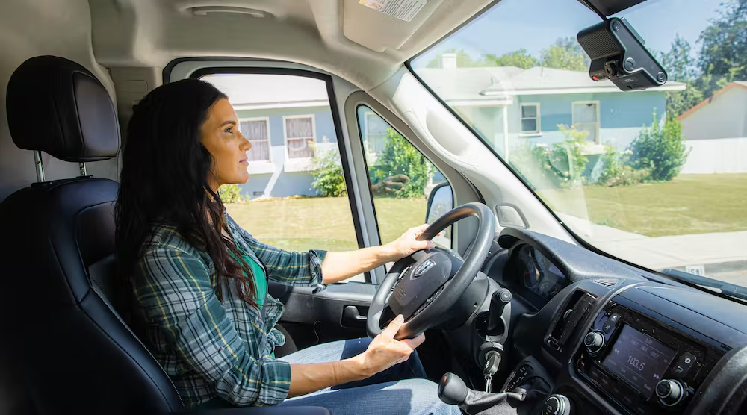
AI in Fleet Management
Verizon Connect adds more AI to fleet dashcams
Fleet Owner August 10, 2022

Slide 10
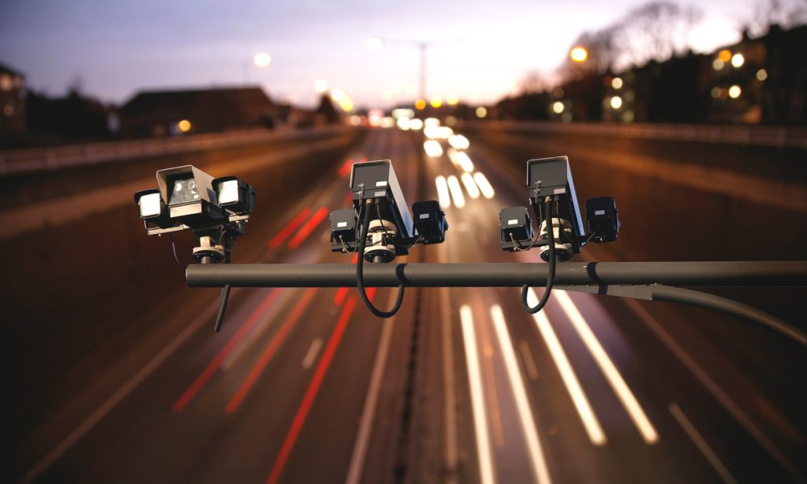
AI in Tolling and Traffic Management
By Making ‘Dumb Cameras’ Smart, AI Is Improving Traffic Efficiency
PYMNTS.com
January 28, 2022

Slide 11
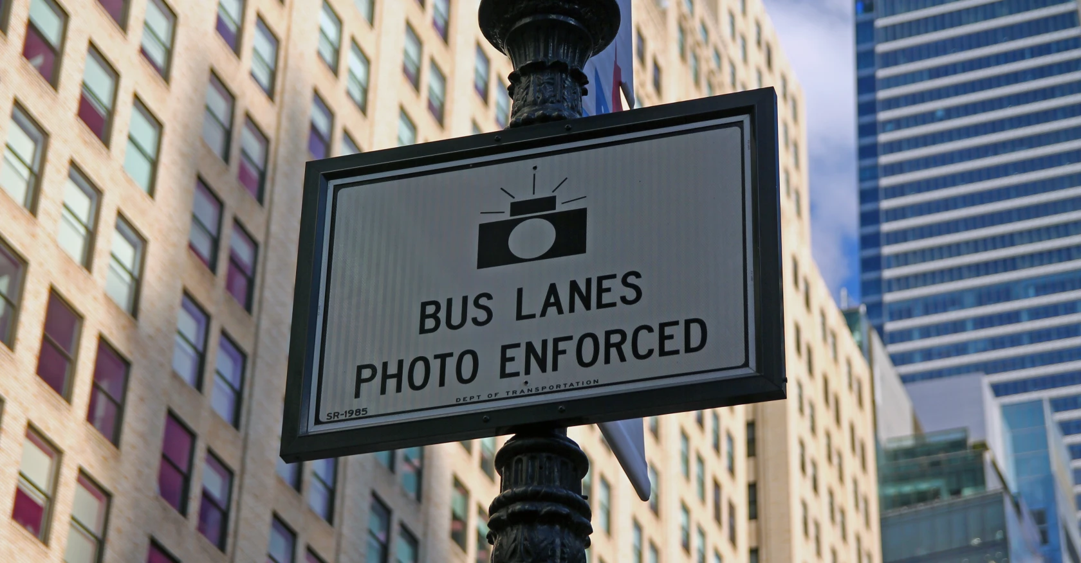
AI in Transit
New York City Deploys Video Bus Lane Enforcement
Government Technology August 18, 2022

Slide 12
Course Motivation
Public and Private Transportation Organizations Impact by AI Today
Hype of AI Creating Misconceptions
Gap in AI Education Opportunities for Current Transportation Managers
Organizations Need Strategic Approach Managing AI

Slide 13
New Executive Education Program
MANAGING AI IN TRANSPORTATION CERTIFICATE PROGRAM
Notes:
A monthly e-publication is also distributed, called What’s Happened at Traffic21? This e-publication, sent to the same distribution list as Breaking in Smart Transportation, specifically highlights the UTC activities, accomplishments, student work, involvement in conferences, and other news.
Before updates are sent out in either publication, they appear as individual updates/articles on the website blog, and are also posted through our Facebook and Twitter accounts.
A new publication has been developed during this reporting period, called the Research Recap. The recaps are easily digestible one-page overviews of the UTC funded research that describe the research project’s purpose, approach, key findings, conclusions, contact information for the research team and a link to the final research report. The goal is to release a new recap after the completion of each UTC project.

Slide 14
Students who complete this program will be able to:
• Describe the current landscape of AI and other disruptive technology in the transportation sector
• Understand the risks/benefits of AI utilization to stakeholders
• Determine the best way to introduce and manage AI within a transportation organization
• Understand the components of an enterprise AI strategy and the tactics for building AI capabilities in an organization

Slide 15
Goals of Managing AI in Transportation
Understand the Opportunity of AI
Know the Risk and How to Mitigate It
Promote and Manage Expectations Inside and Outside of the Organization

Slide 16
Policy and Related Market Implications of AI in Transportation
Citizen concerns with both public and private applications of AI
Privacy
Equity
Security

