Slide 1
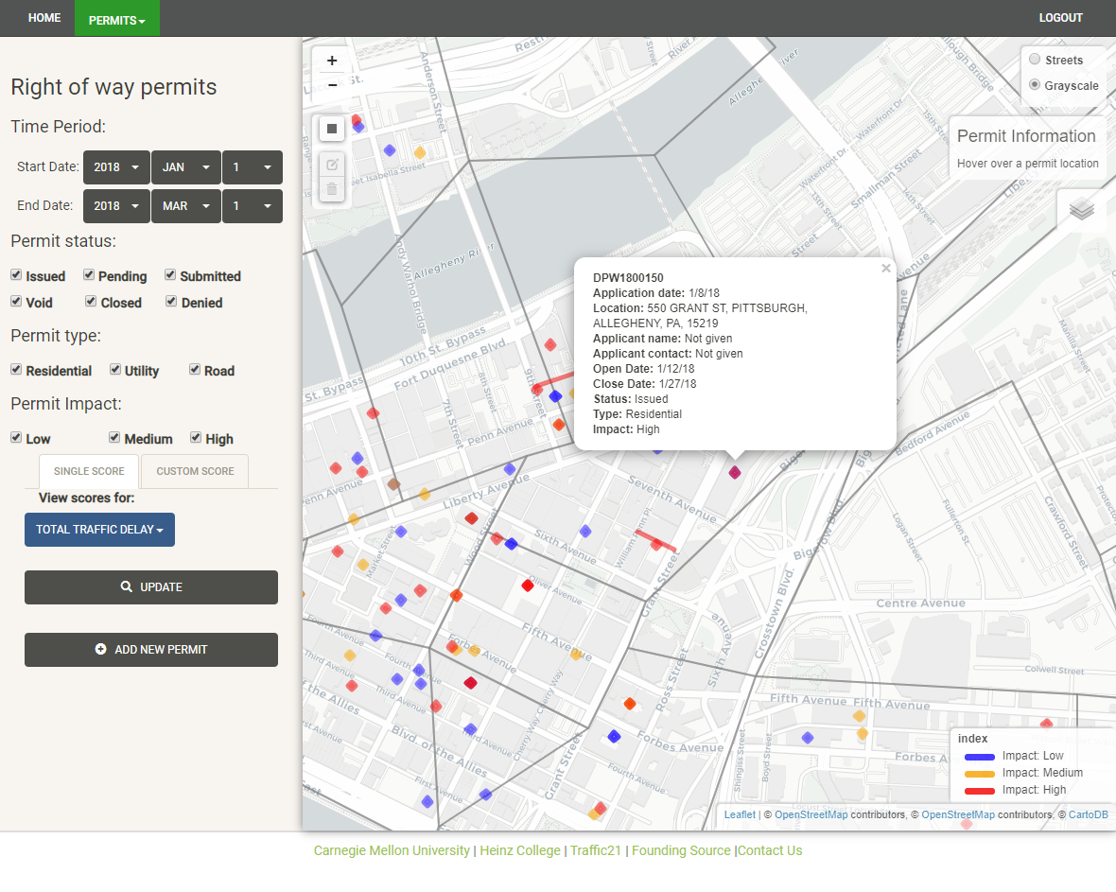
Smart Right-of-Way Permitting System for the City of Pittsburgh: coordination, pricing and enforcement
Lead Researcher: Sean Qian
Project Team: Arnav Choudhry
Project Website (if there is one):
Add a photo/graphic representing project (if there is one)

Slide 2
Smart Right-of-Way Permitting System for the City of Pittsburgh: coordination, pricing and enforcement
Efficiently manage, price and enforce right-of-way permits for the city
1) an impact-based permit pricing system; 2) a data-driven permit supervision system. Both being prototyped using real-world data in Pittsburgh
The City of Pittsburgh, Cranberry Township
Notes:
2

Slide 3
Smart Right-of-Way Permitting System for the City of Pittsburgh: coordination, pricing and enforcement
The right-of-way permitting system would allow the city to efficiently manage and enforce permits, reduce labor costs, and improve revenue management
It would also best allow permits over time and space using the pricing as the leverage, so as to improve city’s mobility and safety.
Notes:
3

