Slide 1
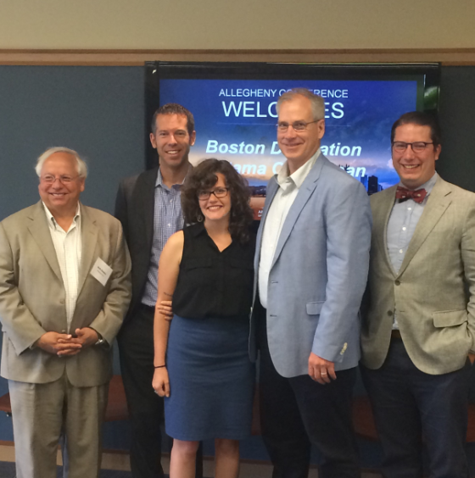
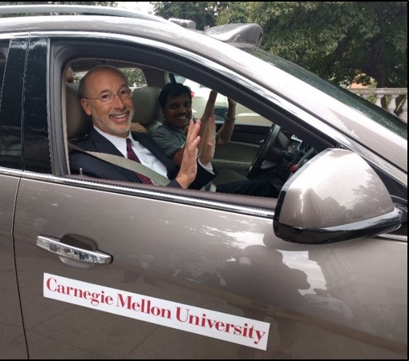

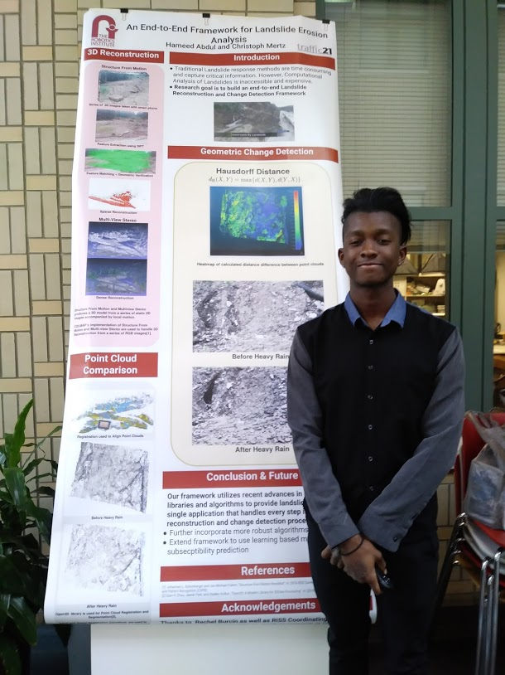
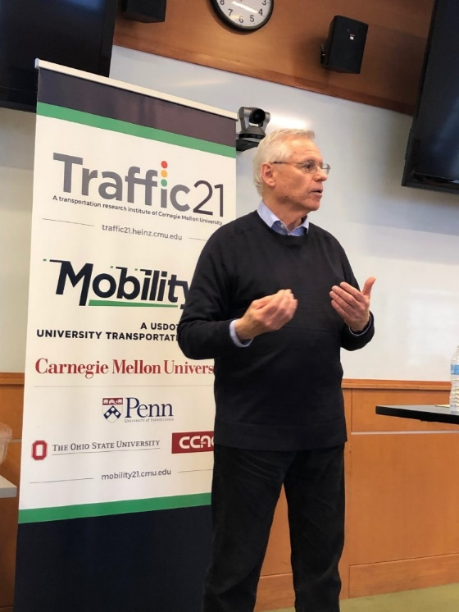
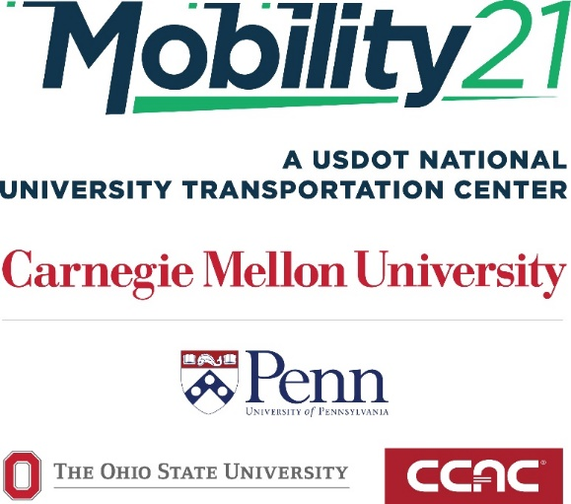
Stan Caldwell
Executive Director
Notes:
Traffic21 is a University wide initiative.
The purpose today is not so much to report on research results;
but rather to report on a research program.
One which may provide you with an opportunity

Slide 2
Trends in Information and Communications Technology
Sensors
Data Analytics (real time and predictive)
Cyber Physical Systems
Internet of Things
Edge Computing
5G and Advanced Wireless

Slide 3
Technologies Disrupting Transportation
Automation
Connectivity
Shared Use
Electrification
Novel Modes; Drones, Hyperloop, etc.

Slide 4
Traffic21’s approach is…
Research
Development
Deployment through partnerships
Over 100 Deployment Partners

Slide 5
How Did Pittsburgh and Pennsylvania Evolve as a Smart Transportation Test Beds and Build Industry Clusters?

Slide 6
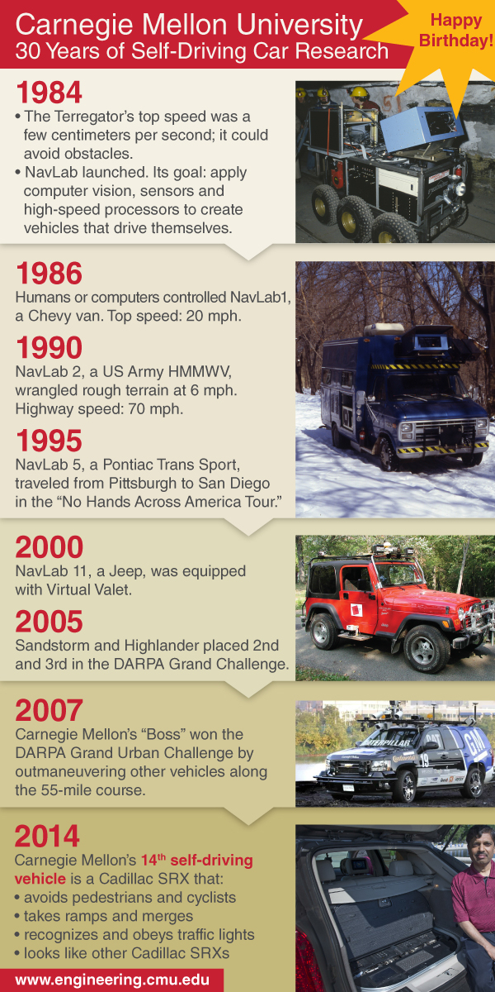

Notes:
Anyone have the horizontal image of this information?

Slide 7
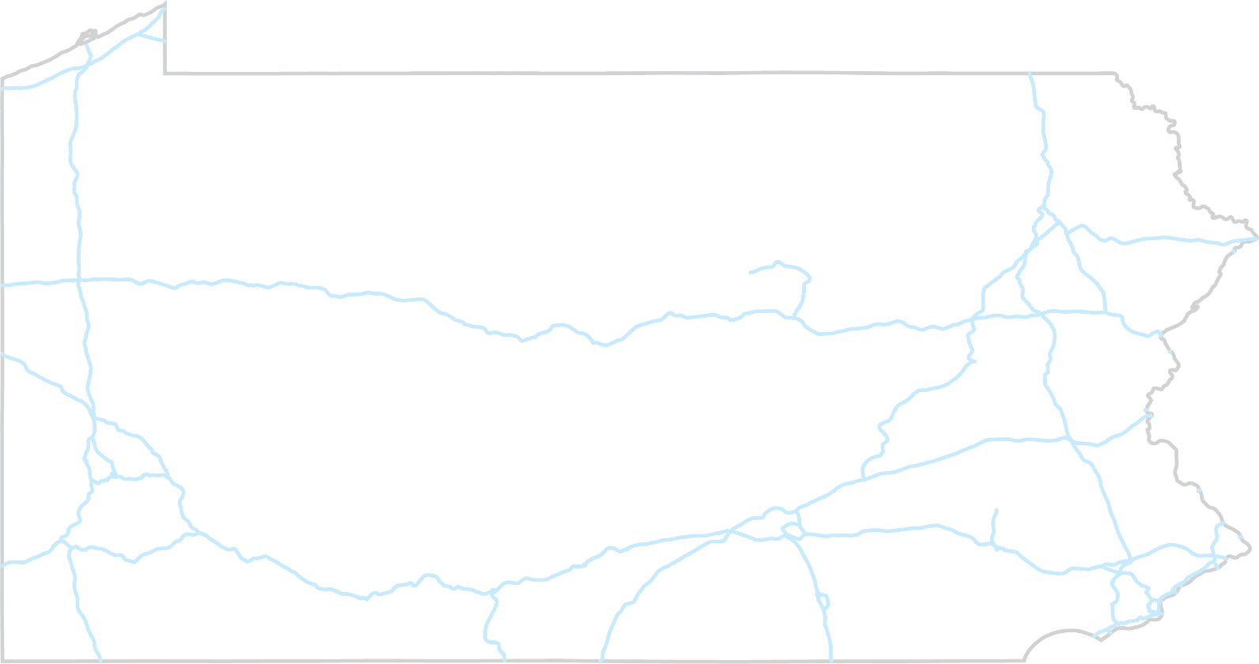

V2I Deployments
CURRENT
PLANNED
Cranberry
11 RSUs
Ross Twp.
11 RSUs
Autonomous TMA
Pilot
Pittsburgh
24 RSUs
Pittsburgh
125 RSUs
726 OBUs
iCone
Pilot
Harrisburg
8 RSUs
Philadelphia Region
160 RSUs

Slide 8
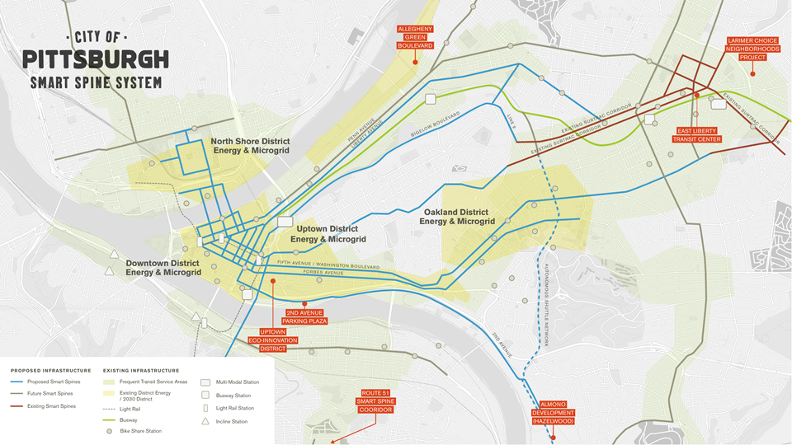
50 intersections today
150 more in the next 3 years
Notes:
Surtrac is already installed at 50 intersections in Pittsburgh.
When U.S. Department of Transportation Secretary Anthony Foxx was in Pittsburgh 2 weeks ago, he announced an $11 million grant to expand Surtrac to 150 more intersections in the city over the next 3 years, with additional funding coming from PennDOT and the city of Pittsburgh.

Slide 9
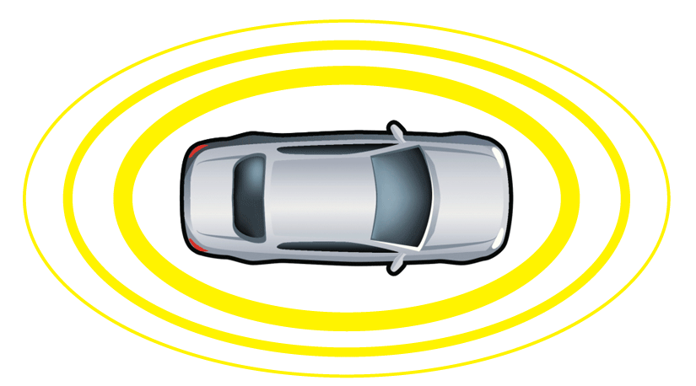
Connected and Autonomous
Vehicles
Connectivity
  Includes all types of communication with vehicles and infrastructure (Wi-Fi, DSRC, Cellular, etc.)
Connected Vehicle
Communicates with nearby vehicles and infrastructure

Slide 10
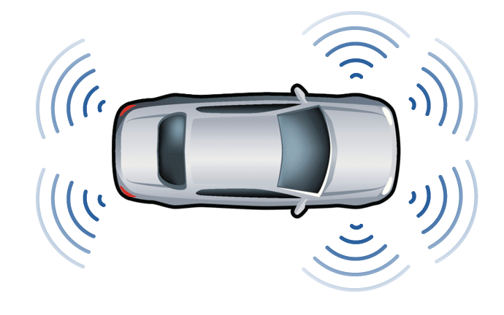
Connected and Autonomous
Vehicles
Connectivity
  Includes all types of communication with vehicles and infrastructure (Wi-Fi, DSRC, Cellular, etc.)
Autonomous Vehicle
Operates in isolation from other vehicles using internal sensors
Connected Vehicle
Communicates with nearby vehicles and infrastructure

Slide 11
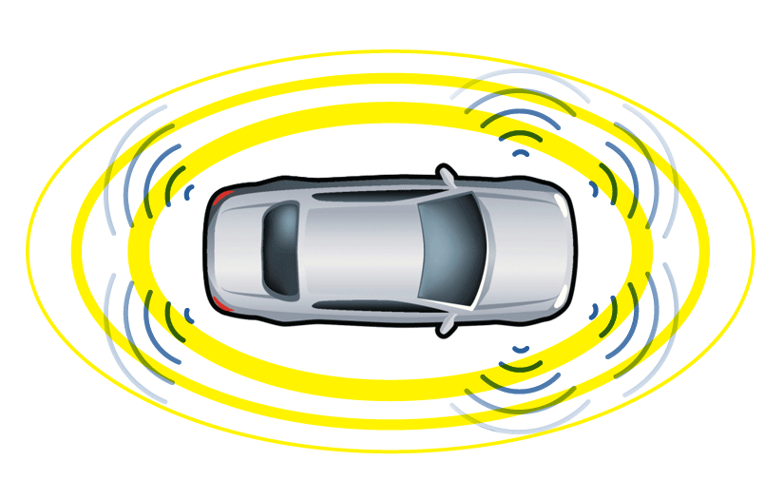
Connected and Autonomous
Vehicles
Connectivity
  Includes all types of communication with vehicles and infrastructure (Wi-Fi, DSRC, Cellular, etc.)
Autonomous Vehicle
Operates in isolation from other vehicles using internal sensors
Connected Automated Vehicle
Connected Vehicle
Communicates with nearby vehicles and infrastructure

Slide 12
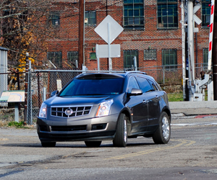
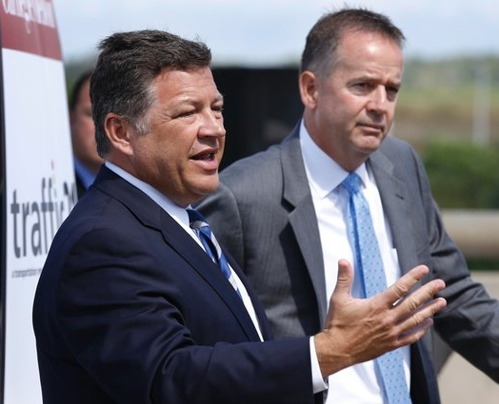
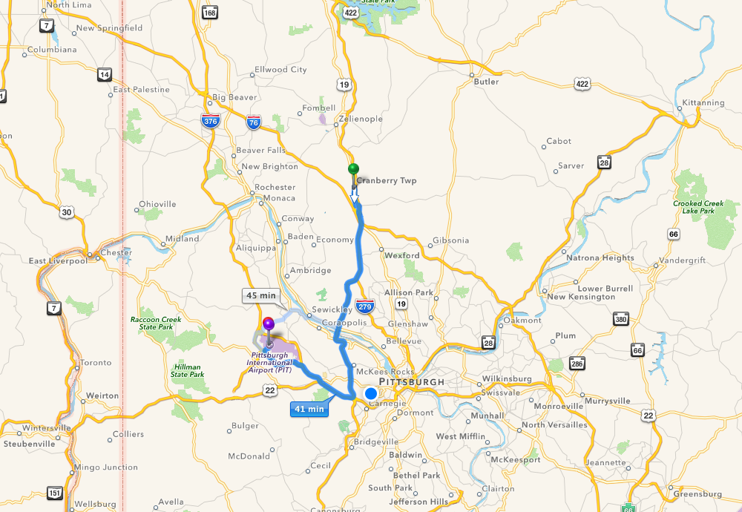
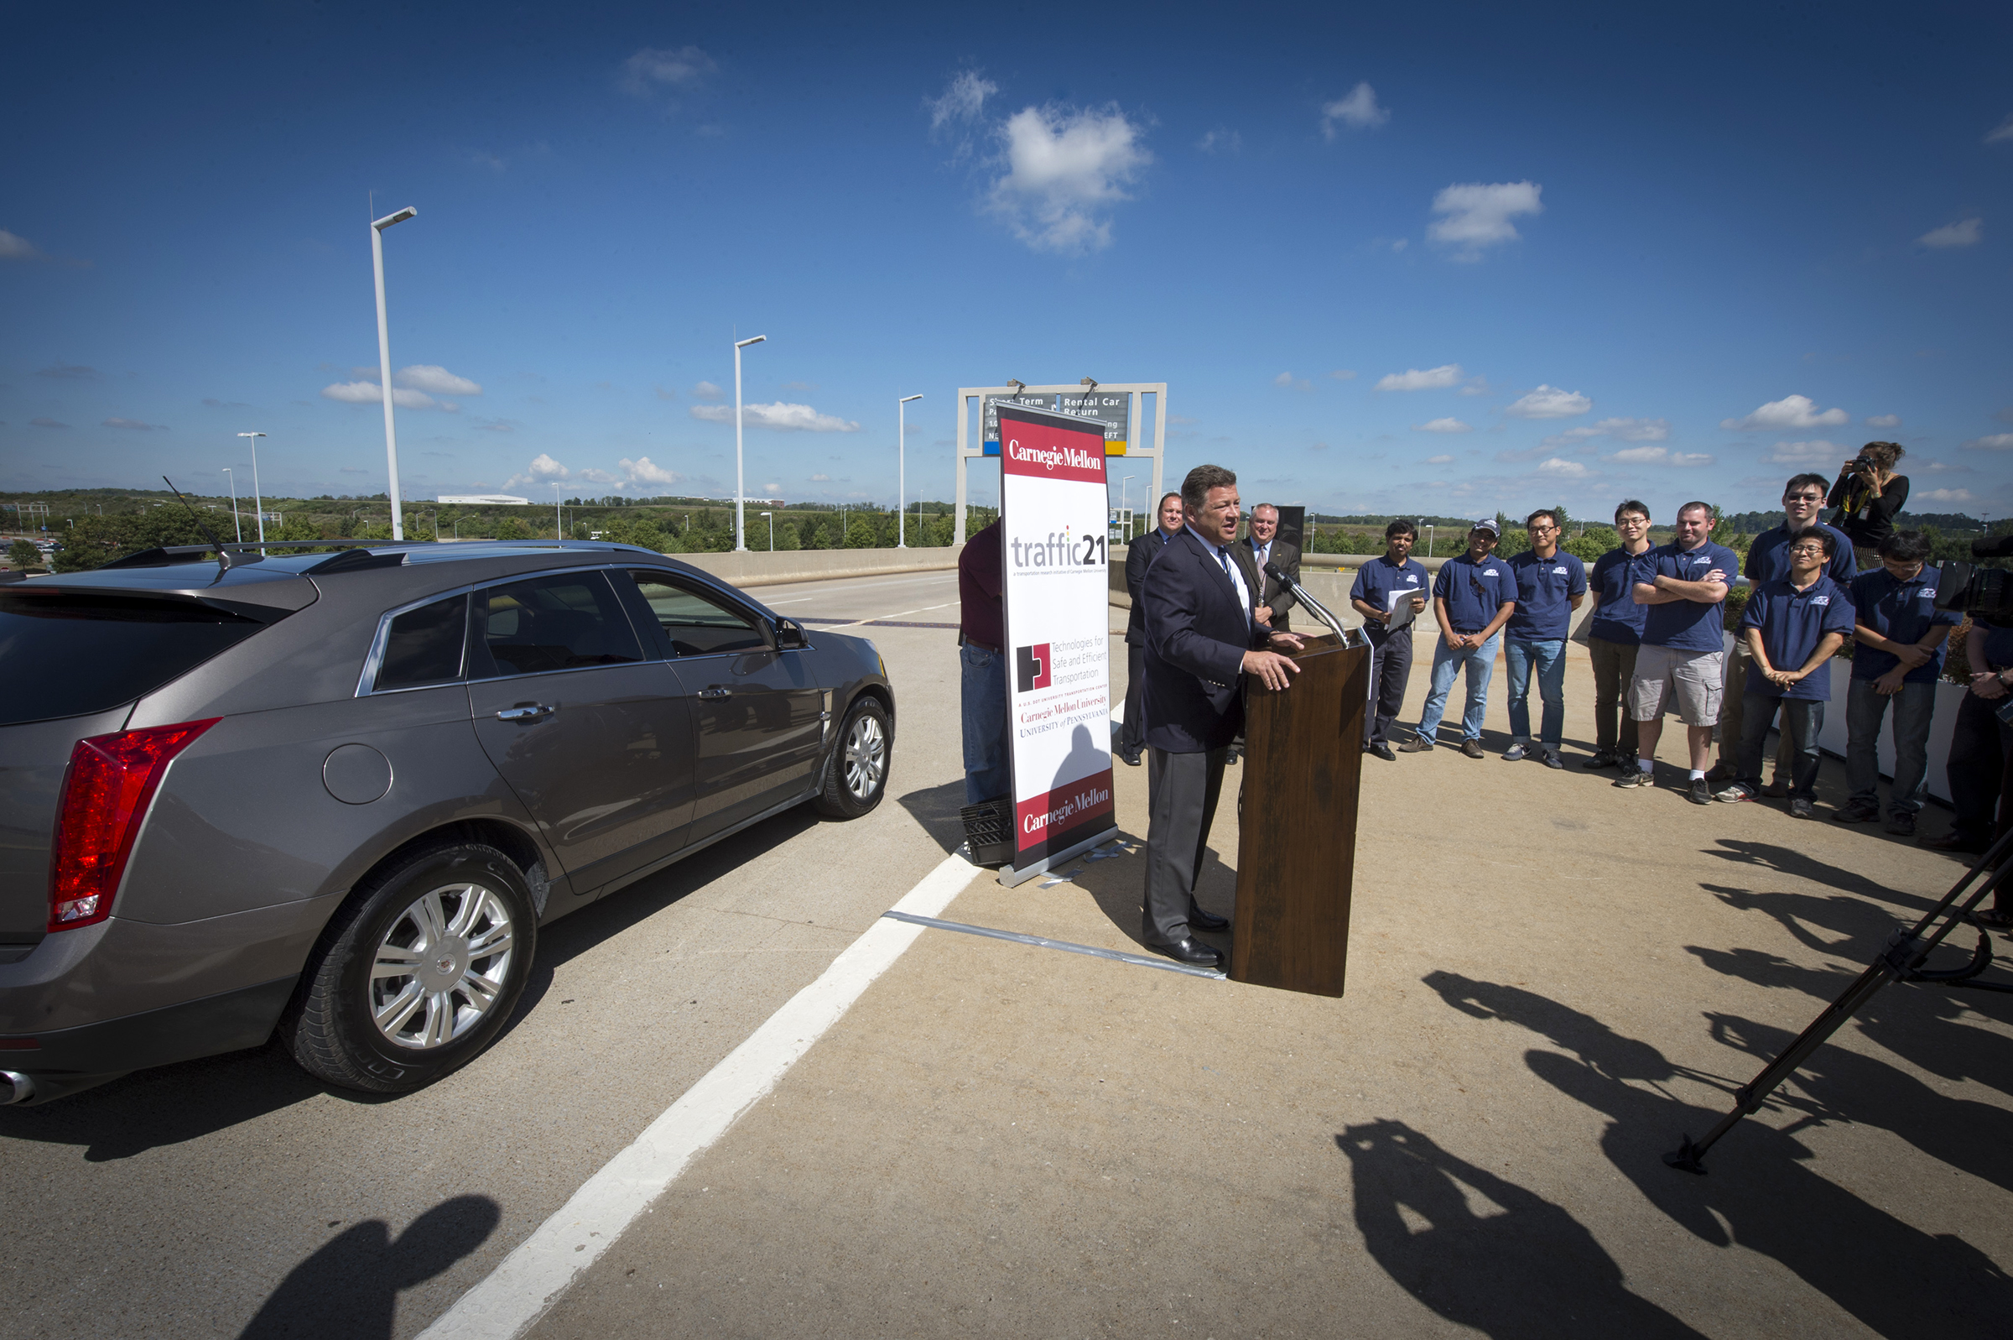
Pittsburgh Demonstration
9-4-14
Cranberry
Township
Pittsburgh
Airport
33 miles along Route 19 in multi-lane, dense traffic with lights and two interstate highways

Slide 13
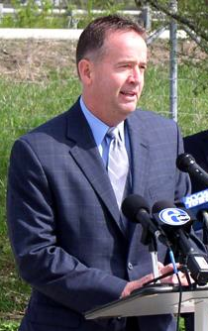

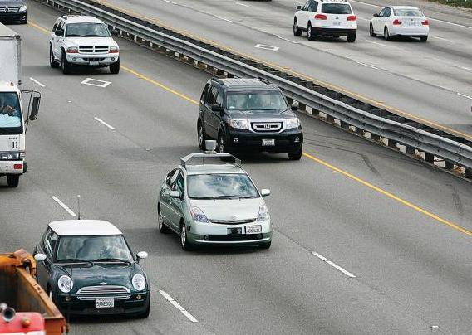
Connected and Autonomous Vehicles 2040 Vision

Slide 14
Proposed PennDOT Actions
2014 - 2020
2014-2016
Thorough evaluation of all existing and planned capacity/LOS enhancement and ITS related investments.
Collaboration with private sector to convert data into information for sending to cloud.
Prioritization of safety and mobility applications.
Identification and prioritization of key locations for DSRC and roadside equipment deployment.
Funding allocation for DSRC and roadside units.
2015: FHWA Guidance to V2I Deployment
2016-2020
Upgrading signal controllers, equipment and firmware where necessary.
Early small-scale deployment of V2I applications at key locations.
2021 - 2030
Collaboration with local and state educational institutions to enhance workforce training.
Update of testing criteria for level 3 automation.
Design of driver licensing training for emergency situations, system malfunctions, regulations and human interaction levels.
Work with the trucking industry and State Police to design features tailored to these stakeholders.
Deployment expansions – large scale deployment of equipment and applications.
2031 - 2040
Provisions for a new license class for those wishing to drive their manual cars.
Dedicating some highway lanes to autonomous vehicle use.
Reconfiguration and repurposing of the lanes.
Phasing out the freight infrastructure (e.g. over-height warnings, weigh stations) as new technologies are introduced.

Slide 15


Report to the Citizens of Pennsylvania
Vehicle Automation
in Pennsylvania
February 1, 2018
Notes:
Roger

Slide 16






AV Policy Task Force
- Government -
- Advocacy -
PennDOT
DCED
Insurance
PTC
PSP
FHWA
AAA
ATA
PMTA
City of Pittsburgh
- Academia -
- Industry -
CMU
U Penn
Penn State
Uber
SAE
GM
Global Automakers

Slide 17
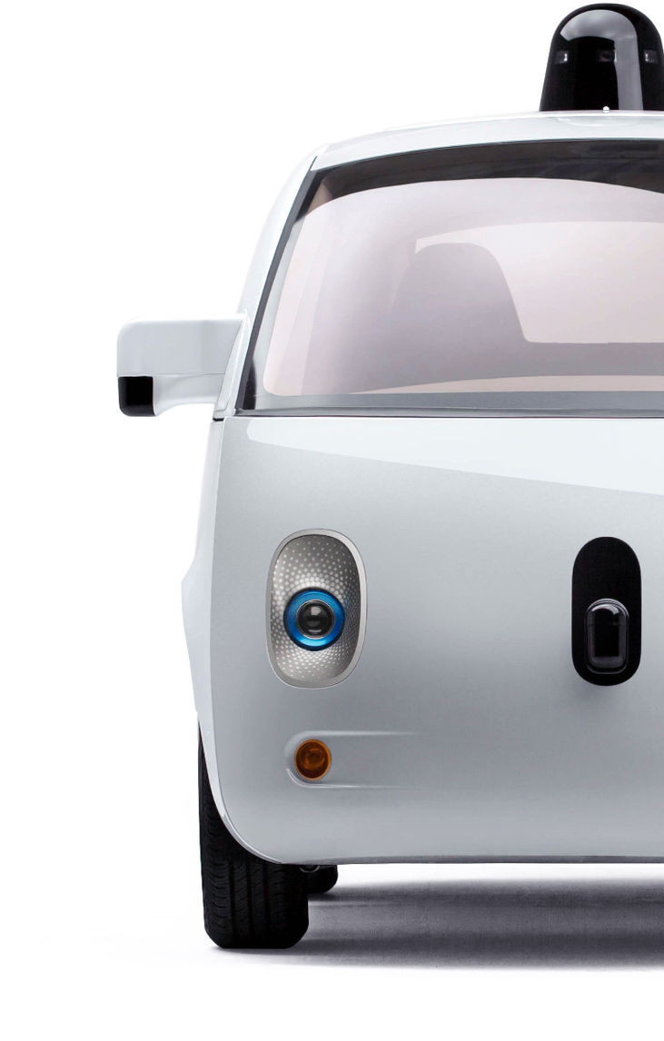
PREPARING
for the
FUTURE
Stay Informed
Understand the Implications
Start Small & Work With Partners
Develop a Plan

Slide 18

Infrastructure Requirements
Line Paint
Retroreflectivity
Asset Databases
Pavement Condition

Slide 19
Sample Infrastructure Research Projects

Slide 20
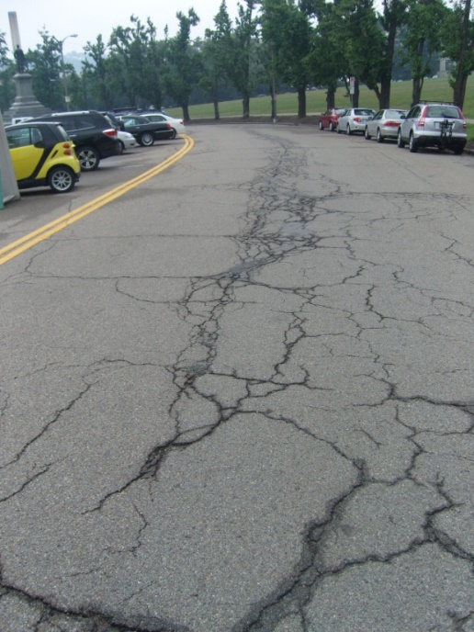
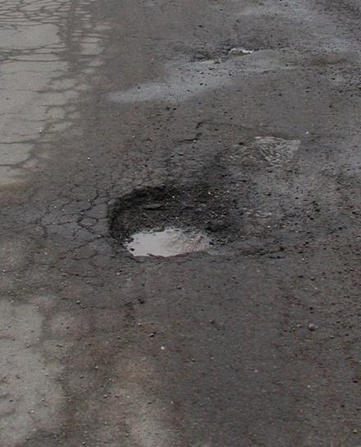
Monitor Road Surface Damage
Inexpensively
Accurately
Continuously

Slide 21
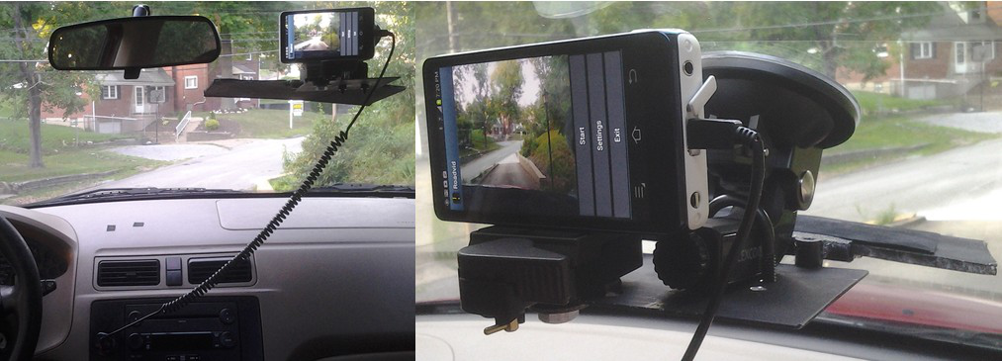
Smartphone Mounted in Car

Slide 22
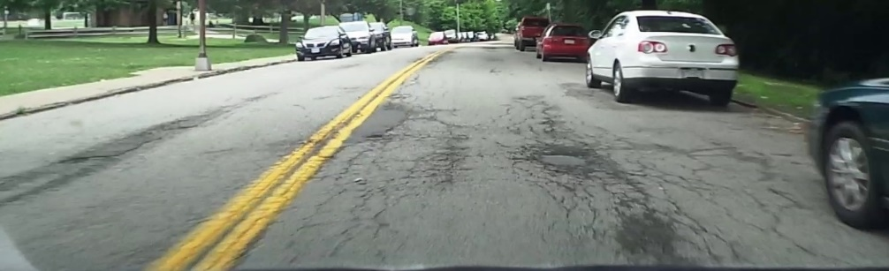
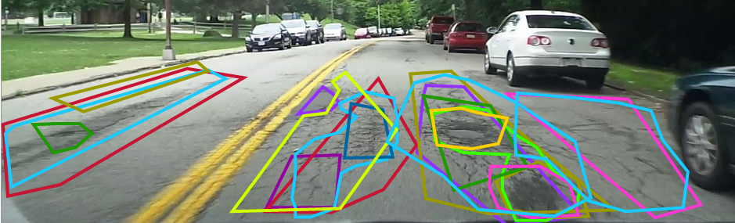

Convert Images to Data

Slide 23
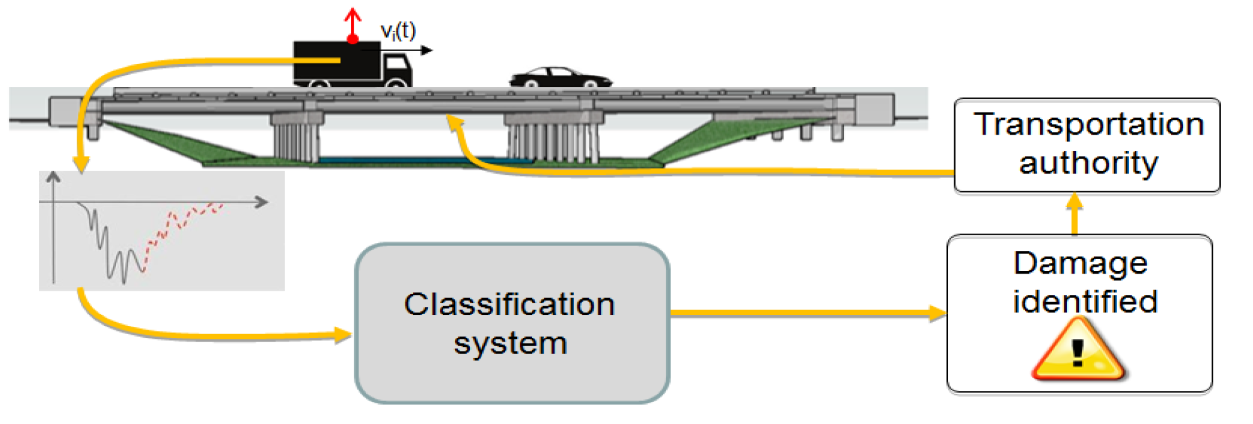
Indirect Structural Health Monitoring

Slide 24
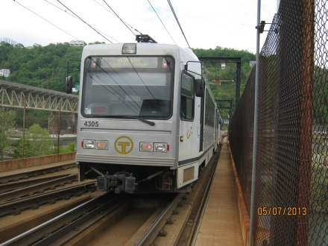
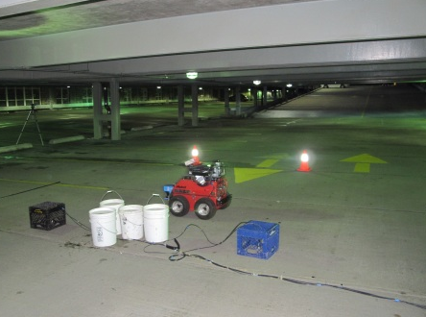
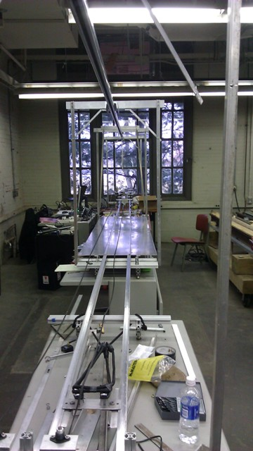
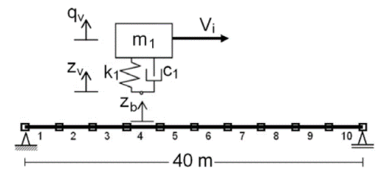
Research process
Field implementation
Field experiment
Laboratory model
Numerical model

Slide 25
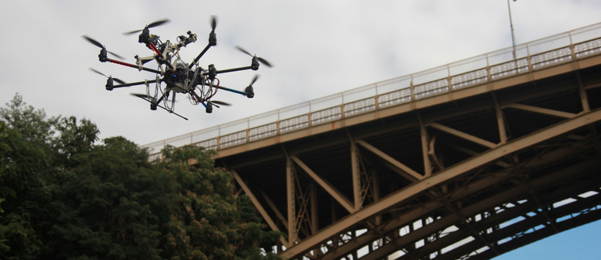




Autonomous Aerial Mapping and Inspection for Infrastructure
Civil & Environmental Engineering
Notes:
Good evening, I’m Varun from Carnegie Mellon University. Today I will be talking about our project - autonomous aerial mapping and inspection using drones for infrastructure; some early results from case studies
This is a collaborative research project involving CMU robotics, CMU Civil Engineering and Northeastern Civil Engineering departments.
This project is funded by National Science Foundation (NSF)

Slide 26
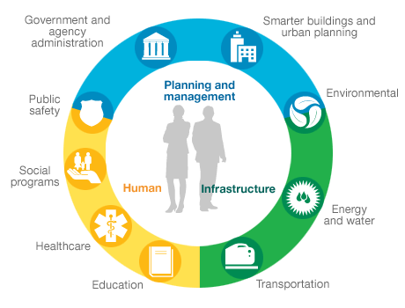

Slide 27

Metro21 Smart City Institute at CMU

Slide 28

30 cities, 30 universities, 100 projects

Slide 29
Connecting Smart Cities, States and Regions

Slide 30
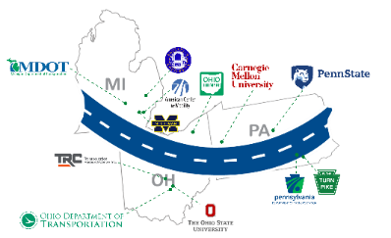
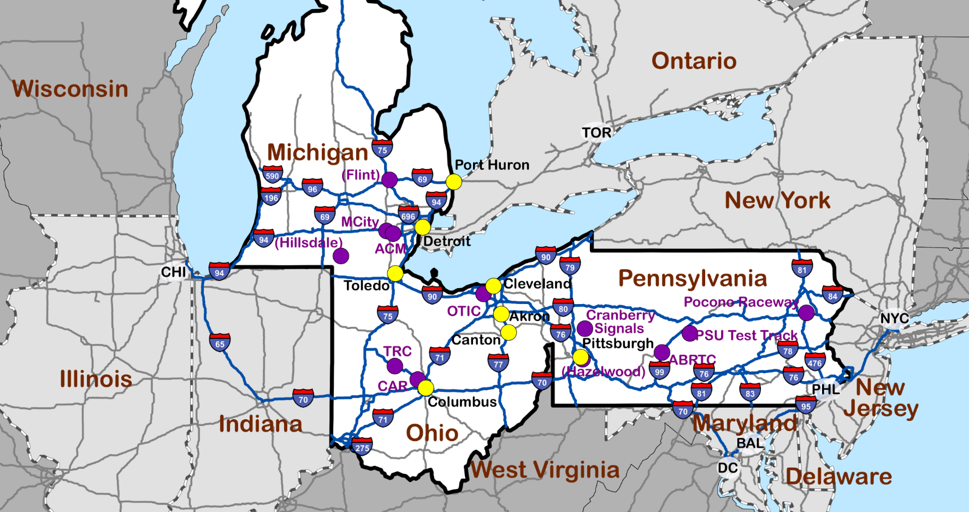


Smart Belt Coalition (SBC)
Smart Belt Coalition
A Regional Connected and Automated Vehicle Collaborative
Notes:
2/10 BT comment:
Use wide slide format
Use template with SMART Belt Coalition and Member logos (all along the bottom of the slide)

Slide 31
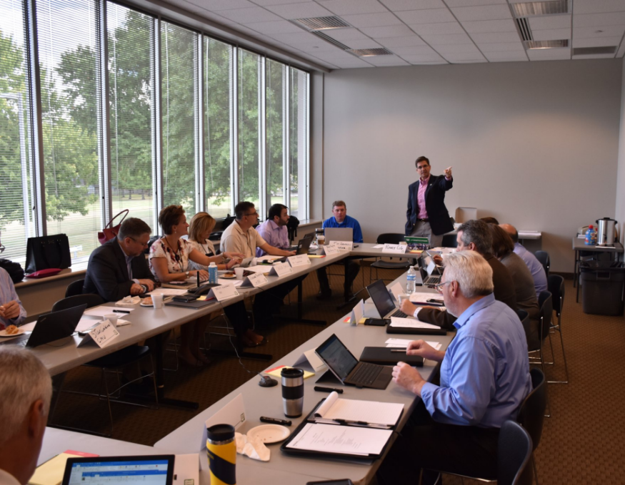


What is it?
High-profile, high-impact, and long-distance connected and automated vehicle network
  Multi-jurisdictions
  Four distinct seasons
  Urban and rural roadways
Support the testing and deployment of connected and automated vehicles
Cooperative deployments
University research
Leverage opportunities for Federal grants
Notes:
2/10 BT comment: put picture as a backdrop/background and the text on top.

Slide 32
Questions and Discussion
StanCaldwell@cmu.edu
mobility21.cmu.edu/

