Slide 1
The Real Deal Challenges in Transferring Reinforcement Learning-Based Traffic Signal Control Systems to Reality
REX CHEN, FEI FANG, NORMAN SADEH
School of Computer Science
Carnegie Mellon University
Notes:
Good morning. My name is Rex Chen, and I’m presenting my survey paper about reinforcement learning for traffic signal control. This is joint work with my co-advisors, Fei Fang and Norman Sadeh, at the School of Computer Science at Carnegie Mellon University.

Slide 2
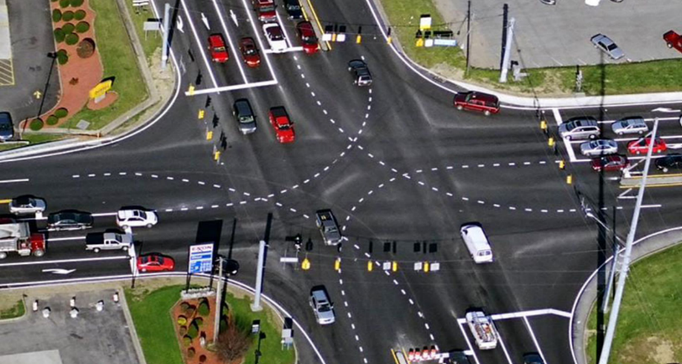
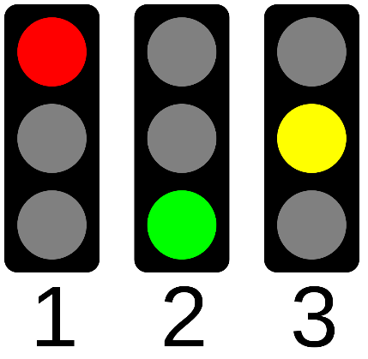
Traffic signal control
Improving traffic signal efficiency is a key mechanism of alleviating gridlock
2021 Urban Mobility Report: Gridlock caused 4 billion hours of travel delay, $100 million in congestion costs across US in 2021
Traffic signal control is a popular research problem that deals with this issue
Yao & Qian (2019)
Wikimedia Commons/R. Pocztarski
Notes:
To motivate traffic signal control, or TSC, one only needs to look to the growing traffic volume of metropolitan areas worldwide. Persistent surges in demand lead to critical inefficiencies such as gridlock. The 2021 Urban Mobility Report showed that traffic congestion caused, across the United States in 2021, about four billion hours of delay and $100 million in opportunity cost. One important way to alleviate gridlock is to improve the efficiency of traffic signaling so that road users don’t spend unnecessary amounts of time waiting at intersections. TSC aims to set efficient sequences of traffic lights to control the movements of road users.

Slide 3
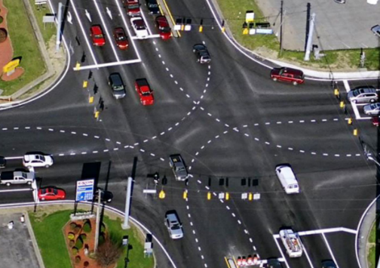
Types of TSC
Reinforcement Learning
Controllers
Detectors + Controllers
Detectors + Controllers
Fixed Plan
Logical Rules
Adaptive Algorithms
Fixed-Time Control
Actuated Control
Adaptive Control
Notes:
Generally speaking, there are three different types of approaches to TSC. Historically, the most common approach has been to fix a single signaling plan or a few plans that are rotated throughout the day. These are usually based on data about historical traffic volume. However, fixed plans can’t deal with variations in traffic demand. Next, we have actuated control, in which detections of road users trigger certain predefined logical rules. Finally, we have adaptive control, which generally uses more sophisticated algorithms to adjust plans in response to traffic conditions. Reinforcement learning, which we focus on in this review, falls into the last category.

Slide 4
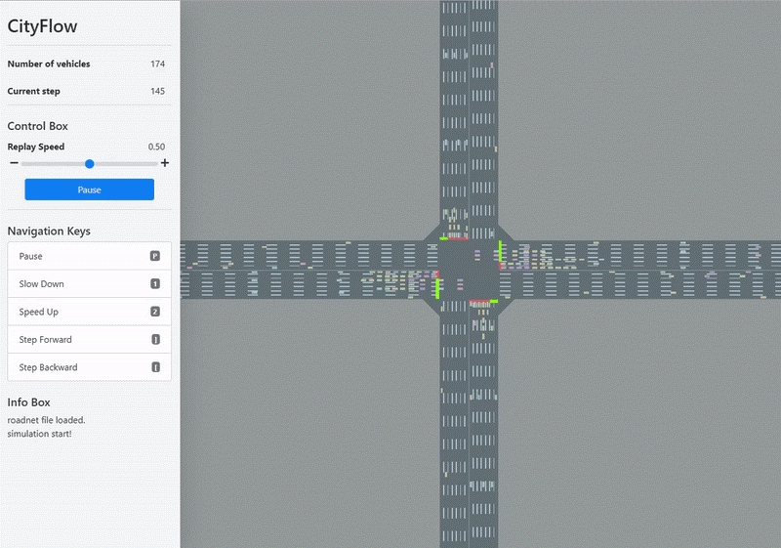
Reinforcement learning
Traffic Simulator
Observation $o$
Local observations
Vehicle positions
Vehicle speeds
Queue lengths
Lane volumes
…
Action $a$
Signal control policy
E.g.: Phase length
Phase split
…
Global observations
Upstream & downstream signals
Other intersections
Reward $r$
Percent on green
Queue lengths
Waiting times
Change of delay
…
RL Algorithm
Zhang et al. (2019)
Notes:
What is reinforcement learning? It’s a promising approach to adaptive TSC that is based on learning from trial-and-error interactions with an environment. RL has shown successes in many large-scale domains with abundant data, such as card games, strategy games, and – indeed – also TSC. In the TSC context, an RL agent, often representing one intersection controller, would make local observations of its own intersection, and potentially receive observations from others in the road network. It would then choose an action to decide how the signaling plan should change next, like how long the next phase should be signaled for. Finally, it would receive a reward indicating how good the effect of the action was on the environmental state, like how many vehicles arrived at the intersection on a green light.

Slide 5
Reinforcement learning
Traffic Simulator
Detectors + Controllers
Traffic Simulator
RL Algorithm
Learned RL Policy
RL Algorithm
Training
Deployment
Notes:
RL for TSC has outperformed prior state-of-the-art adaptive methods. Considering the current pace of research, a reasonable question would be why it hasn’t achieved widespread deployment. By nature, deploying an RL algorithm is different from training it. Trial-and-error can’t take place in the field, so a learned policy must be deployed. Environmental simulations must also be replaced with real detectors and controllers. Although deployment is often listed as a desideratum for future work, we have not found any descriptions of deployments in the literature. Where does the gap exist, and is it being filled? Our review paper aims to answer these questions.

Slide 6
Challenges to deployment
Why have RL-based TSC algorithms not been deployed yet?
We suggest that there has been: A focus on methodological contributions over systems thinking
We review four engineering challenges central to deployments
Uncertainty in detection
Reliability of communications
Compliance and interpretability
Heterogeneous road users
Notes:
We suggest that this gap primarily exists because most research in RL for TSC has focused on methodological contributions over taking a more holistic approach based on systems thinking: that is, considering how the RL policy would interact with the rest of the TSC system through inputs and outputs. Taking a systems thinking approach would entail addressing the challenges that arise from such interactions. We review four of them, which can broadly be described as “uncertainty in detection”, “reliability of communications”, “compliance and interpretability”, and “heterogeneous road users”. For each challenge, we review why the challenge is significant for RL in TSC; how non-RL deployments of TSC have addressed the challenge; and what progress has been made on the challenge among RL-based approaches.

Slide 7
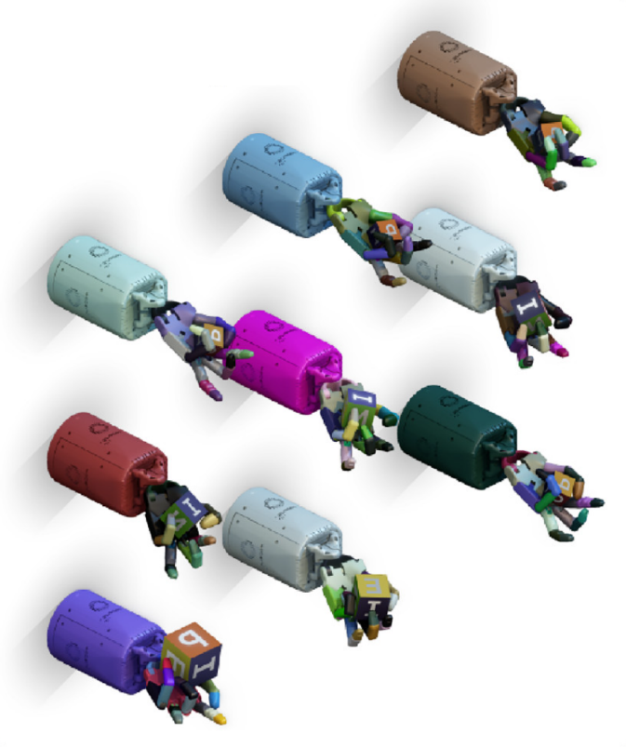
Related work
Sim-to-real methods
The work we review here has analogues to some work in RL for robotics
In both TSC & robotics, RL needs simulators to learn from abundant environmental interactions
But simulators can never perfectly emulate reality, yielding a reality gap
But TSC has unique domain challenges:
Essentially uncontrolled environmental conditions
Interactions with human users
Andrychowicz et al. (2020)
Notes:
TSC is not the only application of RL where considerations about deployment are critical. There has been a long line of work in RL for robotics that aims to close the gap between simulations and reality. TSC and robotics are alike in that it’s not feasible to collect the large quantities of environmental interactions needed to train RL policies from the real world, and that makes simulations necessary. But simulations are abstractions of reality, and this results in what is known as the “reality gap”. The sim-to-real literature for robotics has tried to fill this gap with techniques such as domain randomization, domain adaptation, meta-RL, and imitation learning. We will see how some of these techniques can be applied to TSC, but TSC is more complex than robotics because it’s harder to control environmental conditions (which include human users).

Slide 8
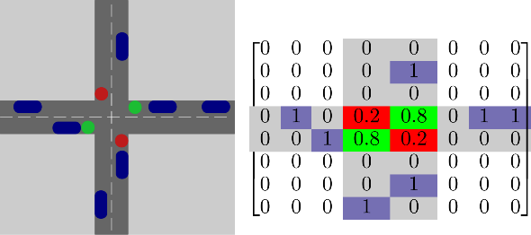
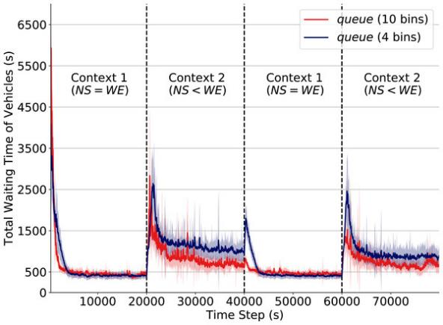
Uncertainty in detection
Significance of challenges
Many works assume that state features are available, but few works give any consideration to how they are collected (Noaeen et al., 2022)
Detection uncertainty can cause two potential issues for RL:
Learned policies are not robust to detector uncertainty and failure
Learned policies cannot readily distinguish states, causing state aliasing and harming generalization
van der Pol & Oliehoek (2016)
Alegre et al. (2021)
Notes:
We turn to the first deployment challenge in our review paper: uncertainty in detection. As we discussed, observations of the road state are an important part of RL. RL algorithms observe numerically encoded state features, but these features must be derived from detector data. Few papers actually consider how detectors would impact this process. Not considering the possible effects of detector noise and failure can cause two issues. First, if the policies are insufficiently robust, their performance could degrade. Second, if the policies receive similar observations for distinct states (which is known as state aliasing), they might be overly general and fail to identify optimal actions in specific states. For instance, the authors of this paper report that coarser discretizations of queue length harm performance when generalizing to new scenarios.

Slide 9
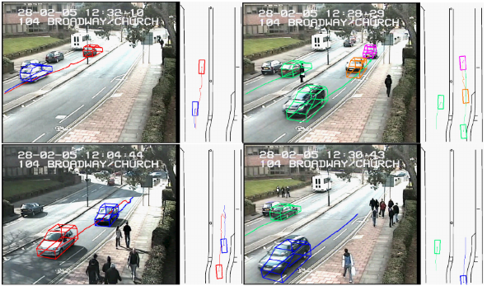
Uncertainty in detection
Lessons from deployments
Different detector types have different strengths and weaknesses
Intrusive detectors: Loop detectors are robust to environmental conditions but often break
Non-intrusive detectors: Video and radar are not robust to environmental conditions
Ensemble learning can help
It is beneficial to overestimate demand for adaptive TSC (up to a point)
Koonce et al. (2008)
Buch et al. (2009)
Notes:
So what types of vehicle detectors exist, and how have existing deployments of TSC algorithms addressed their strengths and limitations? We found that there are two primary types of detectors. Intrusive detectors, like induction loops, are installed into road surfaces. This means that they can reliably detect vehicles regardless of environmental conditions, but also that they can break easily. Non-intrusive detectors, like cameras and radar, are mounted above the road surface, and so their accuracy degrades in poor weather and at night. Some agencies have both types; RL algorithms can leverage this by learning ensemble models. Heuristic post-processing has been applied to handle underestimated observations, but it has been reported that mild overestimation of demand can improve the performance of TSC.

Slide 10
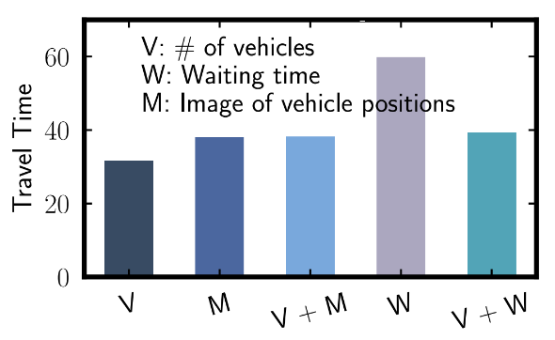
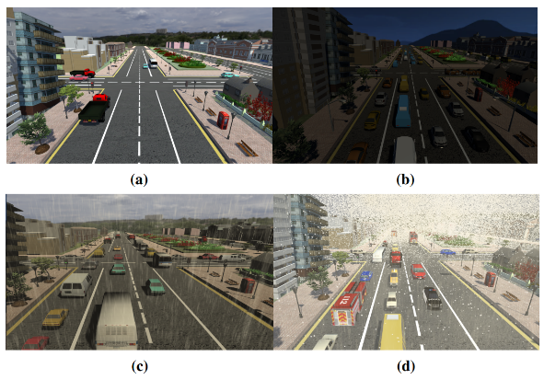
Uncertainty in detection
Progress towards solutions
State space reduction
Simpler state representations are useful for debugging
Complex state representations don’t always give better performance (Zheng et al., 2019; Wei et al., 2019)
Domain randomization
Analogues to sim-to-real techniques: in simulators (Garg et al., 2022), in observations (Tan et al., 2020), in NN models (Rodrigues & Azevedo, 2019)
Zheng et al. (2019)
Garg et al. (2022)
Notes:
On the RL side, what are some promising lines of work for addressing issues of detection uncertainty? First, simpler state representations can make it easier to identify and debug these issues. Many papers leverage image-based representations and CNN models to capture as much information as possible, but this makes them harder to debug and – as shown in this figure – doesn’t necessarily benefit performance. At the same time, the effect on performance wouldn’t be monotonic either; recall the state aliasing example. Second, domain randomization techniques from the robotics sim-to-real literature readily apply here. Various approaches have been taken in this space, including randomizing weather and lighting in simulations; injecting Gaussian noise into observations; and applying Dropout to neural network models.

Slide 11
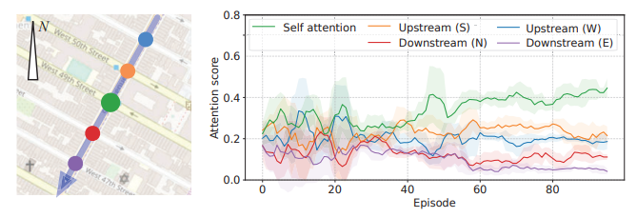
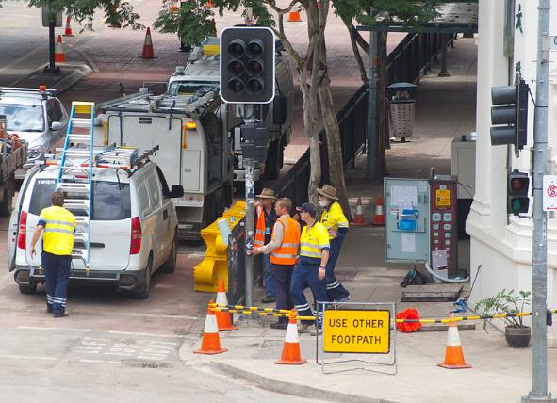
Reliability of communications
Significance of challenges
Coordination in RL for TSC relies on sharing information between controllers for different intersections
Substantial literature has designed models to use shared information
But what happens when information doesn’t get shared in the first place?
Intersections may differ in detection and communication capabilities
Intersections could experience failures in communication
Wei et al. (2019)
Wikimedia Commons/R. Allen
Notes:
Let’s move to the next deployment challenge: reliability of communications. This can be viewed as an extension of the previous challenge to the multi-agent domain. To achieve scalable coordination between intersections in TSC, various models make use of observations shared between intersections. By allowing agents to act locally based on global information, information sharing mitigates the need for centralized control. But, again, these methods generally don’t consider the hardware needed for other intersections to collect and share their observations. It could be that there are fundamental differences between the detection and communication capabilities of different intersections. Even when the level of instrumentation is uniform, it could still be that communication failures prevent the expected transmission of information.

Slide 12
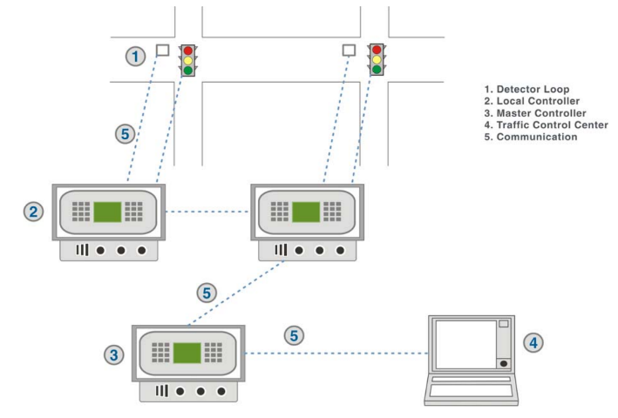
Reliability of communications
Lessons from deployments
Differing capabilities exist in the hierarchical closed-loop architectures that RL will likely be deployed into
Domain adaptation techniques can help transfer between intersections
Signal strength is more of a concern for deployment than bandwidth
Bandwidth will likely be high; fibre-optic and wireless communications are becoming increasingly common
Koonce et al. (2008)
Notes:
So how does communication between intersections happen in deployed TSC systems? At least in the United States, most systems follow what is known as a “closed-loop” architecture: a three-level model that delegates finer decisions to successive levels. This is likely the framework that RL policies will be working in. The costs of upgrading infrastructure mean that, as discussed on the previous slide, differing detection and communication capabilities may well exist. Domain adaptation, from the sim-to-real literature, can help homogenize the feature spaces of different intersections. In terms of the actual hardware for communication, agencies nowadays consider signal strength more of a concern than bandwidth, mostly due to the increasing prevalence of fibre-optic and wireless communications.

Slide 13
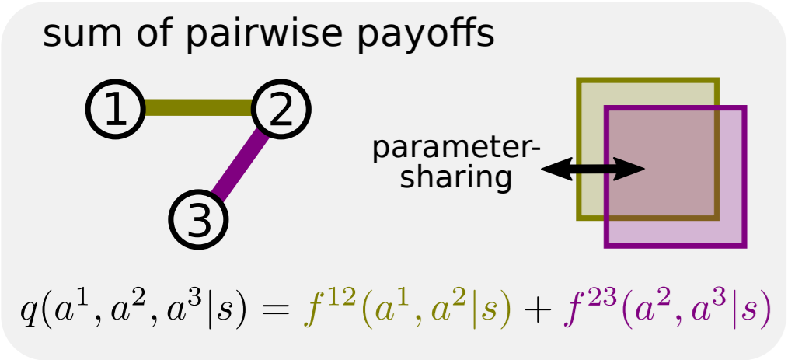
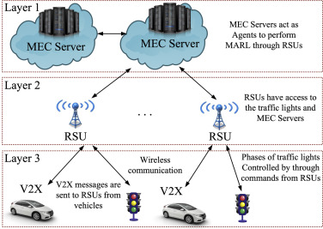
Reliability of communications
Progress towards solutions
Message-passing architectures
Approaches include: coordination graphs (Yang et al., 2019) latency-aware methods (Xie et al., 2020)
Learning more compact messages may mitigate communication failures
Hierarchical architectures
Designing for closed-loop systems could improve RL’s deployability
Various conceptual architectures proposed (e.g., Abdoos et al., 2021)
Böhmer et al. (2020)
Abdoos et al. (2021)
Notes:
On the RL side, what work can handle issues of communications reliability? First, message-passing architectures try to exchange more compact messages distilled from raw observations. Some approaches have theoretical guarantees, such as those based on coordination graphs as shown in this figure; another approach also models the temporal dimension by exchanging older messages to handle latency. This can all mitigate the impact of communication failures. Second, hierarchical architectures that emulate closed-loop systems can be a good basis for evaluating RL algorithms. In this architecture, for instance, there are two dimensions of decentralization: first, in the learning algorithm that is deployed in the top layer; and second, in the layered control of signals through commands. But more work is needed to make these deployable.

Slide 14
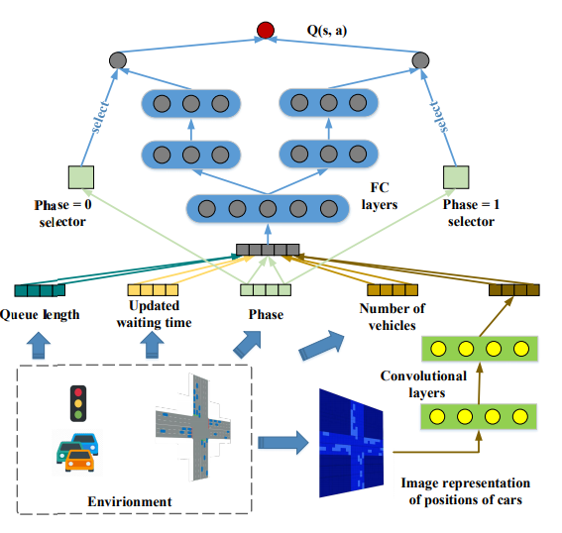
Compliance and interpretability
Significance of challenges
How can stakeholders build trust in RL for TSC? By verifying its decisions
RL policies need to comply with standards and expectations
But RL policies based on deep neural networks are hard to interpret
Compared to other applications of RL, TSC has unique safety risks:
Interactions with many users
Potentially fatal consequences
Wei et al. (2018)
Notes:
Next, we discuss the deployment challenge concerning the compliance and interpretability of RL. This is perhaps one of the primary reasons why RL for TSC is not deployed yet. Stakeholders need assurances that deploying an RL policy won’t introduce undue risk. They can’t trust that this is the case without verifying the decisions made by policies and ensuring that they comply with standards and expectations. But the state of the art in RL for TSC uses complicated neural network architectures like this one, which are difficult to interpret. These kinds of considerations are by no means unique to TSC, but they are more critical for TSC because of its scale: learned policies must interact with many road users, while mistakes and unexpected behavior could have fatal consequences.

Slide 15
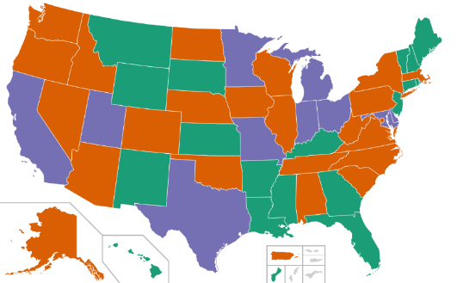
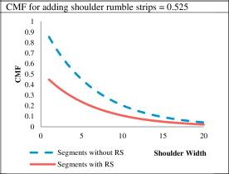
Compliance and interpretability
Lessons from deployments
Various standards for traffic signals (e.g., minimum/maximum green time) exist
But their specific implementation often depends on agencies’ engineering judgement
Standards should be treated as input, but preference learning may help
Crash data is used for quantitative assessment of signalling changes
Work in RL has hitherto not used accident modification factors
Wikimedia Commons/M. Nguyen
Park et al. (2014)
Notes:
So, what kinds of standards and expectations might stakeholders have for signaling plans? These might include constraints such as the minimum or maximum green time for a phase. But standard vary from jurisdiction to jurisdiction and from agency to agency; this figure shows that US states don’t consistently adopt national standards. Overall, whatever standards do exist should be treated as input constraints, while soft preferences between scenarios could be formalized with preference learning techniques. Post-hoc assessment is also common. So-called accident modification factors are frequently used by agencies to quantitatively assess how signaling changes impact crash rates and thus safety, but as far as we can tell the RL literature has not used them as an evaluation metric.

Slide 16
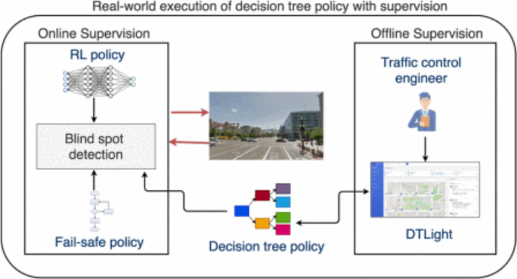
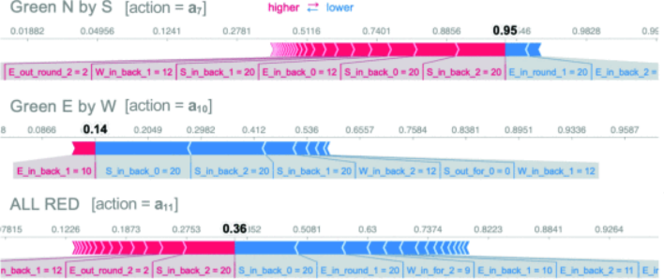
Compliance and interpretability
Progress towards solutions
Interpretability
Standard methods for ML/RL interpretability: VIPER (Jayawardana et al., 2021) SHAP (Rizzo et al., 2019) Grad-CAM (Garg et al., 2022)
Heuristic constraints
Many papers design rewards/action constraints to enforce safety (e.g., Liu et al., 2017; Essa & Sayed, 2020)
Constrained optimization may help
Jayawardana et al. (2021)
Rizzo et al. (2019)
Notes:
On the RL side, what interpretability techniques can be used? One could directly learn simple models. But standard methods for interpretability in machine learning and RL allow us to avoid sacrificing performance; these include learning surrogate models, computing feature importances, and generating heatmaps. Surrogate models in particular – like the decision trees in the top figure – support mixed-initiatives control by allowing stakeholders to directly audit and modify models. A number of other papers take a more ad hoc and heuristic approach by designing reward penalties and action constraints to induce desired behavior. The rigour of such approaches could be improved by using constrained RL algorithms. But we’d need to ensure that all of these approaches actually result in what stakeholders want to see.

Slide 17
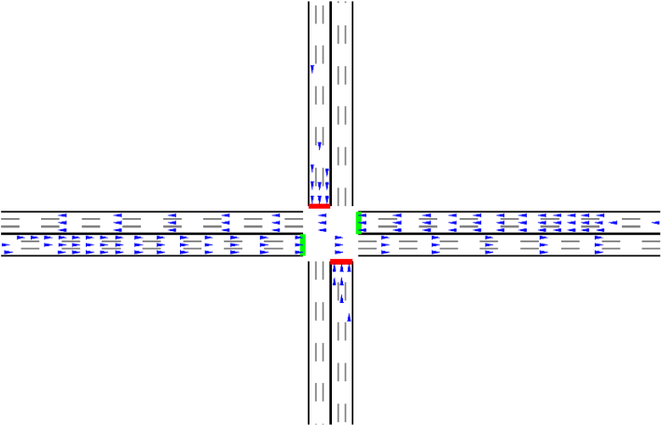
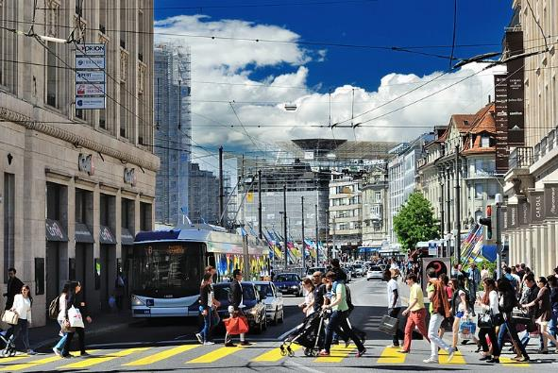
Heterogeneous road users
Significance of challenges
Traditional traffic models and simulators in TSC generally assume unimodal traffic with uniform behaviour
But RL also implicitly encodes similar assumptions in state variables that don’t distinguish vehicles
Many of non-car road users exist, e.g. pedestrians, transit/emergency vehicles
They may behave differently relative to normal traffic, but few papers consider them (Noaeen et al., 2022)
Zhang et al. (2019)
Wikimedia Commons/Z. Grossen
Notes:
Finally, we review the deployment challenge of heterogeneous road users. The traffic models that underlie traditional fixed-time control assume that all vehicles on the road are unimodal in type and uniform in behavior. Various simulators also make this assumption; the top figure shows a simulator designed for RL training, where vehicles are shown as arrows. Work in RL is not free of this assumption either: most state feature representations used in the literature are agnostic to vehicle types. But we know that not all road users are exactly the same. Pedestrians often use roads, as do non-car vehicles such as buses and ambulances. They likely won’t behave in the same way as a passenger car, and that may well influence the performance of TSC. Yet, again, few papers in RL for TSC consider different classes of road users.

Slide 18
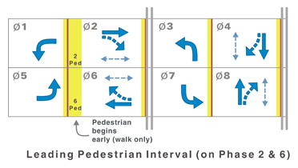
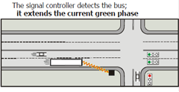
Heterogeneous road users
Lessons from deployments
For pedestrians
Leading pedestrian intervals before turning phases can ensure safety, but no works in RL for TSC use them
Metrics should be equitably optimized for cars and pedestrians
For transit/emergency vehicles
Prioritization is based on requests and can be included in optimization
Preemption is deterministic and disrupts traffic; RL can aid recovery
Koonce et al. (2008)
Notes:
So, how do deployed TSC systems handle non-car road users? Our review focuses on two categories of road users. For pedestrians, a common concern is that they may conflict with turning traffic in crosswalks. It’s common to insert leading pedestrian intervals so that pedestrians can get a head start (although this does assume unimodal pedestrians). Safety isn’t the only important objective for pedestrians; their travel time also matters. For transit or emergency vehicles, two types of signal alterations exist in practice. In prioritization, vehicles like buses send requests, which increase their priority in actuation rules or signal plan optimization. In preemption, vehicles like ambulances override signal plans with pre-defined routines, which can be highly disruptive; we believe that there is potential in using RL for recovery from preemption.

Slide 19
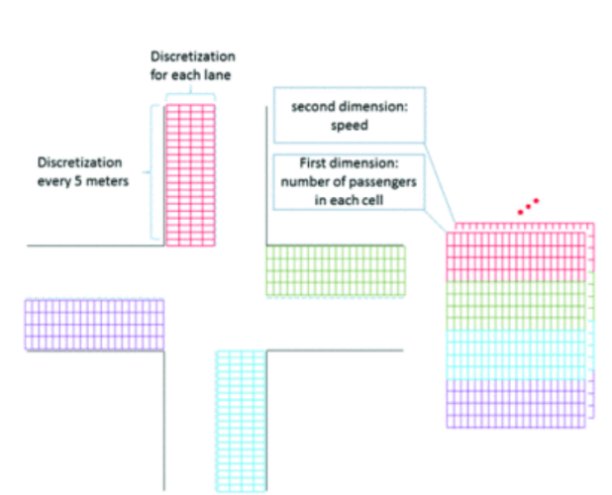
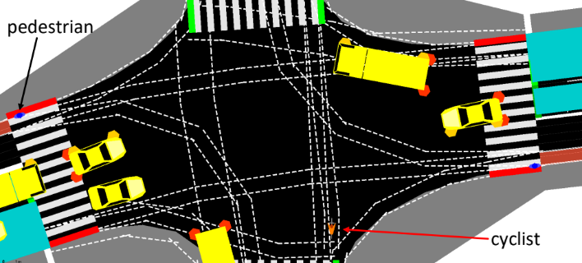
Heterogeneous road users
Progress towards solutions
Solutions for different classes of road users exist in the literature
Optimizing pedestrian queues (e.g. Liu et al., 2017; Yin & Menendez, 2019)
Weighting vehicles for prioritization (e.g. Garg et al., 2022; Shabestray & Abdulhai, 2019; Kumar et al., 2021)
Routing emergency vehicles with preemption (e.g. Su et al., 2021, 2022)
Ecologically valid integration is needed through simulators (e.g., Mueller et al., 2022)
Shabestray & Abdulhai (2019)
Mueller et al. (2022)
Notes:
On the RL side, we do see various lines of work making progress towards handling pedestrians, prioritization, and preemption, but further integration of real-world considerations is needed. For pedestrians, there are various works that treat pedestrian queues at crosswalks as a distinct component of the reward, but none have added leading pedestrian intervals to the action space. For prioritization, transit vehicles have been upweighted by constants, or by their passenger volumes as depicted in the top figure. For preemption, there is a small body of work on learning to route emergency vehicles through connected vehicle traffic. Lastly, there are also simulations, like the one shown in the bottom figure, that incorporate different classes of road users; these are important for ensuring the ecological validity of algorithms.

Slide 20
Moving forward
We have suggested ways further research can address deployment issues:
Uncertainty in detection: Use simpler states; apply techniques from domain randomization; tune to address site-specific challenges
Reliability of communications: Ensure algorithms are robust to failure or latency in communication caused by weak signals; send small messages
Compliance and interpretability: Design algorithms and interpretability techniques that facilitate auditing; consider safety as a metric
Heterogeneous road users: Incorporate leading pedestrian intervals, prioritization, and preemption; equitably optimize multiple objectives
Notes:
Through our review, we’ve outlined some directions that future work in RL for TSC should start or continue to take. For uncertainty in detection, compact state representations and domain randomization will likely be helpful. For reliability of communications, strategies for handling failure and latency caused by weak signal strength are key, and domain adaptation may help deployment into closed-loop systems. For compliance and interpretability, work in designing explainable algorithms and applying interpretability techniques should ensure that they align with stakeholder expectations, and safety should be used for evaluation. Finally, for heterogeneous road users, TSC should be viewed as a multi-objective problem that equitably incorporates actions such as leading pedestrian intervals, prioritization, and preemption.

Slide 21
Moving forward
The key to future work in RL for TSC is engaging with stakeholders
Conversations between RL experts, TSC experts, and agencies can break down information silos that would otherwise exist
Reproducibility techniques can bring more of the field into this space
Real-world datasets with realistic domain constraints help generalizability
But all of this progress shows that deployment is within reach!
Design the RL problem formulation
Gather some data to build environment simulations
Implement RL algorithms to interact with simulations
Allow the RL algorithms to learn from interactions
Transfer the RL policies to real-world environments
Notes:
Taking a step back, what does this mean for research in RL for TSC? Usually, in RL, once we’ve trained and deployed a policy, we’d consider ourselves done. But we believe that engagement with stakeholders is crucial for deployment, and this might mean repeated iteration. Having agencies work with RL and TSC experts on a deployment can facilitate progress by allowing parties to exchange unique insights and challenges, thus breaking down information silos. We believe that reproducible codebases and realistic datasets can collectively drive the field towards open collaboration on moving RL for TSC from simulations towards reality. There are researchers thinking about deployment challenges; now the task is to make this the norm. If the papers that we have reviewed are any indication, this goal is closer than we might think.

Slide 22
Q&A
Extended paper available at arxiv.org/abs/2206.11996
Notes:
So, the accepted version of this paper, which is slightly longer than the camera-ready, is available on arXiv. Thank you for listening. I’m happy to take any questions.

