Slide 1
Incentivizing Vehicular Crowdsensing System for Large Scale Smart City Applications
Susu Xu¹, Xinlei Chen², Xidong Pi¹, Carlee Joe-Wong², Pei Zhang², Hae Young Noh¹
¹Department of Civil and Environmental Engineering, Carnegie Mellon University
²Department of Electrical and Computer Engineering, Carnegie Mellon University

Slide 2
City-scale Urban Monitoring
To ensure safety of city environment and efficiency of city management
Air pollution map
Noise map
Heat hazard map
1

Slide 3
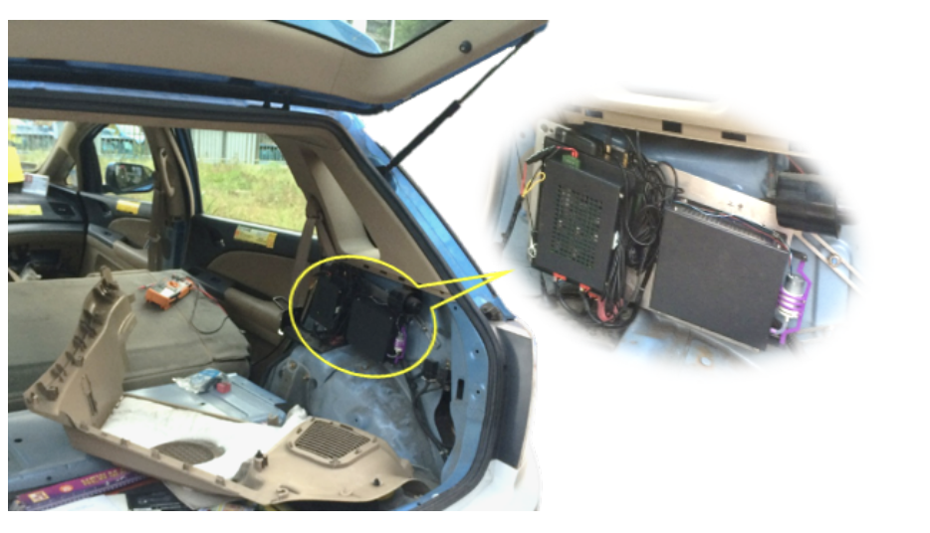
City-scale Urban Monitoring Network
Static monitoring stations
Mobile monitoring system
Precision
Flexibility
Coverage
Cost
2

Slide 4
Urban Mobile Crowd Sensing Systems
Mobile Crowd Sensing Systems: non-dedicated sensing platforms
Pros: Low cost, easy maintenance
Taxi-based mobile sensing network
Delivery Drone-based mobile sensing network
3
Notes:
animations

Slide 5
Components of Mobile Crowd Sensing Systems
Crowdsourcer
Processed Data
Collected Data
Desired Distribution &Budget
Incentive
Data Request End
Vehicle Agents
4
Notes:
Define first and then show the interaction
Crowdsourcer provide incentives to vehicles if they want vehicle to follow some special trajectories

Slide 6
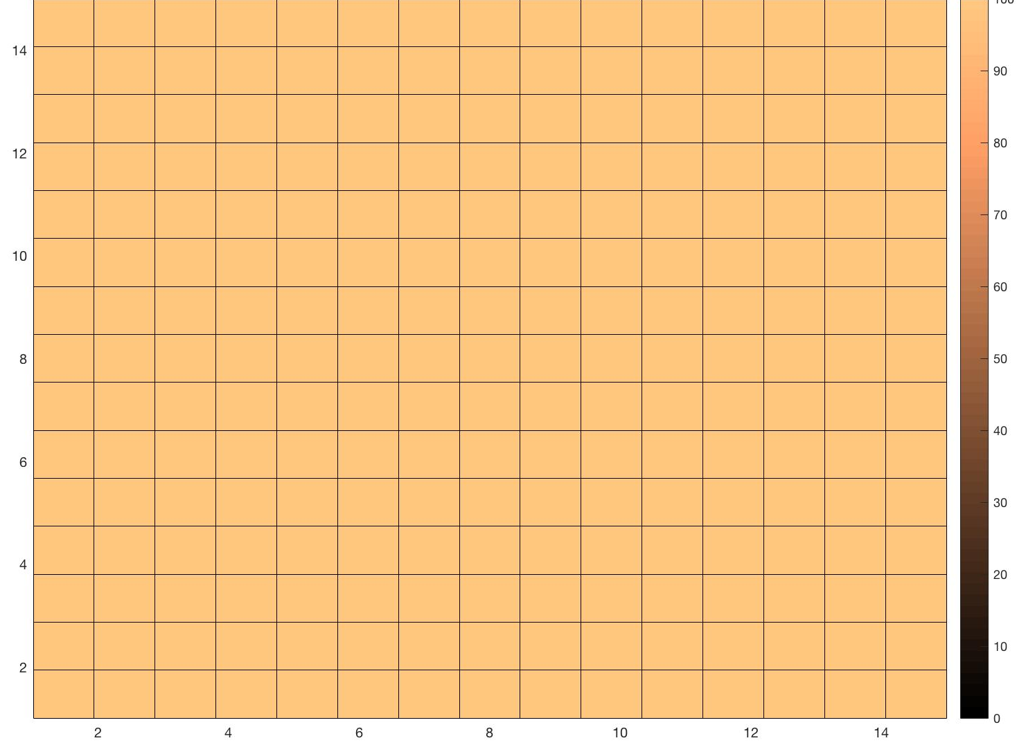
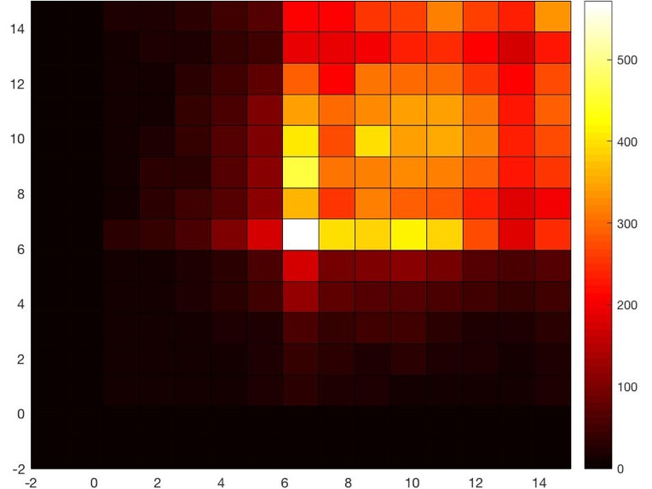
Goal of Crowdsourcer
Match the collected data distribution to desired distribution provided by data request end.
Ensure as much effective information as possible.
Target Distribution Map
6pm
11pm
5
Notes:
Better figure to show the idea of uniform
Interprete
arrow

Slide 7
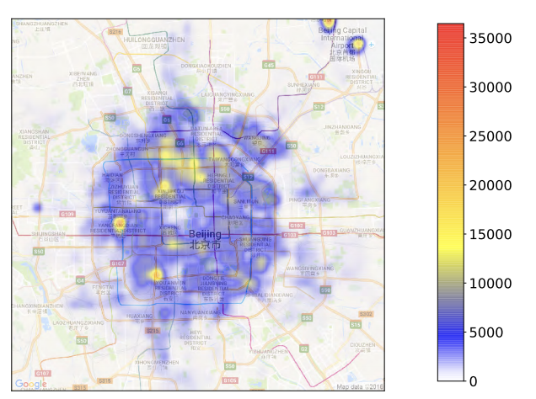
Challenge: Inconsistent Goals between Crowdsourcer and Agents
Sensing side: desired distributions for further data analysis
Vehicle side: find ride(task) requests to optimize the reward of running
?
Collected Data Distribution Map
6
Notes:
Color bar

Slide 8
Research Objective
Develop an efficient vehicle incentivizing mechanism to optimize the quality of sensing coverage
7

Slide 9
General Vehicle Incentivizing
Which vehicles to incentivize
Which trajectories to incentivize the selected vehicles to
How much to pay the vehicles
Problems:
Heterogeneous Target Spatio-temporal Distribution
Limited Budget
8
Notes:
Define first and then show the interaction

Slide 10
System overview
GPS
Assigned trajectory (Assignment)
Temperature sensor
Normal trajectory
Sensor
Incentivized agent
Occupied agent
Free agent
Agent location
&occupancy status
Agent a
Budget&
Target
distribution
Planning
Agent b
Data request end
Crowdsourcer
Agent c
9
6
Notes:
animations

Slide 11
System overview
GPS
Assigned trajectory (Assignment)
Temperature sensor
Normal trajectory
Sensor
Incentivized agent
Occupied agent
Free agent
Agent location
&occupancy status
8:20
Agent a
8:30
Budget&
Target
distribution
Trajectory
Planning
8:10
Incentive
Agent b
Data request end
Crowdsourcer
Agent c
9
6
Notes:
animations

Slide 12
System overview
GPS
Assigned trajectory (Assignment)
Temperature sensor
Normal trajectory
Sensor
Incentivized agent
Occupied agent
Free agent
y
Agent location
&occupancy status
8:20
Agent a
8:30
Budget&
Target
distribution
Trajectory
Data collection
& organization
Planning
8:10
x
Incentive
Agent b
8:10
Data request end
Crowdsourcer
Crowdsourcer
8:20
Agent c
8:30
t
9
Notes:
animations

Slide 13
System overview
GPS
Assigned trajectory (Assignment)
Temperature sensor
Normal trajectory
Sensor
Incentivized agent
Occupied agent
Free agent
y
Agent location
&occupancy status
8:20
Agent a
8:30
Budget&
Target
distribution
Trajectory
Data collection
& organization
Planning
8:10
x
Incentive
Agent b
8:10
Data request end
Crowdsourcer
Crowdsourcer
8:20
Agent c
8:30
t
Collected data with target distribution (temporal-spatial)
9
Notes:
animations

Slide 14
System overview
GPS
Assigned trajectory (Assignment)
Temperature sensor
Normal trajectory
Sensor
Incentivized agent
Occupied agent
Free agent
y
Agent location
&occupancy status
8:20
Agent a
8:30
Budget&
Target
distribution
Trajectory
Data collection
& organization
Planning
8:10
x
Incentive
Agent b
8:10
Data request end
Crowdsourcer
Crowdsourcer
8:20
Agent c
8:30
t
Collected data with target distribution (temporal-spatial)
9
Notes:
animations

Slide 15
General Vehicle Incentivizing
Which vehicles to incentivize
Which trajectories to incentivize the selected vehicles to
How much to pay the vehicles
Problems:
Heterogeneous Target Spatio-temporal Distribution
Limited Budget
10
Notes:
Define first and then show the interaction

Slide 16
The Optimization Problem: Objective Function Design
Objective: minimize the dissimilarity between collected data distribution and target distribution
Kullback-Leibler divergence from O to P
$P$: Collected data distribution
$O:$Target distribution
The change of information when one revises beliefs from the prior probability distribution O to the posterior probability distribution P
11
Notes:
Give name for each equations
Easy to estimate

Slide 17
General Vehicle Incentivizing
Which vehicles to incentivize
Which trajectories to incentivize the selected vehicles to
How much to pay the vehicles
Problems:
Heterogeneous Target Spatio-temporal Distribution
Limited Budget
12
Notes:
Define first and then show the interaction

Slide 18
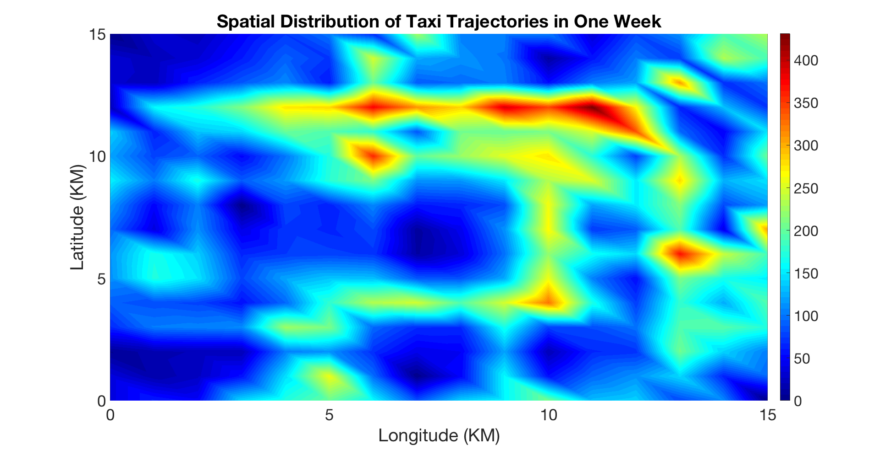
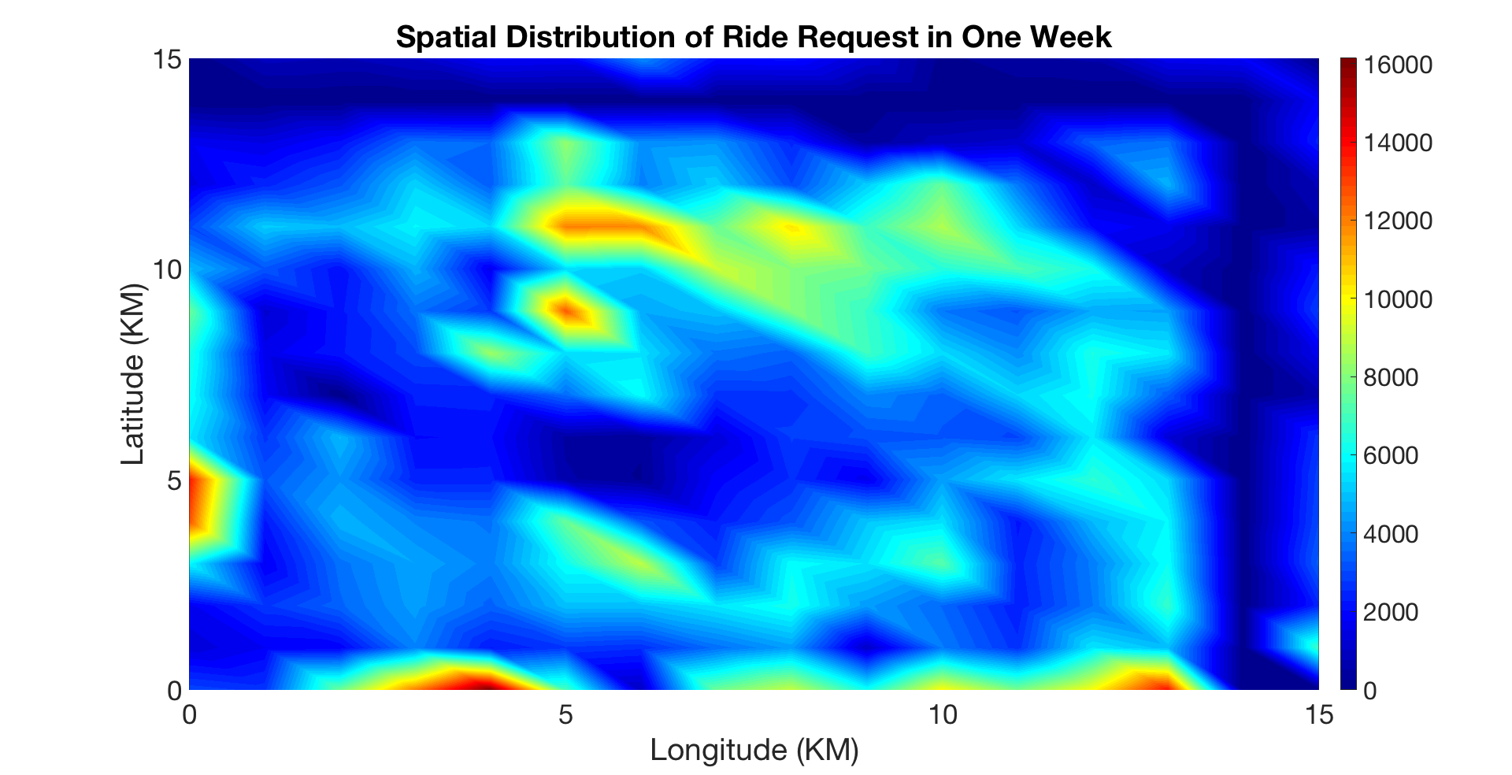
The Optimization Problem: Incentive Design
Taxis may over-estimate the ride request density in the crowded area, since all taxis are heading there (Bandwagon effects in crowd)
Taxi distribution
Ride request distribution
11
Notes:
Give name for each equations

Slide 19
The Optimization Problem: Incentive Design
Crowdsourcer:
Following the red route, you will get more passengers there. If not, I will pay you the remaining
Agent: Sure. It is a win-win game
8:10
11
Notes:
Give name for each equations

Slide 20
The Optimization Problem: Problem Formulation
dissimilarity
$P$: Collected data distribution
$O:$Target distribution
$B:$ Budget limit
Budget constraint
Ic
Whether to incentivize c
kc
Which trajectory to incentivize
Trajectory constraint
Dc
Vehicle trajectory
Trajectory constraint
High computational complexity!
12
Notes:
Give name for each equations

Slide 21
Solution Insight: Multiple-choice Knapsack
10
10
7
8
7
7
Budget
8
7
5
5
Classic knapsack problem
Multiple-choice knapsack problem
Our Multiple-choice knapsack problem
Heuristic algorithm based on steepest coordinate gradient descent and value approximation
13

Slide 22
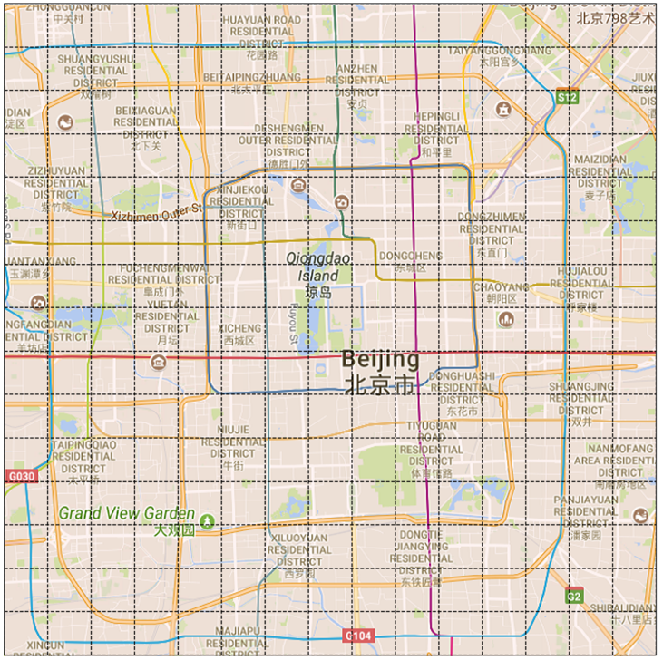
Experimental Setup
Location: Beijing City
(15km X 15km)
Time length: 5 days
Car Number: 20,067 taxis
Vehicle trajectory Occupancy status
Ride request data
14
Notes:
Experimental setup

Slide 23
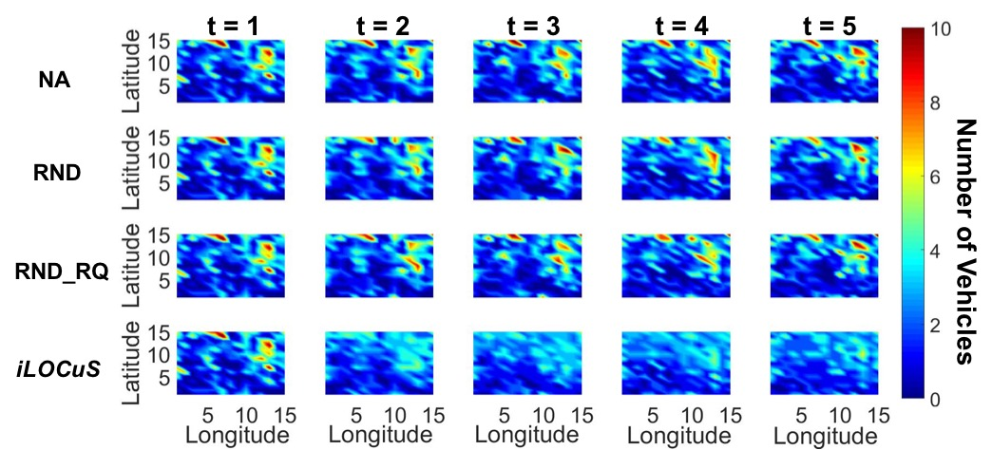
Results visualization (target distribution: Uniform)
15

Slide 24
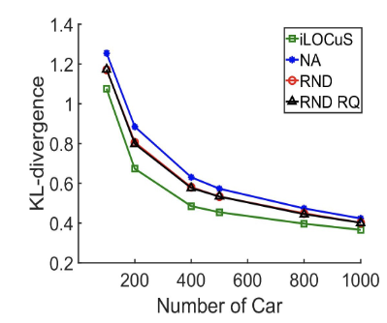
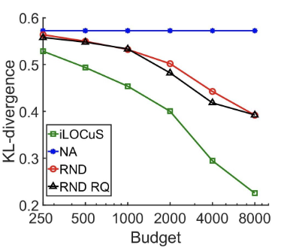
Results: Number of Vehicles and Budget
Dissimilarity is further decreased with more cars
Dissimilarity is further decreased with more budget
16
Notes:
figures

Slide 25
Conclusions
A novel formulation of the incentivizing problem: first proposed KL-divergence as objective function, formulated the problem as a non-linear multiple choice knapsack problem.
A novel incentive design to reduce the incentivizing cost: combined increasing of ride request as hidden incentive to reduce the cost of incentivizing each vehicle
Evaluation on real-world large-scale vehicle data: achieved upto 27% reduction in the dissimilarity between the collected sensing data distribution and target distribution.
17

Slide 26
THANKS! &QUESTIONS
Susu Xu (susux@andrew.cmu.edu)

