Slide 1
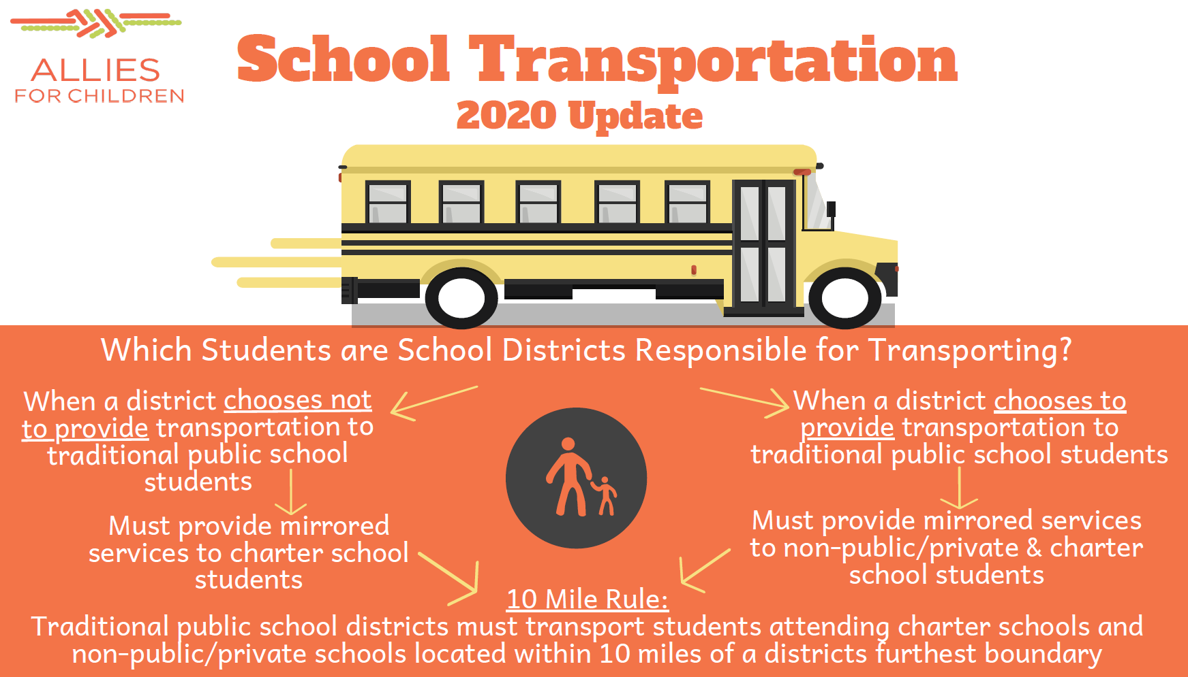
Joint Optimization of School Bus Routes and Last Mile Services
Lead Researcher: Peter Zhang
Project Team: Hai Wang (co-PI) and PhD researcher
Graphics Source: Allies for Children

Slide 2
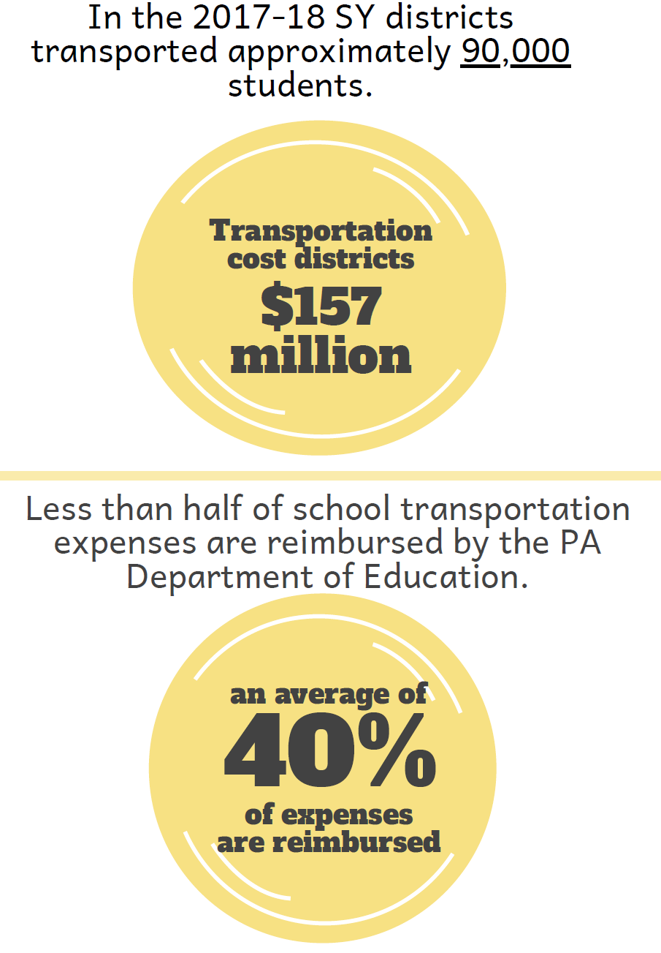
School Bus Last Mile – Brief Overview
Design efficient, safe, and implementable multi-modal transportation systems to help children move to and from schools in Allegheny County
Anticipated Outcomes
Data on school bus routes, class schedules, students
Analytical decision support framework for school bus route design considering last-mile segments
Partners
Allies for Children
Graphics Source: Allies for Children
Notes:
2

Slide 3
School Bus Last Mile – Expected Outcomes
1. Data collection for the various components required for the design of efficient and equitable multi-modal transportation systems for multiple districts (details of data can be found in the data management plan). Data management and storage in a safe and re-usable format.
2. Understanding of key technical, strategic, and political issues underlying the problem.
3. Identification of timely and useful technical and strategic angles to improve transportation service to students. For example, a communication protocol that could connect buses, ridesharing and last-mile service vehicles, school districts, and student families.
4. Understanding the feasibility to collaborate with Allegheny County Port Authority (e.g., with the utilization of Global Transit Feed Specifications (GTFS)).
5. Pilot to test the feasibility of multi-modal transportation for students: joint optimization of bus routes, stops, and last-mile services.
Notes:
3

