Slide 1
Automatic Detection and Understanding of Roadworks
Lead Researcher: Srinivasa Narasimhan
Project Team: Robert Tamburo, Dinesh Reddy, Kheim Vuong

Slide 2
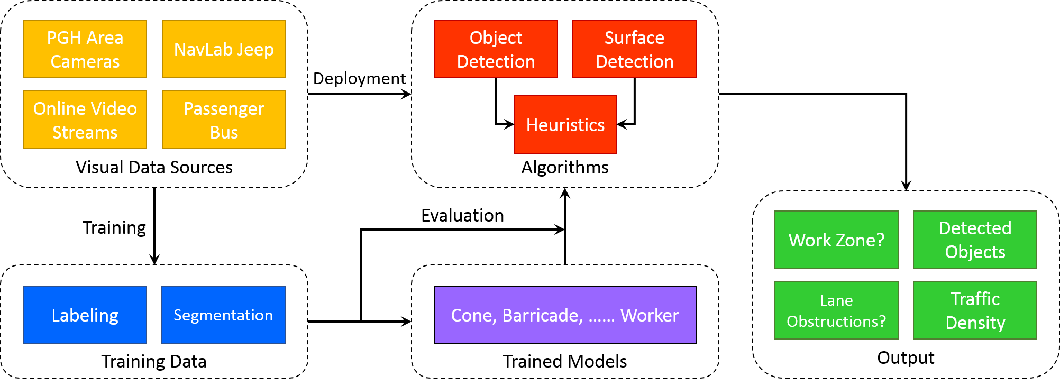
Automatic Detection and Understanding of Roadworks
Goals: Develop methods to detect roadwork zones
Anticipated Outcomes: Dataset collection and algorithm development
Partners: City of Pittsburgh (DOMI) and Shaler
Notes:
2

Slide 3
Automatic Detection and Understanding of Roadworks
Expected outcomes:
Labeled dataset, algorithms for detecting roadwork objects, test results, and report
How will the research improve the “subject” you are researching, how will it benefit the people using the service/product:
First known method to automatically identify road work zones.
Notes:
3

