Slide 1



Applications of Connected Vehicle Technologies to Improve Safety, Mobility, and Emissions
Scott Matthews
Civil and Environmental Engineering / Engineering and Public Policy
Carnegie Mellon University

Slide 2
The Three Parts That Define Me
Engineered
Systems
Economics &
Policy
Data-Driven
Decision Support
Notes:
here are a few slides on me. - its important to both convey my research but also understand why I approach problems the way I do.
CLICK
As undergraduate, I majored ECE / EPP. One of the capstone projects I did while there was the first study to consider the waste disposal implications of electronics. This was the first “e-waste” study, and estimated the then-cumulative, and projected, volumes of computers in landfills, in 1991. It was never published in a journal, and has been grey literature for 25 years. Last I checked, it had been cited 500 times.
CLICK
It gave me the inspiration to get a PhD, and I had taken many economics courses. I was drawn to study the effects of regulation, especially from an environmental perspective.
CLICK
I studied under my mentor, the late Lester Lave. Lester as a mentor taught me two critical things:
Work on problems that matter AND
Occasionally ask yourself how you want to be remembered. At that time, I would have been remembered for counting PCs in landfills. There had to be more.
I consider my main field to be industrial ecology, and my background of engineering and economics has been very useful in pursuing research in that area.
I’m mostly called “an LCA Person”. But I’ve been called worse.
I see myself more generally as someone who seeks data to build models to inform technology and policy decisions. LCA has been a great testbed.

Slide 3
Why Care About Transportation?
Has not historically been “high tech”
Notes:
Let’s start off with a bit of motivation.
Transportation, like construction and the other core engineered system technologies that are a focus of the AIS group.. Interacts with everything.
And by interacting with everything, it means it has wide-ranging impacts that we need to study and manage.
Lets look at some of them.

Slide 4
Historical Methods for Measuring How Much We Drive Cars
Technology
  Traffic sensors / counters
    Mostly useful for roadway use, but can be aggregated to totals
Surveys
  Door-to-door? Telephone calls?
  Check odometers frequently?
Diaries
  On paper or electronically, write down where you drive.
The “gold standard” in the US is the National Household Transportation Survey. Based on about 25k households
Notes:
Lets start by assuming its 2016 and we don’t have data for this, and brainstorm some ways in which you could do this.
Some high-tech things come to mind:
Class 1
We could install sensors on vehicles;
We could install sensors on roads;
Class 2
But what if we don’t want a sensor technology based solution. We could collect data by sending government employees (ok, contractors) door to door and ask people how much they drive their cars. Ask about a “travel day” and then scale up numbers on a yearly basis.
Class 3 – John Oliver moment warning…
If you dont care enough to do those things, and don’t really care about the real value, “you might as well just do something lame like just randomly call phone numbers and ask whoever answers how much they drive*”.
Oh wait – that’s literally what we do.

Slide 5
OK, But Why Study Transportation Now?
Transportation has not historically been “high tech”
  Unless you consider what we have done in the past as such
But on the cusp of dramatic ICT-driven changes
  Will have disruptive impacts on how we get around.
  Have the potential to improve efficiency, safety, and emissions
Notes:
This talk will talk about my continued interests in a few areas that I have cared about a lot for 20 years, specifically the intersection of technology and transportation with a focus on externalities like safety and environmental issues. And even though my own personal interests in energy and environmental issues aren’t as prominent as they used to be, I think there are still some interesting things to consider here.
Thanks to Costa who has been .

Slide 6
What are Connected Vehicles?
Not same as autonomous (although would be connected)
  They have technologies to drive themselves
Leverage internet and radio communications technologies to talk to each other, with infrastructure, cloud, etc.
  They would be connected to various other systems
  Can transmit your speed, location, route, etc. to others
Via these new connections, lots of new value-added services can be achieved
  Traffic management, route optimization, ..

Slide 7
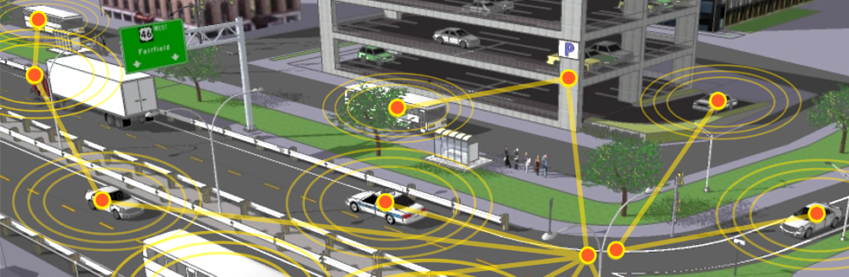
Internet of Things (IoT) / Connected Vehicles Era
Many of the suggested services are user-centric
  But many have very high capital costs to implement
Some have far more social benefits than others
  These are the ones I care about
Source: Volpe Research Center
Notes:
For vehicles, this means Internet-connected cars

Slide 8
Potential Real Time Applications
Long Term
Communication with other vehicles
Communication with traffic signals
Communication with parking lots
Communications with buildings
Short Term
Communication with manufacturers
Communication with service providers
Communication with agencies
High
Capital
$$$
Low
Capital
$

Slide 9
Interesting Short Term Projects
So there are lots of potential platforms to build, some will take lots of design and years of technology development
But are there any that we could do NOW?
I focus on a few emerging areas with very high social benefits that I have been following for 20 years

Slide 10
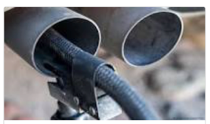
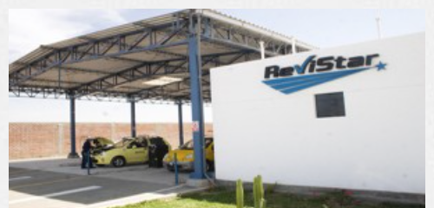
How Vehicle Emissions Are Tested
When I say ‘emissions test’ what comes to mind?
What is done in PA? Other states?
Top methods:
  Direct measurement at vehicle
  Indirect measurement at vehicle
  Remote sensing
Done by ‘jurisdictions’, ~annually
  Countries
  States (in US, not all states do them)
  Cities
Sources: NZTA, Opus

Slide 11



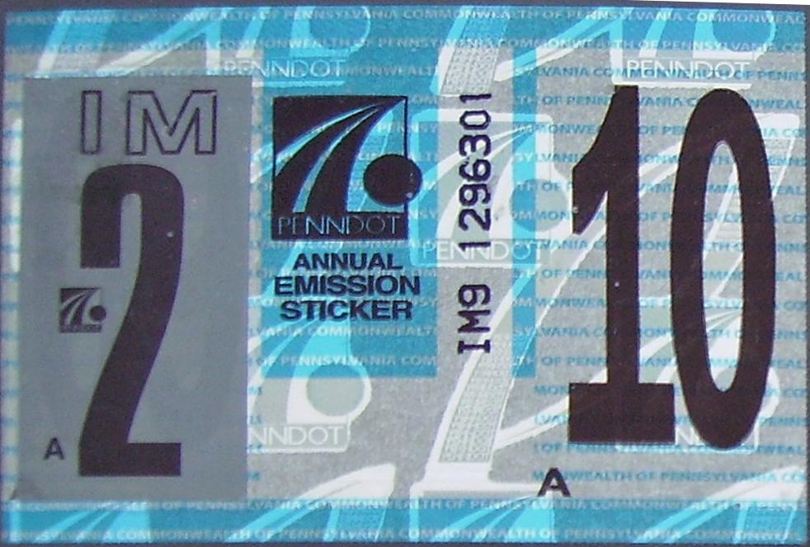
Emissions inspection & maintenance (I/M) programs are an enforcement mechanism for vehicle emissions standards
Jurisdictions can identify and remedy high-emitting vehicles through mandatory testing at regular intervals.
I/M program designs vary, but most follow the same general format.
Over-emitter – FAIL
Failure Rates: 5-10%¹
Within limits – PASS
Source: http://asashop-pa.org/pa-inspection-newsletter/
Source: Work by Prithvi Acharya
Source: http://www.plateshack.com/y2k/Pennsylvania4/pa4y2k.html
Notes:
* Enforce vehicle standards
* Vary between states, but same format
* Annual reports to EPA

Slide 12
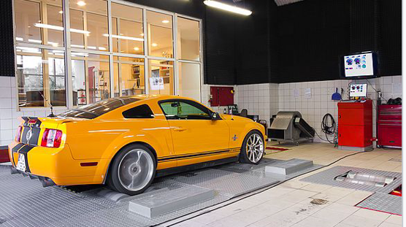
Direct measurement history
Historically, most tests direct tailpipe
measurements in vehicles, ex:
  while the car is running and/or in idle mode
  while simulating a driving cycle (on dynamometer)
The results of these tests are actual scientific values (e.g. grams CO/minute) that can be compared to a standard to assess whether the car “passes the test”
  But these tests are time consuming and costly (inc. equipment)
  Owners typically have to make an extra trip every year to do this
The test increasingly used to ensure compliance around the world may surprise you.

Slide 13
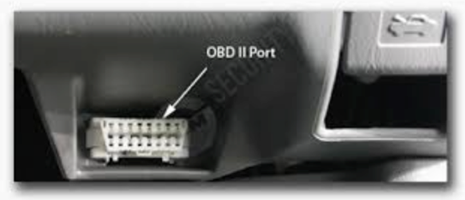

The Way The World is Moving to Test Emissions Is Modern But Problematic in Tracking Emissions
Many states, including ours, over the past 20 years have moved from tailpipe tests to ‘OBD scans’
Most 1996-newer vehicles use OBD-II computer: “is vehicle within spec?”
  If not, turn on the MIL
  OBD emissions test just checks this (fast!)
  But let’s talk about that just a bit more..
Notes:
Whats goind down is that little window of the fleet that needs to be tested.

Slide 14




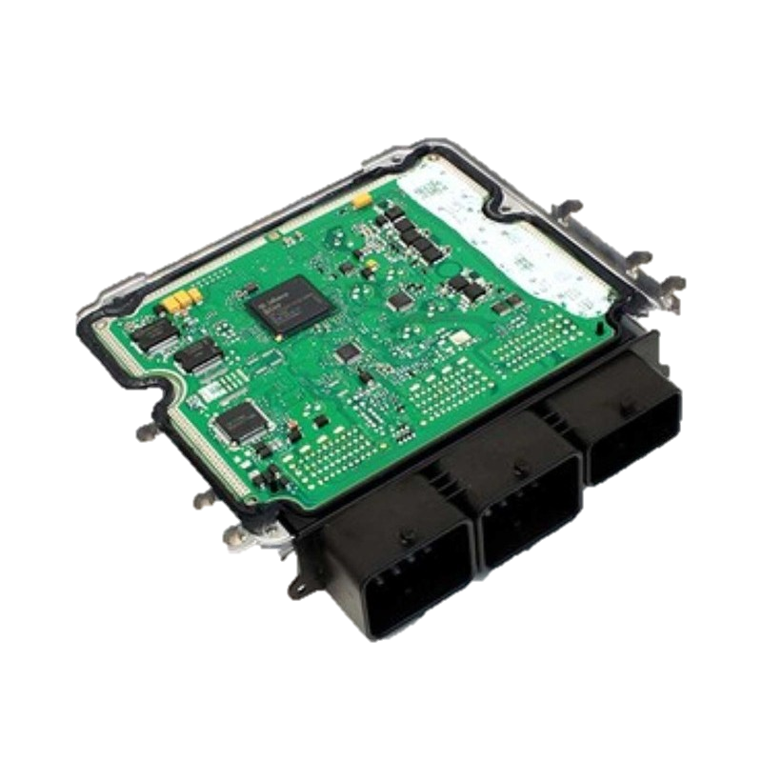



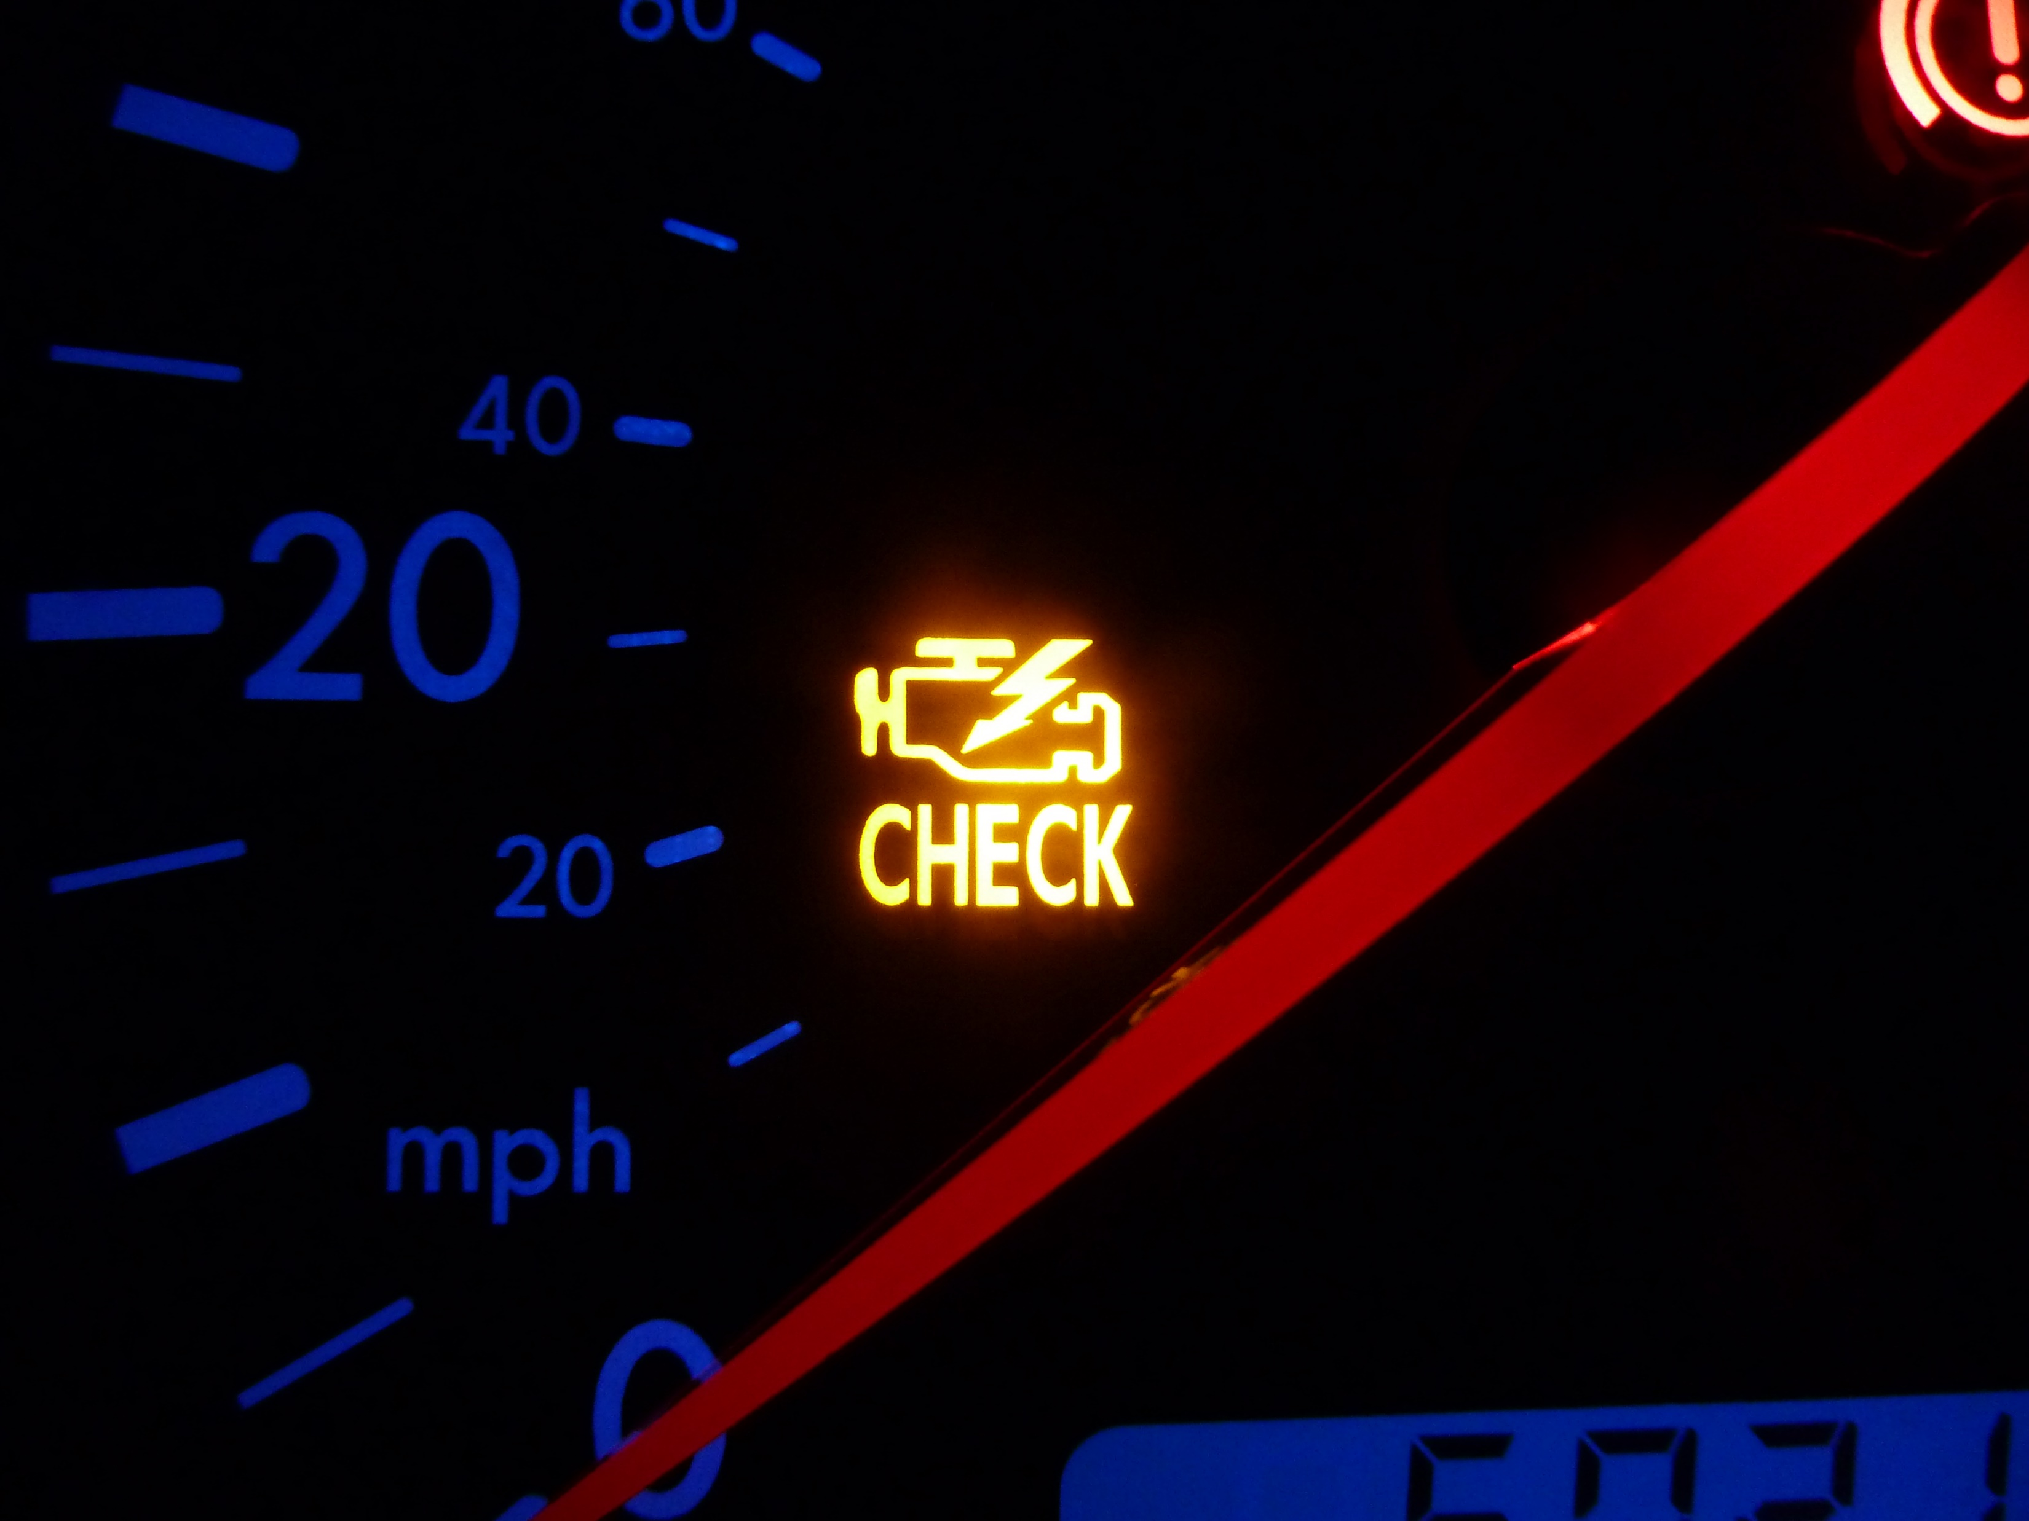
The OBD-II system (indirect measurement) is a proxy to direct measurement, but is not very transparent
Network of sensors, including:
Malfunction Indicator Lamp (MIL)
i.e. Check Engine Light
Oxygen/
Airflow Sensor
Fuel Flow Sensor
RPM, Tire Pressure, etc.
Stored as Diagnostic Trouble Codes (DTCs)
E.g. P0420 means “Catalytic Convertor System Efficiency Below Threshold”
Source: http://blog.lubetech.com/diesel-service-tips
ECU Image Source: https://new.minimania.com/part/G2NME4300-P/Mini-Cooper-S-Ecu-Upgrade-Nm-Engineering-Gen2-R55-r59
Notes:
All vehicles starting 1/1/1996
SAE maintains list of DTC’s – some are universal, some are manuf-specific
Current test – ONLY CHECKING IF THE MIL IS ON.

Slide 15
What Tests Were Done in PA (2016)
Less than 1% of vehicles ‘tested’ now have an emissions value in data (pre-OBD cars)
And we continue to get less actual data
Policy regime now relies on trusting firmware and manufacturers to report failures
Direct Measurements

Slide 16
Emissions Failure Rates by Age (PA, 2016)
Failure rates are not high (~ 5%)
But, we do not really know whether their emissions are “passing”
We are trusting manufacturers to know when to turn on the MIL light!
Not OBD
Generally OBD
Source: Prithvi Acharya, in progress.
Notes:
Nonetheless, some interesting emissions testing results
Cars less than about 5 years old have a failure rate of < 1%
It goes up to a max of about 5% for 20 year old cars
The overall failure rate for emissions is about 2%
This also varies by odometer, body type, etc, but not showing it here.
You might be saying “those failure rates aren’t so bad”. But remember, only 1% of these tests did an actual emissions test!!
The problem is, we are trusting the computers to be programmed to know when the engine performance is sufficiently poor to create an emissons problem!

Slide 17
So Why Is This Worth Studying?
Current emissions inspection system requires everyone to drive to an inspection and have a worker plug a wire into their car for 1 minute to see if MIL is on – cost is $35
We know 90+% of the vehicles are passing the current test
  But are still making them drive to the inspection
If only we had a technology to ‘see’ what was going on with the car in real time and save the trips..

Slide 18
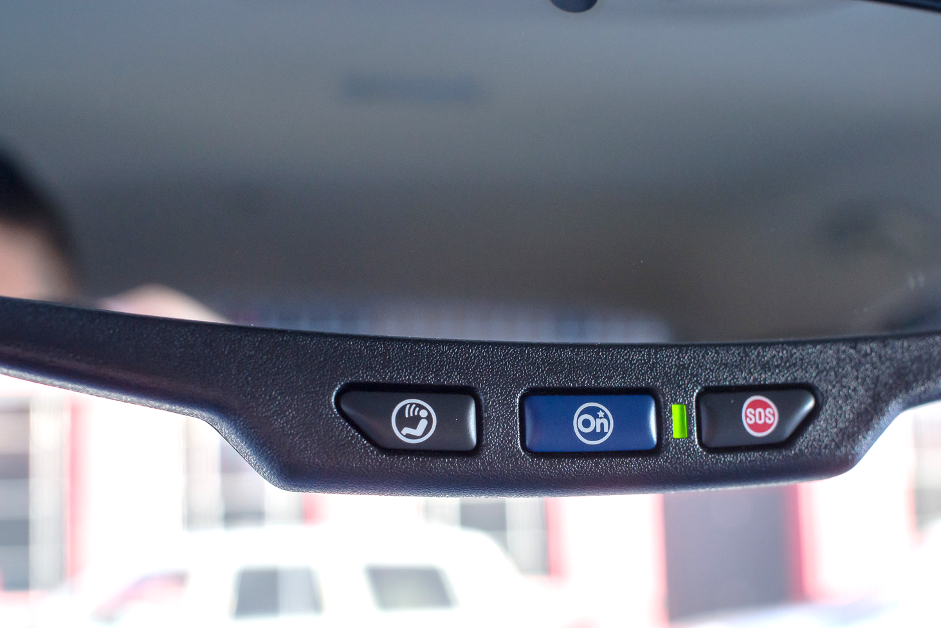
Given the transition to indirect-measurement, we envision remote, selective I/M programs that are cheaper, more convenient
OBD data can (and already is) be collected remotely through telematics systems – both in-built and third party.
We envision an I/M program in which jurisdictions use remotely collected data to identify probable over-emitters and only subject these vehicles to testing.
This vision would require a reliable means of remotely identifying high-emitting vehicles.
Source: https://www.androidcentral.com/using-onstar-car-lte-keep-your-devices-connected-go

Slide 19


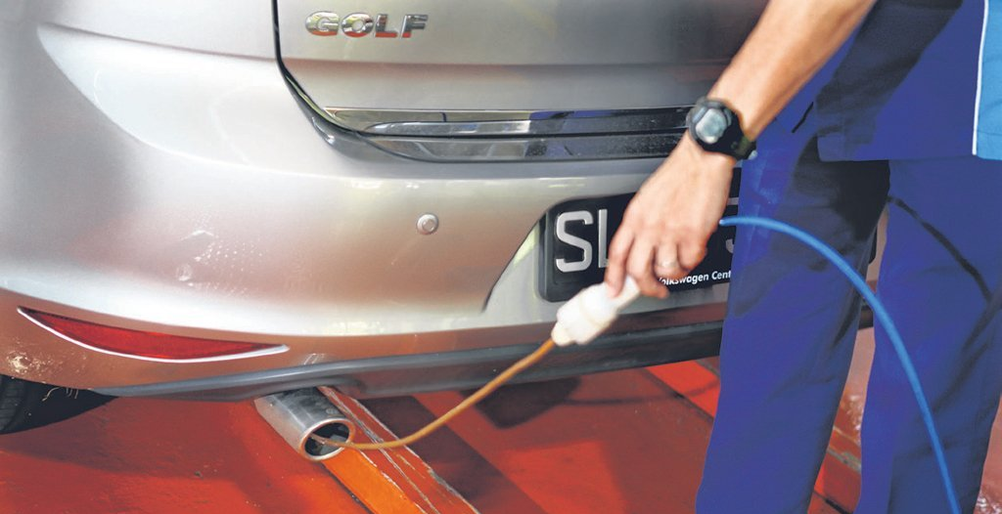
Our vision: selective, remote I/M
Most vehicles will be in this category.
Not likely an over-emitter
PASS
High Probability of Over-Emission –
FLAG
Within limits – PASS
Over-emitter – FAIL
Notes:
We are not trying to predict MIL – already know it
We are trying to identify ACTUAL high emitters

Slide 20
Data: Colorado conducted millions of concordant direct and indirect tests between 2010 and 2017
Colorado transitioned from IM240 to OBD-based testing on 1/1/15.
As part of the transition, many vehicles received simultaneous IM240 and OBD-based tests (though only one result was legally binding).
Over 5 million records – each with over 100 fields.
  IM240 results and measured emission values.
  Snapshot of OBD data – trouble codes, check engine light (MIL) status, etc.
  Vehicle ID Number (VIN), odometer reading.
Unique opportunity to assess the accuracy of the indirect-measurement test, and use test data to develop predictive models.

Slide 21
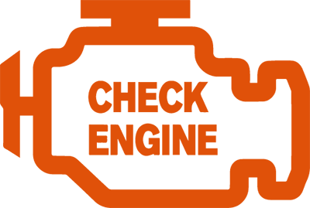

The OBD-MIL is an imperfect proxy for direct-measurement
We assume that the check engine light is a “prediction” and that the IM240 result is “ground truth”
From our dataset, we found the MIL:
  Was right 87% of the time, but,
  Falsely passed 50% of vehicles failing a direct test,
  Falsely failed 11% of all tested vehicles.
An underlying question here is, “how low can the top number go and still be recognized as a useful test”? In lots of schools, ~80% is a “C”.
 | IM240 Pass | IM240 Fail
OFF (Pass)
ON (Fail)
85%
2%
11%
2%
Notes:
The “false positive (i.e. fail) rate” appears really low because overall incidence is really low.

Slide 22
Our models were based on a 50:50 stratified data-set
Frequently used in statistical modeling where occurrence rates are low
  In this case – low overall IM240 failure rate.
Stratified data sub-set of 400,000 records.
~4.8m
records
 | IM240 Pass | IM240 Fail
OFF (Pass) | 45% | 27%
ON (Fail) | 6% | 22%
Random Sample
0.2m
0.2m
Random Sample
~0.25m
Notes:
This is common in statistical analyses for many fields.
ALL RESULTS AFTER THIS ARE BASED ON STRATIFIED DATA

Slide 23





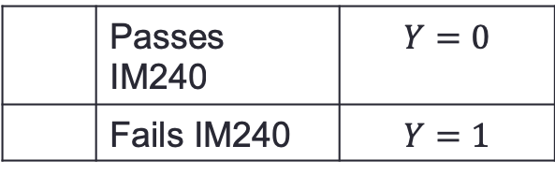
We built various statistical (“ML”) models to try to do better than a “C”
However, focused on predicting the IM240 emissions result, not OBD. OBD prediction is trivial (but inaccurate)
  Skipping lots of technical detail in the interest of time
 | Passes IM240 | $$Y=0$$
 | Fails IM240 | $$Y=1$$
$$Sensitivity= \frac{TP }{TP+FN}=TPR$$
$$Specificity = \frac{TN }{TN+FP}=1−FPR$$
True Pos (TP)
$$Accuracy= \frac{TP+TN }{TP+FN+FP+TN}$$
False Neg.
False Pos.
True Neg.
23

Slide 24
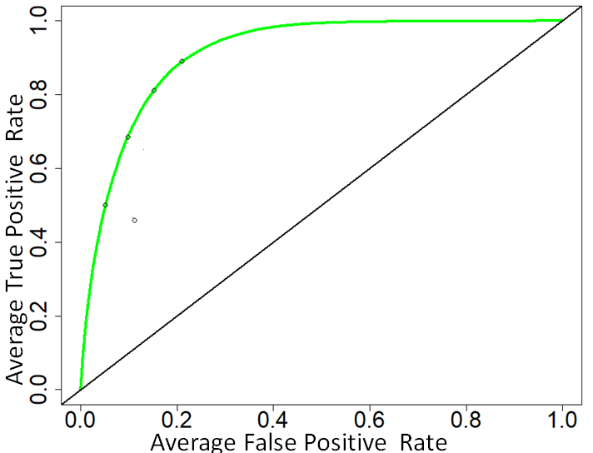
With classifier models, jurisdictions can “turn the dial”
Trade-off between sensitivity and specificity.
Jurisdictions can select a threshold based on program needs.
We tuned for highest accuracy (i.e. closest to the top-left corner of the ROC curve).
0.5
0.6
0.7
0.8
Notes:
Conditional probability.
Vary for rural/urban?
A receiver operating characteristic curve, i.e., ROC curve, is a graphical plot that illustrates the diagnostic ability of a binary classifier system as its discrimination threshold is varied.
The ROC curve is created by plotting the true positive rate (TPR) against the false positive rate (FPR) at various threshold settings.

Slide 25
A two-step model could target specific pollutants
CO | OBD-MIL | GBM
Accuracy | 0.67 | 0.72
Sensitivity | 0.44 | 0.78
Specificity | 0.80 | 0.71
IM240 | OBD-MIL | GBM
Accuracy | 0.68 | 0.82
Sensitivity | 0.46 | 0.91
Specificity | 0.89 | 0.73
HCx | OBD-MIL | GBM
Accuracy | 0.67 | 0.68
Sensitivity | 0.44 | 0.68
Specificity | 0.80 | 0.68
NOx | OBD-MIL | GBM
Accuracy | 0.67 | 0.80
Sensitivity | 0.44 | 0.82
Specificity | 0.80 | 0.79

Slide 26
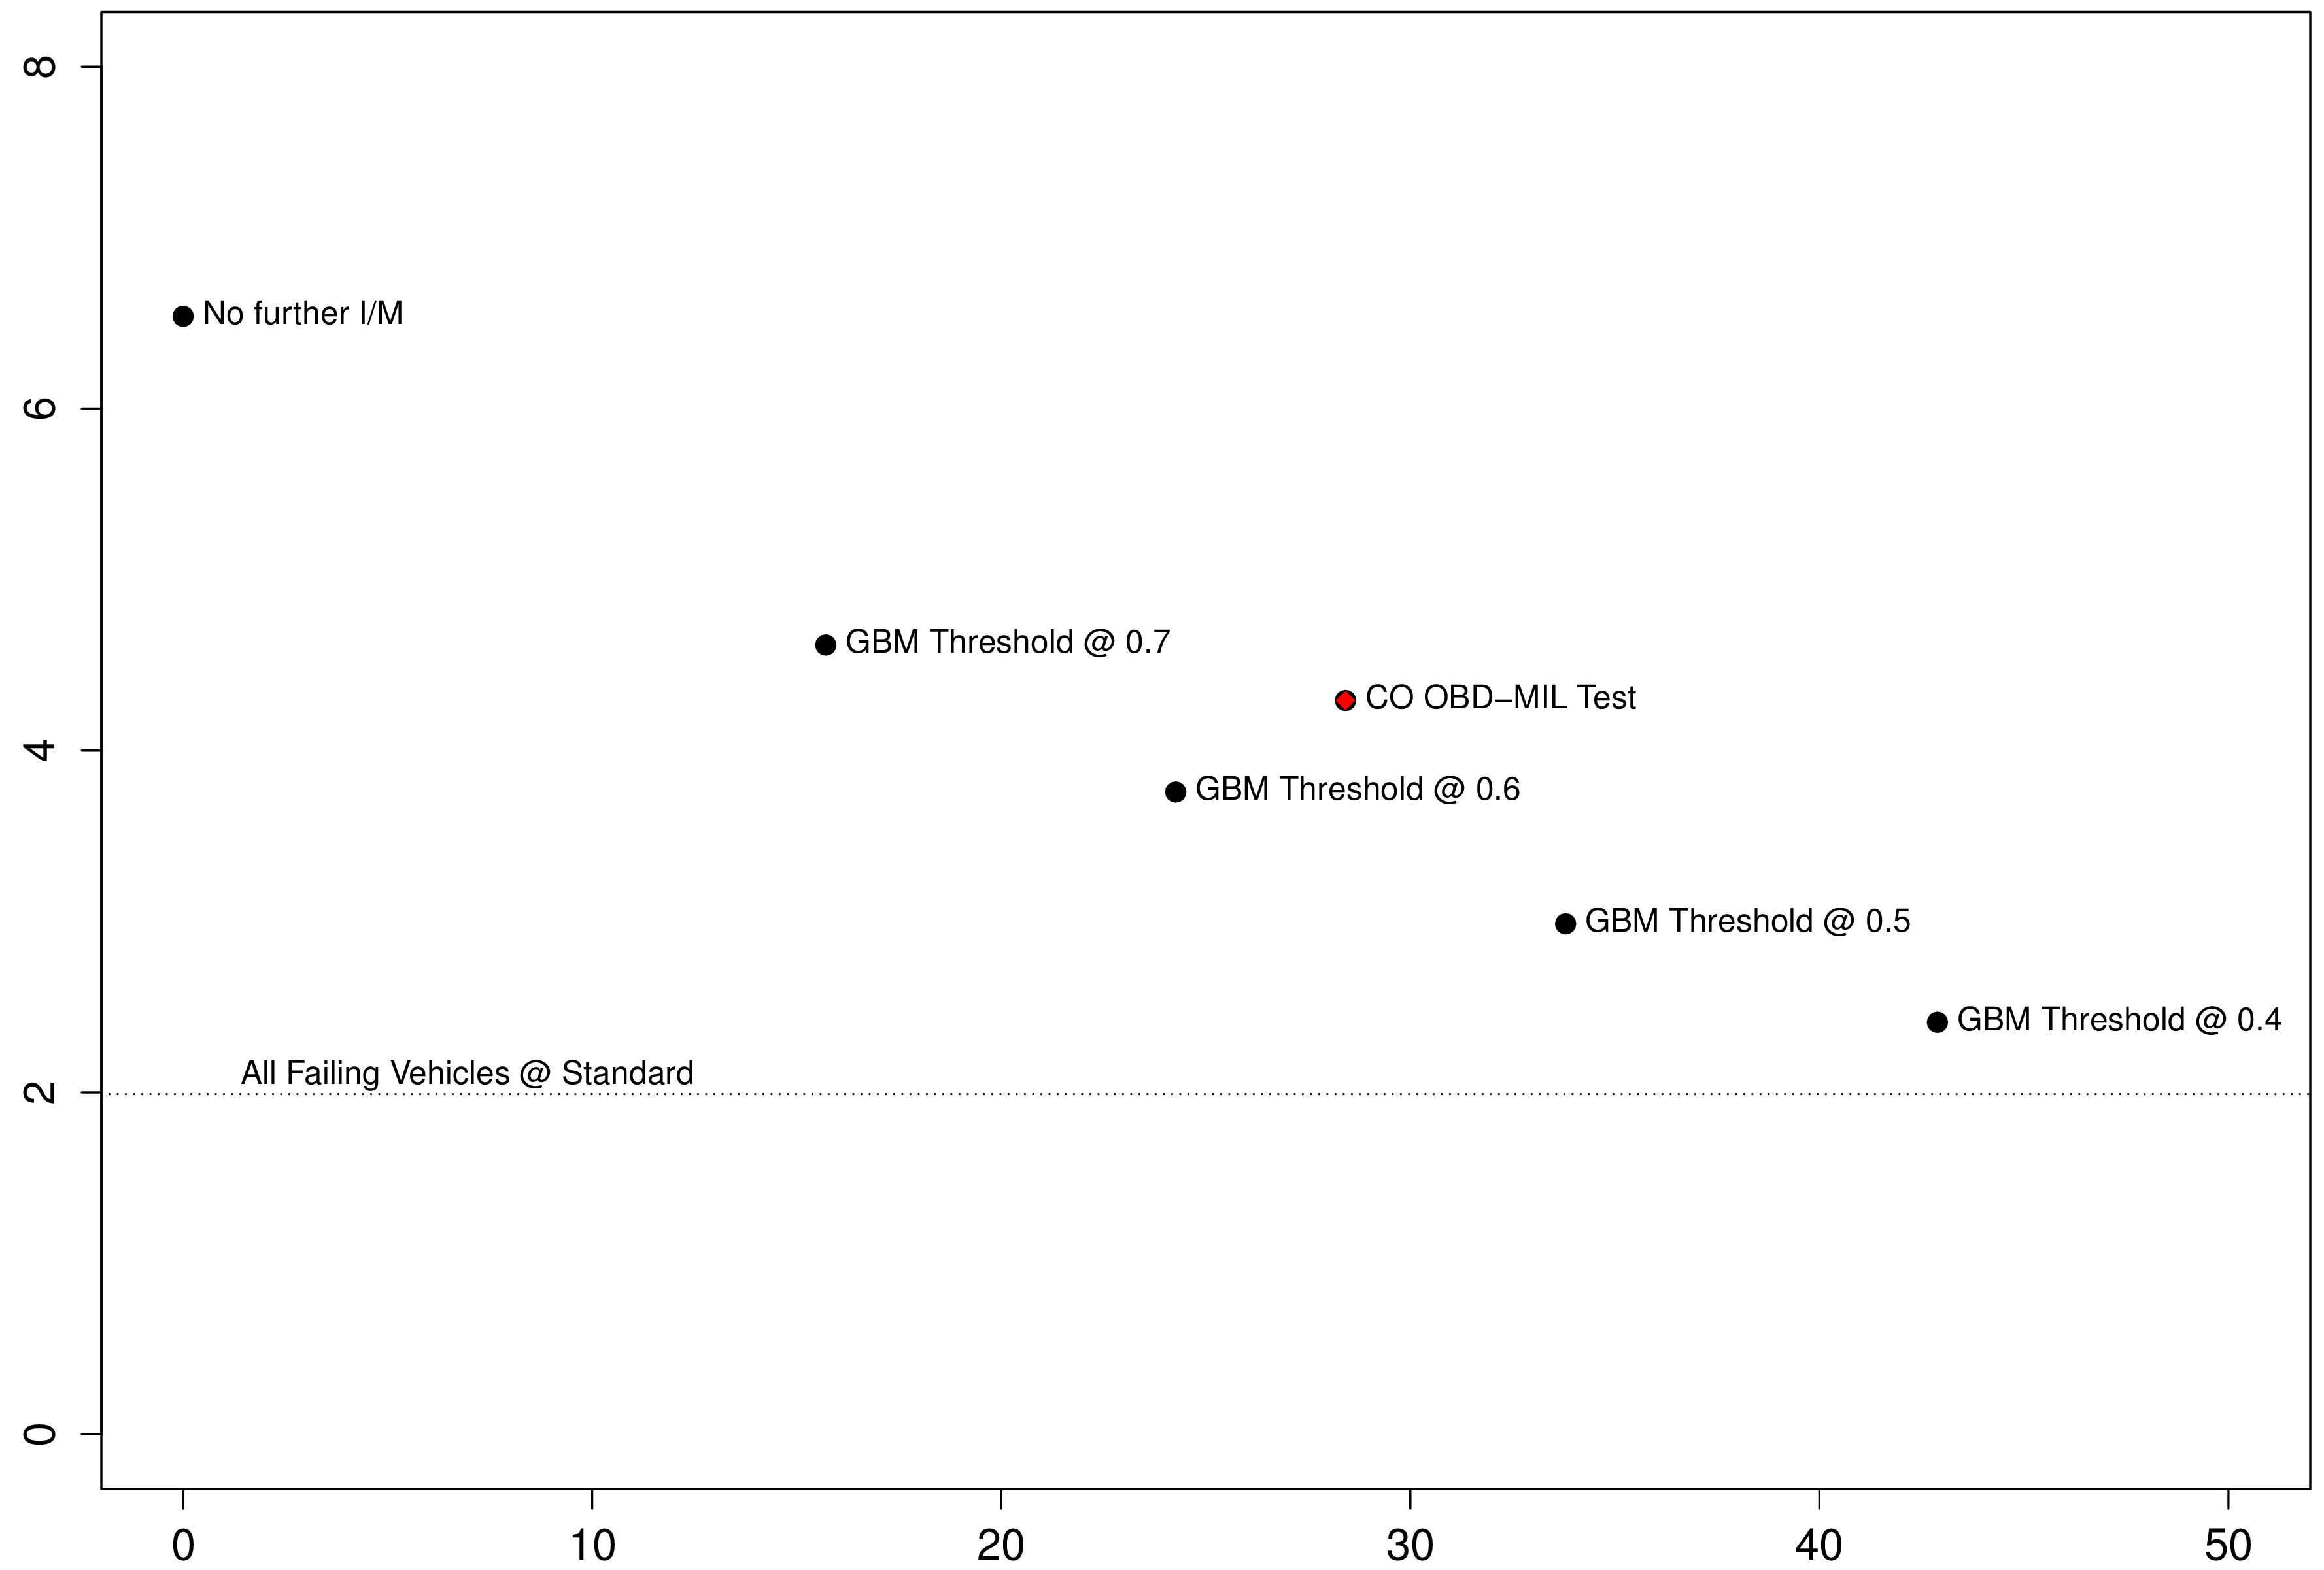
Models can be tuned by jurisdictions based on requirements
No further testing
MIL Only
Flag 27% of Vehicles, Reduce Emissions by 35%
Mean NOx Emissions (g/veh-mi)
0.6
Threshold | Fleet flagged | NOx reduction
0.4 | 43% | 63%
0.5 | 34% | 54%
0.6 | 24% | 43%
0.7 | 15% | 30%
0.5
Threshold can be selected to trade-off between false positives and false negatives
% of vehicles “flagged”
Notes:
ENVISION A SCENARIO
Based on last model,50-50 dataset
Current: 100% flagged?

Slide 27
These models to identify high-emitters support the idea of remote, selective I/M
Statistical models identified high-emitting vehicles more reliably than the OBD-MIL alone.
However, by varying the model threshold, we show that jurisdictions could turn the dial, and either:
  Annoy the same amount of drivers but reduce more emissions
  Reduce the same quantity of emissions and annoy less drivers
  Adjacent states (or counties!) could be tuned differently
There are interesting considerations related to frequency of CV-based ‘testing’, and how to formalize pass/fail
  Once a month instead of once a year?
  Should be able to eliminate many of the existing inspection visits
Notes:
STRATIFIED SAMPLE

Slide 28
How might this work? which companies could be involved?
GM OnStar (started 1996, when OBD was introduced!)
Ford Sync
BMW ConnectedDrive
And many others – almost all volume manufacturers have CV subsidiaries
But…

Slide 29

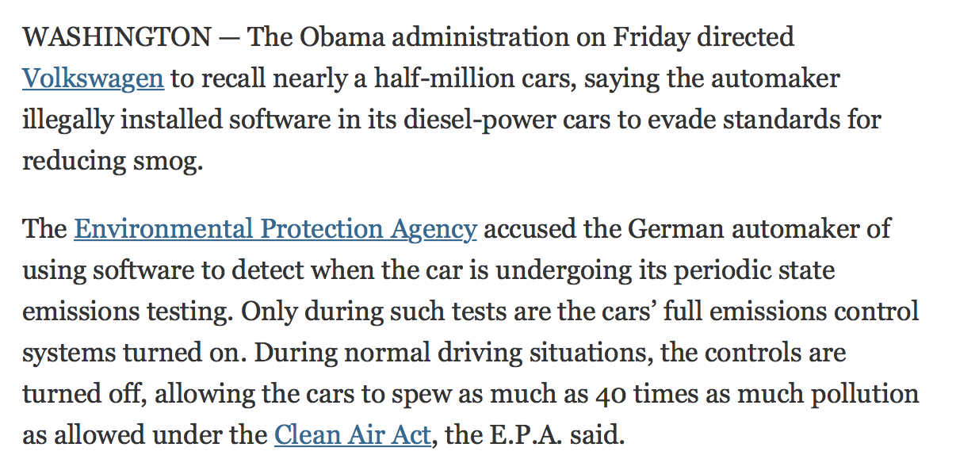
But.. Can We Merely Trust Manufacturers?
Source: NYTimes, 9/18/15
Notes:
In this domain especially (environmental), I don’t think jurisdictions would be willing to trust the manufacturers.

Slide 30
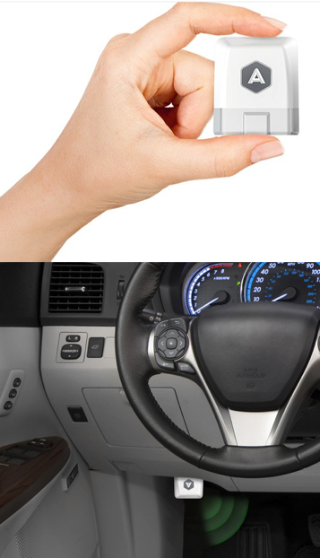
We Don’t Need to Rely on Manufacturers
Also interested in leveraging data from on-board OBD dongles (e.g., Automatic).
  Smartphone or 3G connected
  Used for mileage tracking, insurance, ..
Use their existing data streams to track OBD status (and other information like trouble codes)
In short, envision ‘third party’ CV data platforms
Notes:
NHTS has been done for XX years and is still the “gold standard” for deriving VMT and other metrics for vehicles. DOT has XX data points for Pennsylvania, which means they make funding and other decisions based on these estimates on VMT from this limited sample.

Slide 31
A More Likely Framework
Stakeholders
Manufacturers
Sellers
Drivers
Government
Agencies
Other Companies
Third party data collector and/or intermediary
Ironically, you can envision various stakeholders who would be interested in (paying for) the data, including owners being interested in paying to know more about their own driving!
There is also a value in “vetting and validating” input data

Slide 32
What other Applications Would Exist Beyond Emissions?
Various states also have vehicle safety inspections. There are elements of safety inspections that could be monitored better via CV data infrastructure
  Also, would expect more interest in safety inspections as we enter the autonomous vehicle era
Trip-level information (origin, destination, distance, time, fuel economy, ..)
  Better data for traffic and transportation flow modeling of types of vehicles and trips

Slide 33
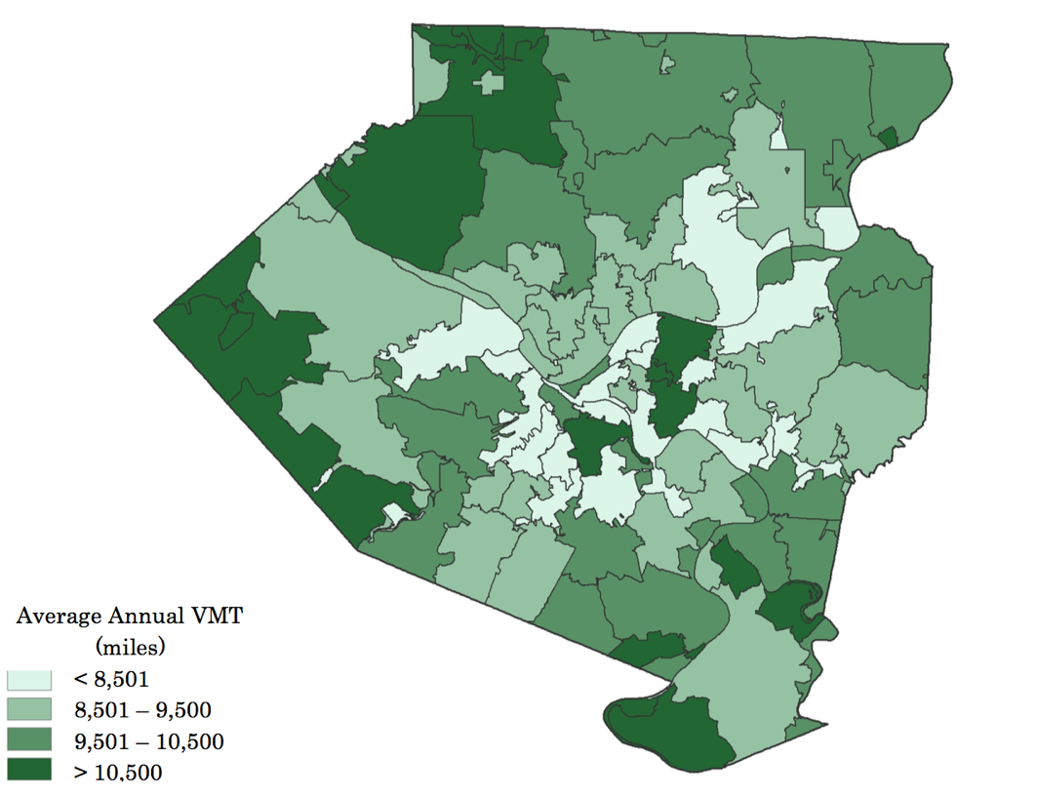
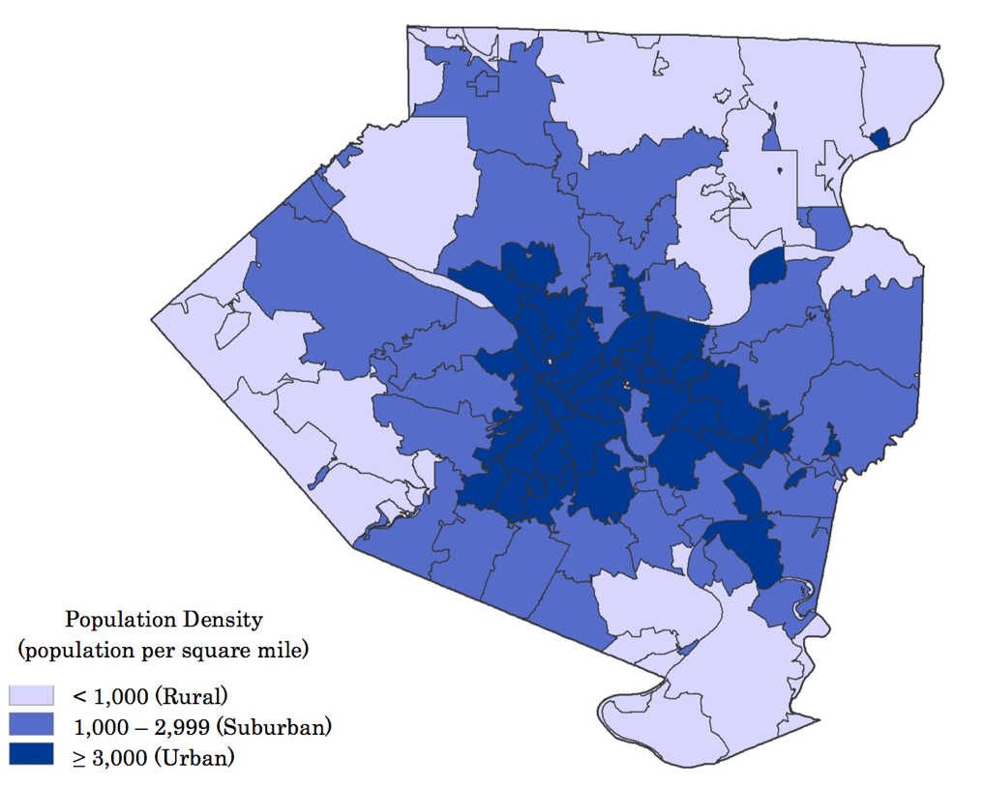
Allegheny County Has Wide Variation in How Much People Drive Their Cars
Average Vehicle Miles
State: 9,800
County : 9,600
Squirrel Hill : 7,500
Source: Dana Peck’s PhD Thesis

Slide 34
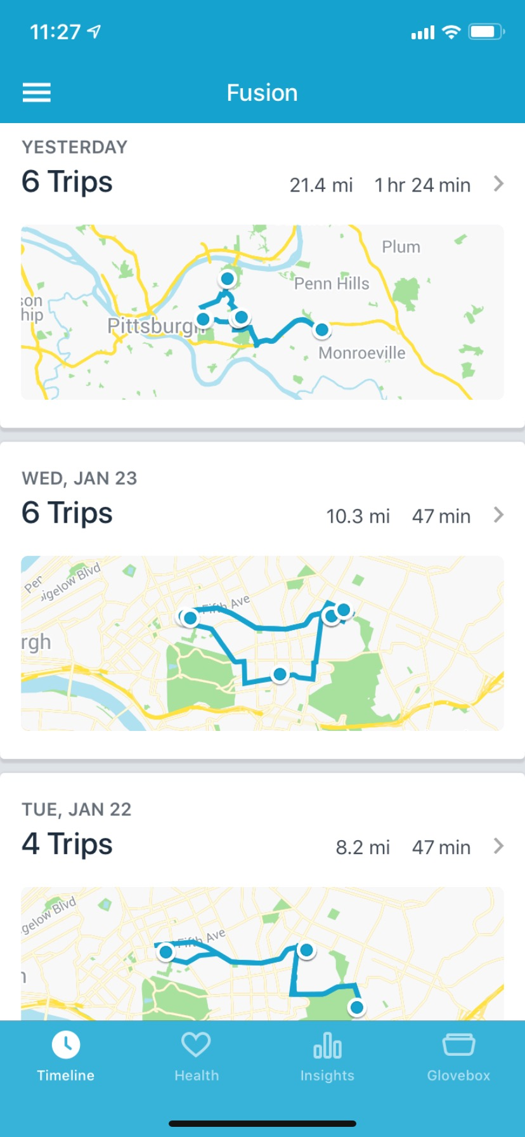
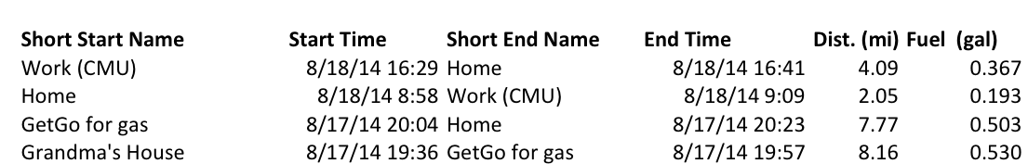
Sample of Data for My Car

Slide 35
Connected Vehicle Trip Data Could Help Us End our Dependence on Fuel Taxes
Challenges are many, including the fact that highly fuel efficient (or electric) vehicles pay little to highway funds
  Let alone that we haven’t raised the federal tax (18c) since 1995
If we have trip level data available, we can easily achieve “Mileage Based User Fees” (MBUFs)
There have been technology pilots for this but even now some continue to try to use dedicated hardware, not CV data and/or smartphones

Slide 36
The Big Business of Transportation Funding
Federal fuel taxes/fees collected: $41 Billion / year
State fuel taxes/vehicle fees: $80 Billion / year
That’s $120 billion being generally collected a gallon at a time.
Imagine a financial intermediary position in this “market”
  Credit card fees ~1%. What’s 1% of $120 billion
Who wants to build a billion dollar company?

Slide 37
Connected Vehicle Data for MBUFs
I believe there is a keen market niche for a ‘connected vehicle data company’ that is able to collect and process CV data streams
And sell it to various parties at significant profits.
And provide great socially beneficial services which justify the CV technology investments

Slide 38
High Level Thoughts on Yearly Revenue
Stakeholders
Manufacturers: ?
Sellers: Cents/transaction
Drivers: ?
Agencies - $1 billion MBUF
$300 million OBD
Other Companies
Third party data collector and/or intermediary

Slide 39
Summary
Transportation is not boring!
An engineering and technology-driven revolution is around the corner
  And so is lots of data
And, coincidentally, there is a ton of money and impact to be made
Now is the time to start working on connected vehicles projects that have benefits to everyone

Slide 41
Safety and Congestion Are Big Challenges
In 2011, 5 million car crashes, 2 million injuries (including 100,000+ pedestrians and cyclists) and 32,000 fatalities (including 4,400 pedestrians)
Congestion costs the U.S. $120 billion annually
  Might increase congestion if we end up driving more
  Might decrease congestion with fewer crashes and greater throughput
Source: DOT and Mashayekh, Michalek, Hendrickson, Samaras, Under Review

Slide 42
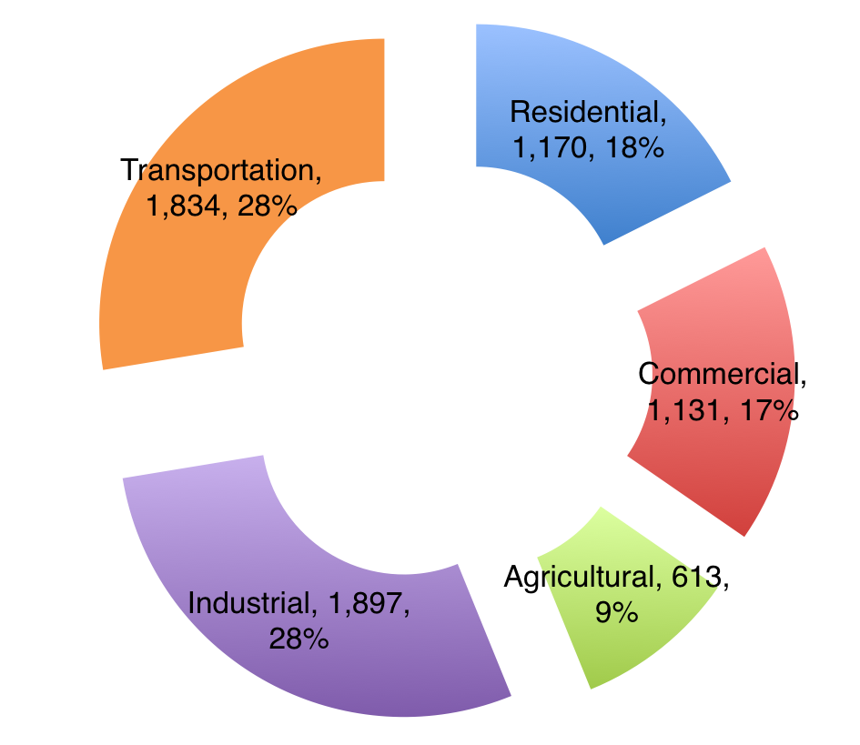
Transportation Emissions are 28% of U.S. GHGs
Note: Million Metric Tons Shown, 2011.
Source: Davis, S.C., Diegel, S.W., Boundy, R.G. Transportation Energy Data Book: Edition 32. Oak Ridge National Laboratory.
Notes:
Of course, GHG emissions are almost entirely a 1:1 correspondence of fossil fuel combustion. So to the extent that we do things that reduce energy use or increase efficiency (or de-carbonize transportation), we reduce GHGs in a straightforward manner.
If we think of the entire transportation sector “baseline” of about 30% of the total GHG emissions and compare that 30% baseline to the other air pollutants, its not so simple..

Slide 43
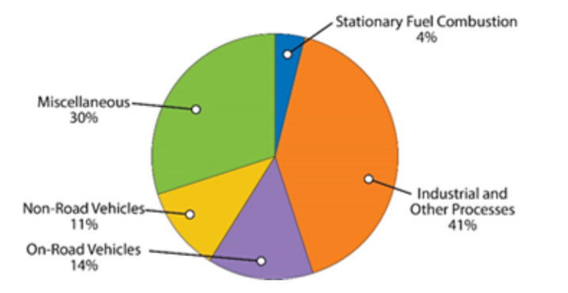
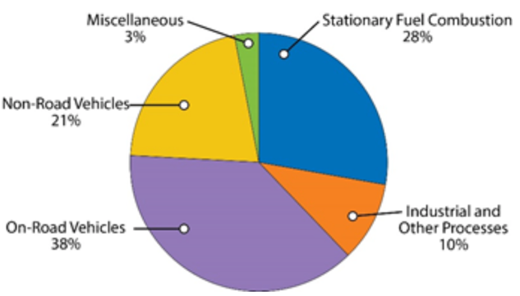
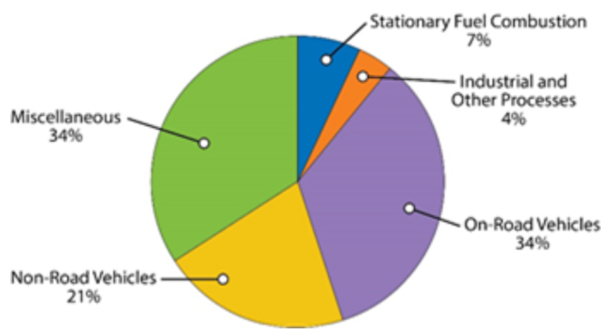
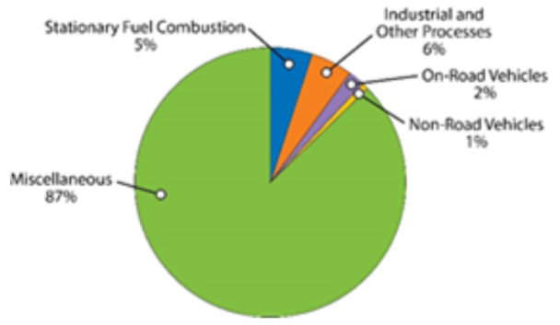
Non-GHG Emissions Matter Too
VOCs
NOx
CO
PM₁₀
Notes:
As you can see on this slide, the share of emissions from transportation (not just passenger vehicles) ranges from 3% for PM to 60% for NOx. So, the relative share of benefits we get just from merely increasing fuel economy (and reducing energy use) isn’t as direct in the total picture here.
And of course, NOx and VOC are pre-cursors to ozone..
Not shown is SO2, where the transportation share is also only about 2%, like PM
If you add up these and other externalities associated with burning fuels for transportation, the costs are large…

Slide 44
Adding Up External Costs of Using Gasoline
One estimate of the external costs per gallon of gasoline:
$3.40/gallon
If we can address these issues, we can save society hundreds of billions of dollars per year!
Oil Security (21 ¢ )
Air Pollution (49 ¢ )
Climate Change (59 ¢ )
Congestion ($1.46)
Accidents (63 ¢ )
Noise (3 ¢)
Note: Illustrative only. Uses NHTSA 2017-2025 Estimates, updated SCC Costs, GREET WTW emissions, assumes 25 mpg, $2013
Thanks to Costa Samaras for internal CMU use of this slide.
Notes:
And gasoline is one of the two primary energy sources in our transportation sector.
I am interested in a few research areas connected to elements of this bar graph. Namely, air pollution, congestion, and accidents. They happen to be pretty big parts of the total. I’m interested in all vehicles but the most obvious application areas are for passenger vehicles (I will mention some commercial vehicles too later)

Slide 45
An Important Thing to Understand is “How is a Fail Classified”?
What Happens within the Inspection Black Box…?
Leave with a ‘pass’ or ‘fail’
INSPECTION
?
Notes:
Before I talk about the data.. Its primarily important to follow whats going on here.
A typical inspection: a vehicle comes in, inspected, leaves with pass or fail, but Important to identify what occurs within the inspection itself
Work performed= may leave with a pass, but in essence, the vehicle “would have failed” if there were no safety program, and work would not have been performed
Really we Need to focus on how cars are entering inspection to get idea of effectiveness of current program

Slide 46
Inspection Process
These vehicles pass with or without the current safety inspection program in place
These vehicles would have failed without the current safety inspection program in place
These vehicles fail with the current safety inspection program in place
Notes:
We look at “pass given maintenance” vehicles because without the current program, these vehicles would not have been repaired. This represents the vehicles that would be unsafe if the inspection program did not exist.

Slide 47


Safety Inspection & Registration Data
From voluntarily reported state data, and private company
Approximately 10 million inspections over 6 years
Records contain:
  VIN
  Odometer
  Date
  Inspection Component Details
  Inspection Result
For subset of PA’s 10M passenger vehicles

Slide 48
Safety Failures Increase as Vehicles Get Older
AGE AVERAGE
OVERALL STATE AVERAGE
  D. Peck, H. S. Matthews, P. Fischbeck, And C. T. Hendrickson, “Failure rates and data driven policies for
  vehicle safety inspections in Pennsylvania,” Trans. Research Part A, Vol. 78, No. C, Pp. 252–265, Aug. 2015.
Notes:
First fail rate distribution I examined was failure by age:
Explain axes, bars, error bars, line
Average failed vehicles over 6 years of data – ranges represent min/max within those 6 years.
Much higher than the 2-3% fail rates published by legislators
Point out that age 0 and 1 not zero, newer cars ARE failing, and also…back to legislator recommendation to exempt up to 2 year old vehicles

Slide 49
.. And As Have Been Driven More
Overall, nearly 2 million vehicles in Pennsylvania “would not have been safe to drive” without inspection program
Notes:
Explain axes, bars, error bars, line
note similar trend as age distr. yet smaller range bars → better predictor of failure rates rather than age of vehicles
Focuses more on – wear and tear on car etc

Slide 50
PA Estimated Failed Vehicles, 2012
Range between state and private datasets
Decreasing number of failed vehicles after age 12 due to fewer in fleet, even though the failure rate is consistently high for the older vehicles
In one year, 1-2 million vehicles would have failed (10% of 10 million)
Notes:
This distribution represents the vehicles that would have failed, without the current inspection implementation scheme
Ranges represent the range of vehicles between the two datasets
Again, age 0,1 vehicle failures are not at zero…thousands → back to legislator suggested amendment, not necessarily ideal
1-2M vehicles are failing annually. (~10.4 million vehicle fleet according to registration count)
What components are most commonly causing these vehicles to fail?... Tires, brakes, lights (lots of deep analysis not shown here)
So, to quickly recap…

Slide 51
But, Its Hard to Convincingly Show that Vehicles “Are Getting Safer”

Slide 52
Why the Disconnect?
Problem is perception of “safer”
  Air bags, ABS, lane following, blind spot monitoring, etc.
Those are safety systems, not vehicle components
  Designed to last for life of vehicle
  And, they aren’t inspected!
Inspected components are generally consumables
  Need to be maintained by driver to continue working (e.g., brakes, tires, lights)
  Drivers who do not do this ’fail’ safety inspections!
Thus, maintenance still a critical factor in the safety chain

Slide 53
Make AV points here instead?
Irony: With Avs, there will likely be renewed push for inspecting components, with states restarting programs!

Slide 54
Light Duty Transportation Has Not Historically Been a “Data Rich” Field
Loop detectors under pavement for presence/count of vehicles
Intersections studied, traffic light timings set, left forever
Surveys of vehicle use, including diaries
What else to put here?
Notes:
This is repetitive to a slide near the end – should it stay up front or back there?
We’ve had data – meaning you get the data on vehicle counts/etc, but it wasn’t an internet connected system where we had real time counts. Real-time data flows were restricted to urban areas with big traffic problems who made big investments in IT-based systems

Slide 55
But there are a few places where I think data and ICT will ’disrupt’ transportation
Vehicle Performance (Inspections)
Vehicle Operation and Use
And these are the areas I will focus on in my talk today.
Throughout, we’ll keep an eye on the emerging era of connected and autonomous vehicles (CAVs)
What are they, what do they mean?

Slide 56
Part One: Vehicle Performance
Safety
Environmental

Slide 57
A Major Policy Instrument in Reducing Emissions, Fatalities are Inspections
Purpose: identifying performance non-compliance
Safety – not federally required. States opt-in
Emissions – motivated by CAA non-attainment
  For both, inspections done by driving to a test facility
  Frequency, rigor of programs vary
Show of hands: how many of you are from a place where cars have to be inspected – Safety? Emissions?
Notes:
Safety - History –used to be almost everybody, now just a few
There are resulting paid and unpaid costs (e.g., time)

Slide 58
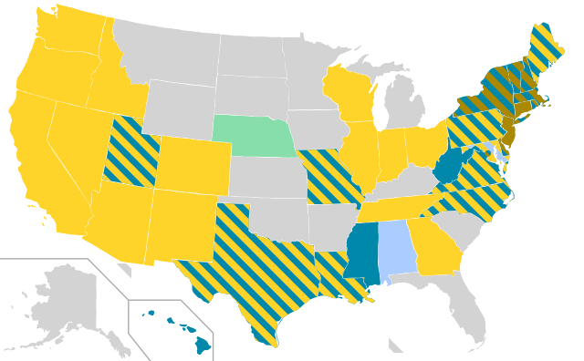
Light-Duty Vehicle Inspections (US)
Today:
Federally-mandated emissions program at the county level
State-regulated safety program
By Szyslak (Own work) [CC BY-SA 3.0 (http://creativecommons.org/licenses/by-sa/3.0)], via Wikimedia Commons
Notes:
First, in all of this work, we focus on light duty vehicles, or vehicles less than 10k lbs., these are also considered passenger vehicles.
Federally mandated emissions
State-regulated safety → focus of the first half of this presentation and shown in blue
A safety inspection typically checks vehicle components, such as brakes, tires, & lights, against an allowable threshold defined by that state where it is implemented
Key takeaway here is that relatively few states currently have safety inspection programs
PA is one of the few that requires annual inspections
As we will see in the next few chapters of my work, VMT will play a large role in both measuring vehicle safety. In addition to this, VMT creates a platform for policy-makers to allocate transportation funds as well as making other policy decisions for states.
As a result, part of this presentation more thoroughly Investigates the uncertainty around VMT estimates that are used
Which brings me to the research goals and outline of this dissertation:

Slide 59
What Safety Components Are Checked?
Tires (tread)
Brakes
Lights
Wheels
Suspension
Steering
Battery
Glazing
Mirrors
…
Source: autotraining.edu

Slide 60
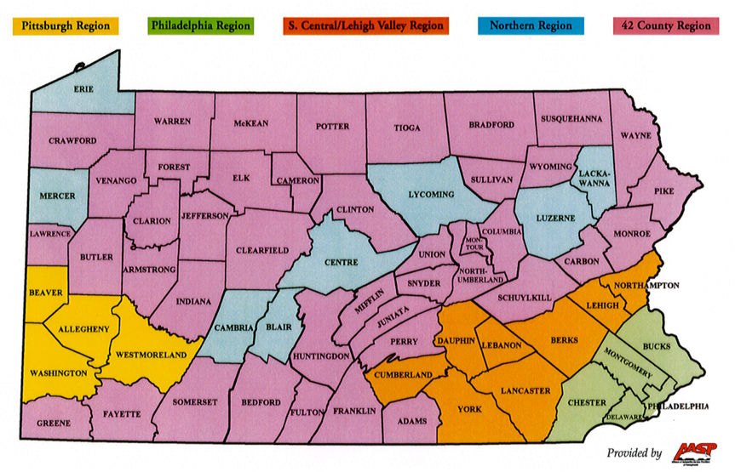
PA Has a Complex Emissions Program
  Urban-ish counties required to have a test program (CAA)
  Some exemptions:
    < 5,000 VMT
    Diesel
    Antique
  Non-test counties still have ‘anti tamper’ part of safety test!
We have 15 years of data, for all vehicles tested in PA
  PA has electronic records, unlike safety
Notes:
Anti-tamper for example makes sure you didn’t take out the catalytic converter!
Our skim of the safety inspection database didn’t find many instances of failed anti-tamper tests..

Slide 61
PA Data Might Not Be Telling Whole Story
Model Year | Colorado Number of Vehicles (717,659) | Colorado Failure Rate | Allegheny Number of Vehicles (552,407) | Allegheny County Failure Rate
1996 | 23,925 | 24% | 2,994 | 6%
1997 | 28,437 | 26% | 4,827 | 6%
1998 | 39,733 | 20% | 19,963 | 6%
2001 | 46,102 | 21% | 13,898 | 7%
2002 | 61,674 | 16% | 19,963 | 6%
2003 | 45,470 | 15% | 25,119 | 4%
2004 | 61,720 | 9% | 29,758 | 4%
2005 | 45,132 | 10% | 35,069 | 3%
2006 | 57,005 | 6% | 36,308 | 3%
2007 | 42,725 | 5% | 41,586 | 2%
2014 OBD test results
Notes:
Dataset 1. We don’t have the incoming failure rate of PA but we do in Colorado. Chronological may be better way to sort than failure rate.
For a given model year, OBD failure rates for Allegheny vehicles were significantly lower than Colorado vehicle's OBD failure rates (kero)
MESSAGE:
1 – not suprisingly, as vehicles age they are more likely to fail the OBD test.
2 – we suspect the Allegheny County failure rates are so low because vehicles that would otherwise fail are getting repaired first, then inspected and passing. This is likely do to inspections that are done at repair stations, rather than at the central testing locations that Colorado has.

Slide 62
Here’s Why You Should Care
VMT estimates by US DOT based on 25k households
Used not just for travel trends, its part of the inputs to allocation of highway funding, etc.

Slide 63
Metrics Possible

Slide 64
One or Two Slides Showing Neat Results from My Car Over Time (Weiran)?

