Slide 1
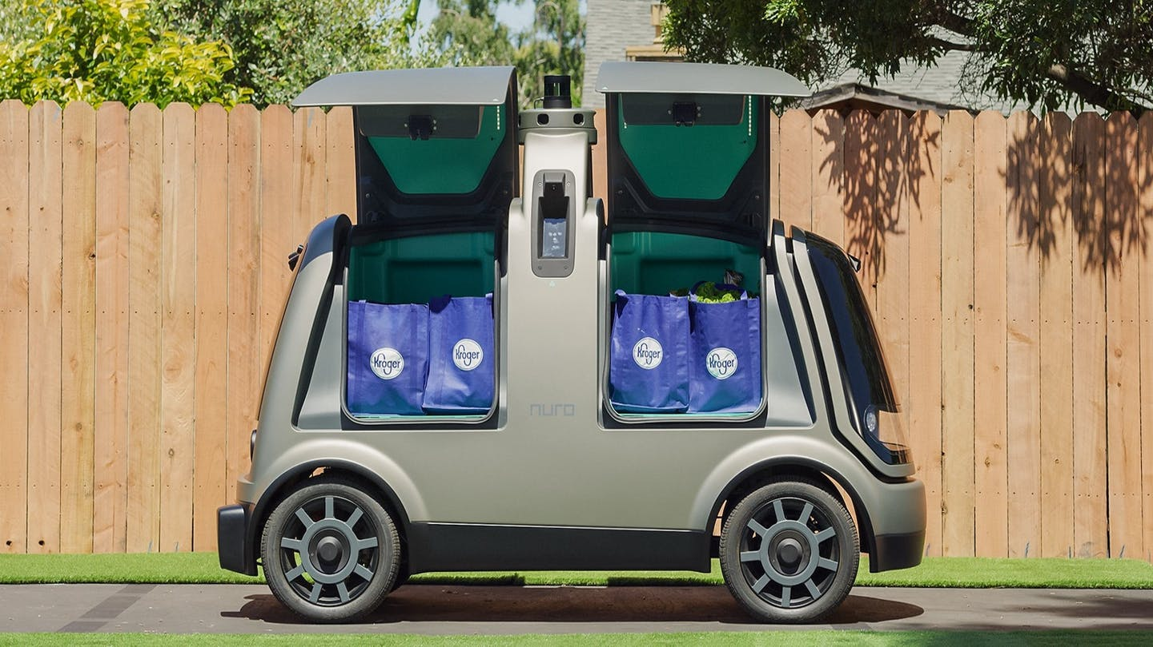
Autonomous Food Delivery Impacts on Traffic and Sustainability
Lead Researcher: Destenie Nock
Project Team: Corey Harper, Gregory Lowry, Mario Berges
8
1
3
Grocery Delivery Concept Car

Slide 2
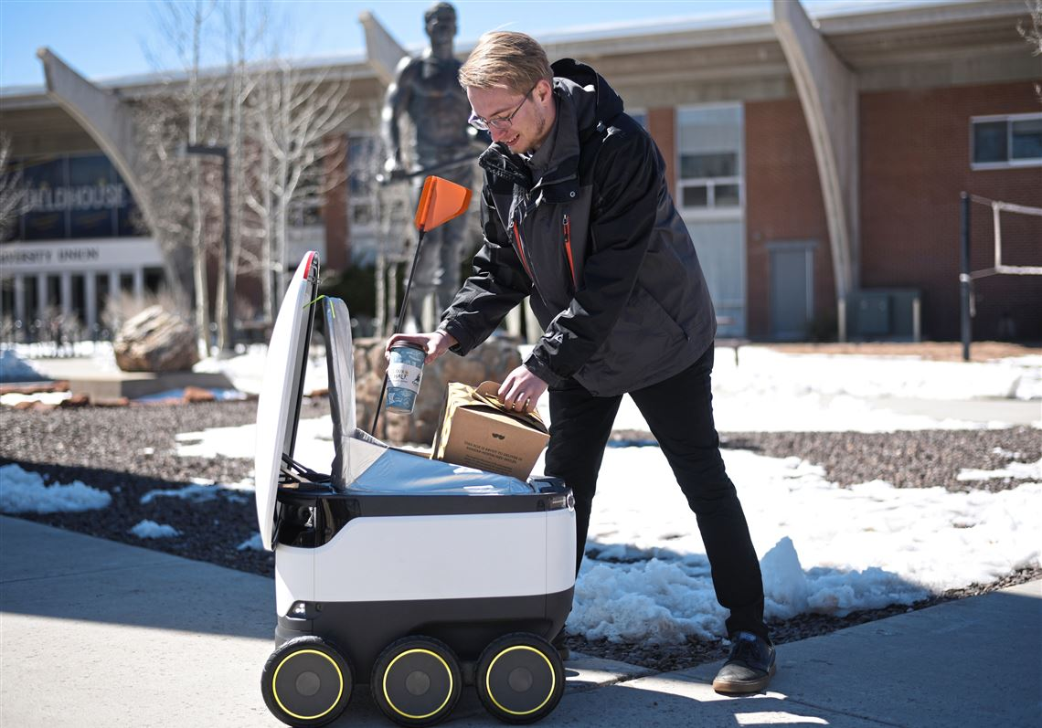
Autonomous Food Delivery Impacts on Traffic and Sustainability– Brief Overview of Project
Goals:
We will develop food delivery demand model(s) and use systems transportation modeling approaches to quantify how autonomous food delivery could affect peak hour traffic operations, and determine delivery alternatives that are most sustainable
Develop a relationship with Giant Eagle (local grocery store), Puget Sound Regional Council (transportation authority), and autonomous vehicle companies
Anticipated Outcomes: Produce a traffic modelling tool for understanding how grocery delivery market penetration will impact congestion and environmental sustainability
Partners – Giant Eagle, EasyMile, Puget Sound Regional Council
Notes:
2

Slide 3
Autonomous Food Delivery Impacts on Traffic and Sustainability– Expected Outcomes
Expected outcomes
Produce a traffic modelling tool for understanding how grocery delivery market penetration will impact congestion and environmental sustainability
Environmental sustainability and equity trade-off assessment. We will perform an analysis of how grocery delivery impacts air pollution and congestion in low income areas.
Develop a relationship with grocery and autonomous vehicle companies to promote interdisciplinary transportation planning.
Notes:
3

