Slide 1
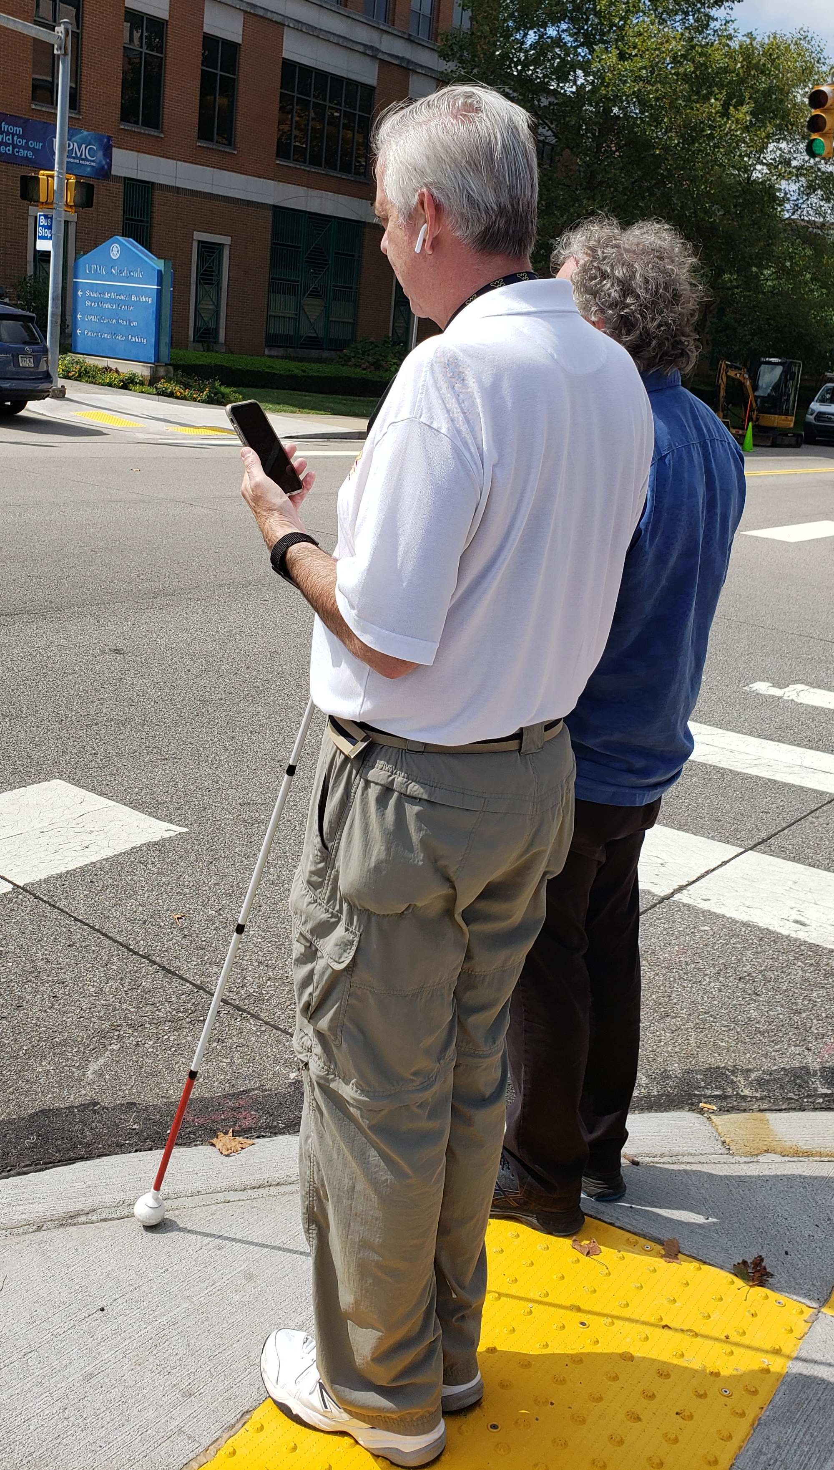
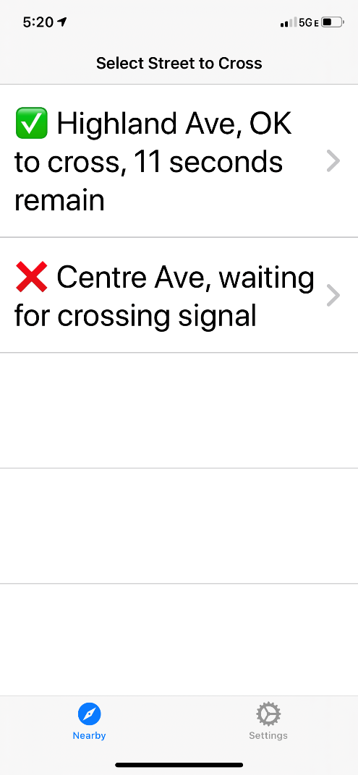
Safe Intersection Crossing for Pedestrians with Disabilities
Lead Researcher: Stephen F. Smith
Project Team: Viraj Parini, Zachary B. Rubinstein
Project Website:
<under construction>

Slide 2
Safe Intersection Crossing for Pedestrians with Disabilities – Overview of Project
Goals: Further development and deployment of the PedPal smartphone app for safe intersection crossing
Anticipated Outcomes:
Real-time monitoring of crossing progress and dynamic extension of green if necessary
Operability at complex intersections involving protected turning phases and/or a separate all-pedestrian crossing phase
A fully-scalable cloud-based P2I communication infrastructure
Partners – Rapid Flow Technologies, Inc.
Notes:
2

Slide 3
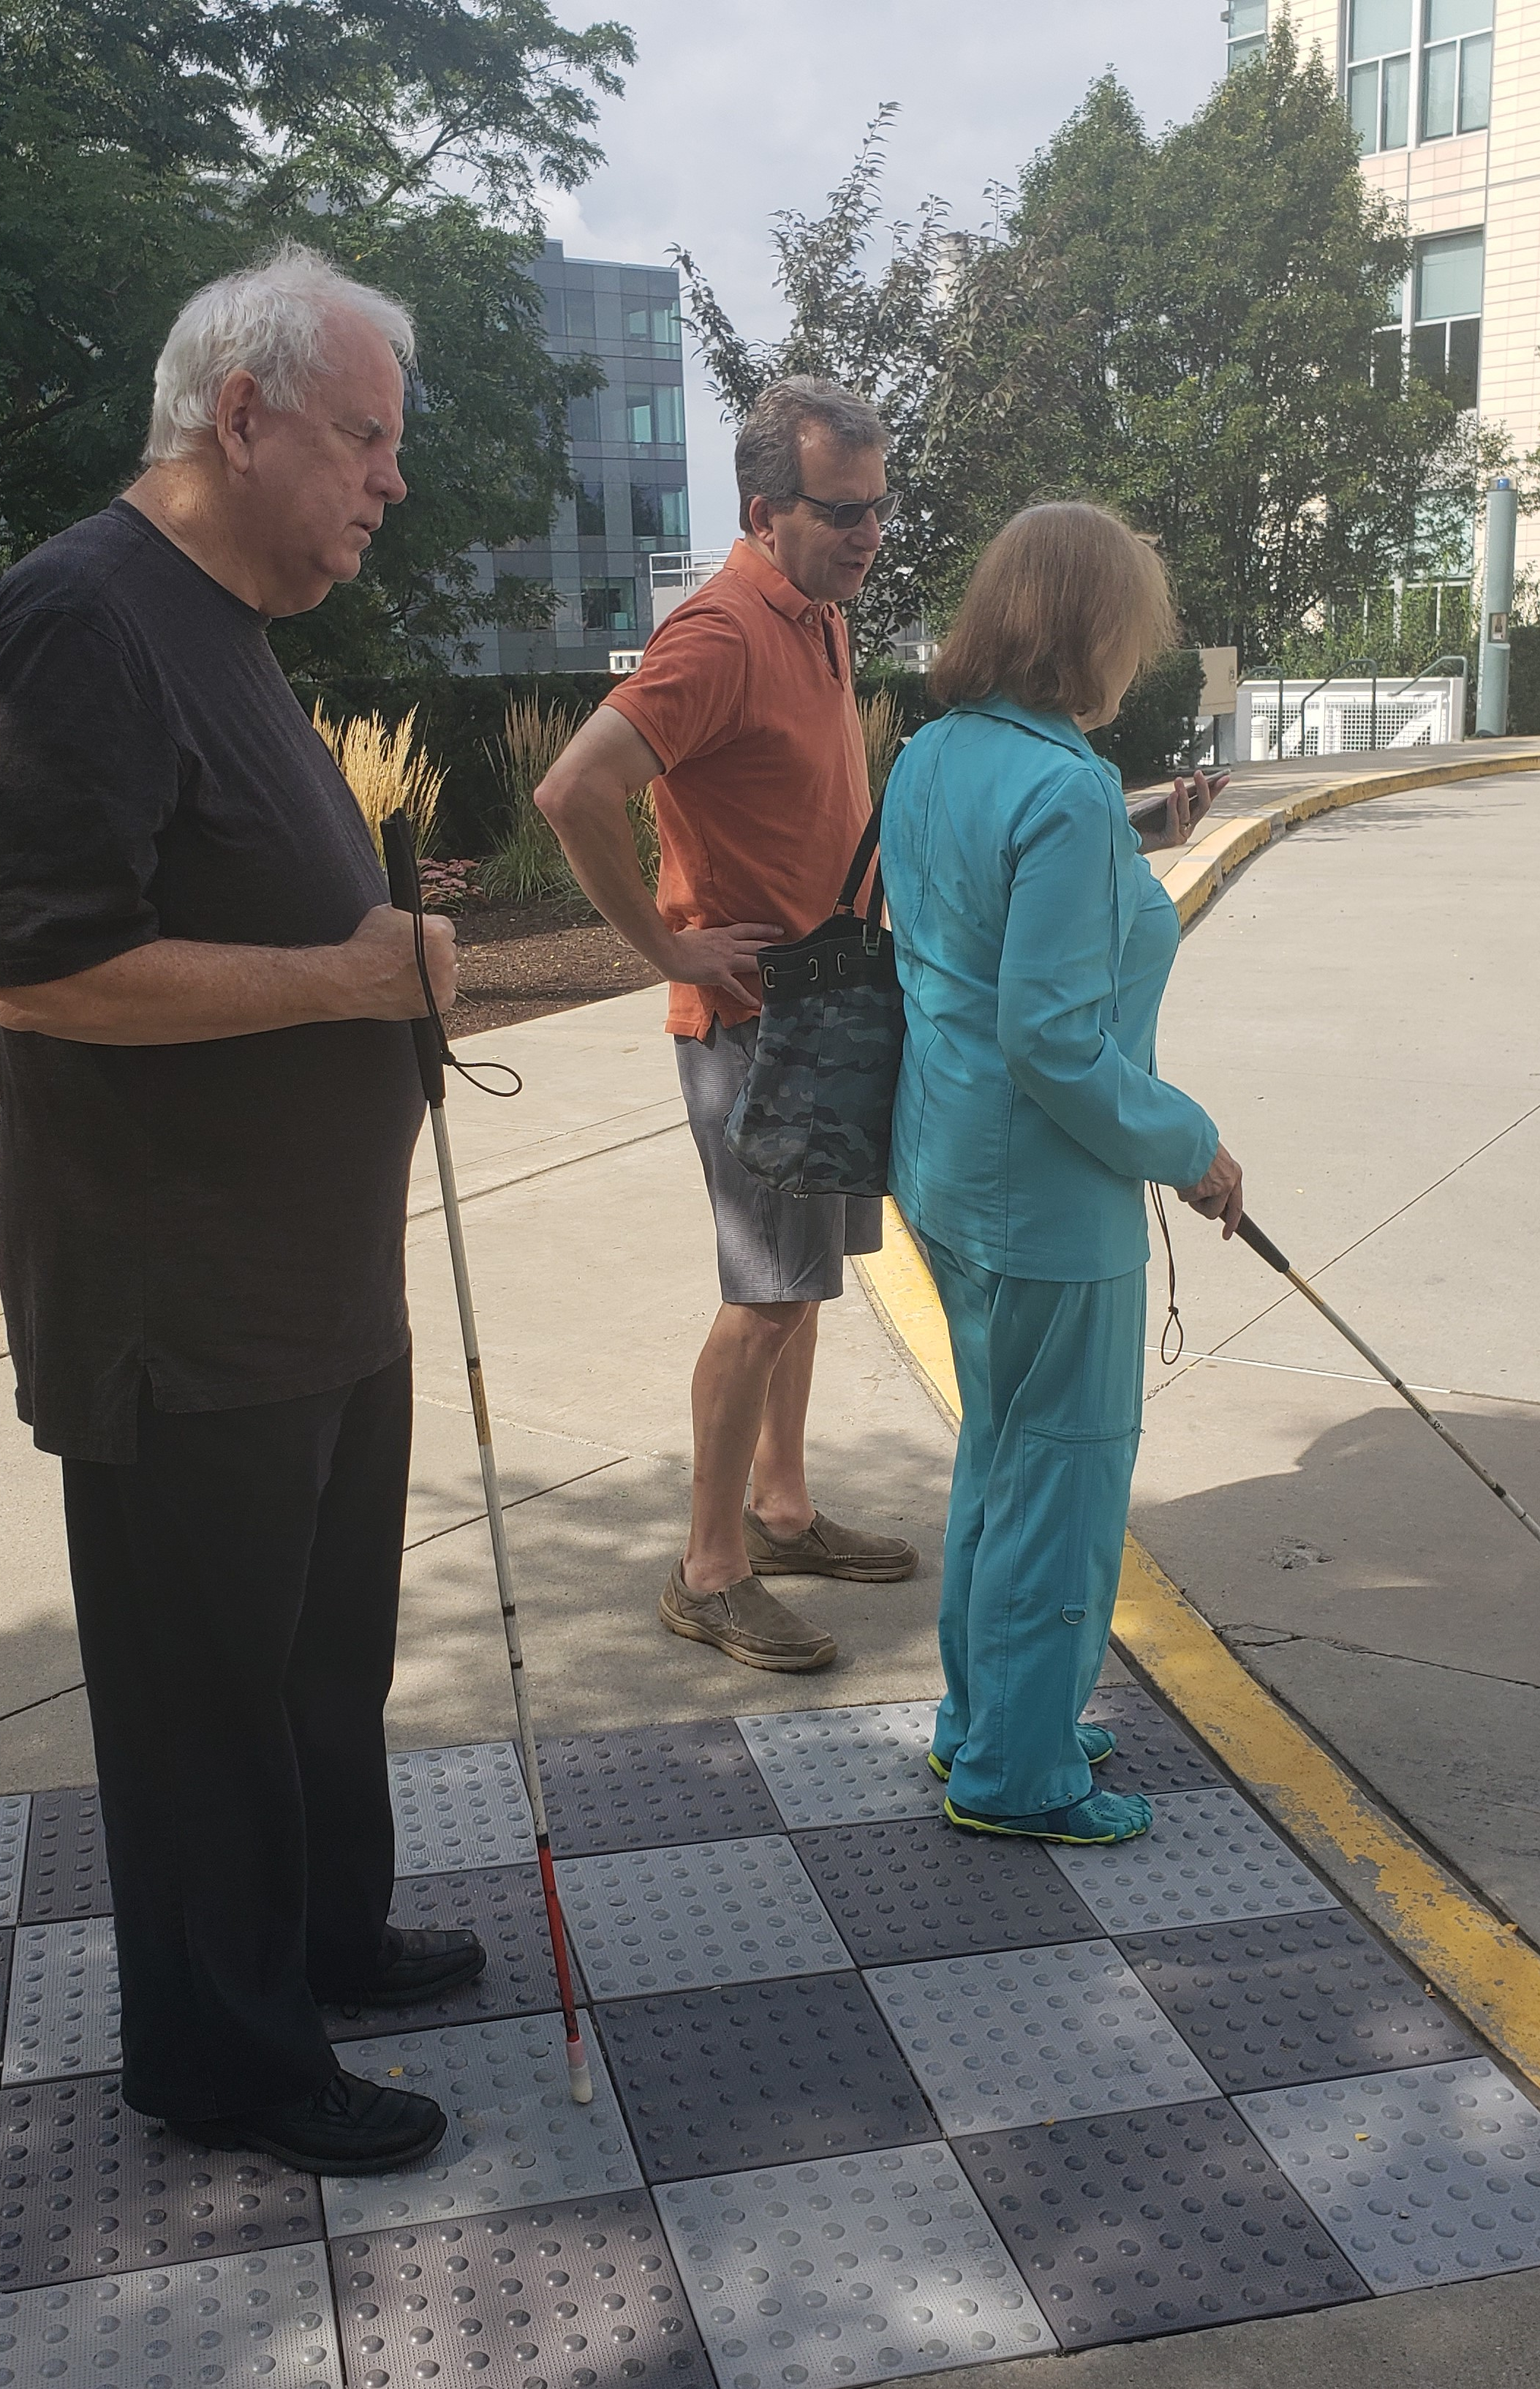
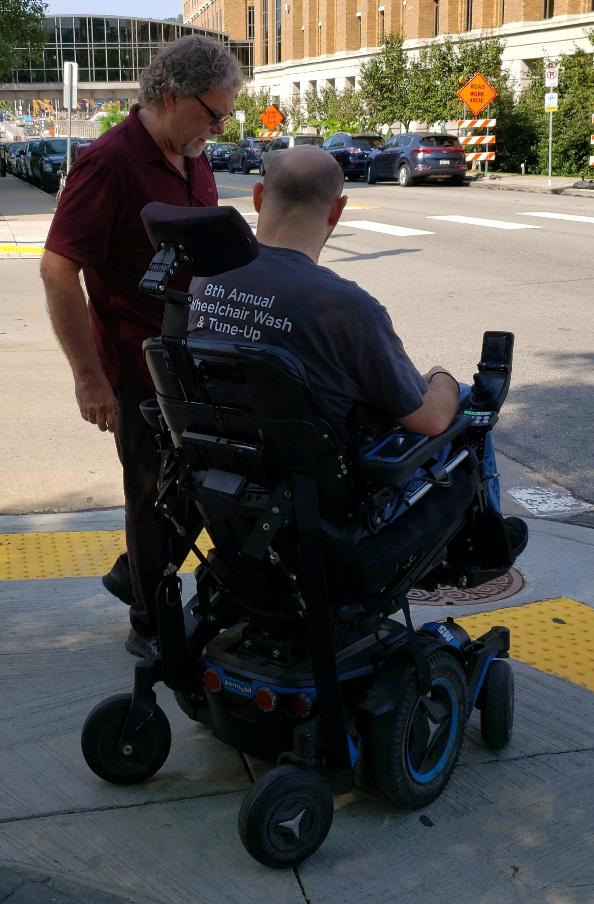
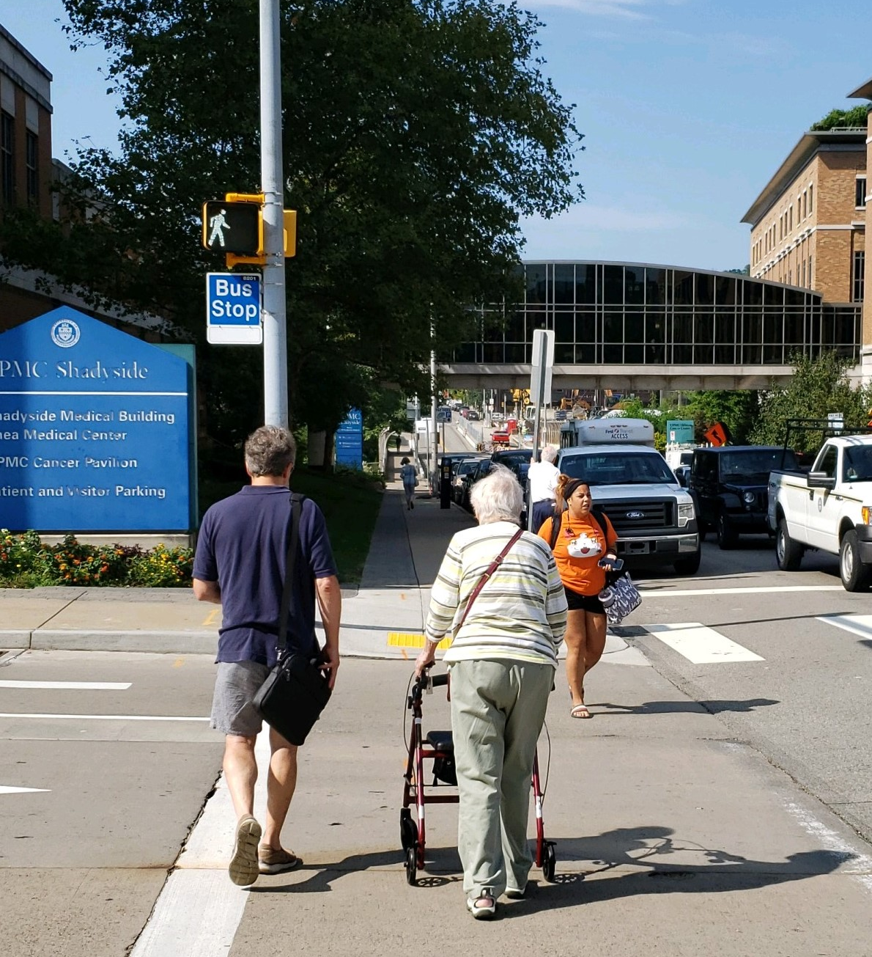
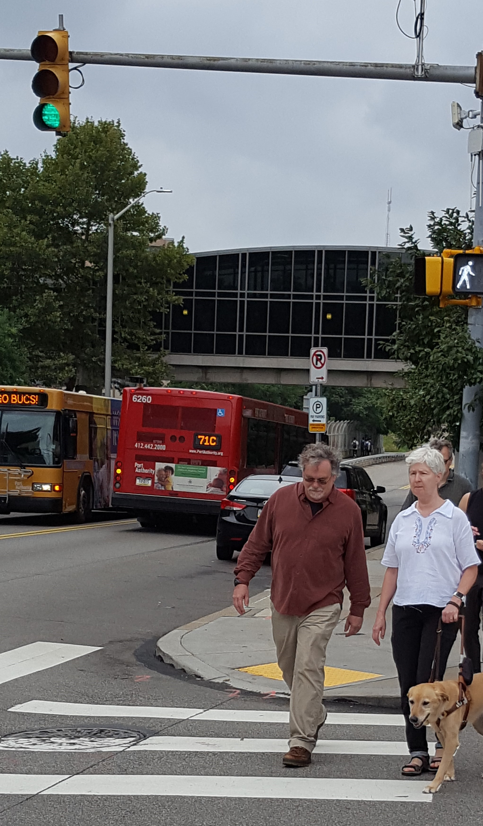
Safe Intersection Crossing for Pedestrians with Disabilities – Expected Outcomes
Hardened PedPal smartphone app with sufficient localization accuracy for deployment
New, state-of-the-art procedures for outdoor localization with Bluetooth beacons
Notes:
3

