Slide 1
Leveraging Inspection Records for Vehicle Miles Traveled Estimates and Analysis of Mileage-Based User Fees in Pennsylvania
Project Team:
Chenyu Yuan (CEE)
Zhufeng Fan (CEE)
Lin Lyu (CEE)
Prithvi Acharya (EPP)
H. Scott Matthews (CEE)
Source: https://beyondstandards.ieee.org/connected-vehicles/
the-internet-of-things-and-the-connected-vehicle/

Slide 2
The Transportation Funding Challenge
Gas taxes ($/gal) have been primary funding source for transportation at the federal and state levels since beginning
Federal funds augment state funds
But federal gas tax rate hasn’t increased since 1990s
Inflation has eroded value of federal share, caused states to have to increase rates
Hybrid/electric/high fuel economy vehicles pay far less
Expected transition from “pay by gallon” to “pay by mile”
Notes:
2

Slide 3
What are Mileage-Based User Fees
(a.k.a. Road User Charges)?
A direct way of charging vehicles for use of transportation
Requires: technology to track mileage (and maybe location), account for gas taxes paid, and a pre-set per-mile fee structure
Various states have done MBUF/RUC pilots
Technology may work
“Double charging” gas taxes is key financial challenge
Fee is independent of fuel economy, all based on VMT
Several states have moved from pilot to program
Notes:
3

Slide 4
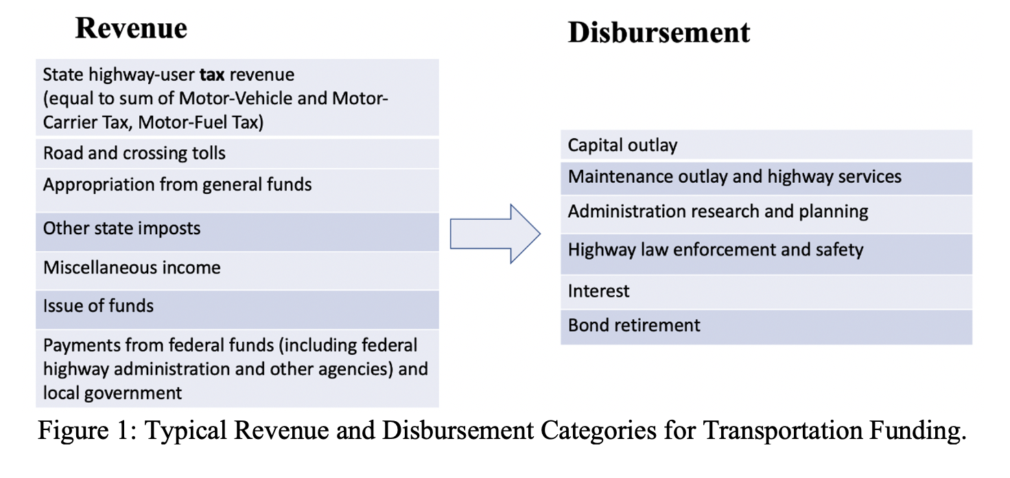
Separate Literature Review:
Existing Transportation Funding Issues
State ‘transportation’ expenditures and funding systems complex
Funds construction, maintenance, administration, police, etc.
Mix of state and federal funds (including gas taxes)
Data Source:
DOT Highway Statistics Series
Gas taxes or MBUFs ->
Need to pay for
all of this
Notes:
4

Slide 5
Focus After Literature Review:
Existing Transportation Funding Issues
Most pilots / programs seeking to set MBUF rates at equivalent of current gas taxes (“revenue neutral”)
Replacing all gas tax revenues with MBUFs may still not be enough to pay for all relevant disbursements
But this complexity is often overlooked
And would lead to insufficient funding coverage at scale !
We want to create tools and frameworks to help states with the funding transition with decision support
Notes:
5

Slide 6
Findings about Fee Structures
Fee structures for MBUF/RUC could be intentionally complex
Example: rates could differ by fuel type, weight, road, ..
Higher rates for privacy-protecting systems (no location)
But existing data flows on highway use might not be sufficient to predict total fees collected (vs. gas tax rate)
We gathered vehicle-level data from Pennsylvania for more than 10 years to assess how a MBUF might work..
Notes:
6

Slide 7
Data Processing
Raw data we use:
120 million inspection records (1999 – 2018), provided by PennDOT and CompuSpections, a private software company
To find VMT, organized by consecutive VIN pairs
118 million (96%) records and 22 million (98%) unique VINs preserved (around 5 inspection records per VIN)
Only keep VINs with ≥3 inspection records and maximum gap < 467 days (90 percentile of all date intervals), remaining 7 million vehicles for VMT estimation
“Decoded” VIN by webscraping, found fuel economy and type of vehicle
Notes:
7

Slide 8
VMT Estimation Method
Estimation Method:
$daily VMT= \frac{{Odometer Reading}_{latter}− {Odometer Reading}_{former} }{{Inspection Date}_{latter}− {Inspection Date}_{former}}$
Then allocate daily VMT to both years used for estimation depending on number of days in that year
Notes:
8

Slide 9
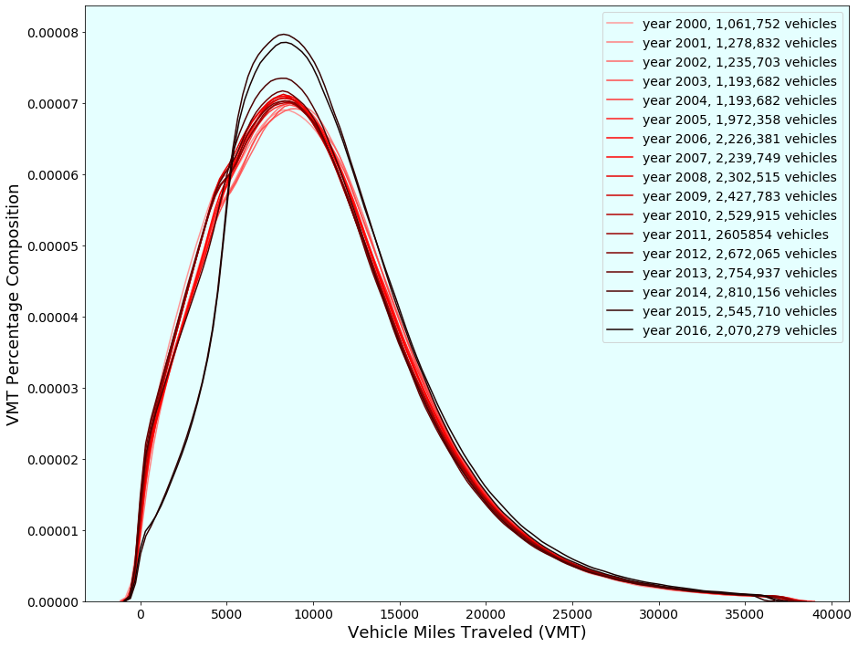

Slide 10
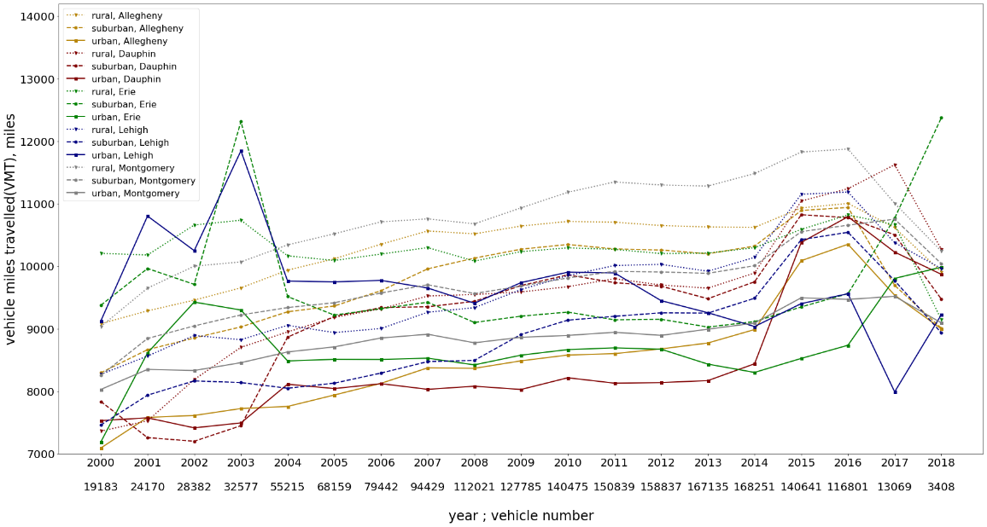
VMT Estimation by County and Urbanity
Calculate VMT by county and urbanity, in every inspection year
We pick five representative counties that include urban, suburban, and rural zipcode areas
Beginning and end of time period have data problems
Pick year 2014 for subsequent analysis, as it is relatively recent, robust, and sufficient records
VMT 2000-2018 by counties and urbanity
Notes:
10

Slide 11
Subsequent Data Analysis Method
PennDot inspection data
Pennsylvania vehicle, VMT and fuel economy data
CompuSpection inspection data
Geographical matching process
Statistical matching process
US census urban-suburban-rural classification in PA counties
NHTSA/EPA fueleconomy data
Final geospatial analysis with VMT distribution and fuel tax/MBUF comparison
Pennsylvania vehicle, VMT, geographical and fuel economy data
VMT distribution adjustment; fuel tax and MBUF calculation

Slide 12
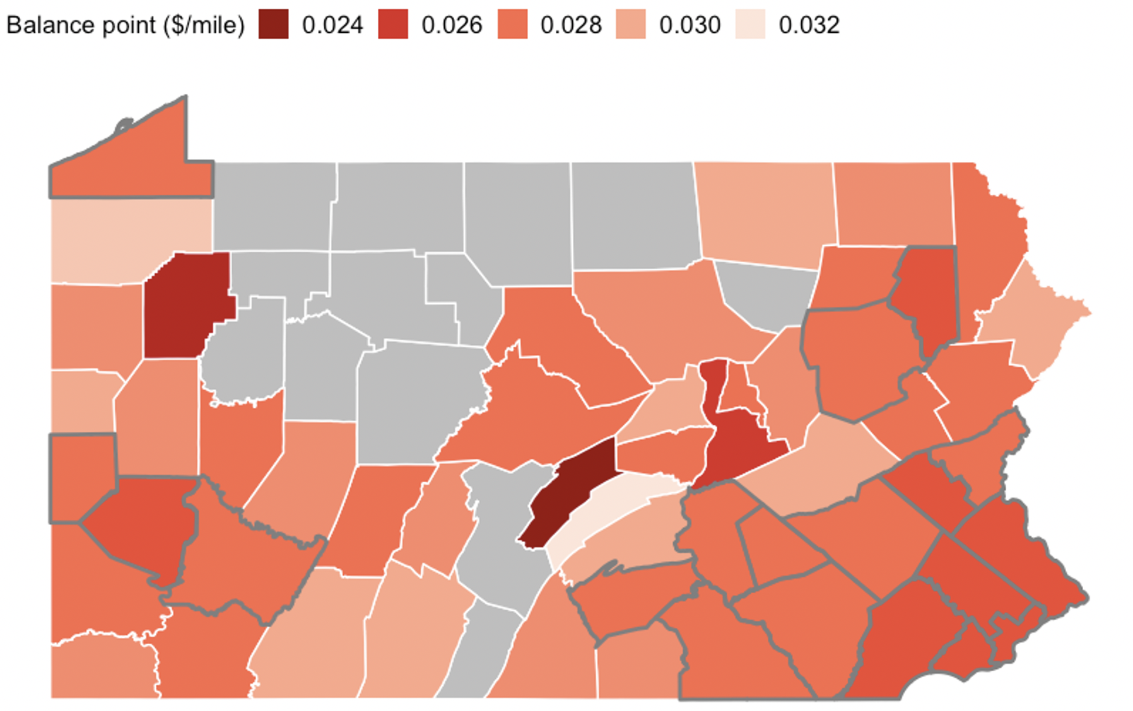
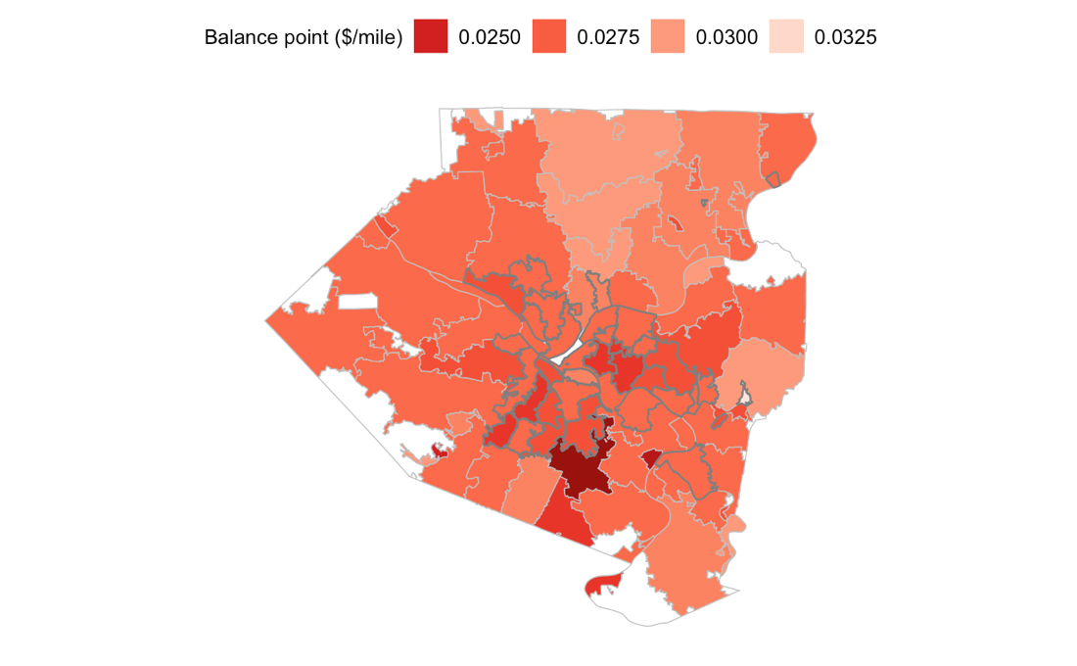
Pennsylvania Examples Using Inspection Records and Algorithms
MBUF Balance points at county and zip code level
Direct conversion of gas tax to MBUF at a county level should be ~ 2.5-3 cents/mile
In Allegheny County, urban areas have a lower MBUF rate than suburban and rural area
Balance point between MBUF and fuel tax in each county in Pennsylvania
Balance point between MBUF and fuel tax in each county in Allegheny County
Notes:
12
Balance point (half part of the vehicle pay more with either policies) is introduced in county and zip code level to see rural and urban distribution discrepancy in Pennsylvania and average MBUF rate level.
Direct conversion of gas tax to MBUF in a county level should be ~ 2.5-3 cents/mile
In Allegheny County, urban areas have a lower MBUF rate than suburban and rural area

Slide 13
Representative PA Vehicle Examples (high, low FE and VMT)
Make/Model | Vehicle Type | VMT (miles/year) | Fuel economy (MPG) | Annual Fuel Tax ($) | Change in cost between fuel tax and MBUF of:
 |  |  |  |  | ¢1/mi | ¢2/mi | ¢3/mi
2013 Chevrolet Malibu | Sedan | 13,277 | 26 | 292 | -55% | -9% | 36%
2013 Ford Fusion | Sedan | 33,399 | 36 | 541 | -38% | 23% | 85%
2013 Honda Insight | Hybrid Sedan | 16,323 | 42 | 222 | -27% | 47% | 120%
2010 Toyota Prius | Hybrid Sedan | 6,364 | 50 | 74 | -14% | 72% | 158%
2008 Honda Pilot | SUV | 35,348 | 18 | 1159 | -70% | -39% | -8%
2011 Toyota RAV4 | SUV | 8,121 | 24 | 196 | -59% | -17% | 24%
2012 Ford F-150 | Pickup | 27,162 | 16 | 985 | -72% | -45% | -17%
2010 Dodge Ram 1500 | Pickup | 9,266 | 15 | 359 | -74% | -48% | -23%
Hybrid vehicles may cost over 150% more with a ¢3 per mile MBUF than a fuel tax.
Low fuel economy vehicles will likely have a lower overall annual cost with MBUF than with the existing per-gallon tax.
Overall, this emphasizes the point that fuel economy and VMT are both very important in determining whether a vehicle owner would be better or worse off with a MBUF system.
Notes:
13

Slide 14
Conclusions
Transition from per-gal to per mile is inevitable, and necessary!
To do it smoothly, states need the tech, but also need to know:
how much money they need, and
what kind of rate structure they want to use.
Data for either of these is lacking.

Slide 15
Our Eventual Goal – Planning Dashboard Tool
The wide range of results from the “consistent data source for all states” shows us the challenge in using national data
We can do better via direct collaboration with state DOTs, who can verify the data needed and disbursements to be ‘covered’
Can organize available data for passenger and commercial vehicles (VMT), revenues, disbursements and create what-if scenarios relevant to rate setting decisions
Note: Revenue neutral may be a mistake!
Notes:
15

Slide 16
How Can you Help?
We need partners interested in using our work to date, and willing to help us improve the planning tool.
Ideal partners are state DOTs and technology providers – anyone who has data that can make this better
Contact me if interested or for copies of the papers!
hsm@cmu.edu
Notes:
16

