Slide 1
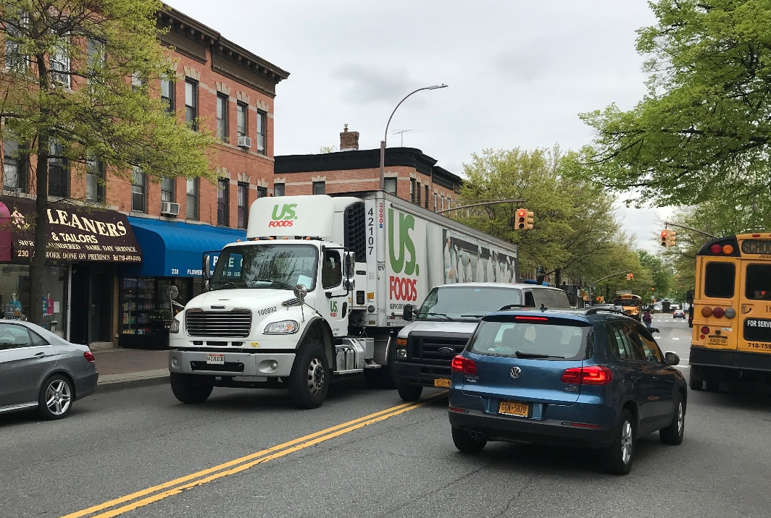
Smart Curbspace Optimized Parking Reservations for Diverse Stakeholders
Lead Researcher:
Prof. Jeremy Michalek
Project Team:
Aaron Burns
Earliest Arrival
Latest Departure
Scheduled Unloading Period
Double Parking
2
Parking Spaces
1
Time
Source: https://nyc.streetsblog.org/2019/05/02/the-dot-quandary-double-parking-isnt-illegal-except-when-it-actually-is/
Notes:
Add a photo/graphic representing project (if there is one)

Slide 2
Brief Overview of Project
Goals:
Model an optimized curbspace reservation system for delivery vehicles
Assess impacts to energy use, traffic flow, and congestion externalities associated with changes in delivery parking behaviors, including double parking and searching for parking
Provide relevant policy and technology insights for city officials
Partners:
Street Sense Inc. (curbspace computer vision startup – data sharing)
City of Pittsburgh Department of Mobility and Infrastructure (expected)
Notes:
2

Slide 3
Expected Outcomes
Characterize changes in energy use, traffic flow, and congestion externalities with optimized parking schedules provide by a Smart Curbspace system relative to (1) first-come-first-serve systems and (2) building additional parking infrastructure
Characterize sensitivity of findings to variations in scenarios and assumptions, including degree of driver flexibility, non-compliant behavior, and on-demand requests
Analyze the benefits and challenges associated with the technology
Identify regions of best performance given delivery vehicle parking demand and schedule flexibility
Improve methods for optimizing smart curb allocation
Write policy brief and present findings to:
City officials, including the City of Pittsburgh
The National Academies Transportation Research Board
The larger academic community through research article publication
Notes:
3
How will the research improve the “subject” you are researching, how will it benefit the people using the service/product
Add any relevant photos/graphics

