Slide 1
Controlled Deployment of Analytical Solutions for Essential Transportation Services in Low-Income Neighborhoods
Lead Researcher: Peter Zhang
Mobility21 Project #400
Photo Credit: Heritage Community Transportation

Slide 2
Brief Overview of Project
Background
Heritage Community Transportation (HCT) provides transportation in 16 communities via three routes (East Pittsburgh, Monroeville, McKeesport) and 75 stops. HCT’s service is the only viable transportation mode for many residents in these communities.
Partners
Heritage Community Transportation (HCT)
Delta Development Group
Notes:
2

Slide 3
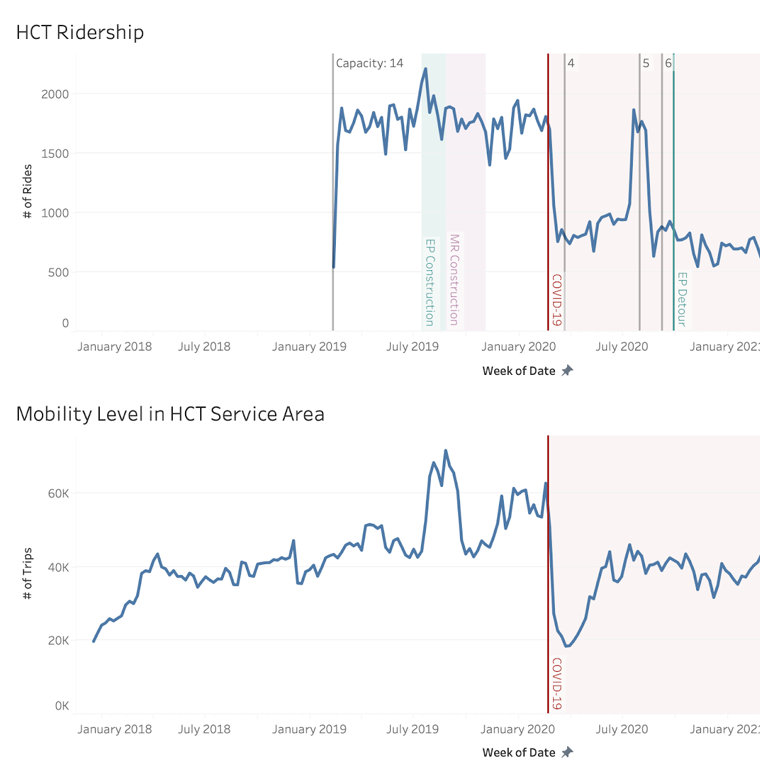
Brief Overview of Project (continued)
Problem
Since April 2020, HCT ridership continuously decreased. But at the same time, ambient mobility level is recovering slowly. (Figure 1)
Goals
Understand the supply-demand gap
Design and deploy service changes to bring the service to those in need
Figure 1
Notes:
3

Slide 4
Expected Outcomes
This project will focus on deploying service changes in the HCT’s current service area and surrounding neighborhoods
Notes:
4

Slide 5
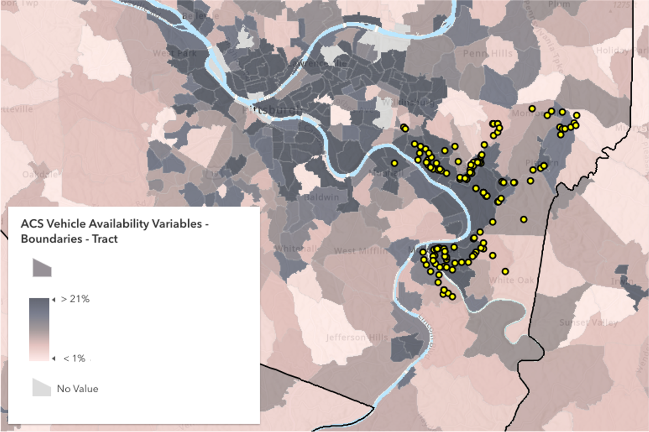
Expected Outcomes (continued)
Bring HCT’s service to new riders, and reduce the wait time for many existing riders (hundreds of riders per week)
Figure 2. Yellow dots: HCT Service Stop.
Heatmap: Vehicle Ownership Level by Census Tract.
Notes:
5

Slide 6
Expected Outcomes (continued)
Academic paper submissions, focusing on insights that can be transferred to other service providers: methodology of demand-supply analysis, and transportation equity metrics and datasets.
Conference presentations and seminars (INFORMS, POMS, TRB, etc.)
Education and Training (one PhD student, two master students, one or two undergraduate students)
Notes:
6

Slide 7
Additional Background
More than 3,000 riders (based on active registration)
85% of riders use it to connect to the larger bus service
According to July 2013 survey: The service is the only option for 97% of riders!
Average rider age: 47
81% of riders use the system to connect with Port Authority routes
820,000 rides
Adding $132 Million in economic activity in the region
Source: Heritage Community Initiatives – connecting residents of the Mon Valley to jobs. (2019, October 07). Retrieved February 15, 2021, from https://t4america.org/
Notes:
7

Slide 8
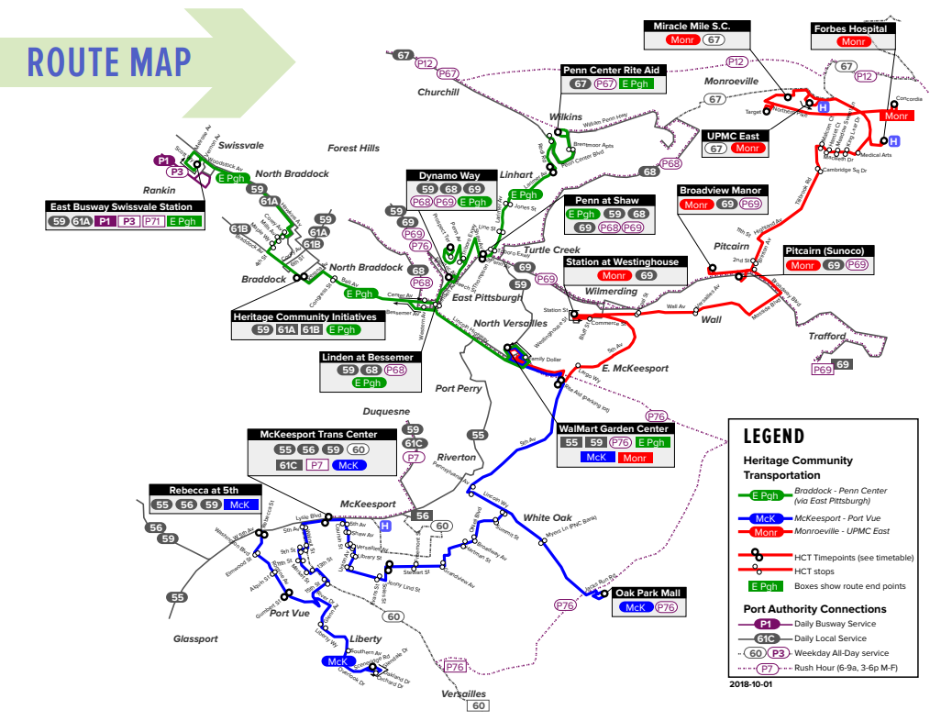
Additional Background
Notes:
8

