Slide 1
Demand Learning and Supply Optimization for Last-Mile Transportation in Disadvantaged Neighborhoods
Lead Researcher: Peter Zhang
Mobility21 Project #368
Photo Credit: Heritage Community Transportation

Slide 2
Brief Overview of Project
Background
Heritage Community Transportation (HCT) provides first/last-mile transportation in disadvantaged communities (east Pittsburgh) that lack access to public transit
Problem
COVID increased pressure on cost management due to ridership decrease and increased driver/passenger health risk
Goals
Analyze HCT service data and public transit data to ensure that their vehicles are utilizing the best available routes and operating in a cost-effective, rider-focused manner
Notes:
2

Slide 3
Project Name – Expected Outcomes
Exploratory data analysis on existing rider surveys
Collect data to understand latent demand
Review of existing routes and fixed-route strategies
Review of similar first/last-mile systems in other communities
Qualitative and quantitative comparison of the benefits and drawbacks of different routing strategies, including on-demand schedule, mixed fleet (e.g., van + TNC)
Notes:
3

Slide 4
Deployment Plan
July – September 2021
Hold kick-off meeting with deployment partner (Heritage).
Meet with stakeholders to gather data for the model development.
October – December 2021
Survey/data collection from current users.
Meet with stakeholders to share findings of current system performance
January – March 2022
Beta test the model/software.
April – June 2022
Submit publication for consideration into an academic publication and/or conference.
Provide Heritage with the findings via written report and presentation, which includes
Review of existing routes and fixed-route strategies
Review of similar first/last-mile systems in other communities
Qualitative and quantitative comparison of the benefits and drawbacks of different routing strategies, including on-demand schedule, mixed fleet (e.g., van + TNC)
Recommended strategies for HCT
Proposal for Phase 2 collaboration
Notes:
4

Slide 5
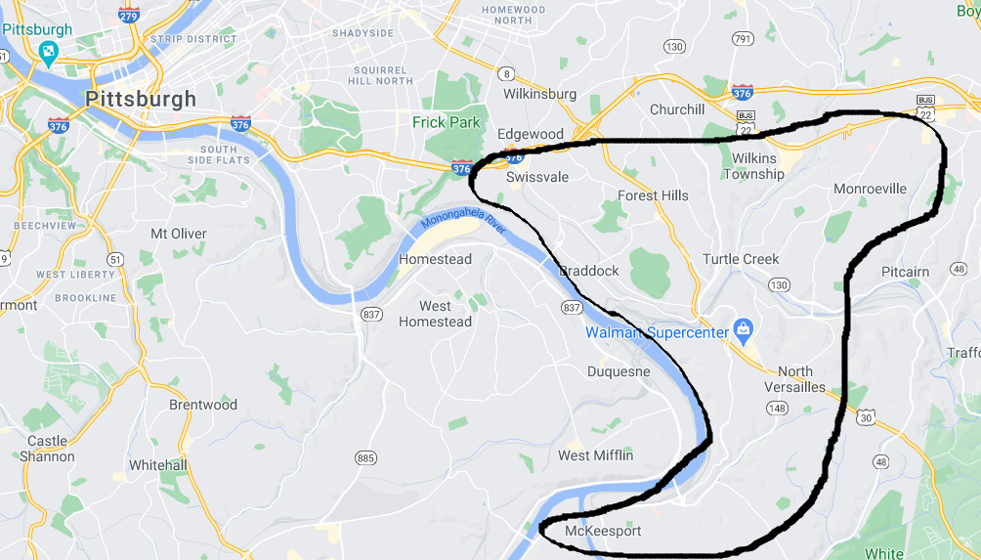
Additional Background
63% of riders’ household incomes are less than $10,000 a year
Notes:
5

Slide 6
Additional Background
More than 3,000 riders (based on active registration)
85% of riders use it to connect to the larger bus service
According to July 2013 survey: The service is the only option for 97% of riders!
Average rider age: 47
81% of riders use the system to connect with Port Authority routes
820,000 rides
Adding $132 Million in economic activity in the region
Source: Heritage Community Initiatives – connecting residents of the Mon Valley to jobs. (2019, October 07). Retrieved February 15, 2021, from https://t4america.org/
Notes:
6

Slide 7
Additional Background
Three fixed routes that charge 25 cents a ride
Monroeville, East Pittsburgh, McKeesport
For all routes, it takes about an hour
Begin at 6 a.m. or earlier and end at 10:45 p.m. or later on weekdays
Source: Heritage community Transportation. (n.d.). Retrieved February 15, 2021, from https://www.heritageserves.org/transportation.html
Notes:
7

Slide 8
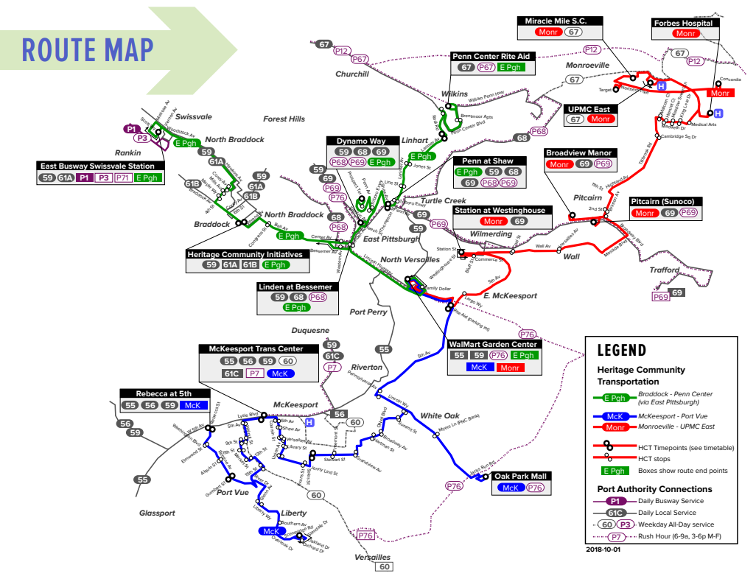
Additional Background
Notes:
8

Slide 9
Proposed Data Collection
Passenger side
Number of passengers per day
How much fee they need to pay
The reason why they need this service
Wait time
Which stop they need to get off the van
Van operation
Route
Number of drivers
How many shifts per day?
Schedule
TNC
Normal costs and surge multipliers
Notes:
9

