Slide 1
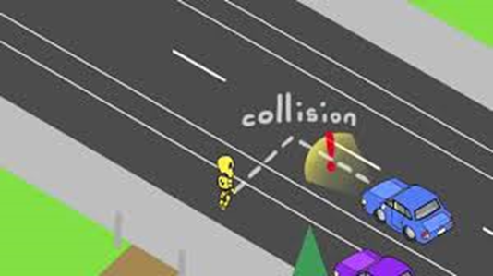
Safety in Connected Automated Vehicles in the presence of Vulnerable Road Users
Lead Researcher/Faculty: Prof. Emeritus Umit Ozguner
Project Team: U. Ozguner, K. Redmill, M. Saim
(Mert Koc)

Slide 2
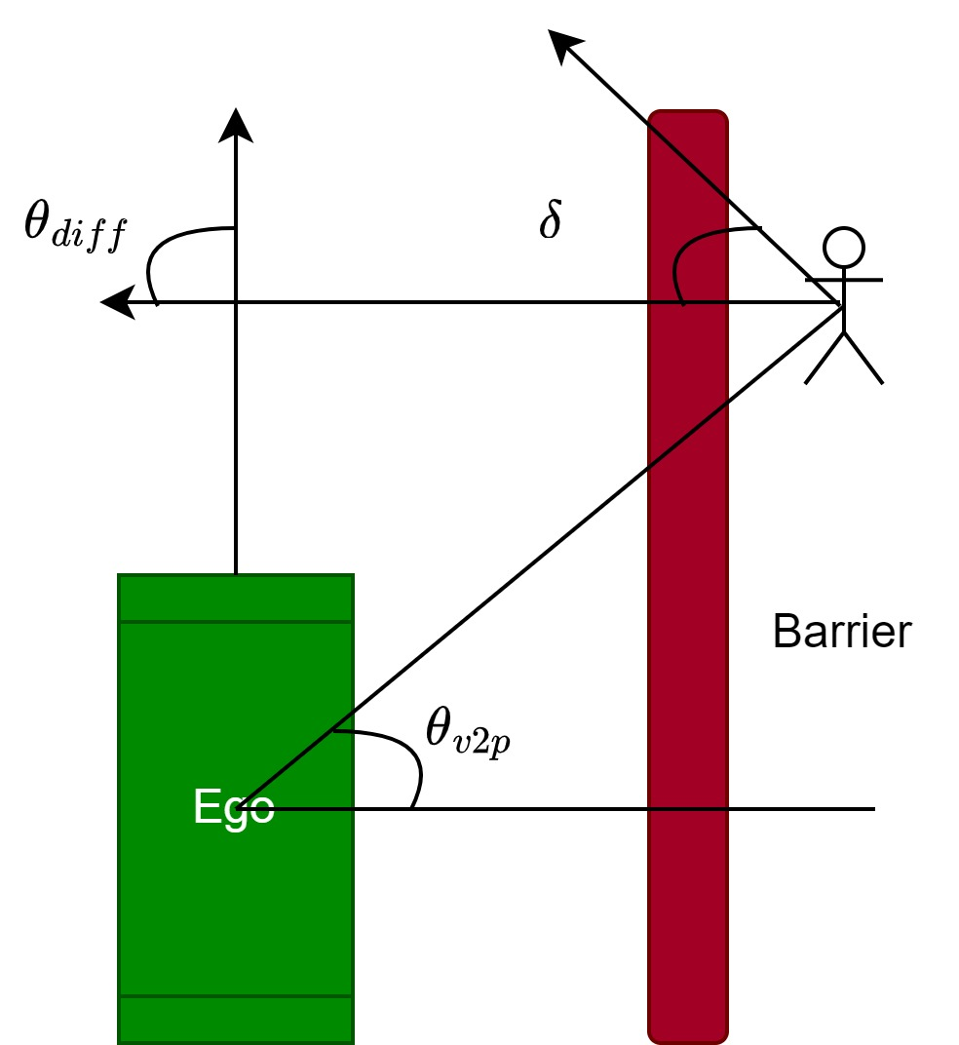
Background #1:
Value of Location Information of VRUs
Previously reliability of location information is measured [1]
Objectives
Develop a control strategy for vehicle to avoid collision
Adjust vehicle response to Location Information
Assess location Information value using cost metrics
Problem Scenario
Pedestrian jaywalking through the street
Vehicle cannot observe pedestrian with its local sensors
Approximate Pedestrian location information is transmitted through communication channel
[1] Saim, M., and U. Ozguner. "Entropy Based Metric to Assess the Accuracy of PNT Information⋆." IFAC-PapersOnLine 55.24 (2022): 292-297.
Supported by a different UTC at OSU. (CARMEN)
Notes:
2

Slide 3
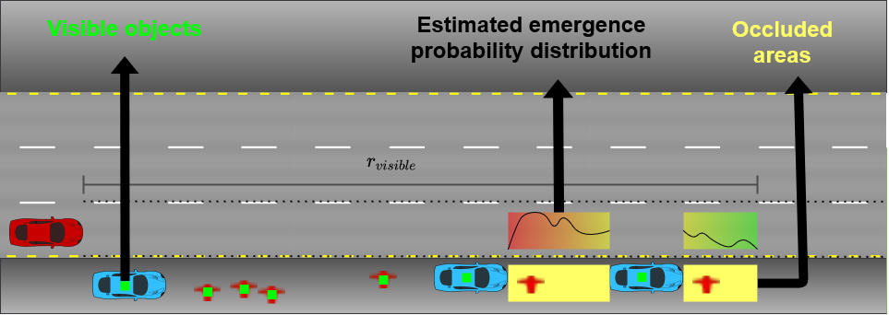
Background #2:
Speed control based on existence of VRUs
Motivation of this Work
Hypothesis: using the information available such as: the density of visible parked cars and the distance to the closest one, the density of visible pedestrians and the distance to the closest one, the distance to the crosswalk (if visible) can improve the performance of the controller for occluded pedestrian scenarios.
Specifically, for places where the GPS accuracy is low (tall buildings, crowded metropolitans)
Supported by a different UTC at CMU. (Mobility21)
Notes:
Why: To estimate unknown prior probability dist. w/ available info
Humans estimates are good enough, and as a driver I use these info
How: Read the hypothesis

Slide 4
Control and Evaluation of AVs in presence of Indecisive Pedestrian
Problem
Indecisive Pedestrian
Pedestrian Intention is unknown
Pedestrian alters its goal randomly
Solution
Physics based Hierarchical Vehicle Control (using position and speed information of vehicle and pedestrian)
Probabilistic estimation based vehicle control (modeling pedestrian intention as a probabilistic function and vehicle devises control based on predicted pedestrian next position) [2]

Slide 5
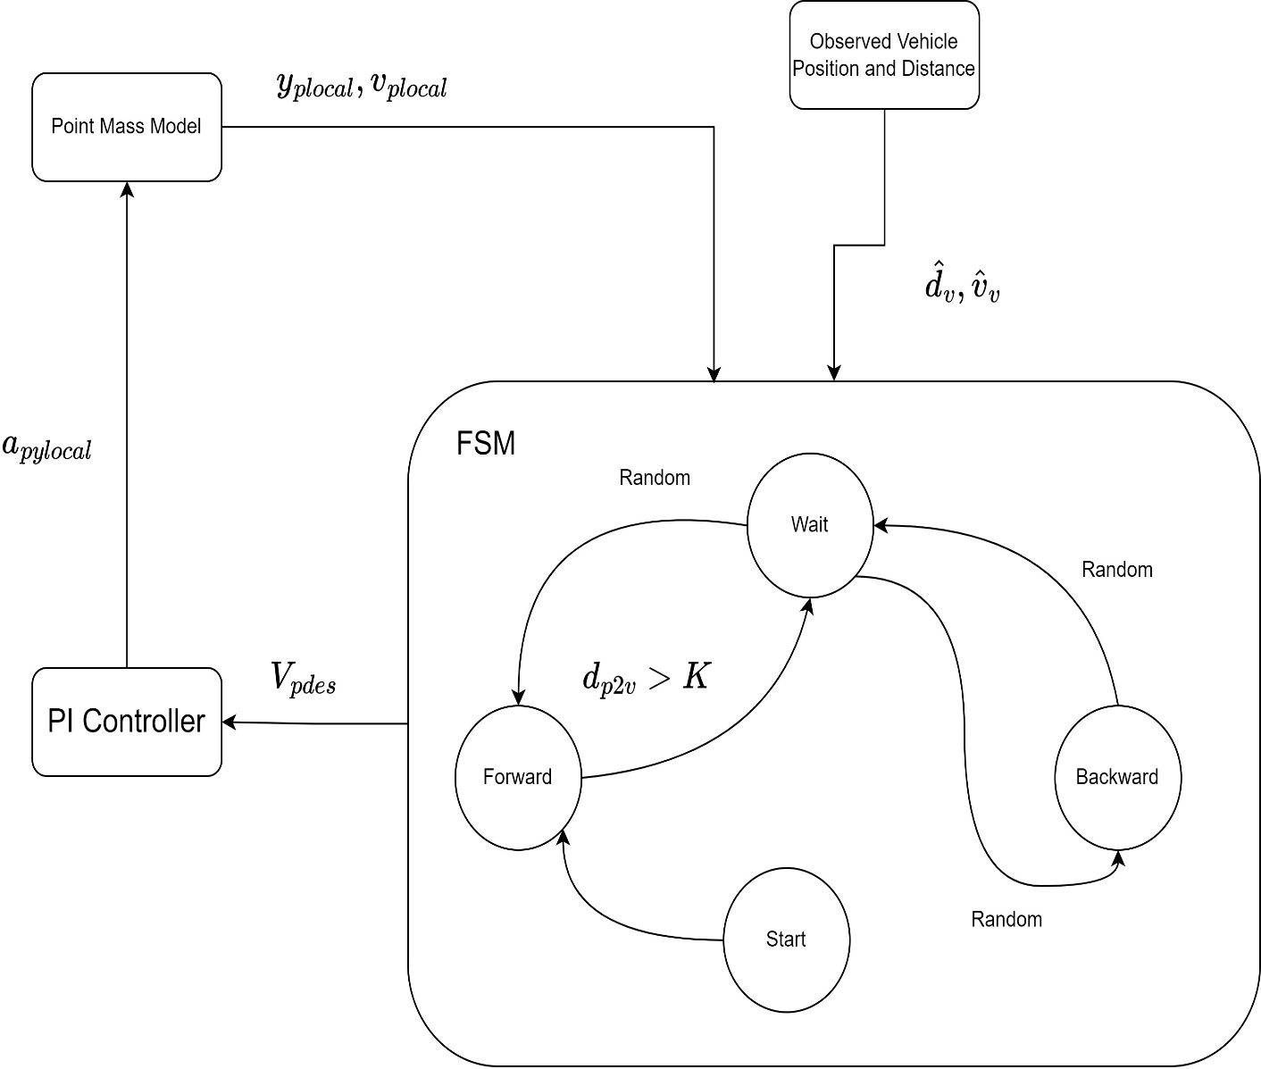
Indecisive Pedestrian Motion Model
Random Function
$X\left(k,λ\right)=\frac{λ^{k}e^{−λ}}{k!},$
$$λ=mean, K=occurences$$
probability of values far away from mean are less If mean is chosen closer to 1.
Occurrences are assigned certain states
e.g if K=10 and $λ$ = 3.
Forward state [1-5], Backward state [6,7], Stop[8-10]

Slide 6
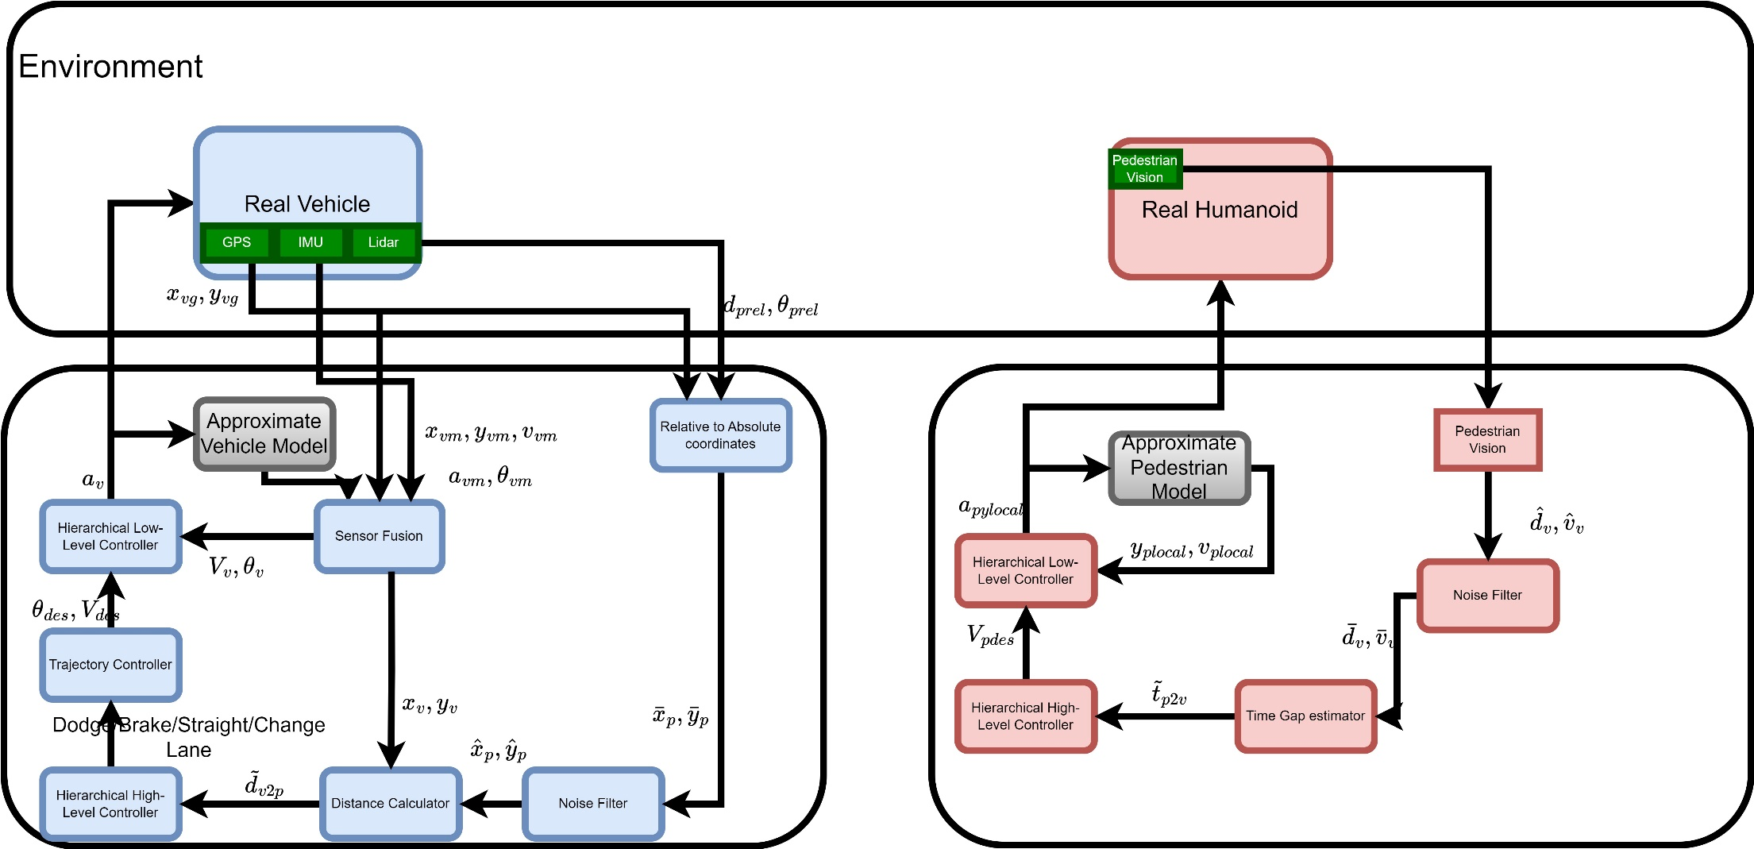
System Process
System Process for Physics Based Control and Motion Model for Pedestrian
Relative position of pedestrian and vehicle is known from their sensors
Vehicle/pedestrian position, speed information contains error

Slide 7
Expected Outcomes
Value of Location Information of VRUs
Control and Evaluation of AVs in presence of Indecisive Pedestrian
Collision avoidance control for AVs in presence of occluded pedestrians
Improved efficiency of vehicle navigation
Collision avoidance control for AVs in presence of indecisive pedestrians
Benefits of using physics-based approach vs statistical approach

