Slide 1
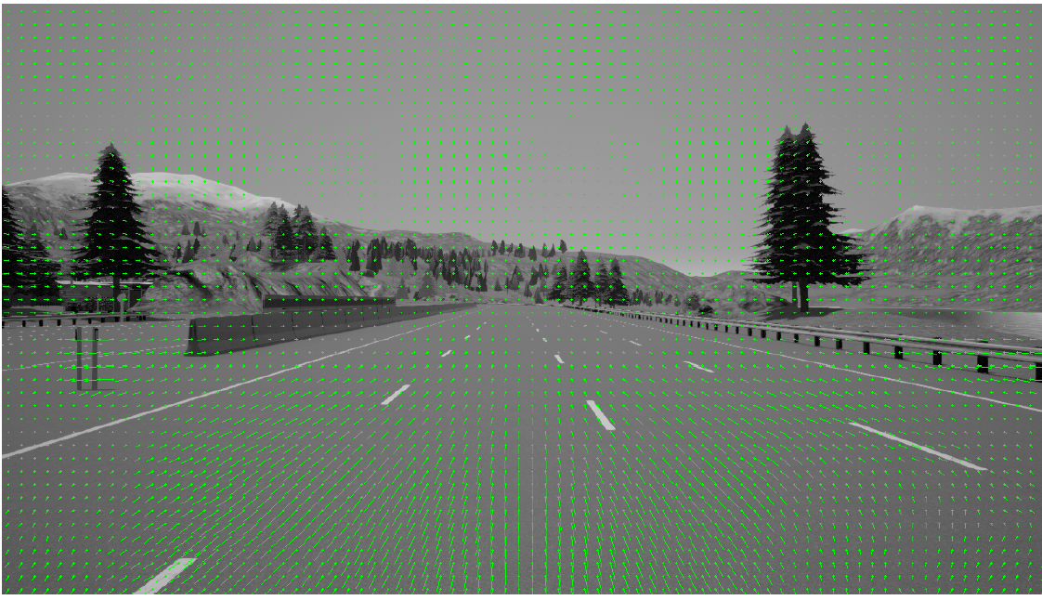
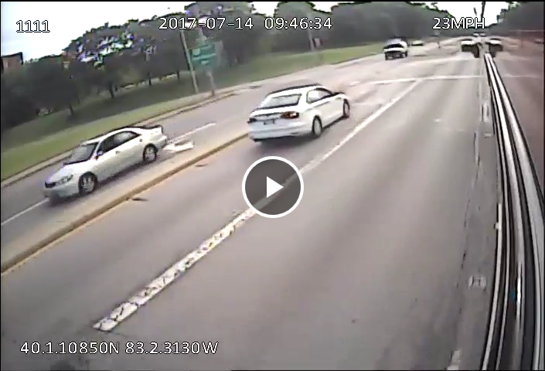
Image Processing Approaches to Traffic Situation Understanding, Risk Assessment, and Safety
Lead Researcher: Keith Redmill
Project Team: Keith Redmill, Mark McCord, Rabi Mishalani, Ekim Yurtsever, Linda Capito Ruiz, Umit Ozguner

Slide 2
Image Processing Approaches to Traffic Situation Understanding, Risk Assessment, and Safety
Goals- explore image processing and NN/deep learning techniques as applied to developing methodologies for:
  Traffic scene risk assessment and driver behavior understanding
  Methodologies for extracting information from transit vehicle video for traffic flow estimation
  Optical flow for autonomous vehicle navigation
Notes:
2

Slide 3
Image Processing Approaches to Traffic Situation Understanding, Risk Assessment, and Safety
Anticipated Outcomes
  Understanding and modeling driver and surrounding vehicle behaviors through signal symbolization
  Develop driving data and risk assessment analysis
  Develop image processing techniques to leverage existing transit video collection practices to improve traffic flow understanding
  Explore optical flow based artificial potential field generation for autonomous vehicle navigation
Notes:
3

Slide 4
Image Processing Approaches to Traffic Situation Understanding, Risk Assessment, and Safety
Partners:
  OSU Transportation and Traffic Management, CABS Bus Service
  Mid Ohio Regional Planning Commission
Notes:
4

