Slide 1
Design and Demonstration of an Arterial-friendly Local Ramp Metering Control System
Lead Researcher: Sean Qian
Project Team: Weiran Yao
Project Website (if there is one):
Add a photo/graphic representing project (if there is one)

Slide 2
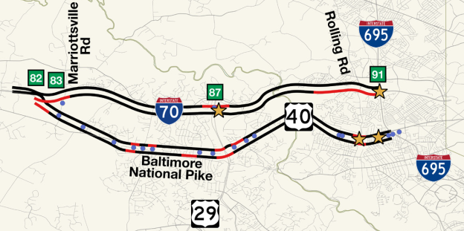
Design and Demonstration of an Arterial-friendly Local Ramp Metering Control System – Brief Overview of Project
We propose to develop theories, models and algorithms of machine learning to predict traffic patterns in real time being a typical recurrent pattern or non-recurrent pattern, and to optimize the timing plans for both ramp metering and street signals in the TSMO system.
The project will demonstrate the effectiveness and replicability of the models and algorithms in TSMO 1 system
Partners – Maryland DOT
Notes:
2

Slide 3
Design and Demonstration of an Arterial-friendly Local Ramp Metering Control System – Brief Overview of Project
We will develop a dynamic network model for TSMO 1 that provides estimated 5-min origin-destination demand among all street segments that vary by time of day.
The network model is capable of estimating network-wide traffic impact caused by 1) any incident in the TSMO network consisting of freeway and major arterials; 2) any signal timing; 3) any ramp metering rates. It has the capacity of modeling dynamic traffic evolution with the consideration of real-time travel control and traffic demand management.
This research advances knowledge and practice on real-time traffic management for TSMO systems, particularly on the coordination of local arterial signals and ramp metering.
Notes:
3

