Slide 1
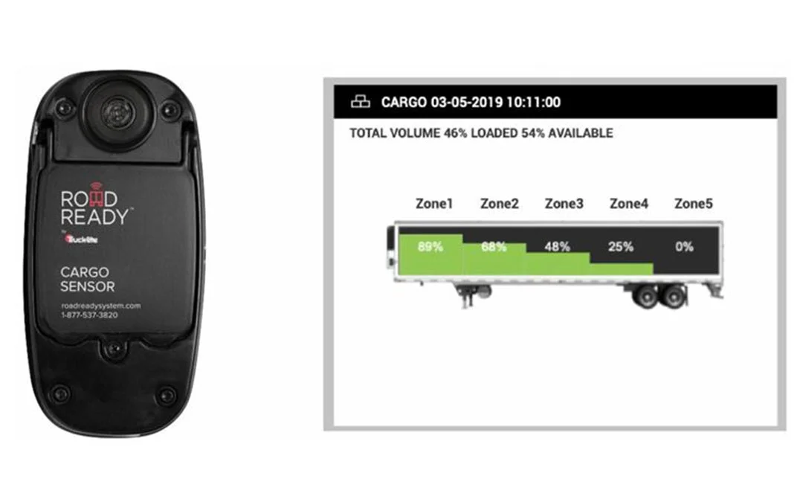
Towards Data-Driven and Continuous Safety Inspection of Commercial Trucks and Trailers
Lead Researcher: H. Scott Matthews, CEE
Project Team: Paul Fischbeck, SDS/EPP

Slide 2
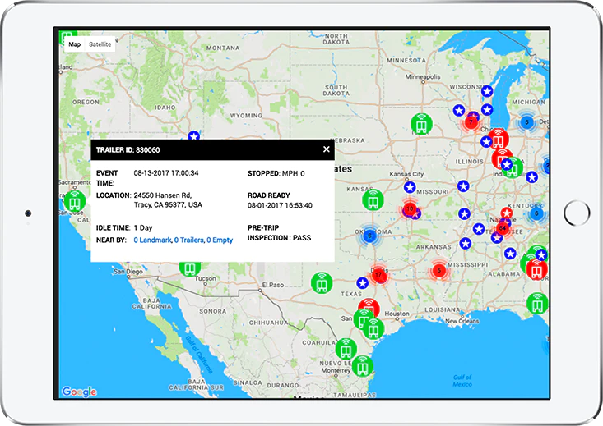
Towards Data-Driven and Continuous Safety Inspection of Commercial Trucks and Trailers
Brief Overview of Project
Goal: Creation of an integrated commercial truck telematics system that considers common safety failure modes and tracks/anticipates them
Partners – TruckLite, Road Ready, CompuSpections, and potentially FMCSA, PA State Police/PennDOT
Notes:
2

Slide 3
Towards Data-Driven and Continuous Safety Inspection of Commercial Trucks and Trailers
Expected Outcomes
Data Analytics of existing inspection failure modes, creation of IoT based dashboard
Journal paper submissions of project
Improved overall safety and awareness of issues in the commercial trucking fleet and to owner/operators
Notes:
3

