Slide 1
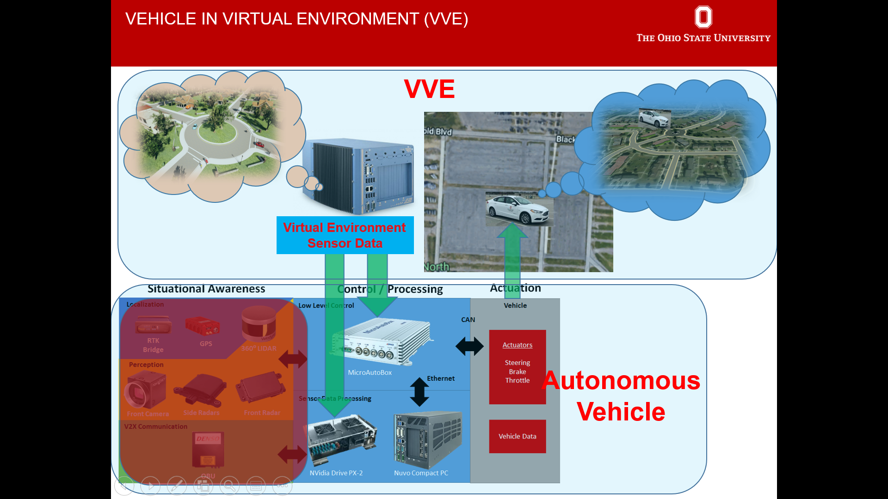
Vehicle-in-Virtual-Environment (VVE) Method for Developing and Evaluating VRU Safety of Connected and Autonomous Driving
Lead Researcher/Faculty: Levent Guvenc
Project Team: Bilin Aksun-Guvenc, Haochong Chen

Slide 2
Vehicle-in-Virtual-Environment (VVE) Method for Developing and Evaluating VRU Safety of Connected and Autonomous Driving – Brief Overview of Project
Goals: Improve safety of vulnerable road user (VRU) sharing the road with connected and automated vehicles using vehicle-to-VRU communication using the VVE development and evaluation method.
Focus on pedestrian safety (year 1)
Focus on bicyclist safety (year 2)
Notes:
2

Slide 3
Vehicle-in-Virtual-Environment (VVE) Method for Developing and Evaluating VRU Safety of Connected and Autonomous Driving– Expected Outcomes
Expected outcomes
Development of the VVE method for evaluating connected and autonomous driving functions with particular focus on VRU safety
Improved Vehicle-to-VRU communication based VRU safety system
Integration of project results into OSU courses
Notes:
3

