Slide 1
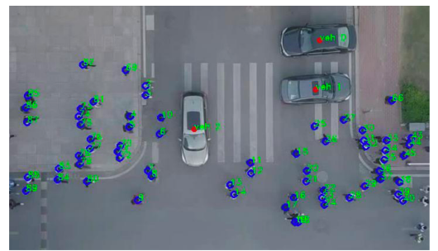
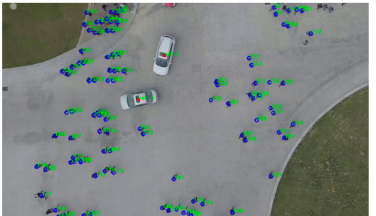
Understanding and Guiding Pedestrian and Crowd Motion for Improving Transportation (Driving) Efficiency
Lead Researcher: Ümit Özgüner
Project Team: : Ümit Özgüner, Dongfang Yang

Slide 2
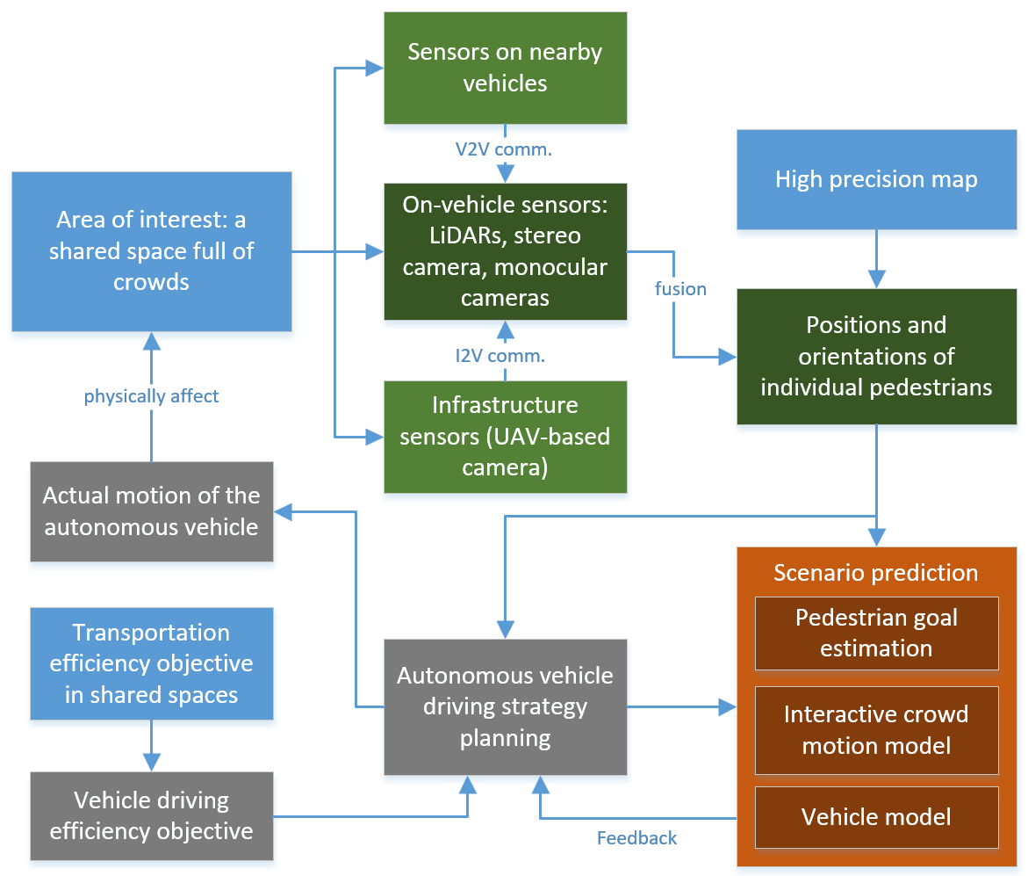
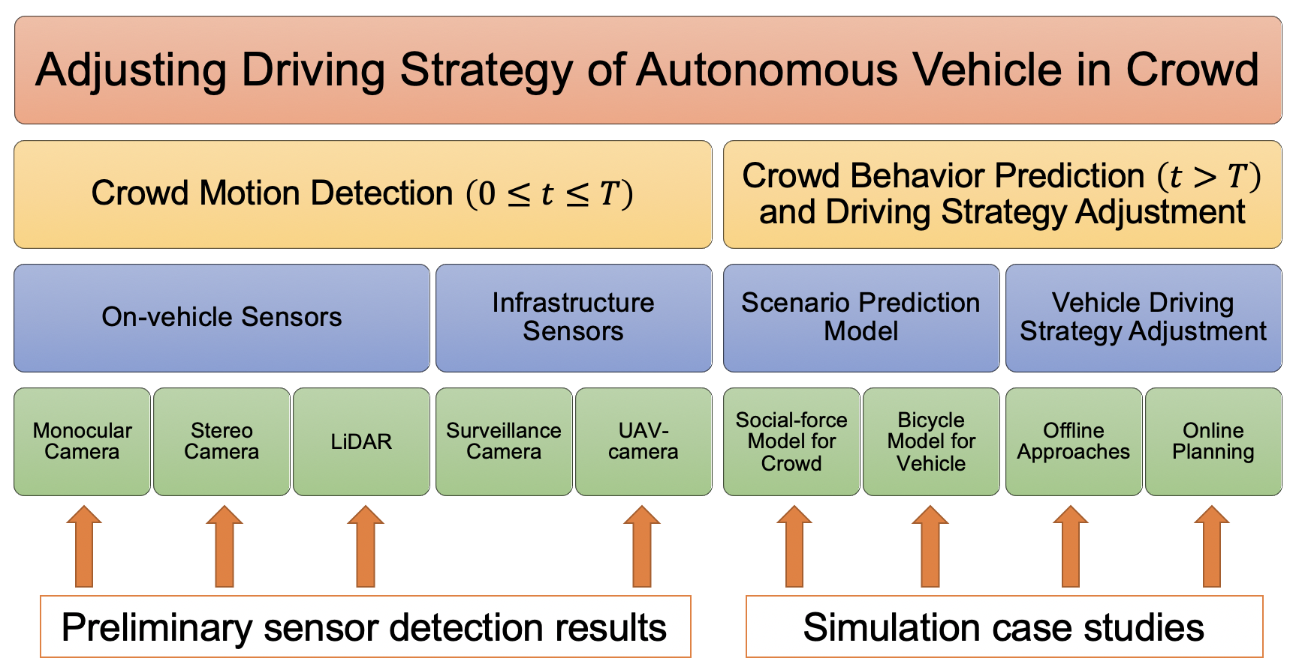
Project: Understanding and Guiding Pedestrian and Crowd Motion for Improving Transportation (Driving) Efficiency
Goal: improving transportation (driving) efficiency in shared spaces
A variety of sensors (stereo cameras, mono cameras, lidars, infrastructure sensors) to detect pedestrian motion
Vehicle-crowd interaction (VCI) models to predict pedestrian motion
Applications in vehicle in combination with VCI models
Offline approach: use simulation results in similar scenarios to guide the autonomous vehicle to generate a better driving strategy
Case study: using regression method to minimize the time of passing a pedestrian-dense area
Online approach: the autonomous vehicle constantly adjusts its driving strategy based on the immediate detection of pedestrians
Case study: applying model predictive control to regulate longitudinal speed of a vehicle in pedestrian-dense area

Slide 3
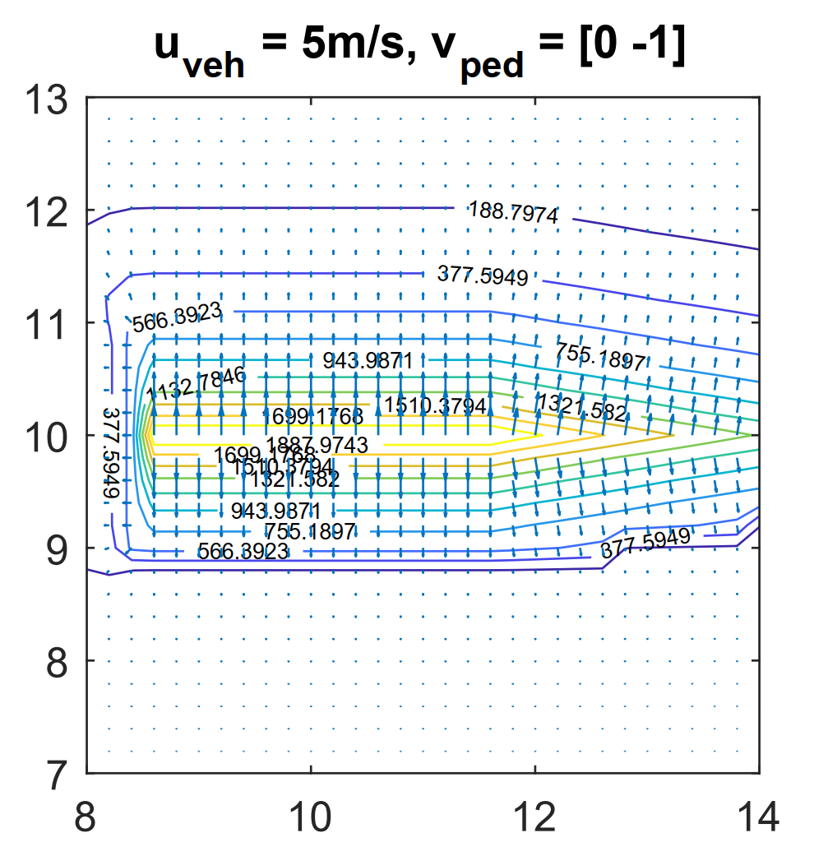
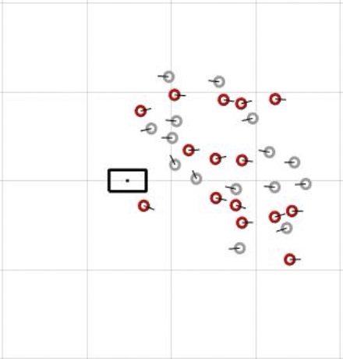
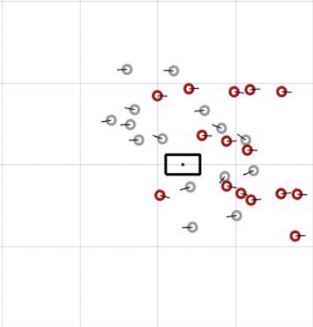
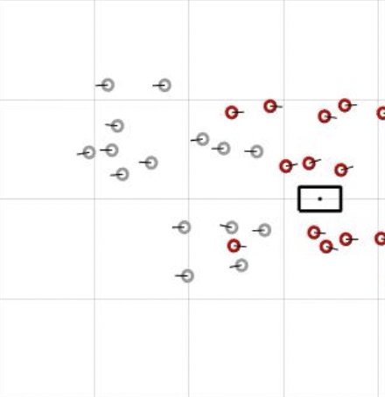
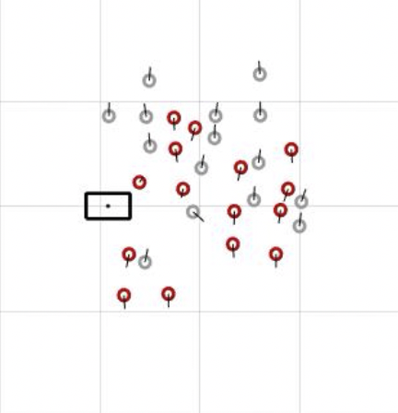
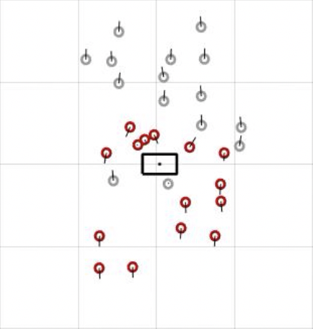
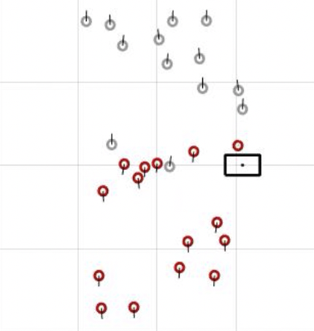
Project: Understanding and Guiding Pedestrian and Crowd Motion for Improving Transportation (Driving) Efficiency
Modeling Vehicle-Crowd Interaction (VCI)
Goal: describing the collective behavior of a crowd of pedestrians under the influence of an approaching vehicle
Improvement on social force model
Added vehicle influence on pedestrians, which is not available in most existing models
Adjusted/re-designed pedestrian-pedestrian interaction mechanism such that the vehicle influence can be incorporated
Calibrated the proposed model by using Genetic Algorithm (GA) based on the dataset of fundamental VCI scenarios
Validated the proposed model by evaluating the simulation result.
Modified individual forces in social force model:
An example of vehicle influence (force) on a pedestrian walking from +y to -y:
(1) contours - force magnitude;
(2) arrows - force directions
force from nearby pedestrians
force from the vehicle
force from destination
force from environment
back/front interaction
lateral interaction

Slide 4
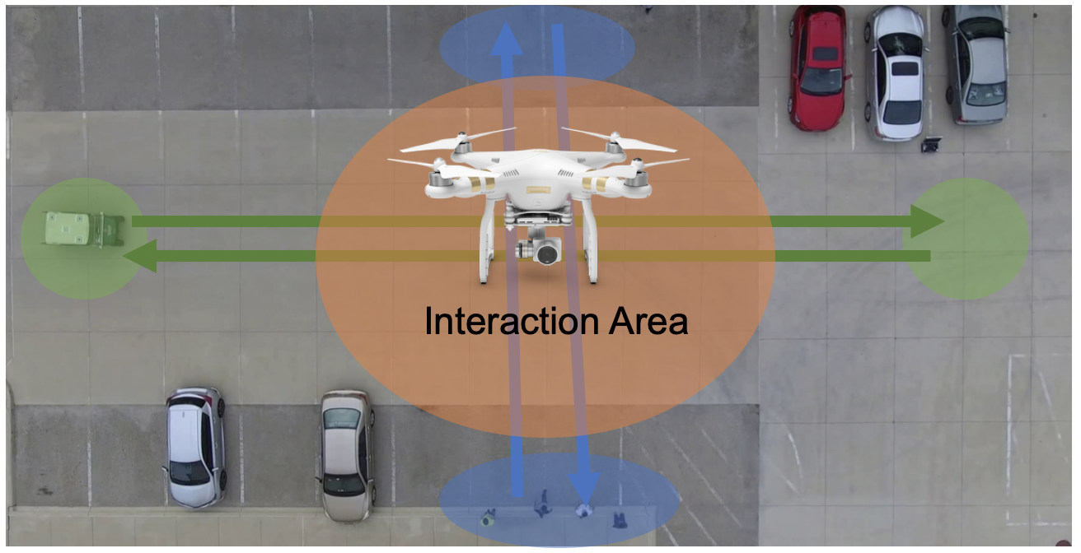
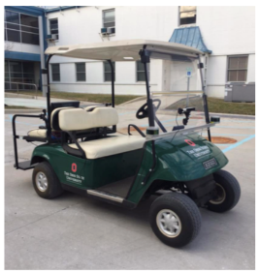
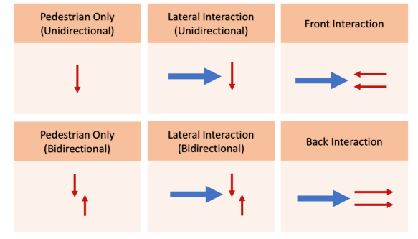
Project: Understanding and Guiding Pedestrian and Crowd Motion for Improving Transportation (Driving) Efficiency
Dataset Development
We provide two new datasets:
CITR Dataset: controlled experiments including fundamental VCI
DUT Dataset: everyday campus scenarios including natural VCI
Our dataset covers vehicle-crowd interaction:
Use drone as recording equipment – eliminate possible occlusions
Robust tracking techniques (CRST) – automatically (need initial position) obtain accurate trajectories
Kalman Filters for trajectory refinement: point-mass model for pedestrians, bicycle model for vehicles
CITR Dataset
DUT Dataset
Two locations:
- Crosswalk at unsignalized intersection
- A shared space near a roundabout
Controlled experiments
6 scenarios that can be pairwise compared and analyzed
CITR dataset on GitHub: https://github.com/dongfang-steven-yang/vci-dataset-citr
DUT dataset on GitHub: https://github.com/dongfang-steven-yang/vci-dataset-dut

