Slide 1
Towards Data-Driven and Continuous Safety Inspection of Commercial Trucks and Trailers
Monthly Progress
Pingbo Tang, Chenyu Yuan, Ruoxin Xiong
8.27.2021

Slide 2
Meeting Agenda
Overview of recent research activities
Problem Statement and Literature Review
Current Companies’ Concerns about Telematics
Current Practice
Data Analysis with Compuspections and Clarience
To dos

Slide 3
Overview of Recent Research Activities
Problem Definition and Literature Review
Literature review about Current Fleet Management Concerns
Comprehending the current practice
Exploratory Data Analysis on FMCSA Dataset
Questions in Clarience Dataset and its potential connection with FMCSA Dataset
Questions in Compuspections Dataset
Potential Data Information Requests

Slide 4
Problem Statement – Current Fleet Management Concerns
The evolution of truck telematics:
Common Trailer Sensors
Improved Trailer Sensors
Wheel-end bearing vibration
Cargo load capacity
Brake temperature and wear
ABS health
Hard braking events
Air tank pressure
Trailer weight
GPS tracking
Lighting
Cargo door open/closed
Temperatures
Tire pressure
Wheel-end temperature
Overall Problems:
How to choose a good and suitable telematics system to fleets?
Identifying priorities before getting started (Tracking the GPS location, early indication of failure…)
Putting data in the right hands (Improving Internet Connection)
Providing power to the system (Extending battery life and shortening charging times)
What KPIs are concerns to supply chain and fleet management?
Driver dispatchment
Internet Connection Improvement
Standardization of basic things like brake wear and inflation
On-time and on-temperature optimization

Slide 5
Current Practice – An Overview of Dataset we had
The Current CMU Team had:
CSA_RANK_12_Months
A description of registration information of each company
Top 100 Fleets in N.America (from Clarience)
A registration table of companies and their vehicle’s information
ALL TRAILER SENSOR REPORT (from Clarience)
Cargo Sensors’ feedback information such as cargo status and speed
6962-inspection
inspection data (from Compuspections)
What analysis has been ongoing or done:
An Exploratory Data Analysis of FMCSA data (Census, Safety Measures Rating, Inspection, Crash)
A connection and comparison between Clarience’s telematics data and FMCSA data: Not very ideal, need more clarification about DOT number. (Need Clarience’s feedback)
Compuspection’s data EDA
A connection between FMCSA data and Compuspections data

Slide 6
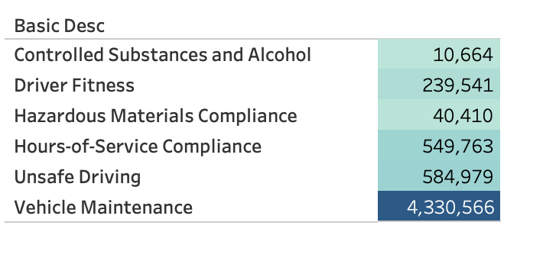
Current Practice – FMCSA Dataset
Motor Carrier Census Information
Motor Carrier Safety Measurement System (SMS) Results
Motor Carrier Inspection Information
Motor Carrier Crash Information
 | Unsafe Driving Performance Measure | HOS Driving Performance Measure | Driving Fitness Performance Measure | Controlled Substances and Alcohol Performance Measure | Vehicle Maintenance Performance Measure
Min | 0.00 | 0.00 | 0.00 | 0.00 | 0.00 0.00 3.18 5.58 8.23 30.00
1st. Qu. | 0.00 | 0.00 | 0.00 | 0.00 | 0.00
Median | 0.00 | 0.00 | 0.00 | 0.00 | 3.18
Mean | 2.07 | 0.54 | 0.57 | 0.03 | 5.58
3rd Qu. | 1.37 | 0.00 | 0.00 | 0.00 | 8.23
Max | 543.00 | 30.00 | 30.00 | 23.00 | 30.00

Slide 7
Current Practice – FMCSA Dataset
Motor Carrier Census Information:
Analyze the carriers by fleet size and functionality
Motor Carrier Safety Measurement System (SMS) Results:
Find the strategies to decrease each BASIC measures
Connect Clarience data to SMS results to compare the performance with or without telematics
Motor Carrier Inspection Information:
Connect Compuspection data to inspection information data to find the most failure-prone component on the truck
Motor Carrier Crash Information
Connect possible environment data (weather, traffic condition) and telematics and inspection data to crash information, to analyze the cause of crash and evaluate the severity

Slide 8
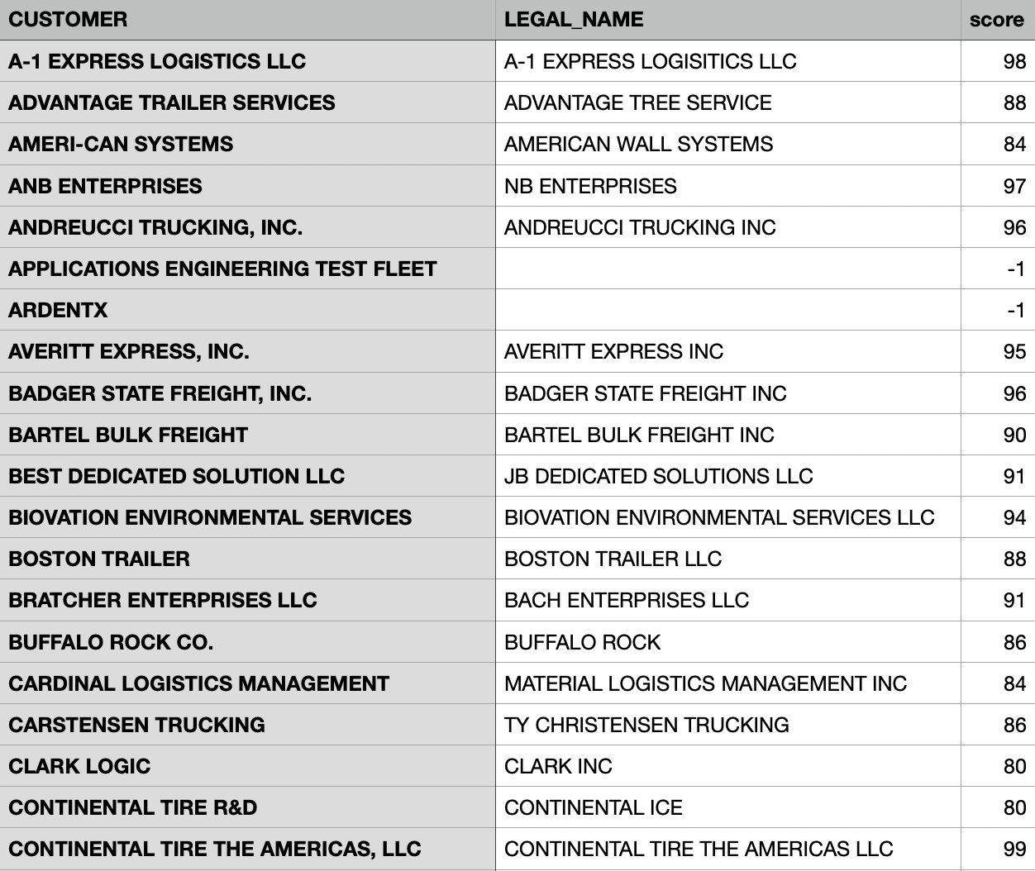
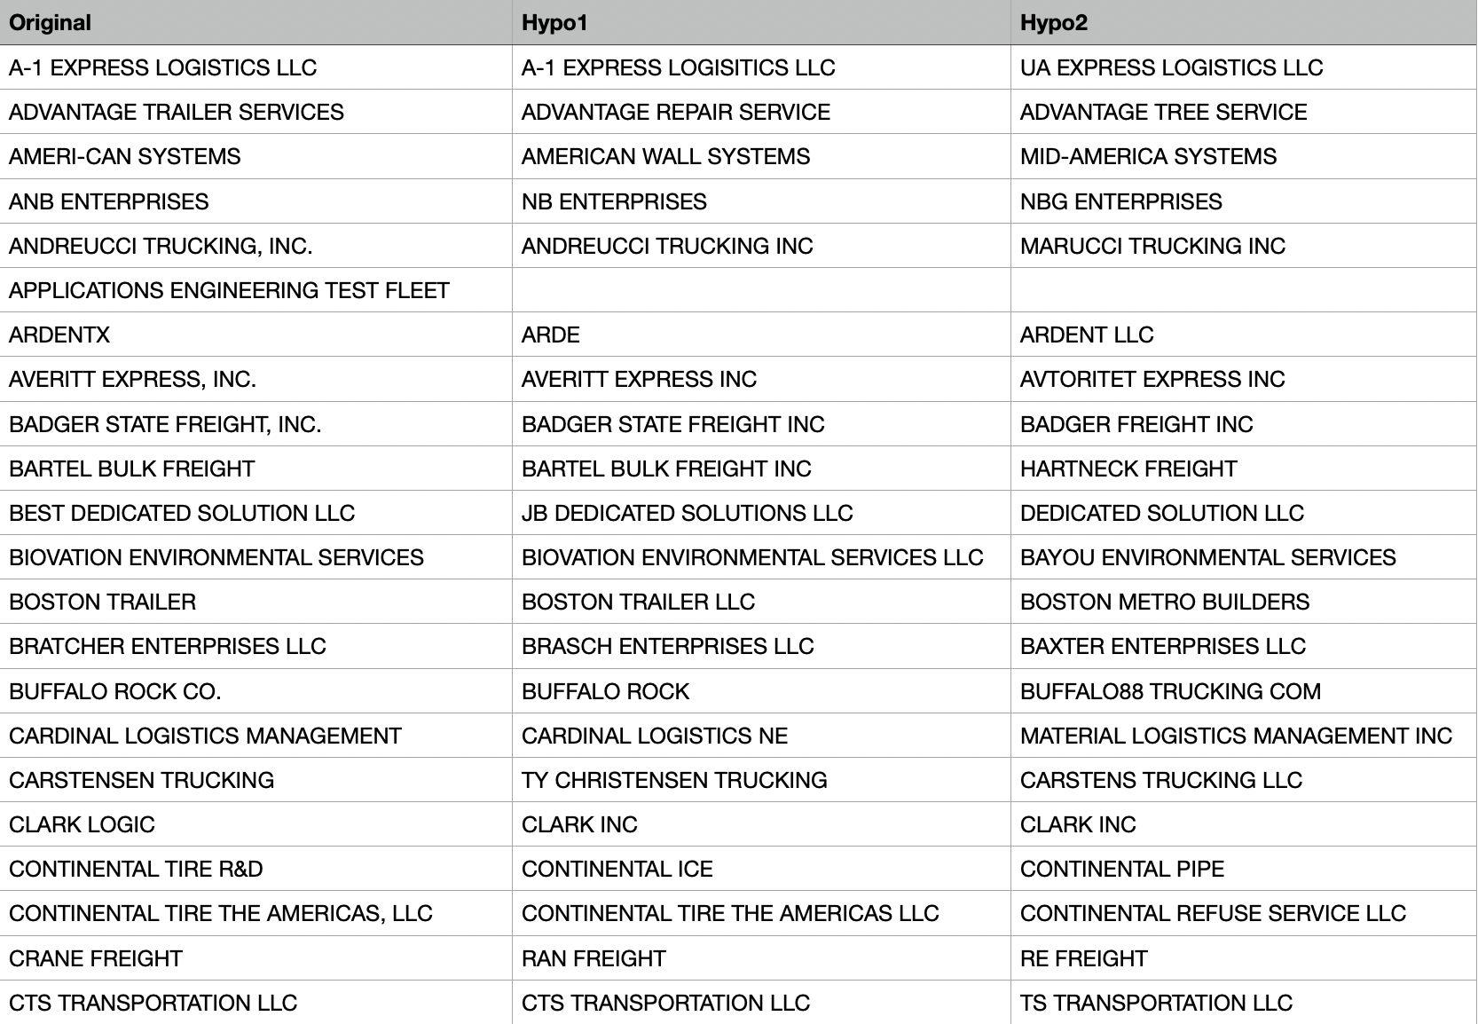
Current Practice – Clarience Cargo Sensor Dataset
Fuzzywuzzy
Difflib
Difficulties: Can’t distinguish correct matches from wrong.
How about a dictionary that we can get registration information? (include DOT number inside)

Slide 9
Current Practice – Clarience Cargo Sensor Dataset
The size of Clarience’s partners:
A comparison of Carrier’s performance:
﻿Size | Count
Very Small (1-6) | 77
Small (7-20) | 16
Medium (21-100) | 16
Large (>= 100) | 10
﻿ | Clarience | Other Carrier
Unsafe Driving Measure | 1.21 | 0.64
Hour of Service Driving Measure | 0.16 | 0.17
Driving Fitness Measure | 0.29 | 0.18
Control Substance Measure | 0.00 | 0.01
Vehicle Maintenance Measure | 2.50 | 1.73
(Count by number of power units)

Slide 10
Naming Questions– Clarience Cargo Sensor Dataset
Could we know the cargo weight? (overload may cause speed slow and potential overload issue)
What’s the meaning ’SIGNAL’ column? Does it mean signal strength? It seems that most signal strengths are less than 30, while a few of them are 99, very few values between 30 and 99, any special reasons for that observation?
For ‘CARGO RAW DATA,’ we saw something like (1700004994, cargo, 25). What’s the meaning of 25 here? We know 1700004994 is sensor id and cargo is cargo status.
What’s the unit of speed?
In ’SENSOR PARAM,’ what’s the meaning of (UNKNOWN, 65.86)? What does 65.86 mean?
What’s the meaning of ‘REPORT’ and ‘UNKNOWN MESSAGE’ sheet? Is there any special purpose to have two different tabs in the Excel file?
Could we explain many missing values for the columns of ‘CARGO SENSOR ID,’ ‘CARGO RAW DATA’ and ‘CARGO STATUS’ records? Most of them remain blank. Would missing values mean anything special?
Could we know which truck the sensor is installed on by the VIN code? It would be great if we could match each sensor to the corresponding truck. It could also be more convenient for us to extract any driver’s fitness information. So we can know who is taking charge of the trailer.

Slide 11
Informational Questions– Clarience Cargo Sensor Dataset
We think it’s good for us if there’s a registration information dataset so that we can match motor carriers to FMCSA datasets.
We are trying to see whether a carrier has a different performance with and without using telematics. One possible way is to find out the date a given company installed or stopped using the telematics system, and then check whether its performance changes. Would it be possible for us to get some historical data from Clarience to show when a carrier installed or stopped using telematics? We can discuss how telematics influenced the performance of a carrier, in terms of safety records or other aspects of the organization, or even the environmental conditions and social-technical contexts (policies, etc.).
Finally, as a summation, here’s a list of telematics that we would love to study more if the data were accessible, any comments or suggestions from you would be appreciated:
Tire tread, inflation(pressure), damage
Brake Condition
Lighting System
Speed, braking distances, acceleration
VIN number
Cargo temperature and weight
Electronic-logging Device (Hour of service?)

Slide 12
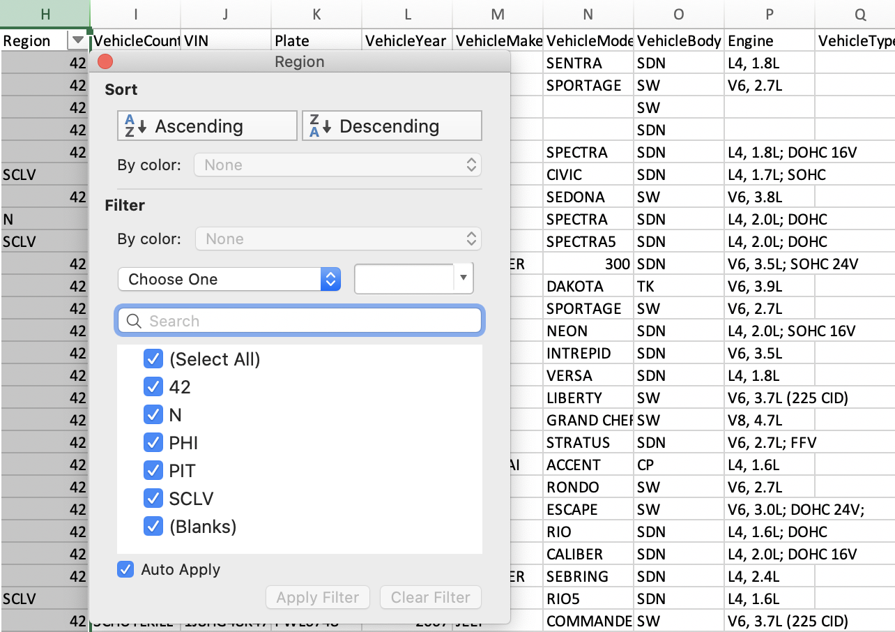
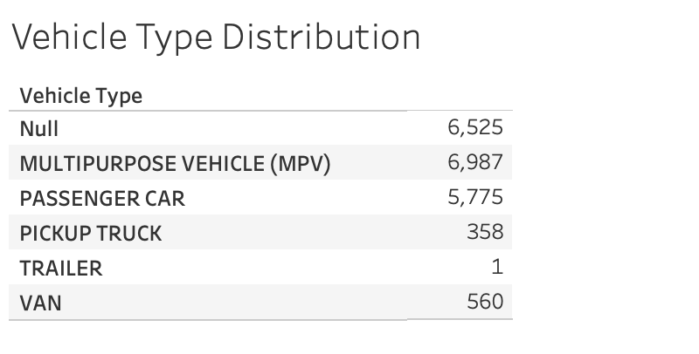
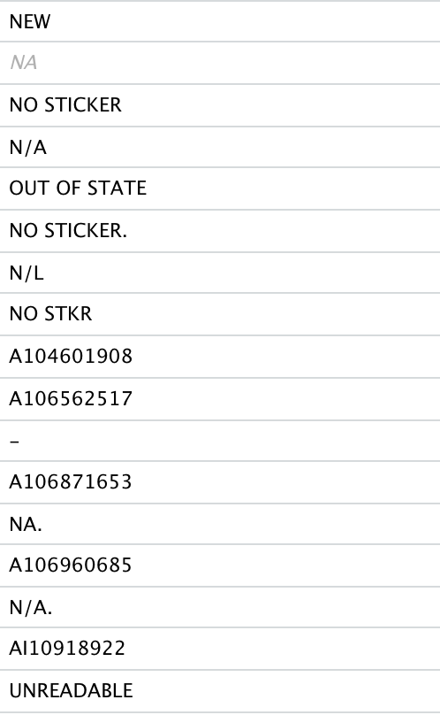
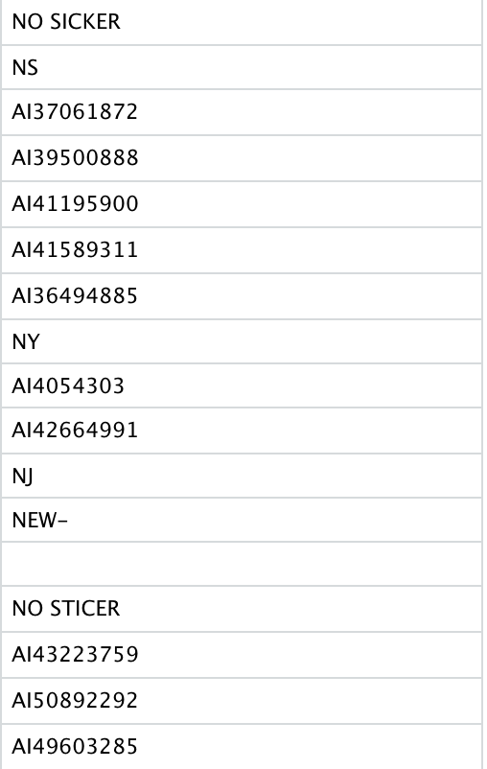
Current Practice - Questions in Compuspections Dataset
Region: What does SCLV mean?
Vehicle Type: I found most of them are passenger car, are they not our research objects? And I can’t match any VIN code from Compuspections to FMCSA datasets.
Unreadable Old Odometer Reading (7747/20206):
NA value
No sticker
Numbers start with ‘A’
State Code

Slide 13
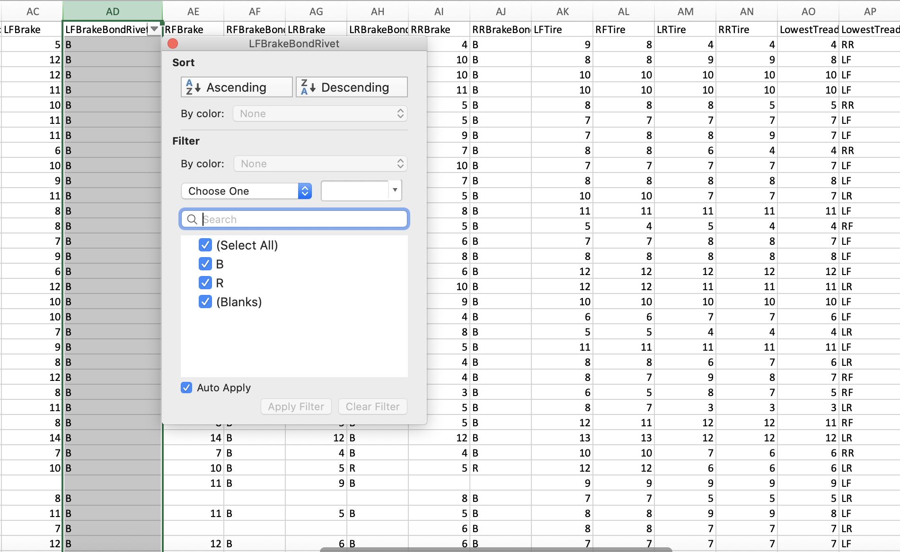
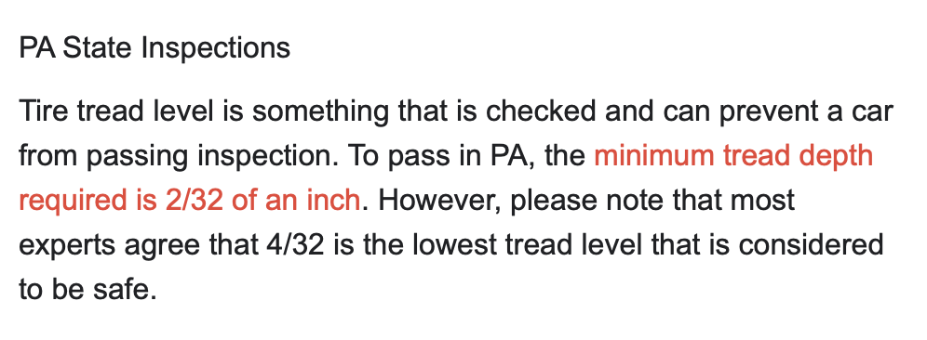
Current Practice - Questions in Compuspections Dataset
The meaning of ‘IP’ ?
I think we need a code clarification of brake bond rivet (B & R)
And we should also ask about the unit of number, I guess it’s ?/32 inches?

Slide 14
Current Practice - Data Analysis about Compuspection Dataset
A description table about Pass/Failed Inspection and each component
 | Failed Doors Test | Pass Doors Test | Failed Valid Registration Card | Pass Registration Card | Failed Lighting | Pass Lighting | Failed Steering | Passed Steering
Failed Inspection Test | 7 | 126 | 5 | 128 | 51 | 82 | 30 | 103
Passed Inspection Test | 3 | 20068 | 0 | 20071 | 549 | 19522 | 131 | 19940
 | Failed Exhaust | Passed Exhaust | Failed Fuel | Passed Fuel | Failed Glazing | Passed Glazing | Failed Other Components | Passed Other Components
Failed Inspection Test | 11 | 122 | 0 | 133 | 10 | 133 | 21 | 112
Passed Inspection Test | 39 | 20032 | 4 | 20200 | 111 | 19960 | 526 | 19545
Some vehicles’ component may fail the test, but their vehicle can still pass the overall inspection. In what kind of regulation, they can pass the inspection test?
 | Failed Brake System | Passed Brake System | Failed Road Test | Passed Road Test | Failed Tires | Passed Tires
Failed Inspection Test | 46 | 87 | 6 | 127 | 47 | 86
Passed Inspection Test | 358 | 19713 | 0 | 20071 | 159 | 14991
A = Accepted?
R = Right?
F = Failed?

Slide 15
Potential Data Requests
Clarience:
A registration information dataset (with DOT number)
A historical data to show when a carrier installed ot stopped using telematics? (in order to compare the performance)
Other potential sensors (tire, brake, light and so on)
Compuspections:
A truck inspection record that included annual-recurring inspection for partners?
Any comparison datasets we can get from annual inspection to road-side inspection?
A code book to explain some abbreviation questions?

Slide 16
To dos
Find the most failure-prone components during each inspection and potential risk if not fixed (Based on data provided)
Discuss the telematics performance for BASICs measure if we got a registration dataset with corresponding DOT number
Compare the performance of road safety with and without telematics
Any other recommendations?

