Slide 1
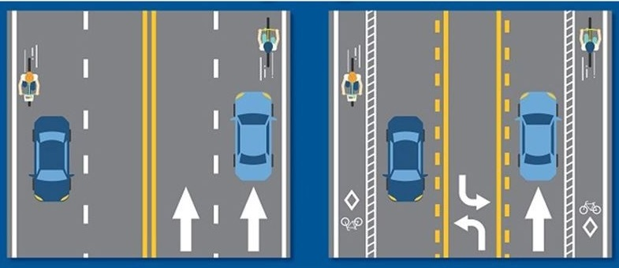
Forbes Avenue Betterment Project: A Before & After Impact Study
Dr. H. Scott Matthews - Dr. Chris Hendrickson - Dr. Zhen (Sean) Qian – Dr. Corey Harper
Lead PhD Student Researcher: Rick Grahn (CEE)
Other Research Assistants: Yanyu Yan, Kangrui Ruan, Anamika Shekhar
Before
After
[https://www.insidehalton.com/news-story/7968904-burlington-committee-votes-to-end-new-street-cycling-road-diet-project/]

Slide 2
Forbes Ave - Before and After Impact Study
Goals: Quantitatively assess transportation network impacts resulting from Forbes Avenue reconstruction project
Assessment topics:
Vehicular volumes, speeds, emissions and noise
Public transit ridership/reliability
On- and near-campus parking demand
Walking/bike transit volumes
Perceptions of safely/accessibility
Existing
Proposed
Partners (public, private, community): CMU, PennDOT, GAI
Notes:
2

Slide 3
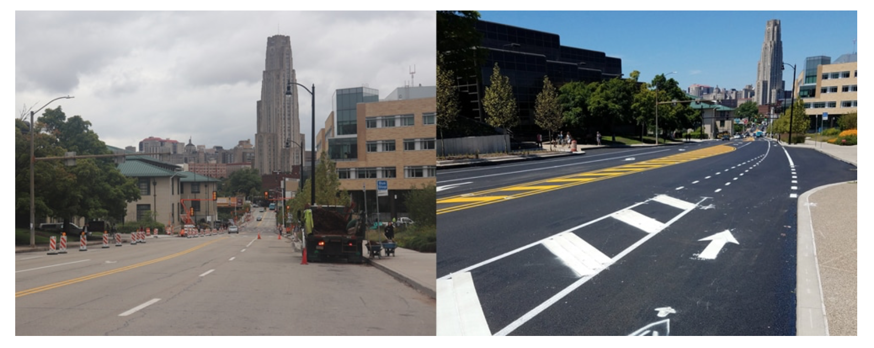
Before
After
Source: bikepgh, https://www.bikepgh.org/2019/07/19/

Slide 4
Relevant Project Challenges
Original Construction Timeline was CY 2018
This project funded to be done by last summer
The “after” phase should have started almost a year ago.
Frankly, its still not quite done so really we haven’t seen the actual after phase yet!
Surtrac system not turned on yet?
Despite this, have some relevant preliminary findings to share
Notes:
4

Slide 5
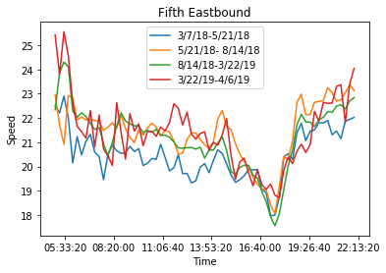
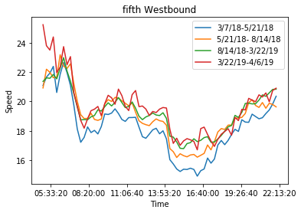
Some Relevant Findings
Benchmark – Parallel City/County owned road (4 lanes) FIFTH AVE
No significant changes in speed observed in time period (diversions)
Data from INRIX
Notes:
5

Slide 6
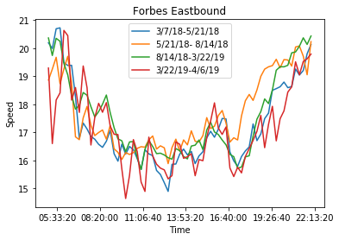
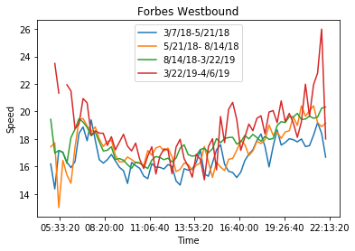
Some Relevant Findings
The actual Forbes Avenue corridor
Also no significant changes in speeds observed, including during construction and reduction from two to one lanes
Notes:
6

Slide 7
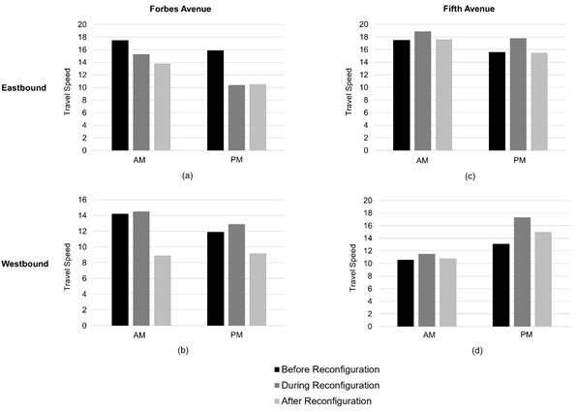
Average Speeds Compared
Notes:
Corey: So I looked at an identical week (i.e., the week after labor day) in September before, during (one-lane eastbound), and after construction for Forbes and Fifth Ave and that's how I got those numbers. It looks like they took the average over some months and data up to April 2019 were captured in the scatter plot.

Slide 8
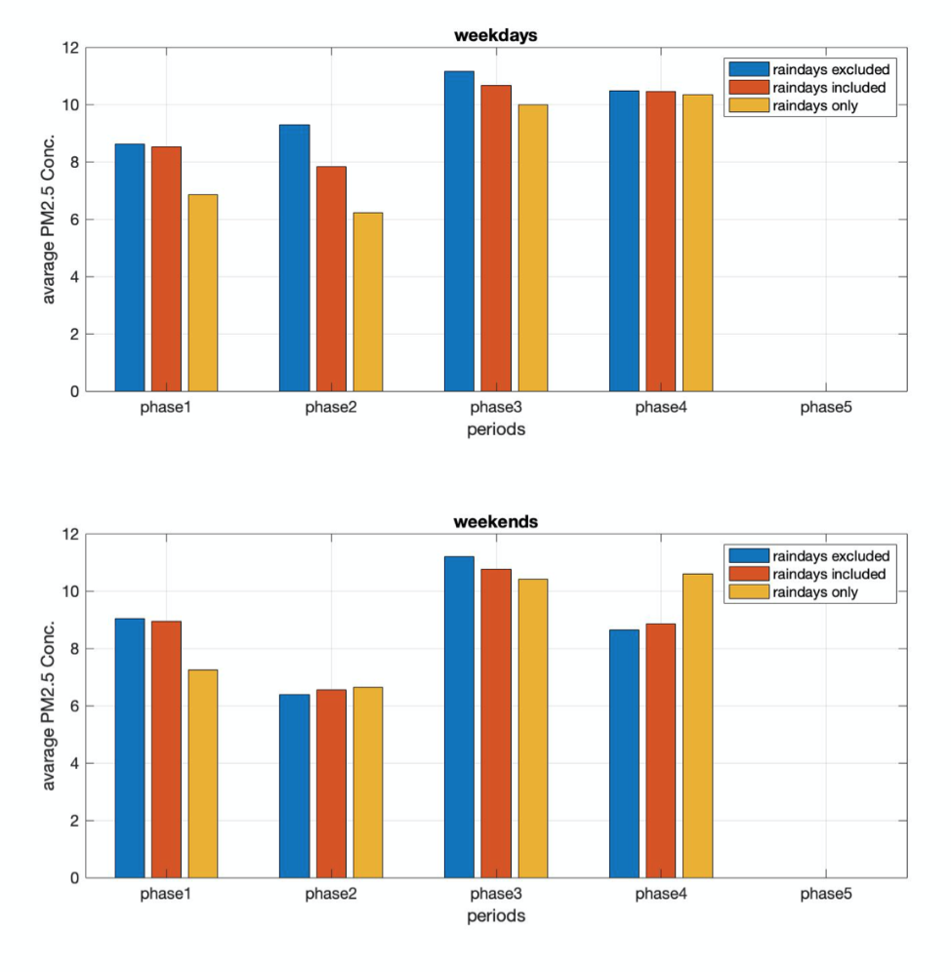
Some Relevant Findings
Particulate Matter Emissions have slightly increased in the last few periods
But these included summer, so we continue to explore statistical tests to separate seasonal effects
Notes:
8

Slide 9
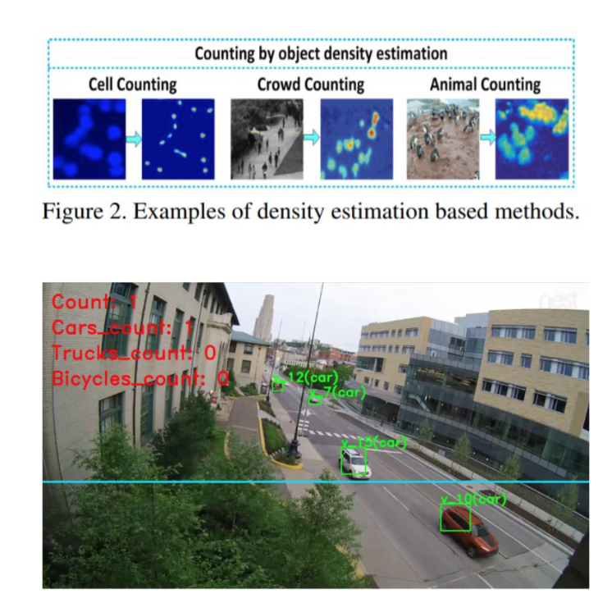
Tracking Use via Video
We installed a network of video cameras to watch Forbes Ave
We are processing hundreds of hours of video to attempt to
track cars, trucks, buses, and bikes
We do not have final results yet, but should soon.
Issues:
Camera placement not ideal (trees have grown!)
Angles make counting problematic
Very hard to distinguish bicycles even in known lanes
Notes:
9

Slide 10
Summary
The Forbes reconstruction was a significant change to this corridor
Large investments by multiple parties (including CMU)
Anecdotally, bicycle use in bike lanes has gone up highly
Speeds do not seem to have changed appreciably despite 50% reduction in capacity
Notes:
10

