Slide 1
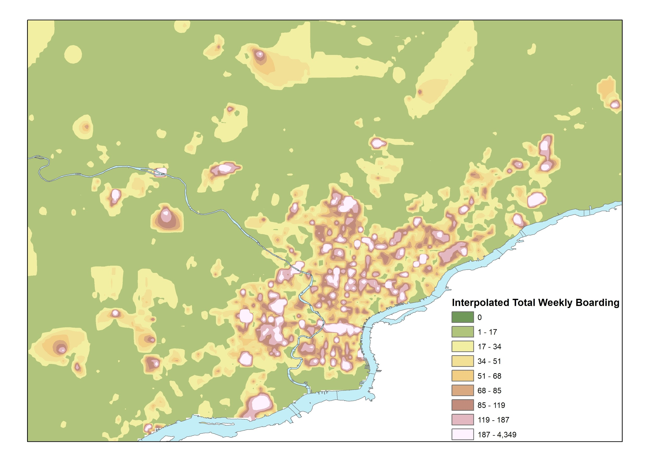
Transit dependents, choice riders, and service criticality
Lead Researcher: Erick Guerra
Project Team: Han Qiao, Tzu Wang, Bingyu Chiu
Weekly Boarding by SEPTA stops
2017 Stop Ridership Data
From GIS Portal

Slide 2
Transit dependents, choice riders, and service criticality
Develop and test an empirically based theory of transit-dependency using a predictive model of transit mode choice in the Philadelphia region
Identify types and locations of neighborhoods most likely to increase transit use in response to service changes from a planned bus network redesign.
Partners – City of Philadelphia, SEPTA, Delaware Valley Regional Planning Commission
Notes:
2

Slide 3
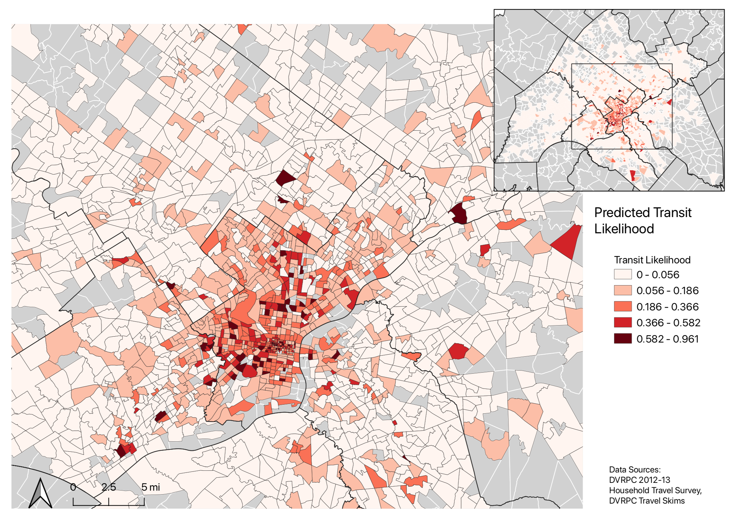
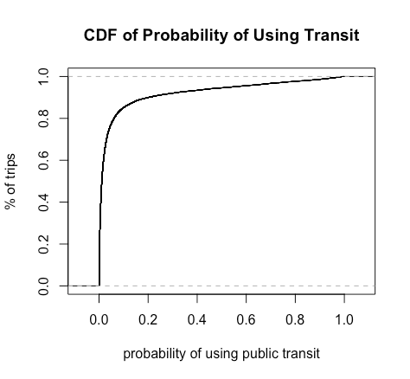
Transit dependents, choice riders, and service criticality
Notes:
3

Slide 4
