Slide 1
Incentivizing Participation in Peer-to-Peer Ride-Sharing Platform
Lead Researcher: Fei Fang
Project Team (CMU): Fei Fang, Alexandre Jacquillat

Slide 2
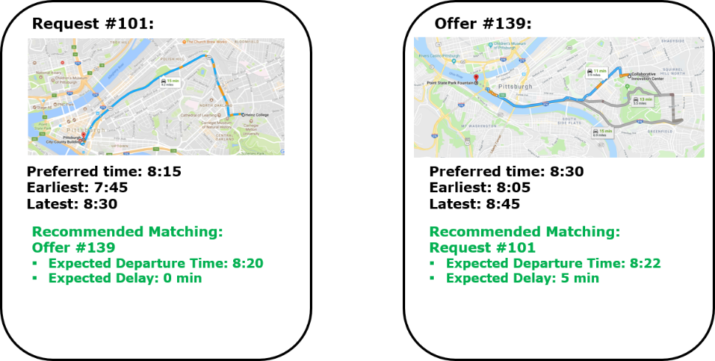
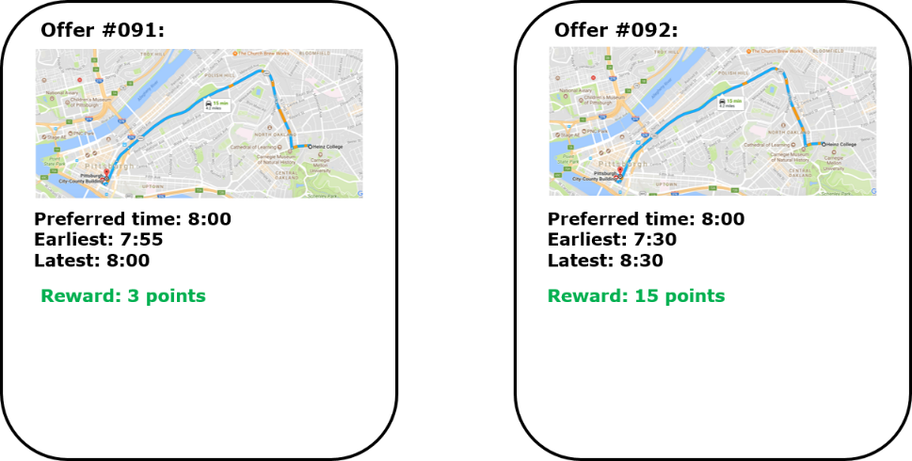
Incentivizing Participation in Peer-to-Peer Ride-Sharing Platform – Brief Overview of Project
Goals:
Promote ride-sharing, reduce the costs of travel, mitigate transportation-induced emissions, and enhance access to urban areas
Incentivize participation in peer-to-peer ridesharing
Anticipated Outcomes
Improved participation through matching algorithms and reward schemes that can be integrated into peer-to-peer ridesharing App (See Figures)
Partners
Allegheny County Office of Children, Youth and Families, Hulton Arbors, Lawrence County
Notes:
2

Slide 3
Incentivizing Participation in Peer-to-Peer Ride-Sharing Platform – Expected Outcomes
Expected outcomes
Improved participation through matching algorithms and reward schemes that can be integrated into peer-to-peer ridesharing App
Benefit
Participants (including riders and drivers) can be matched efficiently, with all their needs taken into account
Participants will be more motivated to share rides with others
Savings in total travel cost and improved mobility
Notes:
3

Slide 4
Current Progress - Scheduling
Input:
For each driver and rider: origin, destination, preferred, earliest, latest departure time
Distance between each location pair
An estimation of the cost of not being able to pick up a rider
An estimation of the cost of deviation in departure time and delay due to ridesharing per minute
Algorithm
Extending [Alonso-Mora et al, 2017] to consider preferred time
The algorithm is general enough to handle more complicated cost structure
Output:
Assignment of drivers to riders, departure time, and expected delay due to ridesharing

Slide 5
Current Progress - Scheduling
Runtime for finding exact optimal schedule with 3 driver offers

Slide 6
Next Step - Pricing
Give drivers and riders rewards in points
Asking riders to share cost with drivers in a certain way

Slide 7
Need Information
Estimation of driver offer / rider request pattern
Estimation of how well the drivers / riders will be incentivized if rewards / payment is involved

