Slide 1
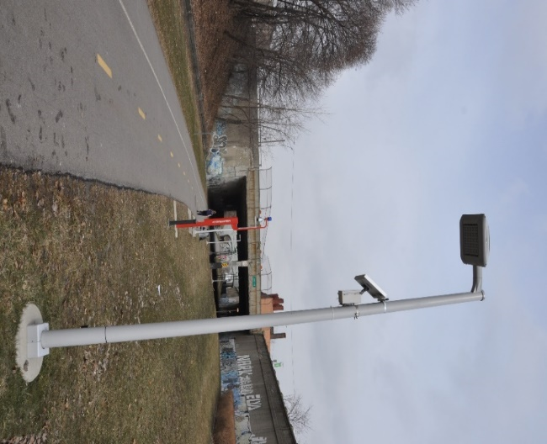
Smart and equitable parks: quantifying returns on investments based on probabilistic mobility-dependent correlates of park usage using cyber-physical system technologies
Lead Researcher:
Katherine A. Flanigan, Ph.D.
Project Team:
Katherine A. Flanigan (CEE)
Karen Lightman (Metro21)

Slide 2
Project Overview
Goal: This work explores social infrastructure (e.g., urban park) use and correlates of use related to mobility services (i.e., their quantitative linkage to economic growth through equitable access to essential services) using cyber-physical system technologies in order to bring to light ways in which city officials and planners can quantify data-driven returns on potential investments to parks and mobility services and implement changes that will uniformly distribute these benefits.
Anticipated stakeholder benefits: Given changes proposed by city officials and the public (such as through the open-source software platform Kurb), we anticipate being able to quantify returns on investments through corresponding shifts in the magnitude of the network probability of failure. Here, a community’s system-wide failure is defined as any subset of the community’s population not being able to access and/or benefit sufficiently (if at all) from its surrounding community’s resources.
-=
Pittsburgh Parks Conservancy
Carnegie Mellon University
City of Pittsburgh
Notes:
2

Slide 3
Expected Outcomes
Outcome #1: Formalization of a data-driven probabilistic spatio-temporal network reliability problem that accounts for stochastic link and nodal weights.
Outcome #2: Formalization of a novel lower limit state function that accounts for a community’s system-wide failure as defined as any subset of a community’s population not being able to access and/or benefit sufficiently (if at all) from its surrounding community’s resources. This lower limit state function is integral to accounting for equity in the system performance metric.
Outcome #3: Application of the theoretical framework to a testbed using 7 months of sensed data. In situ data will provide a wealth of information necessary to characterize the probabilistic health of key transportation linkages based on, for example, daily environmental (i.e., weather) and operational conditions, which influence the network’s probability of failure.
Notes:
3

