Slide 1
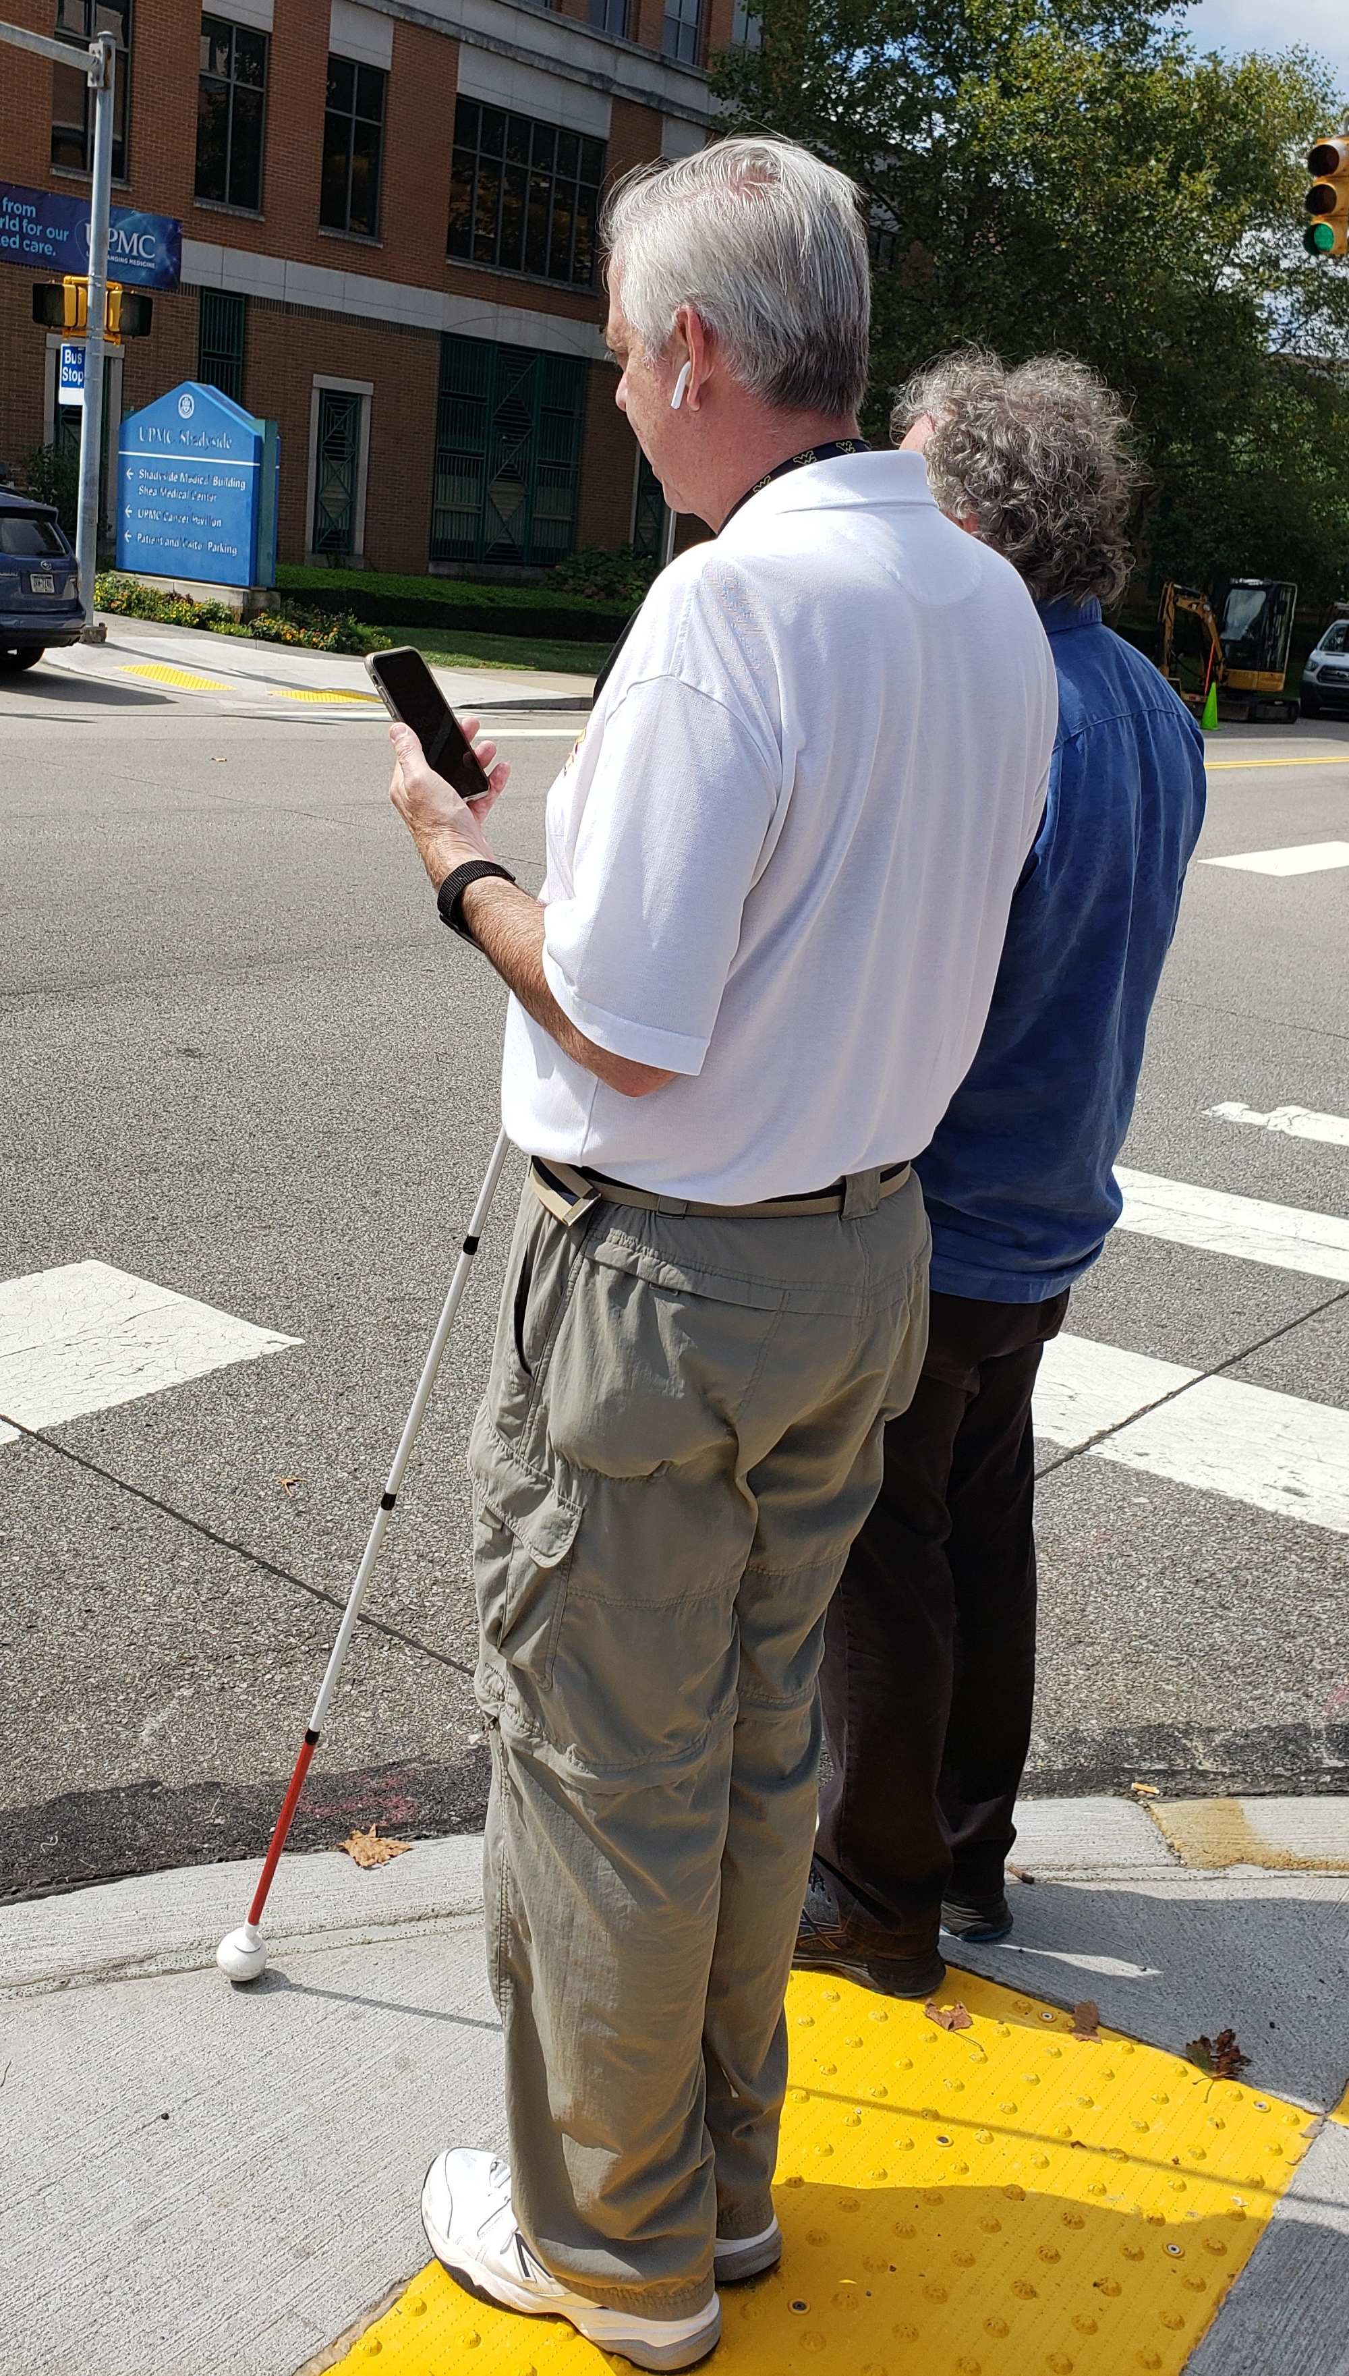
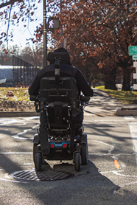
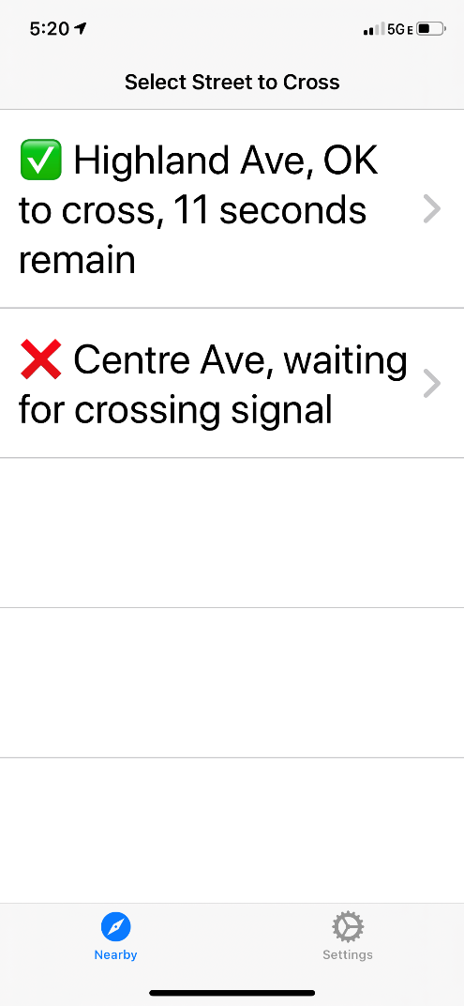
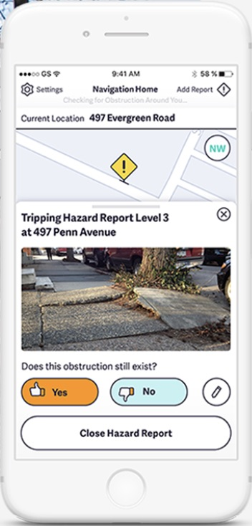
Creating and Integrating Solutions to Enable the ‘Complete Trip’
Lead Researcher: Stephen F. Smith
Project Team: Patrick Carrington, Artur Dubrawski, Srinivasa Narasimhan, Jean Oh, Zachary B. Rubinstein, Robert Tamburo,
Yi Zhang
Project Website: To appear
Pedestrian Friendly Routing and Navigation
Safe intersection crossing

Slide 2
Creating and Integrating Solutions to Enable the Complete Trip – Overview
Goal: Complete trip technology support for travelers with disabilities
Pedestrian friendly routing, Real-time obstacle detection and autonomous wheelchair assist, Safe intersection crossing, Coordination w/ public transit
Anticipated Outcomes: Increased travel safety and efficiency
Partners
PathVu- sidewalk database, wheelchair routing app
Rapid Flow Technologies - real-time signal control
Argo AI - autonomous vehicles
Notes:
2

Slide 3
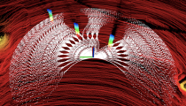
Creating and Integrating Solutions to Enable the Complete Trip – Expected Outcomes
Novel Capabilities
A wearable device that provides support for route planning, navigation, and intersection crossing
Speech-driven autonomous wheelchair navigation
Real-time connectivity to nearby vehicles and buses
Impact
Safer, less stressful, and more efficient travel for pedestrians with disabilities
Advancement of technology for automated wheelchair travel and sidewalk mapping
Notes:
3

