Slide 1
Clustering Heavy Duty Truck Failure Modes for Proactive Safety Inspection and Efficient Operations of Commercial Vehicle Fleets
Chenyu Yuan
Presentation at the 7th Annual UTC Conference for the Southeastern Region in Boca Raton, FL

Slide 2
Content
Motivation and Introduction
Data Sources
Current Practice
Conclusion and Future Work

Slide 3
Motivation and Introduction
Cluster
Explore different failure mode for different groups of vehicles
Historical Truck Inspection Data
Basic Feature Importance Selection
A user-interactive dashboard
Statistical fact of fleet performance
Cost/Safety-Oriented Consultant
Predict the potential risks compared with FMCSA vehicle maintenance criteria
Design
Compare
Historical Truck Crash Data
FMCSA Satisfactory Indicator
feedback
Real-time Telematics Data (under permission)
Set up a data collection plan for fleet and carrier

Slide 4
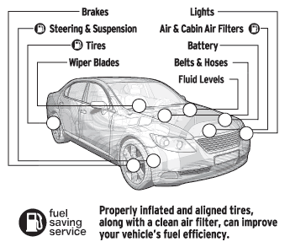
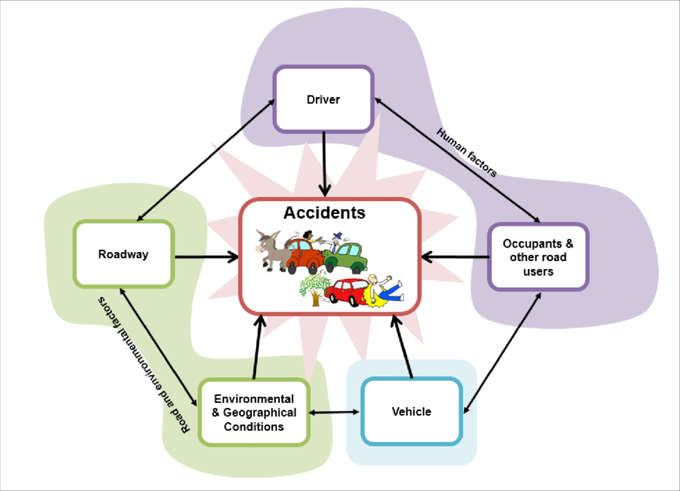
Data Sources
Compuspections
MCMIS Database (From Federal Motor Carrier Safety Administration)
MCMIS Database (From Federal Motor Carrier Safety Administration)

Slide 5
Current Practice – Data Preprocessing
5 Different Datasets:
A: Only 1
B: Only 2
C: 2 + 3
D: 1 + 2
E: 1 + 2 + 3
1. Background Information
2. Key Component Failure Information
3. Key Component Failure Information but with large pieces of missing
5

Slide 6
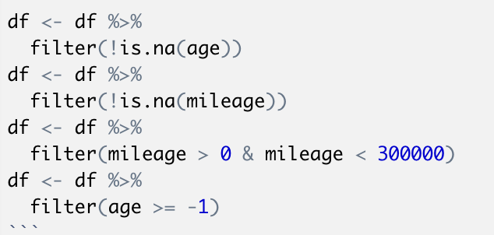
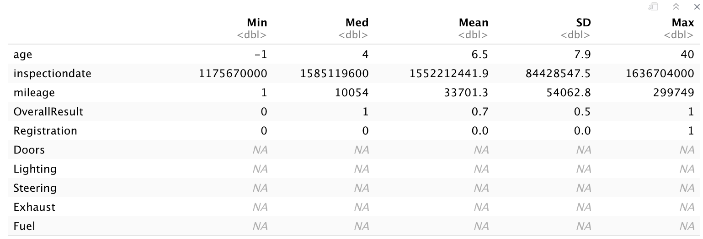
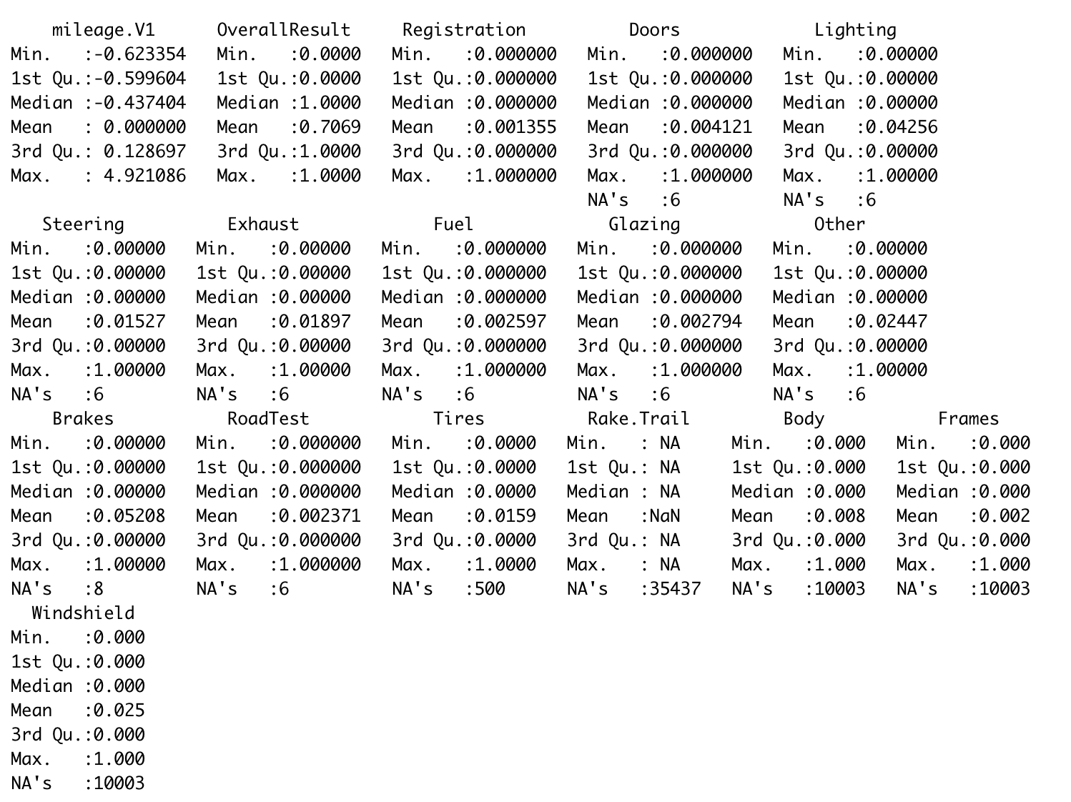
Current Practice – K-means Algorithm
Basic Data Statistics
Data Standardization and Clusterable Evaluation
K Value Estimation
Cluster Evaluation

Slide 7
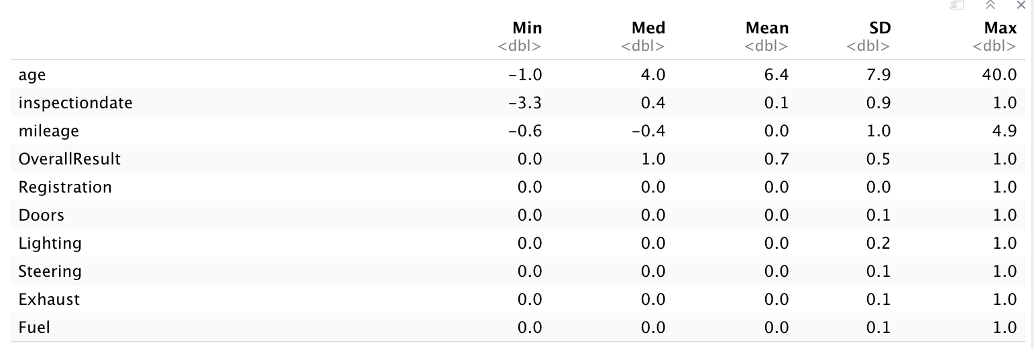
Current Practice – K-means Algorithm
Basic Data Statistics
Data Standardization and Clusterable Evaluation
K Value Estimation
Cluster Evaluation

Slide 8
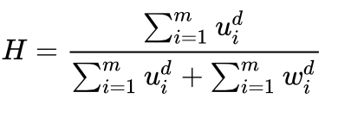
Current Practice – K-means Algorithm
Basic Data Statistics
Hopkins Statistics
Step 1: Let X be the set of n data points, consider a random smaple (without replacement) of m << n data points with members $x_{i}$.
Step 2: Generate a set Y of m uniformly randomly distributed data points.
Step 3: Define two distance measures: $u_{i}$. The distance of $y_{i}∈Y$ from its nearest neighbour in Y
$w_{i}$. The distance of m number of randomly chosen $x_{i}$ $x_{i}∈X$ from its nearest neighbour in X
Data Standardization and Clusterable Evaluation
K Value Estimation
With the above notation, if the data is d dimensional, then the Jopkins statistics is defined as:
A value close to 1 tends to indicate the data is highly clustered, random data will tent to result in values around 0.5, and uniformly distributed data will tent to result in values close to 0.
Cluster Evaluation
Notes:
Source: https://en.wikipedia.org/wiki/Hopkins_statistic

Slide 9
Current Practice – K-means Algorithm
Basic Data Statistics
Dataset A | 0.97872
Dataset B | 0.99932
Dataset C | 0.99851
Dataset D | 0.97394
Dataset E | 0.97394
Data Standardization and Clusterable Evaluation
K Value Estimation
Cluster Evaluation
Notes:
Source: https://en.wikipedia.org/wiki/Hopkins_statistic

Slide 10
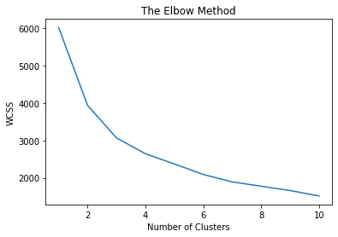
Current Practice – K-means Algorithm
Basic Data Statistics
For Dataset B:
K value Selection: Elbow method （肘部法）
Given Dataset $X=\left\{x^{\left(1\right)}, x^{\left(2\right)}, x^{\left(3\right)}, x^{\left(4\right)}, …, x^{\left(n\right)}\right\}$, every sample point $x^{(i)}∈ℝ^{d}.$
K-means algorithm is trying to classify n data points in to k different cluster $S=\{S_{1}, S_{2}, …, S_{k}\}$, and for each S, sample point in Cluster S has the minimum WCSS (within-cluster sum of squares).
Data Standardization and Clusterable Evaluation
K Value Estimation
K = 3 or 6 might be the best values for K
Cluster Evaluation
Notes:
Source: https://en.wikipedia.org/wiki/Hopkins_statistic

Slide 11
Current Practice – K-means Algorithm
Basic Data Statistics
For Dataset B:
K value Evaluation: Silhouette Coefficient （轮廓系数）
For data point $i ∈ C_{I}$(data point I in the cluster $C_{I}$), let
$a\left(i\right)= \frac{1}{\left|C_{I}\right|−1} \sum_{j∈C_{I}, i≠j}{d(i, j)}$
be the mean distance between i and all other data points in the same cluster, where $|C_{I}|$ is the number of points belonging to cluster i, and d(i, j) is the distance between data points I and j in the cluster $C_{I}$ (we divide by $|C_{I}|$ - 1 because we do not include the distance d(i, i) in the sum). We can interpret a(i) as a measure of how well I is assigned to its cluster (the smaller the value, the better the assignment)
We then define the mean dissimilarity of point to some cluster $C_{J}$ as the mean of the distance from I to all points in $C_{J}$ (where $C_{J} ≠C_{I}$)
For each data point $i ∈ C_{I}$, we now define
$b\left(i\right)=min\frac{1}{\left|C_{J}\right|} \sum_{j∈C_{J}}{d(i, j)}$
to be the smallest (hence the min operator in the formula) mean distance of i to all points in any other cluster, of which i is not a member.
Data Standardization and Clusterable Evaluation
K Value Estimation
Cluster Evaluation
Notes:
Source: https://en.wikipedia.org/wiki/Hopkins_statistic

Slide 12
Current Practice – K-means Algorithm
Basic Data Statistics
For Dataset B:
K value Evaluation: Silhouette Coefficient
Data Standardization and Clusterable Evaluation
S(i) ranges from -1 to +1, where a high value indicates that the object is well matched to its own cluster , and the lower value indicates that the object is poorly matched to its own cluster.
K Value Estimation
Cluster | Silhouette Score
3 | 0.904
6 | 0.928
Cluster Evaluation
Notes:
Source: https://en.wikipedia.org/wiki/Hopkins_statistic

Slide 13
Current Practice – K-means Algorithm
K = 3 Classification:
 | Registration | Doors | Lighting | Steering | Exhaust | Fuel | Glazing | Other | Brakes | RoadTest | Tires | Conclusion
Cluster Category | failure_rate | failure_rate | failure_rate | failure_rate | failure_rate | failure_rate | failure_rate | failure_rate | failure_rate | failure_rate | failure_rate
0 | 0.01108801 | 0.05682606 | 1 | 0.13444213 | 0.17325017 | 0.02286902 | 0.03534304 | 0.23562024 | 0.41926542 | 0.04019404 | 0.11503812 | Vehicles with Lighting Failure and some problems with other components and brakes
1 | 0.00074269 | 0.00111403 | 0 | 0.00495126 | 0.0070246 | 0.00105214 | 0.00077363 | 0.00912889 | 0 | 0.00030945 | 0.00810769 | Vehicles with no or few problems
2 | 0.00169924 | 0.02039082 | 0 | 0.13338997 | 0.14273577 | 0.01869159 | 0.01104503 | 0.17247239 | 1 | 0.01359388 | 0.10790144 | Vehicles with brakes problem
Notes:
Source: https://en.wikipedia.org/wiki/Hopkins_statistic

Slide 14
Current Practice – K-means Algorithm
K = 6 Classification:
 | Registration | Doors | Lighting | Steering | Exhaust | Fuel | Glazing | Other | Brakes | RoadTest | Tires | Conclusion
Cluster Category | failure_rate | failure_rate | failure_rate | failure_rate | failure_rate | failure_rate | failure_rate | failure_rate | failure_rate | failure_rate | failure_rate
0 | 0.00056618 | 0.00081782 | 0 | 0.00396326 | 0.00512708 | 0.00081782 | 0.00050327 | 0 | 0 | 0 | 0 | No problems
1 | 0.01322314 | 0.07933884 | 1 | 0.20826446 | 0.2446281 | 0.0231405 | 0.04958678 | 0.30247934 | 1 | 0.0661157 | 0.13057851 | Vehicles with both lighting and brakes problem, while steering and exhaust problems might occur
2 | 0.00954654 | 0.04057279 | 1 | 0.08114558 | 0.12171838 | 0.02267303 | 0.02505967 | 0.18735084 | 0 | 0.02147971 | 0.10381862 | Vehicles with lighting problems but without any brakes problem
3 | 0.00537634 | 0.0188172 | 0 | 0.04301075 | 0.13709677 | 0.02150538 | 0.00537634 | 0.08602151 | 0.30107527 | 0.01075269 | 1 | Vehicles without any lighting problems but with tires problem, brakes problem might occur
4 | 0.00858369 | 0.04291845 | 0 | 0.16094421 | 0.16309013 | 0.01287554 | 0.0193133 | 1 | 0.43562232 | 0.0472103 | 0.03648069 | Vehicles without any lighting problems but with other components problems, brakes, steering and exhaust problems might occur
5 | 0.00232019 | 0.00812065 | 0 | 0.11600928 | 0.12180974 | 0.01856148 | 0.01276102 | 0 | 1 | 0 | 0 | Vehicles without any lighting, other components, roadtest and tires problems but with brakes problem
Notes:
Source: https://en.wikipedia.org/wiki/Hopkins_statistic

Slide 15
Current Practice – K-means Algorithm
Visualization Method: t-SNE
Given a set of N high-dimensional objects$x_{1}$, …, $x_{n}$, t-SNE first computes probabilities $p_{ij}$ that are proportional to the similarity of objects $x_{i }$ and $x_{j }$
T-SNE aims to learn a d-dimensional map $y_{1}$, …, $y_{n}$ that reflects the similarities $p_{ij}$ as well. So it uses $q_{ij}$ to reflect similarities between two points in the map $y_{i}$ and $y_{j}$ using a very similar approach
And we also use student-t distribution to measure similarities between high dimensional similarities and low dimensional similarities. The locations of the points $y_{i}$ in the map are determined by minimizing the Kullback-Leiber divergence of the distribution P from distribution Q
Notes:
Source: https://en.wikipedia.org/wiki/Hopkins_statistic

Slide 16
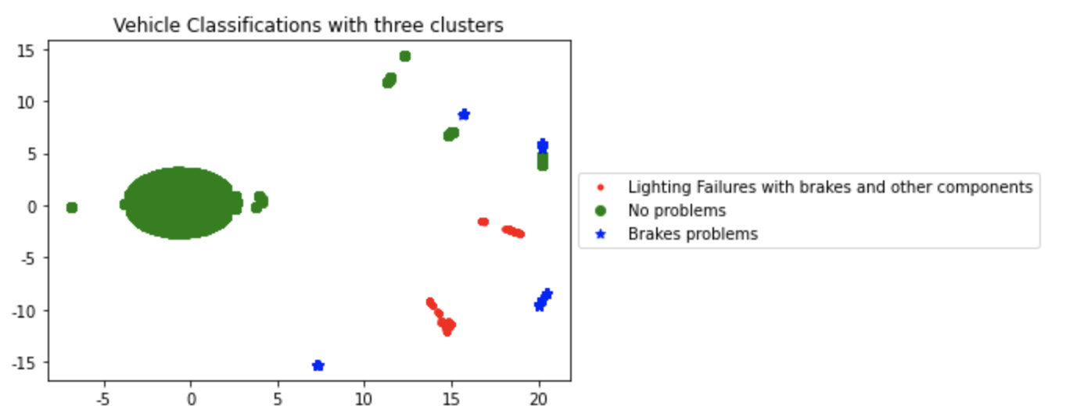
Current Practice – K-means Algorithm
Numbers of vehicle in different Classification
0 | 494
1 | 13602
2 | 368
0 | 13437
1 | 219
2 | 272
3 | 107
4 | 156
5 | 273
Notes:
Source: https://en.wikipedia.org/wiki/Hopkins_statistic

Slide 17
References
[1] https://www.cnblogs.com/ljhdo/p/5556635.html
[2] https://www.i4k.xyz/article/swy_swy_swy/106109004
[3] https://blog.csdn.net/tszupup/article/details/84997804
[4] Francisco C. Pereira, Filipe Rodrigues, Moshe Ben-Akiva, Text analysis in incident duration prediction, Transportation Research Part C: Emerging Technologies, Volume 37, 2013, Pages 177-192, ISSN 0968-090X, https://doi.org/10.1016/j.trc.2013.10.002.
[5] http://www.datakit.cn/blog/2017/02/05/t_sne_full.html

