Slide 1

Technology and Trends in Vehicle Automation
April 1, 2021
Philadelphia Chapter of PSPE

Slide 2
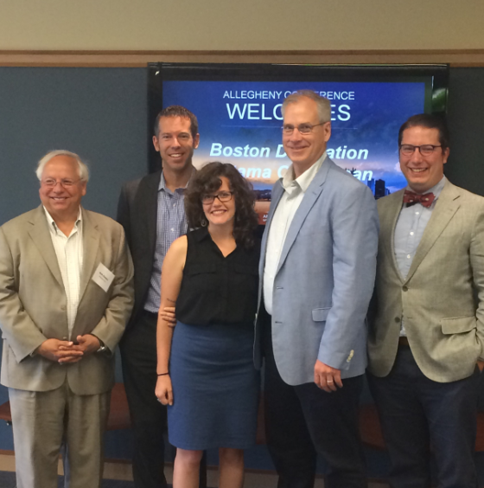
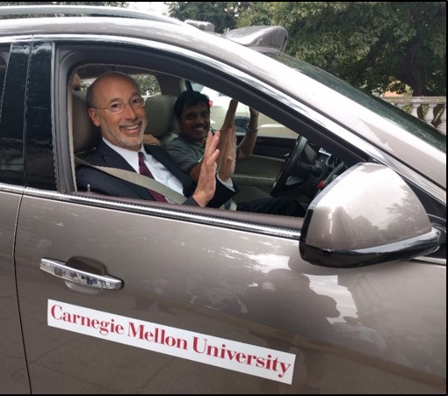
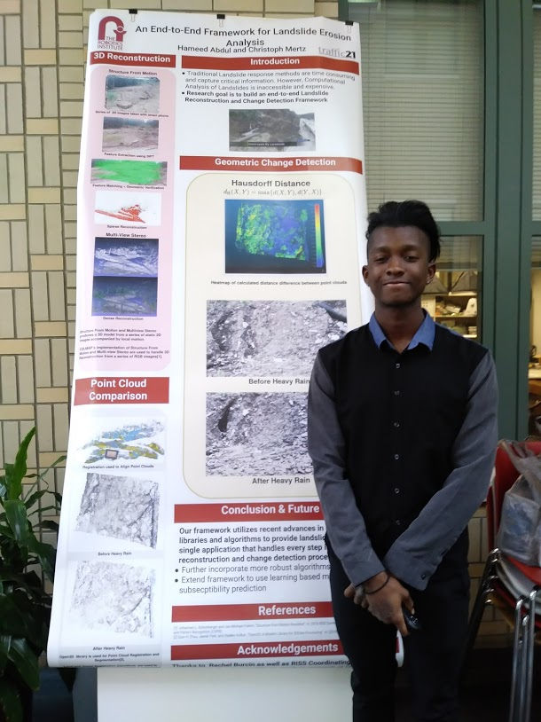
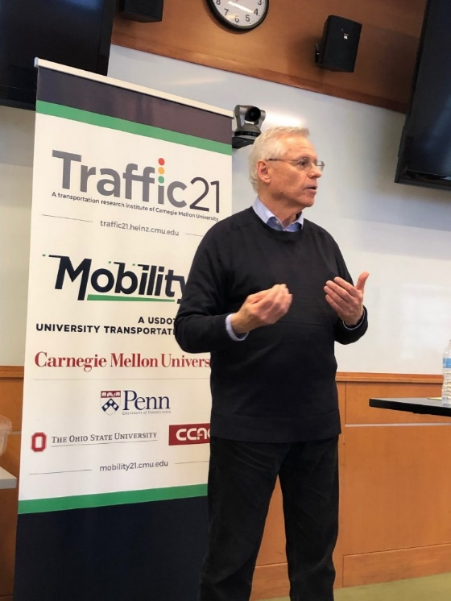
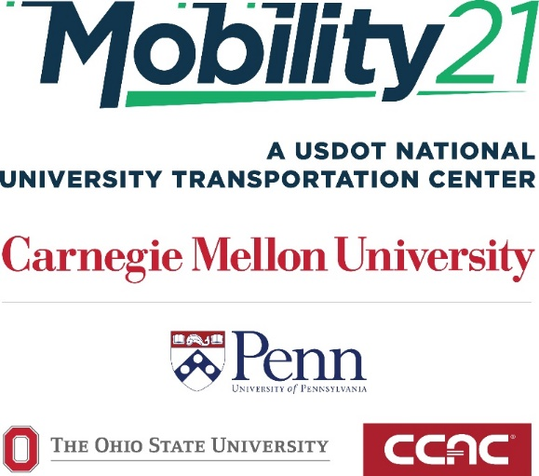
Stan Caldwell
Executive Director
Notes:
Traffic21 is a University wide initiative.
The purpose today is not so much to report on research results;
but rather to report on a research program.
One which may provide you with an opportunity

Slide 3
Trends Driving Intelligent Transportation Systems
Sensors
Data Analytics (real time and predictive)
Cyber Physical Systems
Edge Computing
Internet of Things
5G and Advanced Wireless

Slide 4
Technologies Disrupting Transportation
Automation
Connectivity
Shared Use
Electrification
Novel Modes, Drones, Hyperloop, etc.

Slide 5
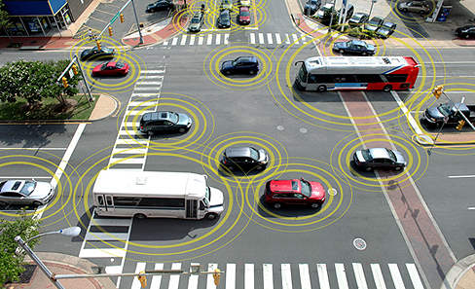
Connected Vehicles
Dedicated Short Range Communication (DSRC)
Notes:
With this slide I will talk about what connected vehicle technology is, and how it works.
It addresses all types of vehicles, pedestrians, cyclists
Give examples of the safety, mobility and sustainability applications

Slide 6
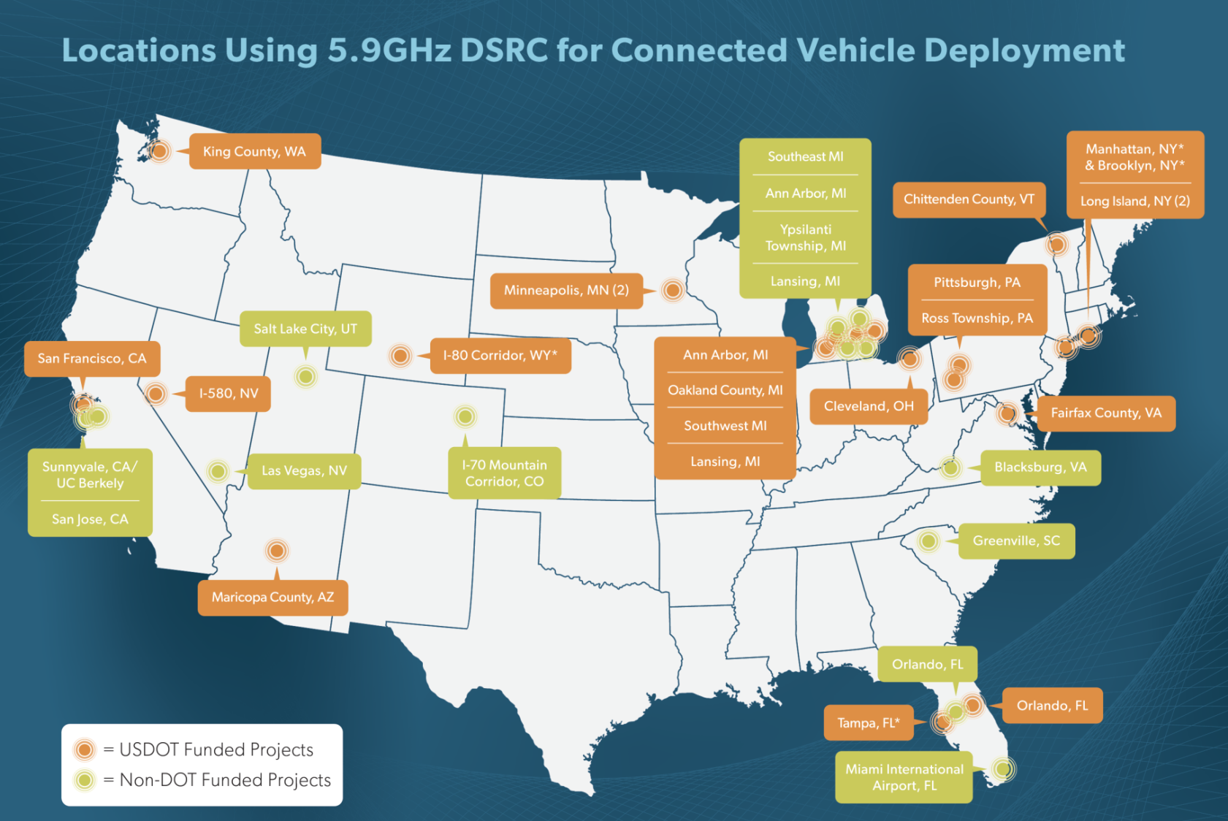

V2I Deployments in the US

Slide 7
CV2X vs DSRC
CV2X Enabled by 5G Cellular Network

Slide 8

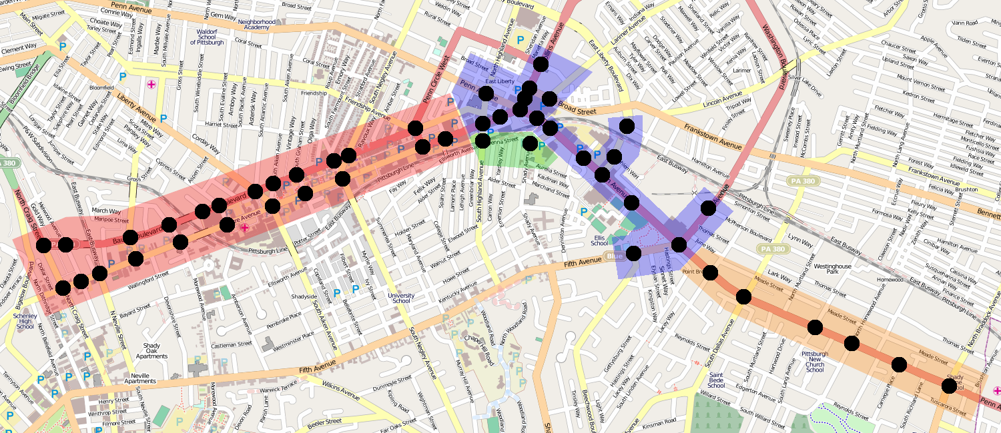
Surtrac Adaptive Signal
Control Expansion
2014-15
Fall 2014
Fall 2014

Slide 9




Safe Intersection Crossing for Pedestrians with Disabilities
Stephen F. Smith
The Robotics Institute

Slide 10
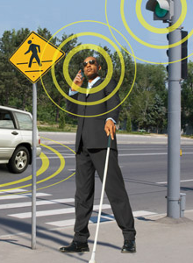
Safe Intersection Crossing
Project Objective: Develop a smartphone application that allows pedestrians to
  interact directly with the intersection and
  actively influence traffic signals for safe and efficient crossing

Slide 11
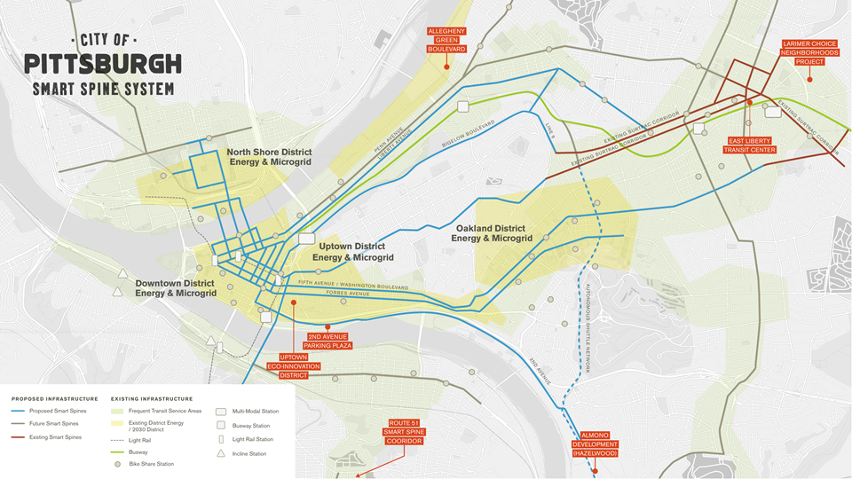
50 intersections today
150 more in the next 3 years
Notes:
Surtrac is already installed at 50 intersections in Pittsburgh.
When U.S. Department of Transportation Secretary Anthony Foxx was in Pittsburgh 2 weeks ago, he announced an $11 million grant to expand Surtrac to 150 more intersections in the city over the next 3 years, with additional funding coming from PennDOT and the city of Pittsburgh.

Slide 12

V2I Deployments
CURRENT
PLANNED
Cranberry
11 RSUs
Ross Twp.
11 RSUs
Autonomous TMA
Pilot
Pittsburgh
24 RSUs
Pittsburgh
45 RSUs
726 OBUs
iCone
Pilot
Harrisburg
8 RSUs
Philadelphia Region
160 RSUs

Slide 13
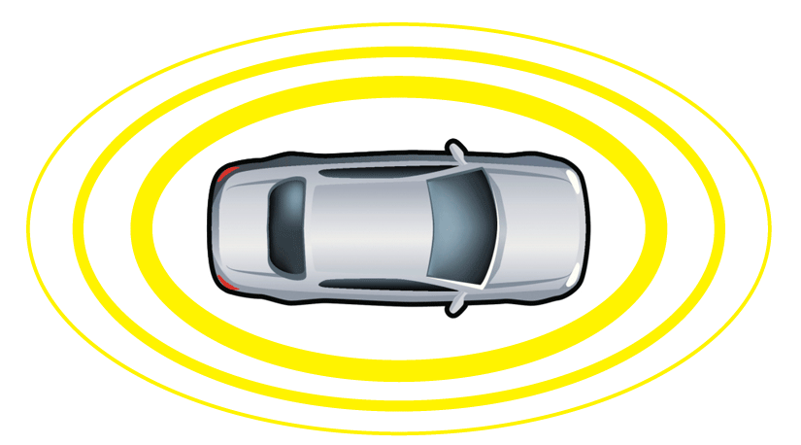
Connected and Autonomous
Vehicles
Connectivity
  Includes all types of communication with vehicles and infrastructure (Wi-Fi, DSRC, Cellular, etc.)
Connected Vehicle
Communicates with nearby vehicles and infrastructure

Slide 14
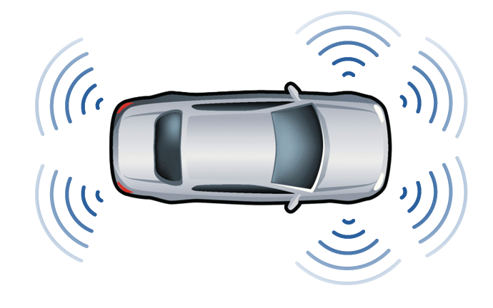
Connected and Autonomous
Vehicles
Connectivity
  Includes all types of communication with vehicles and infrastructure (Wi-Fi, DSRC, Cellular, etc.)
Autonomous Vehicle
Operates in isolation from other vehicles using internal sensors
Connected Vehicle
Communicates with nearby vehicles and infrastructure

Slide 15
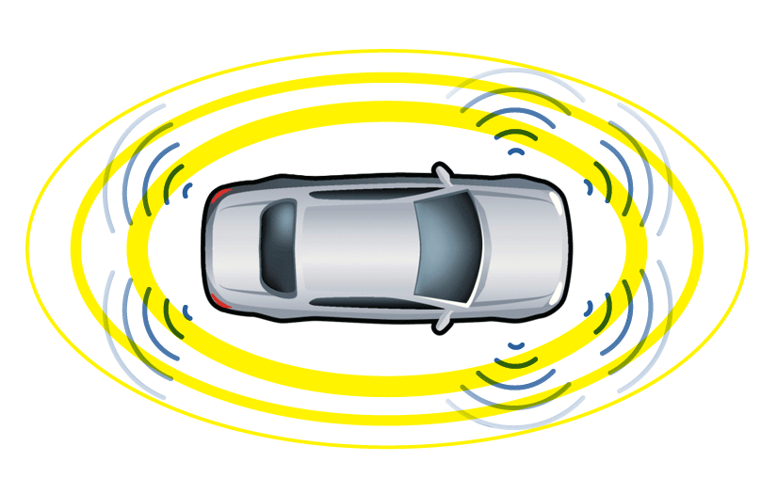
Connected and Autonomous
Vehicles
Connectivity
  Includes all types of communication with vehicles and infrastructure (Wi-Fi, DSRC, Cellular, etc.)
Autonomous Vehicle
Operates in isolation from other vehicles using internal sensors
Connected Automated Vehicle
Connected Vehicle
Communicates with nearby vehicles and infrastructure

Slide 16
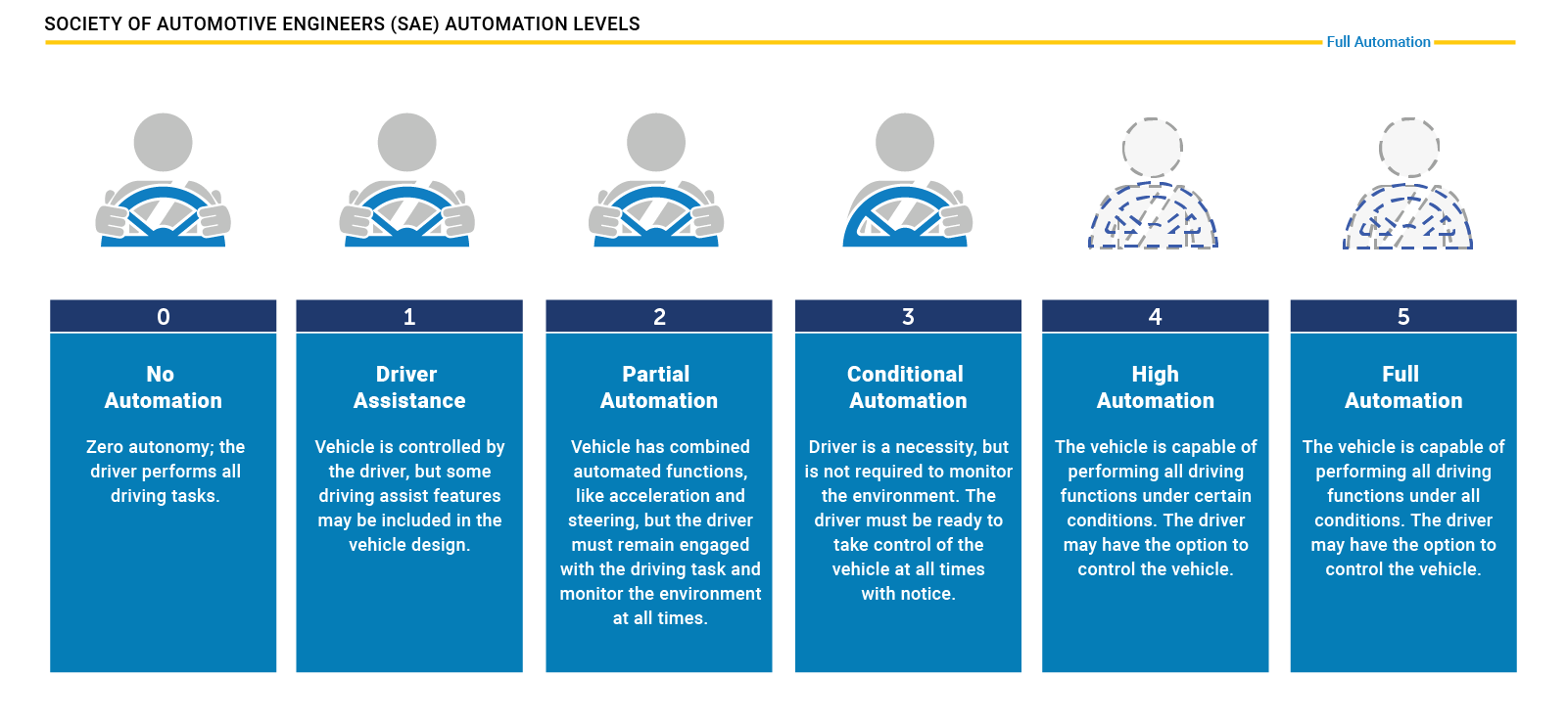
Levels of Vehicle Automation
: Levels of Vehicle Automation Originally Defined by the Society of Automotive Engineers (Source: NHTSA 2019).

Slide 17
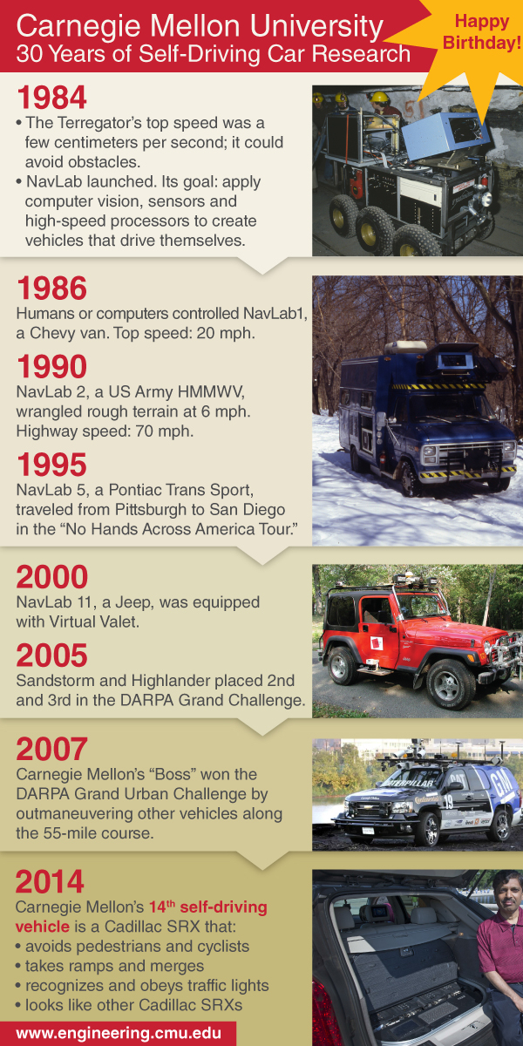

Notes:
Anyone have the horizontal image of this information?

Slide 18
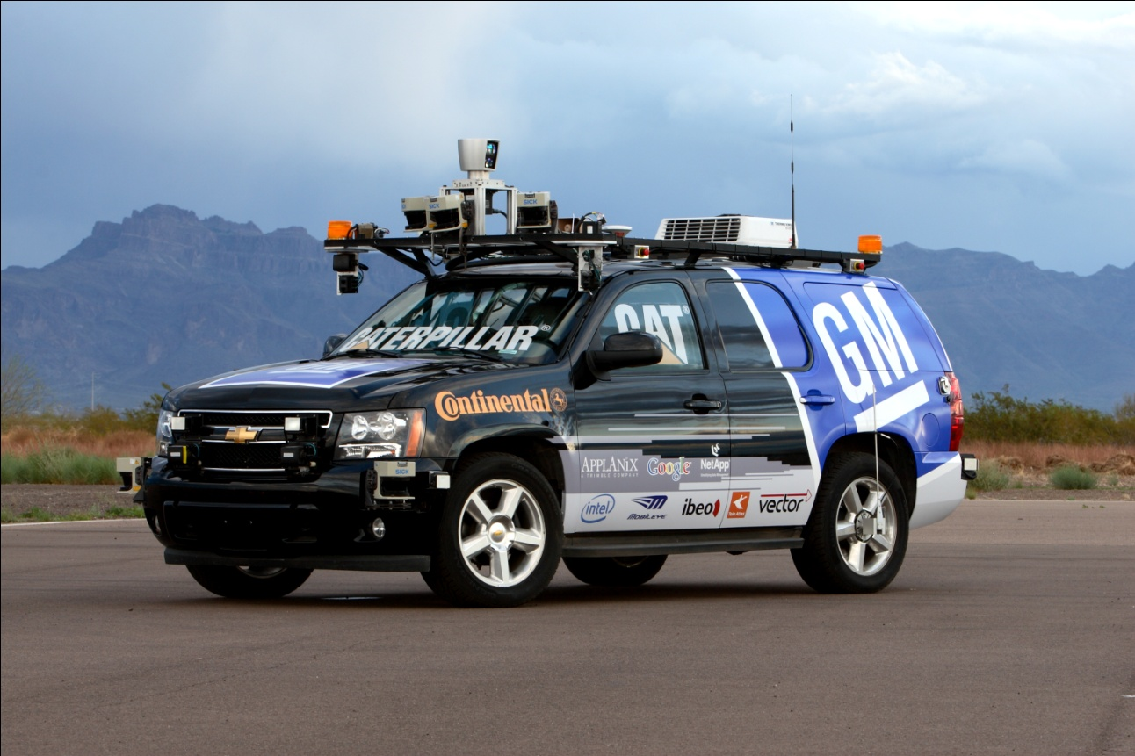
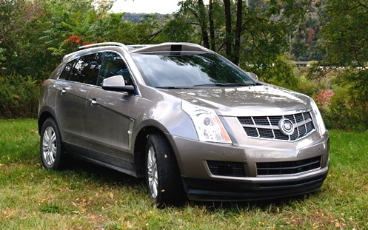
Autonomous Vehicles
2007 GM Lab
2012 GM Lab
Carnegie Mellon

Slide 19
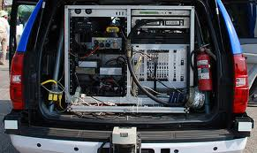
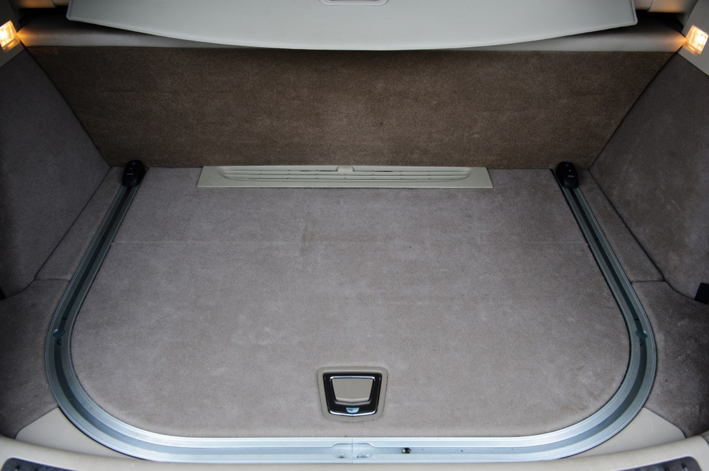
Trunk Space

Slide 20
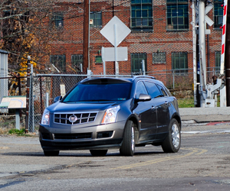
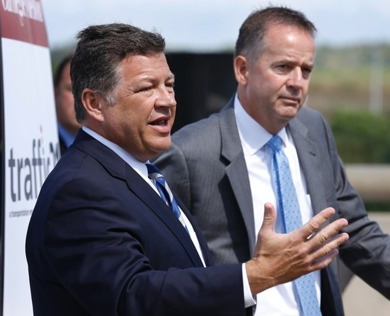
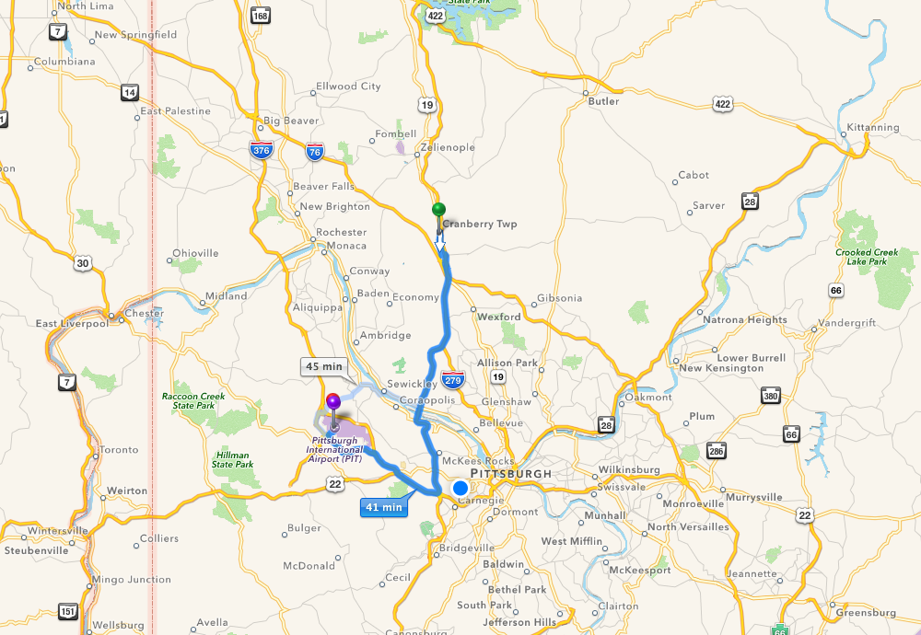
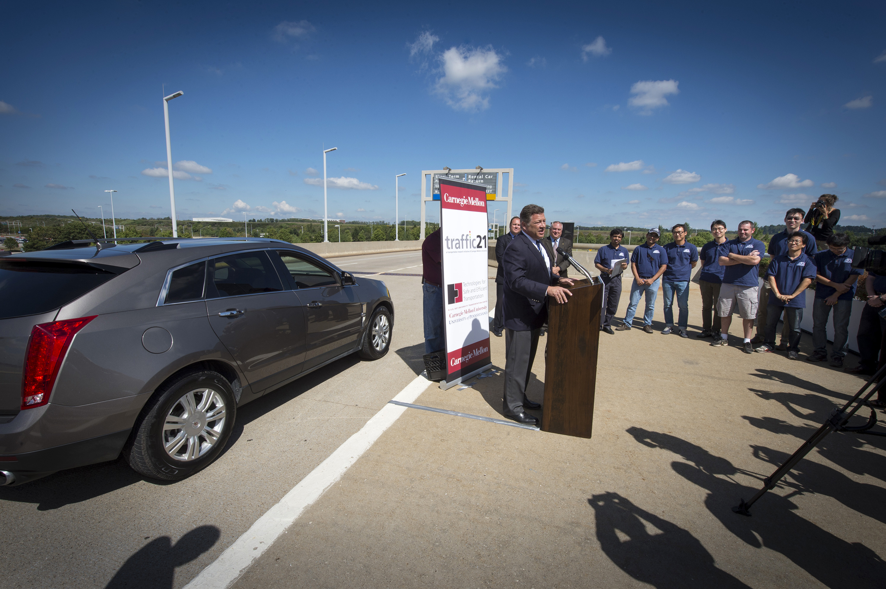
Pittsburgh Demonstration
9-4-14
Cranberry
Township
Pittsburgh
Airport
33 miles along Route 19 in multi-lane, dense traffic with lights and two interstate highways

Slide 21
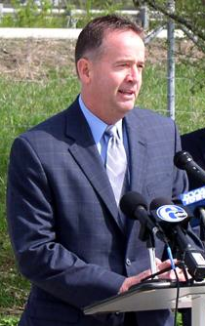
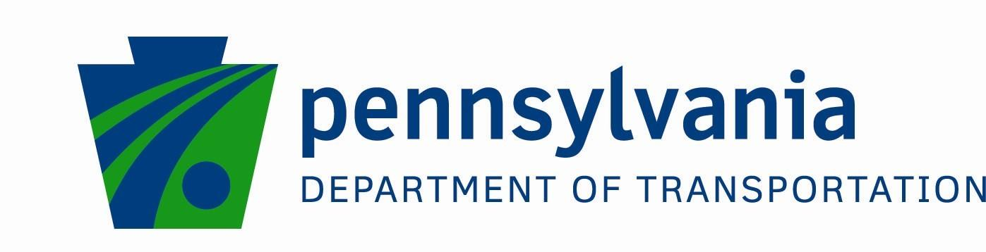
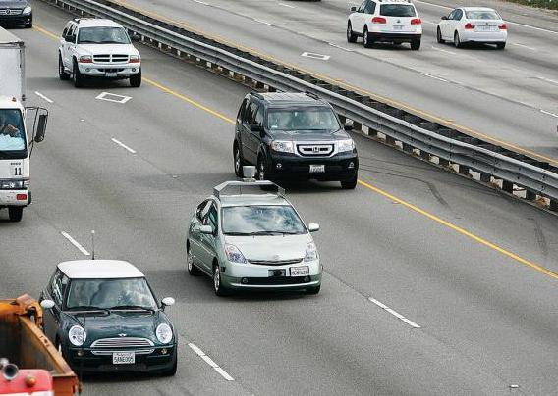
Connected and Autonomous Vehicles 2040 Vision
2014

Slide 22


Report to the Citizens of Pennsylvania
Vehicle Automation
in Pennsylvania
February 1, 2018
Notes:
Roger

Slide 23
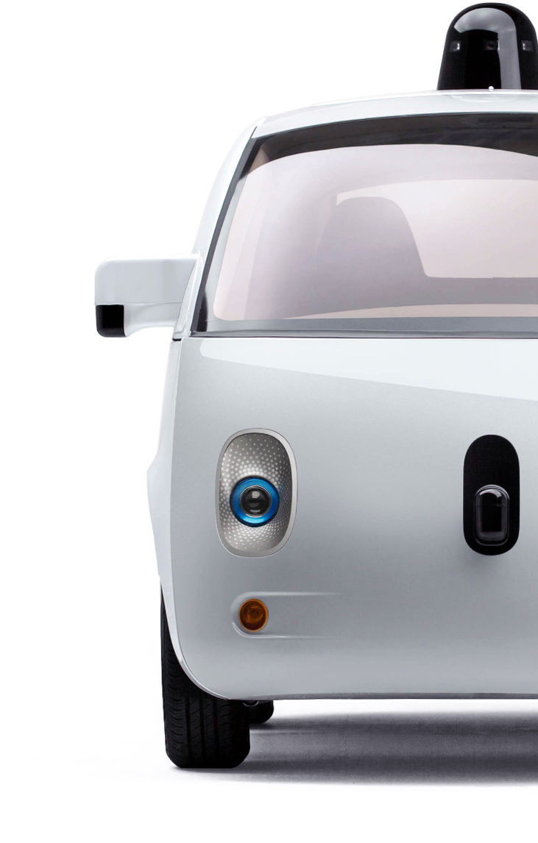
PREPARING
for the
FUTURE
Stay Informed
Understand the Implications
Start Small & Work With Partners
Develop a Plan

Slide 24






AV Policy Task Force
- Government -
- Advocacy -
PennDOT
DCED
Insurance
PTC
PSP
FHWA
AAA
ATA
PMTA
City of Pittsburgh
- Academia -
- Industry -
CMU
U Penn
Penn State
Uber
SAE
GM
Global Automakers

Slide 25
State Policy: PennDOT Automated Vehicle Testing Guidance
Released July 23, 2018
Task force involved major stakeholders
Voluntary registration, driver in the seat and prepared to take charge on public right of way, reporting of use of highly automated vehicles and any crashes.

Slide 26
Local AV Policy
The Pittsburgh Principles include (Pittsburgh 2019):
Instituting transparent lines of communication between the City and partners testing autonomous vehicles, and annual reports on the implementation of AV policies
Promoting automated driving systems that encourage high vehicle occupancy with lower or no emissions, and lower cost and equitable transportation options
Engaging industry leaders and community stakeholders to collaboratively facilitate the further development and deployment of self-driving technology

Slide 27
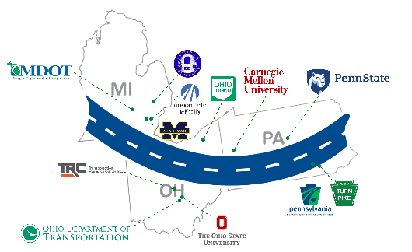
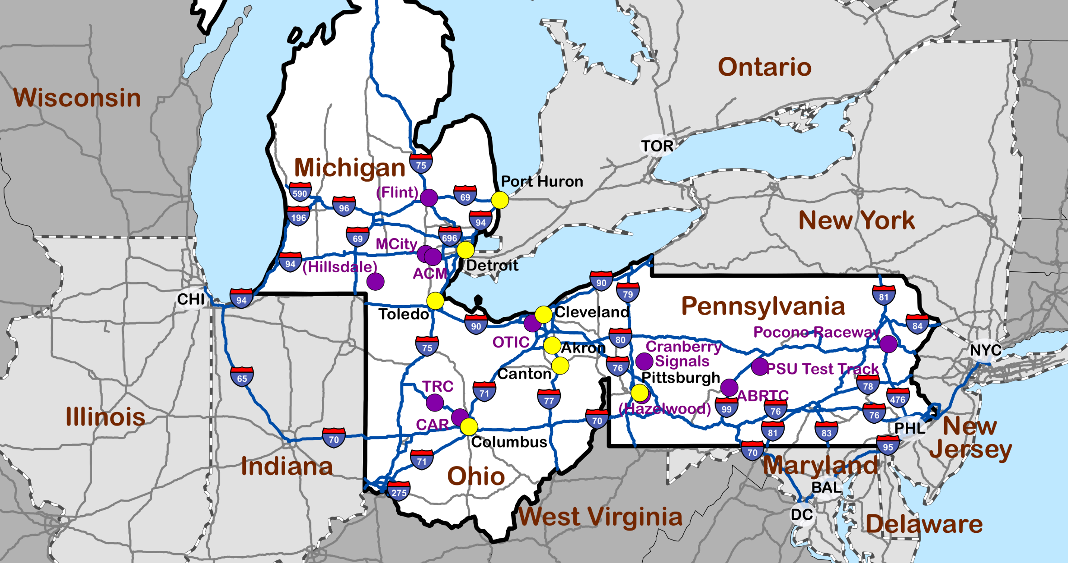


Smart Belt Coalition (SBC)
Smart Belt Coalition
A Regional Connected and Automated Vehicle Collaborative
Notes:
2/10 BT comment:
Use wide slide format
Use template with SMART Belt Coalition and Member logos (all along the bottom of the slide)

Slide 28


Purpose, Vision and Mission
Purpose
The Smart Belt Coalition will organize for the economic benefit, safety, and welfare of the partner states.
Vision
The Coalition’s Vision is to be a multi-jurisdictional network that fosters the advancement of connected and automated vehicle technology.
Mission
The Coalition’s Mission is to create a mechanism for transportation agencies, academic institutions, and others to collaborate on connected and automated vehicle initiatives.
Notes:
2/10 BT comment: Add photos/graphics.

Slide 29
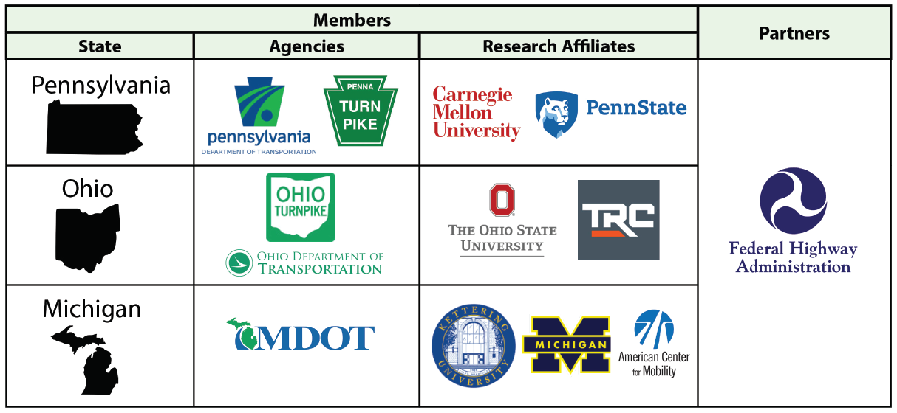

Slide 30
Priority Applications
  Work Zones: Reservation and Traveler Information System
  Freight: Truck Platooning
  TIM: CV Applications
  Work Zones: Intelligent/Connected WZ Detection
  Freight: Truck Parking

Slide 31




Autonomous Vehicle Companies Testing in Pittsburgh
Uber
Argo AI
Aurora
Aptiv (Motional)
Locomation

Slide 32
Early Levels of Automation Improving Safety
According to a study by the Insurance Institute for Highway Safety, the crash involvement rate for vehicles with blind-spot monitoring was 14% lower than the same models without the equipment.
Corey Harper, a researcher at Carnegie Mellon University, says his analysis suggests the combination of vehicle crash avoidance technologies reduces crash frequency by about 3.5%.
“If vehicle crash avoidance technologies were deployed throughout the light-duty vehicle fleet, we could see crash prevention cost savings of up to $264 billion, assuming all relevant crashes are prevented,” he says.

Slide 33
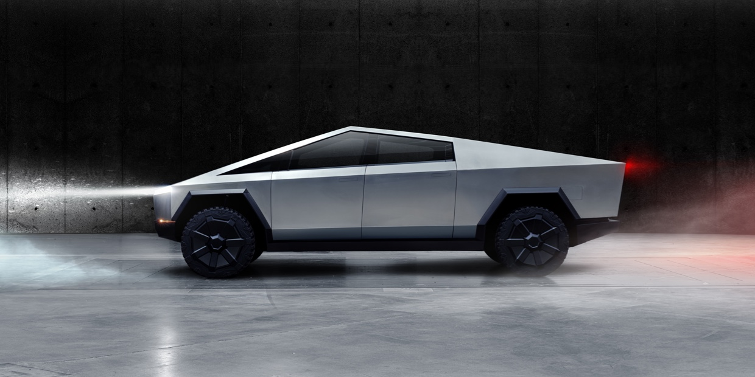
Race for Level 3 AV Commercial Deployment
Mercedes Benz Announces Plans for Industry First Level 3 Deployment, Pending Legal Approval
Tesla Auto Pilot Classified Between Level 2 and 3 But
“Very Close to Level 5”
Per Elon Musk

Slide 34
Industry Collaboration
UL 4600 “Standard for Safety for the Evaluation of Autonomous Products”
SAE Automated Vehicle Safety Consortium
5G Automotive Association
PAVE – Partners for Automated Vehicle Education
ADAS Standard Terminology AAA, Society of Automotive Engineers, Consumer Reports, JD Power and the National Safety Council

Slide 35
Continued Industry Shuffling
Mercedes Benz and BMW dissolve AV partnership
Mercedes Benz partners with NVIDIA on AV platform
Hyundai and Aptiv form Motional
Yandex and Uber spin off AV unit
VW breaks with Aurora
Ford and VW partner on AV technology with ArgoAI
Toyota invests in PonyAI

Slide 36

Federal Government Initiatives
FHWA
Cooperative driving automation (CDA) enables automated vehicles (AVs) to communicate between vehicles, infrastructure devices, and road users such as pedestrians and cyclists.
NHTSA AV TEST Initiative – Interactive web tool to track AV testing
US DOT Inclusive Design Challenge
US DOT AV 4.0 Assuring American Leadership in Automated Vehicle Technologies
FCC Reallocating 5.9 GHz Spectrum Reserved for Connected Vehicles

Slide 37
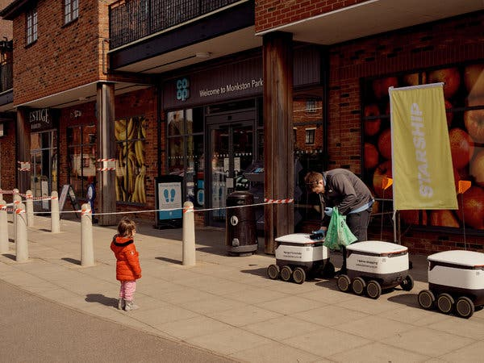
Shift from AV Taxis to Freight Delivery Via Cute Sidewalk Vehicles and Large Trucks
UPS and Waymo Autonomous Van Package Delivery Testing
Amazon Acquires AV Company Zooks for over $1 Billion

Slide 38
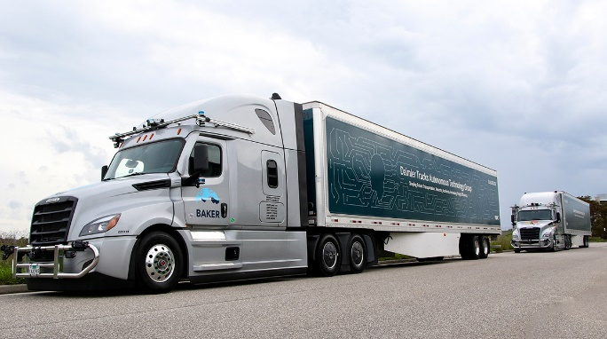
Autonomous Trucking
Daimler Trucks AV Testing Group partnering Torc Robotics with developing Level 4 AV Truck with new facility in New Mexico
Waymo testing heavy duty trucks in Texas
TuSimple teaming with delivery and trucking companies to develop the first AV freight network. fleet of 41 autonomous-capable trucks are pulling 13 loads per day between Arizona and Texas.
FORU Trucking, a technology logistics company, and Trunk, a service provider of autonomous driving technology for trucks
Locomation On Road Testing Autonomous Relay Convoy Technology

Slide 39
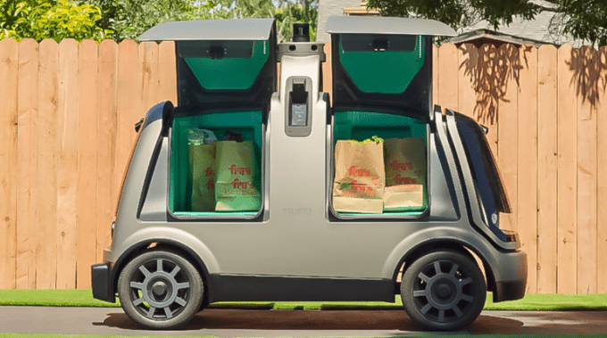
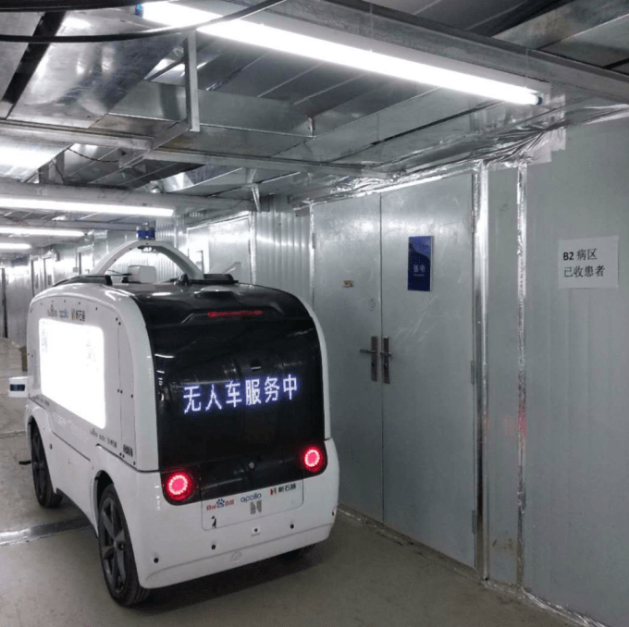
Automated Vehicles Respond to COVID-19
Columbus Re-launches EasyMile Leap Shuttle for Food Delivery
GM Cruise Makes Food Bank Deliveries in San Francisco
Nuro Delivering Medical Supplies in California
Beep and Navya Delivering COVID-19 Tests at Mayo Clinic in Florida
Neolix Delivers Medical Supplies in Wuhan and Disinfects Roadways

Slide 40
Infrastructure
AV companies generally require quality line painting and legible signage.
Connected traffic signals are an early CAV infrastructure.
Dedicated Road Lanes from Detroit to Ann Arbor for Autonomous Vehicles
Audi AG and Ericsson announced success upon wrapping up a three-year cellular vehicle-to-everything (C-V2X) real-world trial that first began in December 2016 in Germany.
Qualcomm Partners with Hawaii DOT and the University of Hawaii to Extend the Deployment C-V2X Infrastructure Across Entire State

Slide 41
Why Now? – Enabling Information and Communications Technologies
Why Pennsylvania?- Research, Development and Deployment of Innovative Technology and Policy

Slide 42
Learning Assessment Questions:
In addition to vehicle automation, provide an example of another technology disrupting transportation.
Give an example of an automated vehicle industry trend.
Identify a how state or local governments are addressing automated vehicle technology through policy.

Slide 43
Questions
stancaldwell@cmu.edu
http://mobility21.cmu.edu/

