Slide 1
Platooning for Improved Safety and Efficiency of Semi-trucks [PISES - IV]
Lead Researcher: Dr. Venkat Viswanathan
Project Team: Alex Wadell

Slide 2
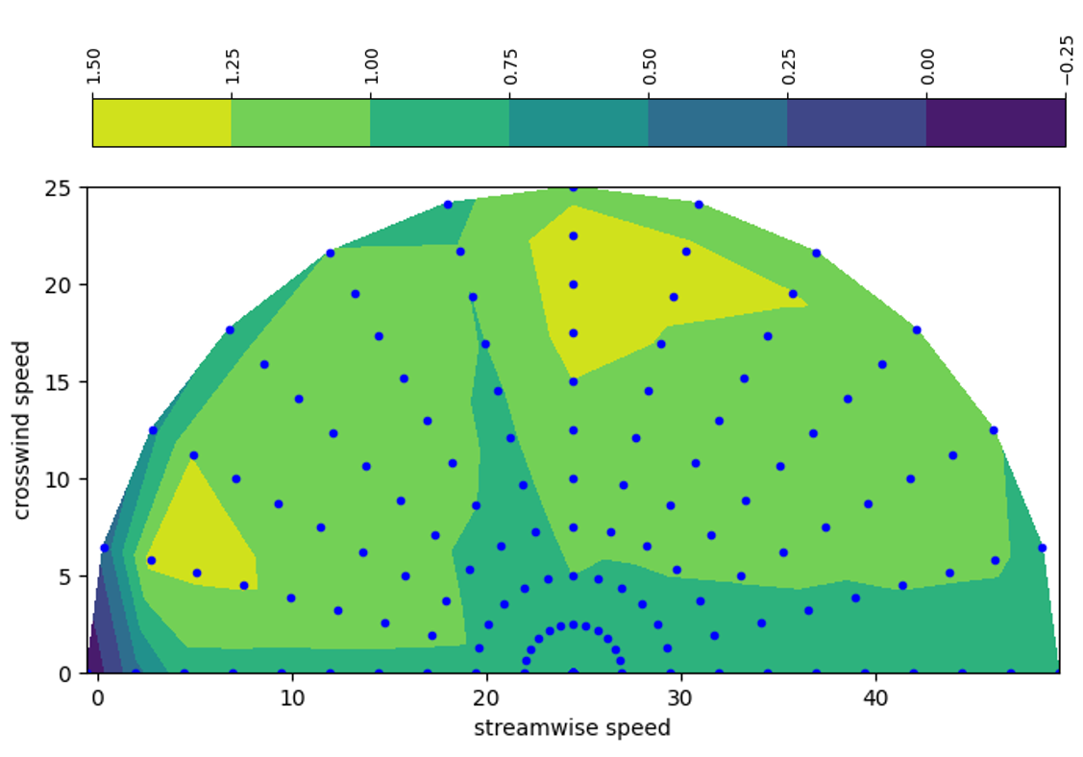
PISES – IV: Brief Overview of Project
Understanding Aerodynamics and Efficiency and Energy Consumption for various platoon configurations, wind speed and wind direction
Partners – Locomation, PA
Notes:
2

Slide 3
PISES – IV: Expected Outcomes
High-fidelity energy-efficiency maps for platoons incorporating platoon-offset, vehicle velocity, wind velocity, relative heading, spacing and number of vehicles.
A refined safety-energy reduction to velocity smoothing for the platooning vehicle.
Notes:
3

