Slide 1
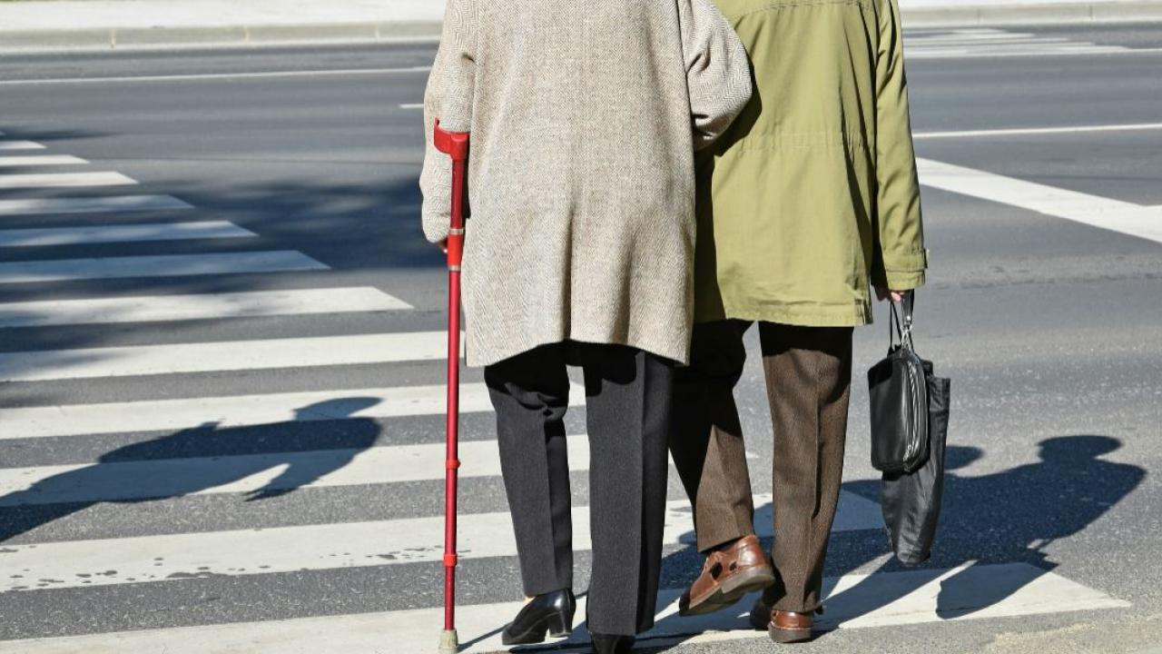
Accessibility with GetGoing
Lead Researcher: Maxine Eskenazi
Project Team: Yulan Feng, Alan W Black
Project Website (if there is one): http://www.cs.cmu.edu/~yulanf/getgoing/

Slide 2
Accessibility with GetGoing
Goals
A phone-based agent that gives information about accessibility in transport and in arriving at a specific destination including hospitals
Anticipated Outcomes
Delivery of a publicly-available phone system that is regularly used by people who have accessibility issues in Western Pennsylvania
Partners – Private, public, community
UPMC, PathVu
Notes:
2

Slide 3
Accessibilty with GetGoing
Expected outcomes
A phone-based system that gives accessibility information will be adopted by a large number of users in the area
How will the research improve the “subject” you are researching, how will it benefit the people using the service/product
It will include information that is not available in regularly used datasets such as Google. It will get information from people who man the information desks at local hospitals and from the PathVu dataset of accessibility information for the city of Pittsburgh
Notes:
3

