Slide 1
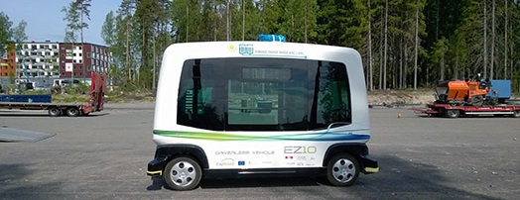
Helping Transit Agencies Assess Opportunities to Improve Access and Equity With Automated Vehicles
Lead Faculty: Costa Samaras
Project PhD Student: Allanté Whitmore
Image:, AutoGuide

Slide 2
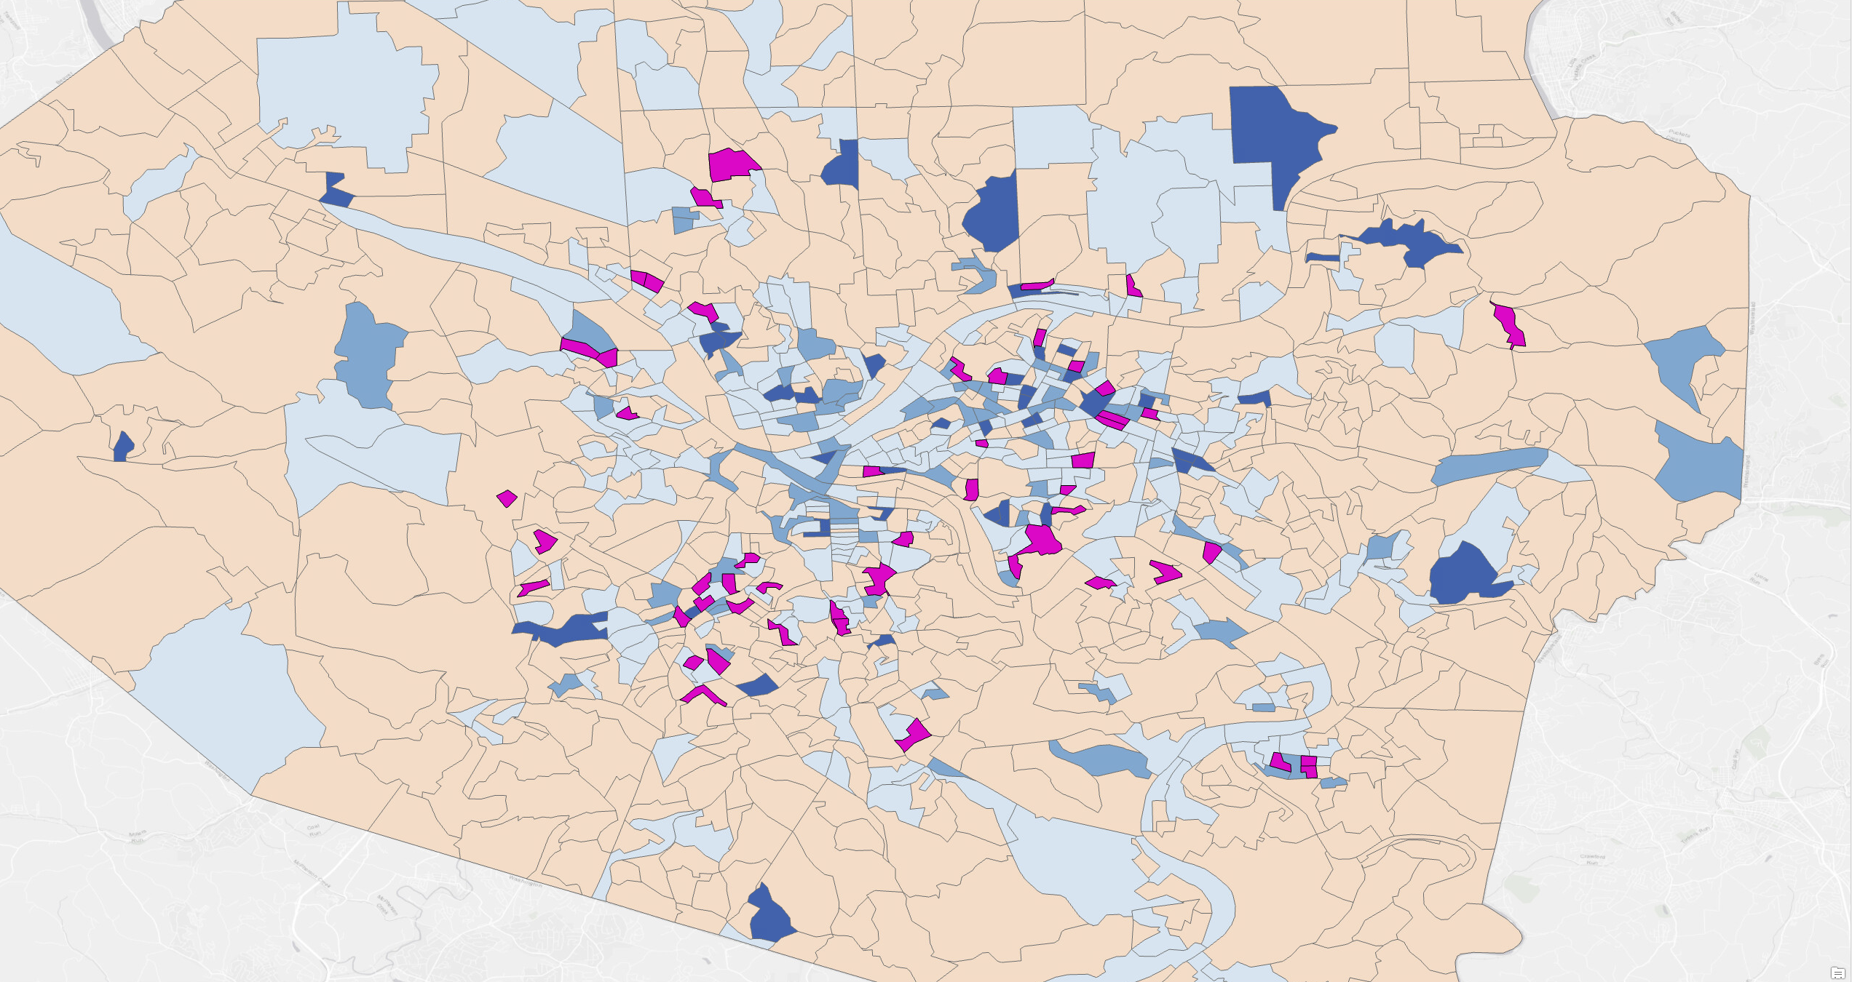
Helping Transit Agencies Assess Opportunities to Improve Access and Equity With Automated Vehicles
This project develops a method to identify areas with unmet transit need, identify equity-designated census blocks, and assess the effectiveness of shared autonomous shuttles to bring microtransit service to areas with inequitable transit service
Notes:
2

Slide 3
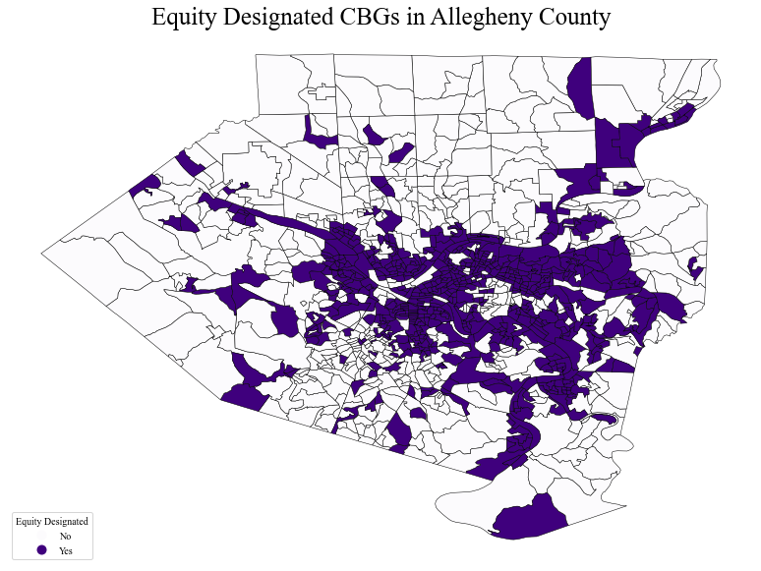
Helping Transit Agencies Assess Opportunities to Improve Access and Equity With Automated Vehicles
The project will estimate the range of capital and operating costs for automated transit mobility services, and compare these to alternatives
Greenhouse gas emissions and travel times will be estimated
Notes:
3

