Slide 1
Prospects for Mileage-Based User Fee Systems to Replace Fuel Taxes for Passenger Vehicles
Project Team:
H. Scott Matthews (CEE)
Paul Fischbeck (SDS/EPP)
Prithvi Acharya (EPP)
Sean Donnelly (CEE/EPP) Zhufeng Fan (CEE)
Lin Lyu (CEE) Rachel Sin (CEE/EPP)
Chenyu Yuan (CEE)
Source: https://beyondstandards.ieee.org/connected-vehicles/
the-internet-of-things-and-the-connected-vehicle/

Slide 2
Project Overview
Studying the data flows needed and available to further enable deployment of mileage-based fees in PA and other states
Data Analytics
Economics
Policy Analysis
Summarizing two papers submitted to 2021 TRB Conference
Partners – CompuSpections, DataDrivenIM, Azuga, MBUFA
Notes:
2

Slide 3
Introduction
Gas taxes ($/gal) have been primary funding source for transportation at the federal and state levels since beginning
Federal funds augment state funds
But federal gas tax rate hasn’t increased since 1990s
Inflation has eroded value of federal share, caused states to have to increase rates
Hybrid/electric/high fuel economy vehicles pay far less
Expected transition from “pay by gallon” to “pay by mile”
Notes:
3

Slide 4
What are Mileage-Based User Fees
(a.k.a. Road User Charges)?
A direct way of charging vehicles for use of transportation
So far we have been focused on passenger fleet
Requires: technology to track mileage (and maybe location), account for gas taxes paid, and a pre-set per-mile fee structure
Various states have done MBUF/RUC pilot programs
Technology is here and can work to assess and collect fees
“Double charging” gas taxes is key financial challenge
Several states have moved from pilot to program
Notes:
4

Slide 5
Existing Transportation Funding Issues
State ‘transportation’ expenditures complex
Funds construction, maintenance, administration, police, etc.
Mix of state and federal funds (including gas taxes)
Replacing all gas tax revenues with MBUFs would still not be enough to pay for all expenses
But this complexity is often overlooked
And would lead to insufficient funding coverage!
Notes:
5

Slide 6
Data Sources
DOT Highway Statistics Series
Annual inspections of safety and emissions in Pennsylvania
Registration data
Notes:
6

Slide 7
Findings about Fee Structures
Setting fee rates appears straightforward, is complicated by diversions of disbursements to other areas (e.g., police)
Seems likely states would undercollect fees
Federal data collected appears inconsistent and not helpful
Fee structures could be intentionally complex
Example: rates could differ by fuel type, weight, road, ..
But existing data flows on highway use might not be sufficient to predict total fees collected (vs. gas tax rate)
Notes:
7

Slide 8
Pennsylvania Examples Using DOT-collected data
While a direct conversion of gas tax to MBUF should be about 2.5 cents/mile, if existing DOT data sources used, fees might look like this:
Example 1: Total highway spending in PA / Total VMT in PA | SF-12 / VM - 2 | Pennsylvania | Total Capital + Maintenance outlay | 4.8
 | SF-4 / VM-2 | Pennsylvania | Total Capital + Maintenance outlay + service + administration + safety | 7.2
 |  |  | Total disbursement | 10.7
Notes:
8

Slide 9
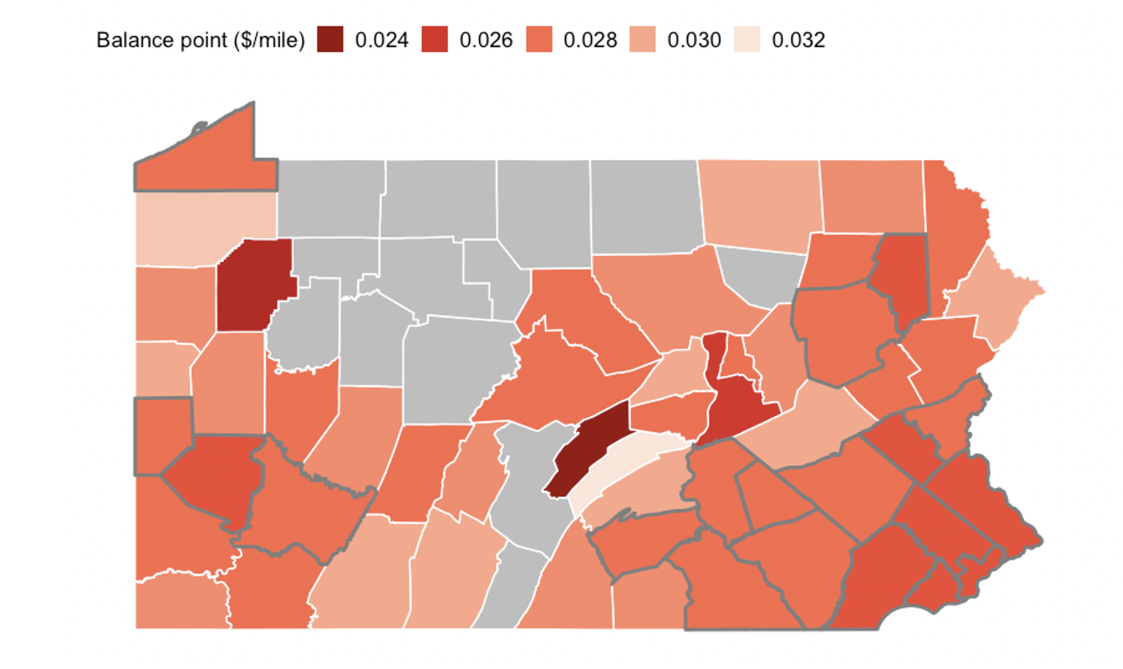
Pennsylvania Examples Using Inspection Records and Algorithms
Direct conversion of gas tax to MBUF should be ~ 2.5-3 cents/mile
But federal DOT data suggests that PA spends 7-10 cents per mile traveled!
Notes:
9

Slide 10
Expected Continuing Outcomes
Further data analysis, report, spreadsheet model
Focus on helping states see discrepancies
Demonstrate technical feasibility of existing data flows to enable mileage-based fees in PA and other states
Interested in finding deployment partner(s) for a pilot to apply our findings in PA or elsewhere!
Notes:
10

