Slide 1
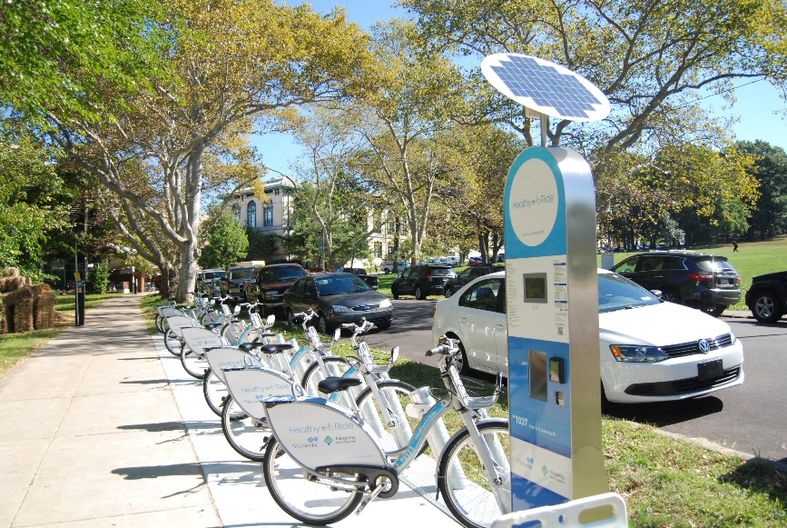
Analysis of the Potential for Micromobility to Replace Short Car Trips in Urban Areas, And Impacts on Congestion
Lead Researcher: Corey Harper
Project Team: Sean Qian

Slide 2
Analysis of the Potential for Micromobility to Replace Short Car Trips in Urban Areas, And Impacts on Congestion– Brief Overview of Project
Goal: Assess the potential for micromobility to replace short car trips in urban areas using a data-driven approach
Anticipated Outcomes: Policy recommendations that could assist policymakers in better understanding where the greatest opportunities for expanding active transportation exist.
Partners – City of Pittsburgh, City of Seattle
Notes:
2

Slide 3
Analysis of the Potential for Micromobility to Replace Short Car Trips in Urban Areas, And Impacts on Congestion– Expected Outcomes
Expected outcomes: Publication in research journals and conference proceedings, engagement with policymakers, development of policy recommendations, and distribution of a policy brief.
This research should provide a methodology for state and local agencies to assess the impacts that individuals switching from SOV travel to micromobility could have on energy use and congestion
Notes:
3

